Slide 1




dRMT: Disaggregated Programmable Switching
Sharad Chole, Andrew Fingerhut, Sha Ma, Anirudh Sivaraman,
Shay Vargaftik, Alon Berger, Gal Mendelson, Mohammad Alizadeh,
Shang-Tse Chuang, Isaac Keslassy, Ariel Orda, and Tom Edsall
Notes:
I am going to be talking about a new hardware architecture for programmable switches. This is a collaboration between many of us at Cisco, MIT, Technion, and VMWare.

Slide 2
Today’s Programmable Switches (e.g., RMT)
Stage 1
Stage 2
Stage N
Parser
Deparser
Pkt Header
Pkt Header
Queues
Match
Match
Match
In
Action
Action
Action
Out
keys
Memory Cluster 1
Memory Cluster 2
Memory Cluster N
results
Notes:
As background, I’ll briefly review how programmable switches are architected in hardware. For concreteness, I’ll focus on the Reconfigurable Match-Action Table or RMT architecture because it is representative of many commercial products today.
Broadly, the RMT architecture is a pipeline consisting of a number of programmable pipeline stages. An operator can program the headers that are matched on in every stage and the actions carried out in response to a hit in a match-action table.
In a bit more detail, bytes come in from the wire. A parser turns these bytes into a bag of packet headers, which flows through the pipeline. Within each pipeline stage, a match unit extracts the relevant part of the packet header (out of all the packet headers) as a key for the look up in the match-action table. It then sends this to the memory cluster, which performs the lookup and returns a result. This result is used by the action unit to transform the packet headers appropriately.
This process then repeats itself.
ONLY IF YOU HAVE TIME:
One example of a key could be the destination IP address for an IP address-based forwarding lookup.
One example of an action could be setting the output port based on the result from a destination address lookup.

Slide 3
dRMT in One Slide
RMT aggregates resources into stages that provide a fixed ratio of memory:match:action
E.g., A large table spanning two stages consumes two match units
dRMT (disaggregated RMT): disaggregate memory, match, and action resources of a programmable switch. Allocate them independently.
Notes:
The problem with RMT is that it aggregates resources into stages, which provide a fixed ratio of memory capacity (for the lookup), match key generation capacity (to generate match keys), and action capacity (to transform a limited number of action fields).
The problem with aggregating resources this way is that it is inefficient for programs that do not confirm to the fixed ratio provided by the hardware. This is because you can’t allocate resources independently. If you increase one, you have to increase the other. For instance, if you have large table that needed more memory than available in one stage, you need two stages, and you also need to consume two match units whether you need it or not. You can’t increase memory capacity independent of match key generation capacity.
The key idea behind dRMT is to disaggregate the reesouces (match, action, and memory) of a programmable switch so that they can be allocated independently.

Slide 4
The dRMT Architecture
Stage 1
Stage 2
Stage N
Parser
Deparser
Queues
Match
Match
Match
In
Out
Action
Action
Action
Memory Cluster 1
Memory Cluster 2
Memory Cluster N
Notes:
OK, what do I mean by disaggregation? Let us look at it in a bit more detail.

Slide 5
Memory Disaggregation
Stage 1
Stage 2
Stage N
Queues
Parser
Deparser
In
Match
Match
Match
Out
Action
Action
Action
Memory Cluster 1
Memory Cluster 2
Memory Cluster N

Slide 6
Compute Disaggregation
Queues
Parser
Pkt 1
Pkt 2
In
Pkt N
Deparser
Distributor
Out
Proc. 1
Proc. 2
Proc. N
Match
Pkt 1
Match
Pkt 2
Match
Pkt N
Action
Action
Action
Memory Cluster 1
Memory Cluster 2
Memory Cluster N

Slide 7
Compute Disaggregation
Queues
Parser
In
Deparser
Distributor
Out
Proc. 1
Proc. 2
Proc. N
Match
Pkt 1
Match
Pkt 2
Match
Pkt N
Action
Action
Action
Memory Cluster 1
Memory Cluster 2
Memory Cluster N
Notes:
Say that each packet stays at one processor and does not move around.

Slide 8
Compute Disaggregation
Queues
Parser
In
Pkt 2
Deparser
Distributor
Out
Proc. 1
Proc. 2
Proc. N
Match
Pkt 1
Match
Pkt N+2
Match
Pkt N
Pkt 2
Action
Action
Action
Memory Cluster 1
Memory Cluster 2
Memory Cluster N

Slide 9
Problems with RMT Architecture
Conflates memory allocation with packet processing
Wastes processing and/or memory resources
Example: Large table split over multiple stages
Stage 1
Stage 2
Stage 3
Stage N
Match
Match
Match
Match
Action
Action
Action
Action
Must extract key multiple times
Wastes match capacity
Action units unused until last stage
Memory
Cluster 1
Memory
Cluster 2
Memory
Cluster 3
Memory Cluster N

Slide 10
Problems with RMT Architecture
Suffers performance cliff if program doesn’t fit
Recirculate packet to “extend” pipeline → Lowers throughput 2x
Stage 1
Stage 2
Stage 3
Stage N
Match
Match
Match
Match
Action
Action
Action
Action
Recirculate to ingress

Slide 11
dRMT solves problems with RMT
RMT conflates memory allocation with packet processing
dRMT decouples memory and processors via crossbar
RMT suffers performance cliff if program doesn’t fit
dRMT’s throughput degrades gracefully as program size grows

Slide 12
Three Questions
Can dRMT provide deterministic throughput and latency?
Yes. Compiler schedule programs to eliminate contention using an ILP.
How does dRMT compare with RMT on real P4 programs?
Needs fewer processors on open-source, proprietary, random programs.
Are dRMT’s processors and crossbar feasible in hardware?
Yes. dRMT takes up some more area than RMT, mostly due to crossbar.
Notes:
Why is first point non-trivial?: Contention at processors and memories.
Why is second point non-trivial?: Mileage may vary depending on the actual program.
Why is third point non-trivial?: Crossbar needs to span a large spatial extent (wiring complexity and area overheads). dRMT processors are run-to-completion and store all operations for a packet instead of an RMT stage.
Say this: We borrow many elements of RMT, such as its instruction set for actions, and its match key unit.
Stuff to say:
1. We designed hardware for the processor+crossbar. We evaluated whether it meets timing and what its area is through synthesis experiments.
Two points to stress:
We can formally show that the throughput of a program on dRMT is at least as good as that of RMT, when normalized to have the same number of hardware resources.
We’ll focus on some of these results through the rest of the talk.

Slide 13
Compiling a P4 program to dRMT
Proc. 1
Proc. 2
Proc. N
Cycle Packet | 0 | 1 | 2 | 3 | 4 | 5
1 | M |  | A | …
2 |  |  | M |  | A | …
3 |  |  |  |  | M | …
Cycle Packet | 0 | 1 | 2 | 3 | 4 | 5
1 | M |  | A | …
2 |  |  | M |  | A | …
3 |  |  |  |  | M | …
Cycle Packet | 0 | 1 | 2 | 3 | 4 | 5
1 | M |  | A | …
2 |  |  | M |  | A | …
3 |  |  |  |  | M | …
Match
Pkt 1
Match
Pkt 2
Match
Pkt N
Action
Action
Action
Memory Cluster 1
Memory Cluster 2
Memory Cluster N
Table placement
Processor scheduling

Slide 14
Xbar decouples scheduling and placement
RMT couples scheduling and placement.
Can prove that dRMT decouples them under natural conditions:
Every table is accessed once per packet
Every processor executes the same schedule with a time offset
Table placement is a variant of bin packing.
Notes:
Explain why RMT couples the two problems.
Say that table placement is handled by prior work by Jose et al.
Say that we focus on processor scheduling here
Decouples them in the sense that you can solve them independently and put them together and the solution will:
Work for the joint problem.
No better than any other solution for the joint problem (the non-trivial part).

Slide 15
Processor Scheduling Example
Proc. 1
Proc. 2
M0
3
A0
1
M1
3
A1
Match
Match
Action
Action
3 cycles to complete a match
1 cycle to complete an action
Two processors
Each does 1 match, 1 action per cycle
Program Dependencies
Resource Constraints
Notes:
Two main aspects: correctness based on program dependencies, resource constraints based on processors.

Slide 16
Processor Scheduling Example
2 processors handle 1 packet per cycle.
Packet arrives every 2 cycles per processor.
M0
3
A0
1
M1
3
A1
Cycle Pkt | 1 | 2 | 3 | 4 | 5 | 6 | 7 | 8 | 9 | 10 | 11 | 12 | 13 | 14 | 15 | 16 | 17 | 18 | 19

Slide 17
Processor Scheduling Example
2 processors handle 1 packet per cycle.
Packet arrives every 2 cycles per processor.
M0
3
A0
1
M1
3
A1
Cycle Pkt | 1 | 2 | 3 | 4 | 5 | 6 | 7 | 8 | 9 | 10 | 11 | 12 | 13 | 14 | 15 | 16 | 17 | 18 | 19
1 | M0 |  |  | A0 | M1 |  |  | A1

Slide 18
Processor Scheduling Example
2 processors handle 1 packet per cycle.
Packet arrives every 2 cycles per processor.
M0
3
A0
1
M1
3
A1
Cycle Pkt | 1 | 2 | 3 | 4 | 5 | 6 | 7 | 8 | 9 | 10 | 11 | 12 | 13 | 14 | 15 | 16 | 17 | 18 | 19
1 | M0 |  |  | A0 | M1 |  |  | A1
2 |  |  | M0 |  |  | A0 | M1 |  |  | A1

Slide 19
Processor Scheduling Example
2 processors handle 1 packet per cycle.
Packet arrives every 2 cycles per processor.
M0
3
A0
1
M1
3
A1
Cycle Pkt | 1 | 2 | 3 | 4 | 5 | 6 | 7 | 8 | 9 | 10 | 11 | 12 | 13 | 14 | 15 | 16 | 17 | 18 | 19
1 | M0 |  |  | A0 | M1 |  |  | A1
2 |  |  | M0 |  |  | A0 | M1 |  |  | A1
3 |  |  |  |  | M0 |  |  | A0 | M1 |  |  | A1
Each processor can only do 1 match per cycle

Slide 20
Processor Scheduling Example
2 processors handle 1 packet per cycle.
Packet arrives every 2 cycles per processor.
M0
3
A0
1
M1
3
A1
Cycle Pkt | 1 | 2 | 3 | 4 | 5 | 6 | 7 | 8 | 9 | 10 | 11 | 12 | 13 | 14 | 15 | 16 | 17 | 18 | 19
1 | M0 |  |  | A0 | X | M1 |  |  | A1
Delay M1 by inserting a no-op

Slide 21
Processor Scheduling Example
2 processors handle 1 packet per cycle.
Packet arrives every 2 cycles per processor.
M0
3
A0
1
M1
3
A1
Cycle Pkt | 1 | 2 | 3 | 4 | 5 | 6 | 7 | 8 | 9 | 10 | 11 | 12 | 13 | 14 | 15 | 16 | 17 | 18 | 19
1 | M0 |  |  | A0 | X | M1 |  |  | A1
2 |  |  | M0 |  |  | A0 | X | M1 |  |  | A1
3 |  |  |  |  | M0 |  |  | A0 | X | M1 |  |  | A1

Slide 22
Processor Scheduling Example
2 processors handle 1 packet per cycle.
Packet arrives every 2 cycles per processor.
M0
3
A0
1
M1
3
A1
Cycle Pkt | 1 | 2 | 3 | 4 | 5 | 6 | 7 | 8 | 9 | 10 | 11 | 12 | 13 | 14 | 15 | 16 | 17 | 18 | 19
1 | M0 |  |  | A0 | X | M1 |  |  | A1
2 |  |  | M0 |  |  | A0 | X | M1 |  |  | A1
3 |  |  |  |  | M0 |  |  | A0 | X | M1 |  |  | A1
4 |  |  |  |  |  |  | M0 |  |  | A0 | X | M1 |  |  | A1

Slide 23
Processor Scheduling Example
2 processors handle 1 packet per cycle.
Packet arrives every 2 cycles per processor.
M0
3
A0
1
M1
3
A1
Cycle Pkt | 1 | 2 | 3 | 4 | 5 | 6 | 7 | 8 | 9 | 10 | 11 | 12 | 13 | 14 | 15 | 16 | 17 | 18 | 19
1 | M0 |  |  | A0 | X | M1 |  |  | A1
2 |  |  | M0 |  |  | A0 | X | M1 |  |  | A1
3 |  |  |  |  | M0 |  |  | A0 | X | M1 |  |  | A1
4 |  |  |  |  |  |  | M0 |  |  | A0 | X | M1 |  |  | A1
5 |  |  |  |  |  |  |  |  | M0 |  |  | A0 | X | M1 |  |  | A1

Slide 24
Processor Scheduling Example
2 processors handle 1 packet per cycle.
Packet arrives every 2 cycles per processor.
M0
3
A0
1
M1
3
A1
Cycle Pkt | 1 | 2 | 3 | 4 | 5 | 6 | 7 | 8 | 9 | 10 | 11 | 12 | 13 | 14 | 15 | 16 | 17 | 18 | 19
1 | M0 |  |  | A0 | X | M1 |  |  | A1
2 |  |  | M0 |  |  | A0 | X | M1 |  |  | A1
3 |  |  |  |  | M0 |  |  | A0 | X | M1 |  |  | A1
4 |  |  |  |  |  |  | M0 |  |  | A0 | X | M1 |  |  | A1
5 |  |  |  |  |  |  |  |  | M0 |  |  | A0 | X | M1 |  |  | A1
6 |  |  |  |  |  |  |  |  |  |  | M0 |  |  | A0 | X | M1 |  |  | A1

Slide 25




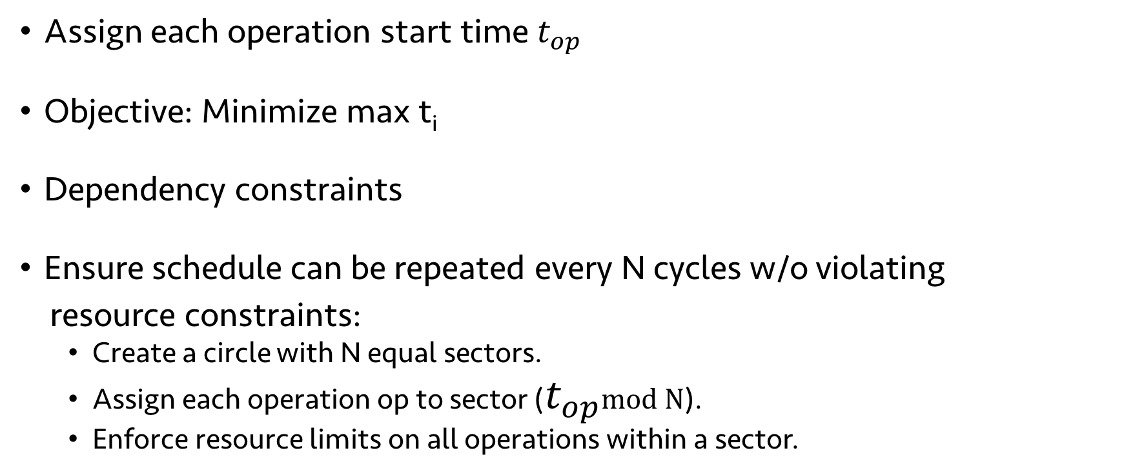





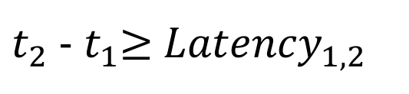

Minimizing no-ops: ILP formulation
$$t_{0}$$
$$t_{1}$$
$$t_{2}$$
$$t_{3}$$
$$t_{4}$$
Assign each operation start time $t_{op}$
Objective: Minimize max t_{i}
Dependency constraints
Ensure schedule can be repeated every N cycles w/o violating
resource constraints:
Create a circle with N equal sectors.
Assign each operation op to sector ($t_{op}$mod N).
Enforce resource limits on all operations within a sector.
$t_{2}$ - $t_{1}$≥ ${Latency}_{1, 2}$
$$t_{3}$$
$$t_{0}$$
$$t_{4}$$
$$t_{1}$$
$$t_{2}$$
Notes:
In this example, we introduced a no-op, but that’s a greedy way of solving it. If we want the optimal schedule, need to solve an ILP.
Packet that arrived this scheduling period, 1 period in the past, 2 in the past, and so on.
TO stress: minimize max ti is equivalent to minimizing number of no-ops
The circle with sectors captures the intuition about operations that conflict in the tableau

Slide 26
Evaluation: Comparing RMT and dRMT
Minimum number of processors to run at 1 packet/cycle
P4 Program | RMT | dRMT | Lower bound
switch.p4 ingress | 18 | 15 | 15

Slide 27
Evaluation: Comparing RMT and dRMT
Minimum number of processors to run at 1 packet/cycle
P4 Program | RMT | dRMT | Lower bound
switch.p4 ingress | 18 | 15 | 15
switch.p4 egress | 12 | 7 | 7

Slide 28
Evaluation: Comparing RMT and dRMT
Minimum number of processors to run at 1 packet/cycle
P4 Program | RMT | dRMT | Lower bound
switch.p4 ingress | 18 | 15 | 15
switch.p4 egress | 12 | 7 | 7
switch.p4 combined | 22 | 21 | 21

Slide 29
Evaluation: Comparing RMT and dRMT
Minimum number of processors to run at 1 packet/cycle
P4 Program | RMT | dRMT | Lower bound
switch.p4 ingress | 18 | 15 | 15
switch.p4 egress | 12 | 7 | 7
switch.p4 combined | 22 | 21 | 21
proprietary (normalized) | 2.0 | 1.0 | 1.0
Gains of 4.5% to 50% on real programs.
Gains lowest on balanced programs optimized for RMT.
On 100 random programs, mean gain of 10% (max 30%)
Notes:
TODO: Maybe add a figure for random program.
Emphasize: Our gains are quite significant. Switch.p4 is optimized for RMT. We give switch.p4 the benefit of full memory disaggregation.

Slide 30
dRMT eliminates performance cliffs

Slide 31
dRMT crossbar design
Crossbar needs to send multiple match keys from processors to clusters every clock cycle
Two extremes
Mem. 1
Mem. 2
Full crossbar connecting
every processor key to
every memory key
Very flexible,
but too many wires
(4 keys * 4 keys = 16).
Proc. 1
Proc. 2

Slide 32
dRMT crossbar design
Crossbar needs to send multiple match keys from processors to clusters every clock cycle
Two extremes
Mem. 1
Mem. 2
Unit crossbar connecting
every processor to every memory
Rigid (all proc. keys go to same mem.)
but cheap to build
(2 proc *2 mems * 2 keys per wire =8)
Proc. 1
Proc. 2

Slide 33
dRMT crossbar design
Crossbar needs to send multiple match keys from processors to clusters every clock cycle
dRMT’s crossbar: 2 parallel crossbars, one per key (8 wires)
Left key
Right key
Mem. 1
Mem. 2
Mem. 1
Mem. 2
Proc. 1
Proc. 2
Proc. 1
Proc. 2

Slide 34
dRMT’s crossbar
dRMT’s crossbar has wire count similar to unit crossbar
But a processor can send keys to different memories by call one the left and the other right.
Equivalent to full if tables are not split across clusters.
Scales to 32 processors, 32 memories, 8 keys through manual place and route.
Notes:
Say that if tables are split, it’s no longer equivalent, which means the previously decoupled problems become coupled.

Slide 35
Comparing areas of RMT and dRMT
dRMT incurs a few mm² additional area.
Modest in comparison to a 300-700 mm² chip.
Notes:
Say that the area is mostly dominated by IO and memories.

Slide 36
Summary
dRMT: Disaggregated architecture for programmable switches
Ongoing work: Implementation in programmable NIC
Many open questions
Scheduling different packet types
Stateful packet processing
Webpage: http://drmt.technion.ac.il/

Slide 37
Backup slides

Slide 38
Evaluation: switch.p4 on RMT and dRMT
Minimum number of processors to run at 1 packet/cycle
P4 Program | RMT | dRMT | Lower bound
Ingress (switch.p4) | 18 | 15 | 15
Egress (switch.p4) | 12 | 7 | 7
Switch.p4 combined | 22 | 21 | 21
Minimum number of threads to run at 1 packet/cycle
P4 Program | RMT | dRMT (IPC=2) | Lower bound
Ingress (switch.p4) | 360 | 243 | 243
Egress (switch.p4) | 240 | 198 | 197
Switch.p4 combined | 440 | 243 | 243
Notes:
Switch.p4 is optimized for RMT.
198 in red is distracting.
Explain briefly what switch.p4 is.
Explain why ingress+egress is not the same as combined.
Explain why combined is not a huge win.
The results seem comparable, not better for dRMT.

Slide 39
Evaluation: switch.p4 on RMT and dRMT
Minimum number of processors to run at 1 packet/cycle
P4 Program | RMT | dRMT (IPC=1) | dRMT (IPC=2) | Lower bound
Ingress (switch.p4) | 18 | 17 | 15 | 15
Egress (switch.p4) | 12 | 11 | 7 | 7
Switch.p4 combined | 22 | 21 | 21 | 21
dRMT is near optimal:
Fewest possible processors
Near-ideal (critical path) latency
Comparable on switch.p4 combined, which is optimized for RMT
Minimum number of threads to run at 1 packet/cycle
P4 Program | RMT | dRMT (IPC=1) | dRMT (IPC=2) | Lower bound
Ingress (switch.p4) | 360 | 245 | 243 | 243
Egress (switch.p4) | 240 | 217 | 198 | 197
Switch.p4 combined | 440 | 243 | 243 | 243
Notes:
Switch.p4 is optimized for RMT.
198 in red is distracting.
Explain briefly what switch.p4 is.
Explain why ingress+egress is not the same as combined.
Explain why combined is not a huge win.
The results seem comparable, not better for dRMT.

Slide 40
Scheduling Constraints
Processor resource constraints:
Generate up to M b-bit keys to match on per cycle (M=8, b=80)
Perform actions on up to A packet fields per cycle (A=32)
Perform match/action on different packets every cycle (Inter-packet concurrency (IPC) = 1 or 2)
Dependency constraints:
Operation depending on a match (action) has to wait d_{M} (or d_{A}) cycles
Notes:
Change this into compiler overview and add a overview diagram P4->DAG->Packet Scheduling. Also simplify constraints. Maybe show constraints in the overview diagram.
TODO: Bring back diagram of the processor to explain
IPC went by too fast. Need to introduce it so that people are not lost. Maybe just call it packet concurrency?
Multi-processor design can lead to reordering. Useful to mention this is not a problem up front because everything has the same latency.
Too much redundancy in the second bullet
TODO: More animations here
Too many details
It wasn’t clear what a key was.
Too many details.
Simplify number of constraints.

Slide 41
Extracting dependencies from P4 programs
Table dependency graph
Operation dependency graph
Routable
Multicast
IGMP
Match
Dep.
Action
Dep.
Routable
Match
Routable
Action
Multicast
Match
Multicast
Action
d_{M}
d_{A}
d_{M}
d_{A}
IGMP
Match
IGMP
Action
d_{M}
Notes:
This leads into the compiler.
Toy example very loosely inspired by L2-L3 with Multicast.
TODO: Might be too detailed.
This part was not very interesting here.
Didn’t get the high-level problem in slide 15. Make it very clear what proc. Scheduling was on slide 15.
Say that you go from P4->Operation dependency graph -> ILP (and then you could say that the P4->ODG transformation is not shown).
Could remove this slide.

Slide 42
dRMT hardware: instruction memory
A dRMT processor executes/stores an entire program; an RMT stage only executes/stores a program slice.
Must reduce memory required to encode an action.
RMT actions can modify 224 packet fields in parallel; we found 32 sufficient
Notes:
Mention that the lower half is a histogram or empirical distribution
The pdf indicates 29 is sufficient, but you seem to have 32.
Seemed like a jump from eval to design (hardware design)
Some sign posting would help.
Make it clear that the processor has to store the program.

Slide 43
dRMT architecture: crossbar
Proc. 1
Proc. 2
Proc. 1
Proc. 2
Proc. 1
Proc. 2
Mem. 1
Mem. 2
Mem. 1
Mem. 2
Mem. 1
Mem. 2
Unit Crossbar
(0.561 mm²)
Full Crossbar
(4.464 mm²)
Segment Crossbar
(0.576 mm²)
The segment crossbar is equivalent to full crossbar if tables are not split across clusters! (see paper for details)
dRMT uses One-to-Many Segment Crossbar
Notes:
Area numbers for 32x32 crossbar with 8 80-bit keys on each side

Slide 44
dRMT Match Action Processor
Packet Header Vector
(4Kb)
Packet Header Vector
(4Kb)
Packet Header Vector
(4Kb)
ALU
Match Key Generation (crossbar)
Scratch
Pad
Action Input Selector
(crossbar)
Action Output Selector
(crossbar)
… …
8x80b Key
ALU
8x96b Action
Memory
Thread Select
Ctrl
Op code
Config
Table
Crossbar to
Memories
VLIW Instruction Table
Notes:
TODO: This diagram might be too detailed.
Maybe just replace it with a high-level overview slide.
Key differences with RMT:
-- dRMT processor needs to store full program → Config table & instruction table more expensive
-- Scratchpad (store results for delayed execution
-- VLIW Instructions: 32 ALUs instead of 224

Slide 45
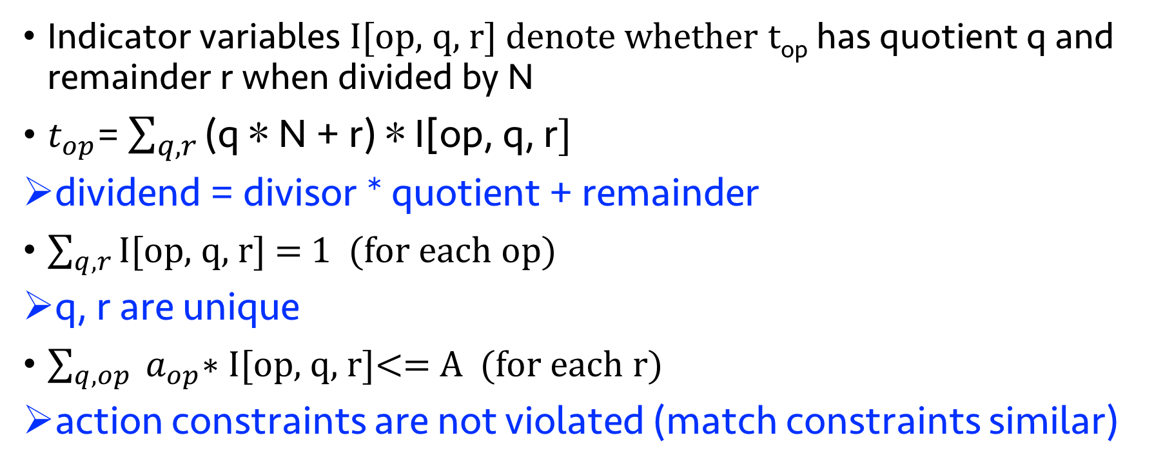
Enforcing periodic resource constraints
Indicator variables I[op, q, r] denote whether t_{op} has quotient q and remainder r when divided by N
$t_{op}$= $\sum_{q, r}{\text{(}\text{q}\text{ ∗ }\text{N}\text{ + }\text{r}\text{) ∗ }\text{I}\text{[}\text{op}\text{, }\text{q}\text{, }\text{r}]}$
dividend = divisor * quotient + remainder
$\sum_{q, r}{\text{I}\text{[}\text{op}\text{, }\text{q}\text{, }\text{r}]}$ = 1 (for each op)
q, r are unique
$\sum_{q, op}{ a_{op}\text{∗ }\text{I}\text{[}\text{op}\text{, }\text{q}\text{, }\text{r}]}$<= A (for each r)
action constraints are not violated (match constraints similar)

Slide 46
Problems with RMT Architecture
Forces rigid order on operations: match→action→match→action→…
Wastes resources for “imbalanced” programs
Example: Tables without a match (default action)
Stage 1
Stage 2
Stage 3
Stage N
Match
Match
Match
Match
Action
Action
Action
Action
Default action
Notes:
TODO: Consider removing slide on tables without a match. Technically, we can pack this with another program that *does* use the match. i.e., could combine slide 4 with slide 3.

