Slide 1



dRMT: Disaggregated Programmable Switching
Sharad Chole, Andrew Fingerhut, Sha Ma, Anirudh Sivaraman,
Shay Vargaftik, Alon Berger, Gal Mendelson, Mohammad Alizadeh, Shang-Tse Chuang, Isaac Keslassy, Ariel Orda, and Tom Edsall

Slide 2
Today’s Programmable Switches (e.g., RMT)
Stage 1
Stage 2
Stage N
Parser
Deparser
Pkt Header
Pkt Header
Queues
Match
Match
Match
In
Action
Action
Action
Out
keys
Memory Cluster 1
Memory Cluster 2
Memory Cluster N
results
Notes:
- Each stage has a local memory cluster
- As a packet enters each stage, the “match unit” extracts search keys from the packet header; sends to the local memory cluster for lookup

Slide 3
Problems with RMT Architecture
Conflates memory allocation with packet processing
Wastes processing and/or memory resources
Example: Large table split over multiple stages
Stage 1
Stage 2
Stage 3
Stage N
Match
Match
Match
Match
Action
Action
Action
Action
Must extract key multiple times
Wastes match capacity
Memory Cluster 1
Memory Cluster 2
Memory Cluster 3
Memory Cluster N
Notes:
Large table:
* Each stage has to extract and search for the key
* Action cannot be executed until last stage
→ Wastes key generation and action capacity
There is space on the right in grey for the memory cluster. It’s confusing.
Don’t talk about unused actions right here. It’s confusing. Make sure each example focuses on only one problem, not two.

Slide 4
Problems with RMT Architecture
Forces rigid order on operations: match→action→match→action→…
Wastes resources for “imbalanced” programs
Example: Tables without a match (default action)
Stage 1
Stage 2
Stage 3
Stage N
Match
Match
Match
Match
Action
Action
Action
Action
Default action
Notes:
Consider removing slide on tables without a match. Technically, we can pack this with another program that *does* use the match.
TODO: Could combine slide 4 with slide 3.

Slide 5
Problems with RMT Architecture
Suffers performance cliff if program doesn’t fit
Recirculate packet to “extend” pipeline → Lowers throughput 2x
Stage 1
Stage 2
Stage 3
Stage N
Match
Match
Match
Match
Action
Action
Action
Action
Recirculate to ingress
Notes:
Large table:
* Each stage has to extract and search for the key
* Action cannot be executed until last stage
→ Wastes key generation and action capacity

Slide 6
Problems with RMT Architecture
Conflates memory allocation with packet processing
Forces rigid order on operations (match→action→match→action→ …)
Suffers performance cliff if program doesn’t fit
dRMT (disaggregated Reconfigurable Match-Action Tables) solves all 3 problems
Key idea:
Disaggregate hardware resources of a programmable switch
Notes:
TODO: Need to explain the concept of disaggregation more crisply
Give an example of a real use case with a default action.

Slide 7
The dRMT Architecture
Stage 1
Stage 2
Stage N
Parser
Deparser
Queues
Match
Match
Match
In
Out
Action
Action
Action
Memory Cluster 1
Memory Cluster 2
Memory Cluster N
Notes:
- Each stage has a local memory cluster
- As a packet enters each stage, the “match unit” extracts search keys from the packet header; sends to the local memory cluster for lookup

Slide 8
Stage 1
Stage 2
Stage N
Queues
Parser
Deparser
In
Match
Match
Match
Out
Action
Action
Action
Memory Cluster 1
Memory Cluster 2
Memory Cluster N
Notes:
- Each stage has a local memory cluster
As a packet enters each stage, the “match unit” extracts search keys from the packet header; sends to the local memory cluster for lookup
Is there a benefit to having differently sized memory clustere?

Slide 9
Queues
Pkt 1
Parser
Pkt 2
Pkt N
In
Deparser
Distributor
Out
Proc. 1
Proc. 2
Proc. N
Match
Pkt 1
Match
Pkt 2
Match
Pkt N
Action
Action
Action
Memory Cluster 1
Memory Cluster 2
Memory Cluster N
Notes:
- Each stage has a local memory cluster
- As a packet enters each stage, the “match unit” extracts search keys from the packet header; sends to the local memory cluster for lookup

Slide 10
Queues
Parser
In
Deparser
Distributor
Out
Proc. 1
Proc. 2
Proc. N
Match
Pkt 1
Match
Pkt 2
Match
Pkt N
Action
Action
Action
Memory Cluster 1
Memory Cluster 2
Memory Cluster N
Notes:
- Each stage has a local memory cluster
As a packet enters each stage, the “match unit” extracts search keys from the packet header; sends to the local memory cluster for lookup
Contrast dRMT and RMT: every packet in RMT goes through every stage. Here it goes through only one processor. Each packet stays at one processor.

Slide 11
Pkt 2
Queues
Parser
In
Deparser
Distributor
Out
Proc. 1
Proc. 2
Proc. N
Match
Pkt 1
Match
Pkt N+2
Match
Pkt N
Pkt 2
Action
Action
Action
Memory Cluster 1
Memory Cluster 2
Memory Cluster N
Notes:
- Each stage has a local memory cluster
- As a packet enters each stage, the “match unit” extracts search keys from the packet header; sends to the local memory cluster for lookup

Slide 12
dRMT solves problems with RMT
RMT conflates memory allocation with packet processing
dRMT decouples memory and processors via crossbar
RMT forces rigid order on operations
dRMT enables arbitrary order for operations
RMT suffers performance cliff if program doesn’t fit (recirculation)
dRMT’s throughput degrades gracefully as program size grows
Notes:
If we combine slides 3 and 4, combine them here as well.

Slide 13
Two Key Questions
Can dRMT provide deterministic performance?
Contention at processors, memories, processor/memory interconnect, etc.
Is dRMT feasible in hardware?
Processor and crossbar area, wiring complexity, etc.
Notes:
The rest of the talk will look at these questions in more depth.
Switch questions to contributions when putting up contributuions

Slide 14
Two Key Contributions
Can dRMT provide deterministic performance?
Contention at processors, memories, processor/memory interconnect, etc.
Yes. Schedule system at compile time to prevent contention.
Is dRMT feasible in hardware?
Processor and crossbar area, wiring complexity, etc.
Yes. Designed dRMT hardware with area comparable to RMT.
Notes:
The rest of the talk will look at these questions in more depth.
Switch questions to contributions when putting up contributuions
Summarize crossbar and instruction memory techniques here into one sentence here.
(But dRMT utilizes hardware resources more efficiently.)

Slide 15
Compiling a program to dRMT
Proc. 1
Proc. 2
Proc. N
Table placement
Processor scheduling
Crossbar decouples the two problems
?
?
?
Match
Match
Match
Action
Action
Action
Memory Cluster 1
Memory Cluster 2
Memory Cluster N
Notes:
TODO: Could provide more intuition for this decoupling.
Assumption that each table is accessed only once per packet.
Crisp way of explaining bin packing
Wasn’t clear what exactly the two problems were. Visual does not depict processor scheduling here.
TODO: Visually depict scheduling here.

Slide 16
Scheduling Constraints
Processor resource constraints:
Generate up to M b-bit keys to match on per cycle (M=8, b=80)
Perform actions on up to A packet fields per cycle (A=32)
Perform match/action on different packets every cycle (Inter-packet concurrency (IPC) = 1 or 2)
Dependency constraints:
Operation depending on a match (action) has to wait d_{M} (or d_{A}) cycles
Notes:
Change this into compiler overview and add a overview diagram P4->DAG->Packet Scheduling. Also simplify constraints. Maybe show constraints in the overview diagram.
TODO: Bring back diagram of the processor to explain
IPC went by too fast. Need to introduce it so that people are not lost. Maybe just call it packet concurrency?
Multi-processor design can lead to reordering. Useful to mention this is not a problem up front because everything has the same latency.
Too much redundancy in the second bullet
TODO: More animations here
Too many details
It wasn’t clear what a key was.
Too many details.
Simplify number of constraints.

Slide 17
Extracting dependencies from P4 programs
Table dependency graph
Operation dependency graph
Routable
Multicast
IGMP
Match
Dep.
Action
Dep.
Routable
Match
Routable
Action
Multicast
Match
Multicast
Action
d_{M}
d_{A}
d_{M}
d_{A}
IGMP
Match
IGMP
Action
d_{M}
Notes:
This leads into the compiler.
Toy example very loosely inspired by L2-L3 with Multicast.
TODO: Might be too detailed.
This part was not very interesting here.
Didn’t get the high-level problem in slide 15. Make it very clear what proc. Scheduling was on slide 15.
Say that you go from P4->Operation dependency graph -> ILP (and then you could say that the P4->ODG transformation is not shown).
Could remove this slide.

Slide 18
Scheduling Example
Proc. 1
Proc. 2
1
1
1
M0
2
A0
1
M1
Match
Match
Action
Action
1
1
A1
Each match → 1 key
Each action → 1 field
d_{M} (Match latency) = 2 cycles
d_{A} (Action latency) = 1 cycles
N = 2 processors
M (Match capacity) = 1 key per cycle
A (Action capacity) = 1 field per cycle
IPC (Concurrency) = 1 pkt per cycle
Notes:
What part of the scheduling was interesting here?
Too much detail.

Slide 19
Scheduling Example
1
1
1
2
Focus on 1 processor
1 packet arrives every 2 cycles
M0
A0
1
M1
1
1
A1
Cycle | 0 | 1 | 2 | 3 | 4 | 5 | 6 | 7 | 8 | 9 | 10 | 11 | 12 | 13
Notes:
TODO: Talk about why focusing on one processor is sufficient. Maybe bring up single vs. multiple packet types?

Slide 20
Scheduling Example
1
1
1
2
Focus on 1 processor
1 packet arrives every 2 cycles
M0
A0
1
M1
1
1
A1
Cycle | 0 | 1 | 2 | 3 | 4 | 5 | 6 | 7 | 8 | 9 | 10 | 11 | 12 | 13
 | M0 |  | A0 | M1 | A1

Slide 21
Scheduling Example
1
1
1
2
Focus on 1 processor
1 packet arrives every 2 cycles
M0
A0
1
M1
1
1
A1
Violates action capacity
Cycle | 0 | 1 | 2 | 3 | 4 | 5 | 6 | 7 | 8 | 9 | 10 | 11 | 12 | 13
 | M0 |  | A0 | M1 | A1
 |  |  | M0 |  | A0 | M1 | A1
Notes:
It wasn’t clear until the example what proc. Scheduling even meant.
From here, it was clear.

Slide 22
Scheduling Example
1
1
1
2
Focus on 1 processor
1 packet arrives every 2 cycles
M0
A0
1
M1
1
1
A1
Cycle | 0 | 1 | 2 | 3 | 4 | 5 | 6 | 7 | 8 | 9 | 10 | 11 | 12 | 13
 | M0 |  | A0 | M1 | X | A1
 |  |  | M0 |  | A0 | M1 | X | A1
Notes:
Stress the cyclical nature of the scheduling problem.
Say that “if there were a no-op here”, instead of making it seem like why the n-op is there is obvious. The location of a no-op is non-trivial.

Slide 23
Scheduling Example
1
1
1
2
Focus on 1 processor
1 packet arrives every 2 cycles
M0
A0
1
M1
1
1
A1
Cycle | 0 | 1 | 2 | 3 | 4 | 5 | 6 | 7 | 8 | 9 | 10 | 11 | 12 | 13
 | M0 |  | A0 | M1 | X | A1
 |  |  | M0 |  | A0 | M1 | X | A1
 |  |  |  |  | M0 |  | A0 | M1 | X | A1
 |  |  |  |  |  |  | M0 |  | A0 | M1 | X | A1
 |  |  |  |  |  |  |  |  | M0 |  | A0 | M1 | X | A1

Slide 24
Evaluation: switch.p4 on RMT and dRMT
Minimum number of processors to run at 1 packet/cycle
P4 Program | RMT | dRMT (IPC=1) | dRMT (IPC=2) | Lower bound
Ingress (switch.p4) | 18 | 17 | 15 | 15
Egress (switch.p4) | 12 | 11 | 7 | 7
Switch.p4 combined | 22 | 21 | 21 | 21
dRMT is near optimal; to run at line-rate:
Fewest possible processors
Near-ideal (critical path) latency
Comparable on switch.p4 combined, which is optimized for RMT
Minimum number of threads to run at 1 packet/cycle
P4 Program | RMT | dRMT (IPC=1) | dRMT (IPC=2) | Lower bound
Ingress (switch.p4) | 360 | 245 | 243 | 243
Egress (switch.p4) | 240 | 217 | 198 | 197
Switch.p4 combined | 440 | 243 | 243 | 243
Notes:
Switch.p4 is optimized for RMT.
198 in red is distracting.
Explain briefly what switch.p4 is.
Explain why ingress+egress is not the same as combined.
Explain why combined is not a huge win.
The results seem comparable, not better for dRMT.

Slide 25
dRMT eliminates performance cliffs
Throughput vs. Processors for switch.p4 egress
Notes:
Didn’t make sense
Conisder flipping axis in the graph
Don’t show all lines at once.

Slide 26
dRMT hardware: instruction memory
A dRMT processor executes/stores an entire program; an RMT stage only executes/stores a program slice.
Must reduce memory required to encode an action.
RMT actions can modify 224 packet fields in parallel; we found 32 sufficient
Notes:
Mention that the lower half is a histogram or empirical distribution
The pdf indicates 29 is sufficient, but you seem to have 32.
Seemed like a jump from eval to design (hardware design)
Some sign posting would help.
Make it clear that the processor has to store the program.

Slide 27
dRMT hardware: crossbar
Requirements: 32 processors, 32 memory clusters, 8 keys
Three designs:
Full crossbar from each processor key to each cluster key
((32 * 8) * (32 * 8) crossbar), very flexible, but very costly
Unit crossbar between each processor and each cluster
Wide 32*32 crossbar, inflexible, but cheap
Segment crossbar: 8 parallel (32 * 32) crossbars
Compromise between full and unit crossbar
Segment and full are equivalent if tables are not split across clusters. dRMT uses a segment crossbar.
Notes:
TODO: Maybe add a decent figure
Make the segment crossbar a more prominent contribution
Don’t present all three as equally worthy choices
Multiple keys under a cluster: explain
Make it clear what was clever about us creating this design.
Sub-sub-sub bullets are super-super-superfluous
Add a diagram

Slide 28
Hardware area estimates (mm²)
Number of Processors | RMT | dRMT(IPC=2) with crossbar
16 | 19.9 | 22.7
24 | 29.9 | 34.1
32 | 39.8 | 45.5
dRMT hardware area is comparable to RMT.
Notes:
TODO: Add results on random P4 DAGs as well?
Highlight the numbers better. Put dRMT at the middle.

Slide 29
Summary
dRMT: Disaggregated architecture for programmable switches
Ongoing work: Implementation in programmable NIC
Many open questions
Scheduling different packet types
Stateful packet processing
Webpage: http://drmt.technion.ac.il/

Slide 30
Backup slides

Slide 31
dRMT architecture: crossbar
Proc. 1
Proc. 2
Proc. 1
Proc. 2
Proc. 1
Proc. 2
Mem. 1
Mem. 2
Mem. 1
Mem. 2
Mem. 1
Mem. 2
Unit Crossbar
(0.561 mm²)
Full Crossbar
(4.464 mm²)
Segment Crossbar
(0.576 mm²)
The segment crossbar is equivalent to full crossbar if tables are not split across clusters! (see paper for details)
dRMT uses One-to-Many Segment Crossbar
Notes:
Area numbers for 32x32 crossbar with 8 80-bit keys on each side

Slide 32
dRMT Match Action Processor
Packet Header Vector
(4Kb)
Packet Header Vector
(4Kb)
Packet Header Vector
(4Kb)
ALU
Match Key Generation (crossbar)
Scratch
Pad
Action Input Selector
(crossbar)
Action Output Selector
(crossbar)
… …
8x80b Key
ALU
8x96b Action
Memory
Thread Select
Ctrl
Op code
Config
Table
Crossbar to
Memories
VLIW Instruction Table
Notes:
TODO: This diagram might be too detailed.
Maybe just replace it with a high-level overview slide.
Key differences with RMT:
-- dRMT processor needs to store full program → Config table & instruction table more expensive
-- Scratchpad (store results for delayed execution
-- VLIW Instructions: 32 ALUs instead of 224

Slide 33



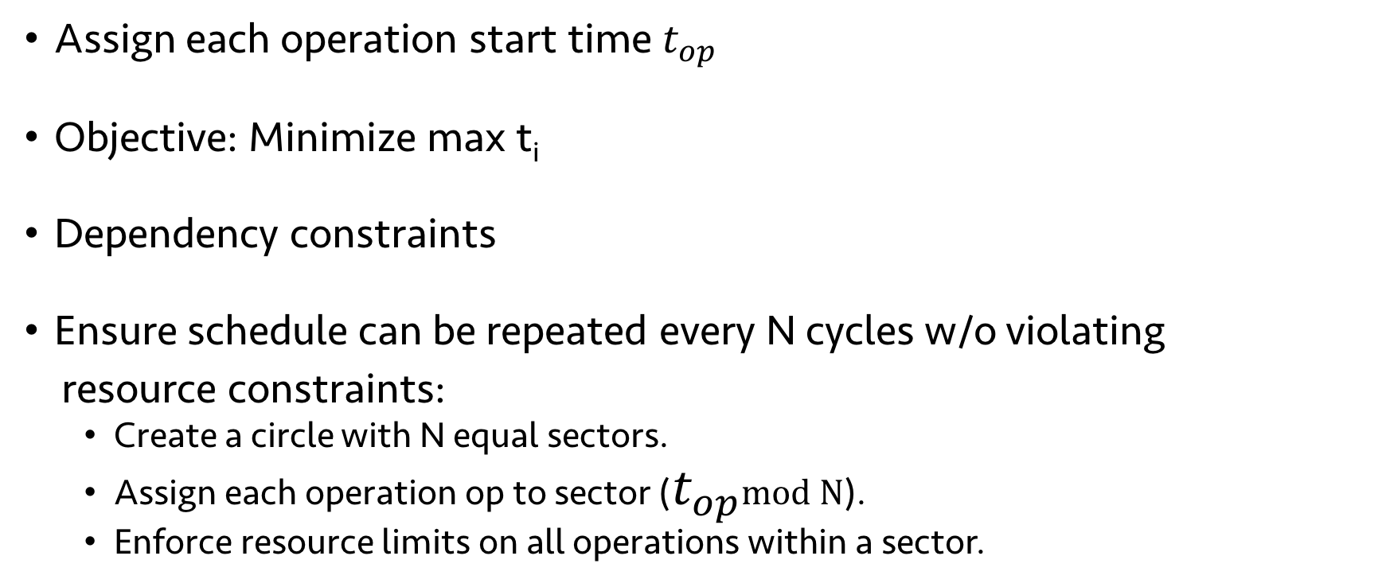





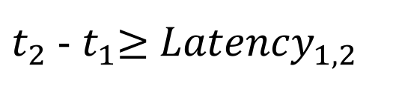

ILP formulation of scheduling problem
$$t_{0}$$
$$t_{1}$$
$$t_{2}$$
$$t_{3}$$
$$t_{4}$$
Assign each operation start time $t_{op}$
Objective: Minimize max t_{i}
Dependency constraints
Ensure schedule can be repeated every N cycles w/o violating
resource constraints:
Create a circle with N equal sectors.
Assign each operation op to sector ($t_{op}$mod N).
Enforce resource limits on all operations within a sector.
$t_{2}$ - $t_{1}$≥ ${Latency}_{1, 2}$
$$t_{0}$$
$$t_{4}$$
$$t_{2}$$
$$t_{1}$$
$$t_{3}$$
Notes:
In this example, we introduced a no-op, but that’s a greedy way of solving it. If we want the optimal schedule, need to solve an ILP.
Packet that arrived this scheduling period, 1 period in the past, 2 in the past, and so on.
Wasn’t very clear here.
What was interesting: scheduling or ILP?
ILP sounded very procedural
What is interesting about the ILP here?
Could remove ILP if the problem is stated clearly before hand.

Slide 34
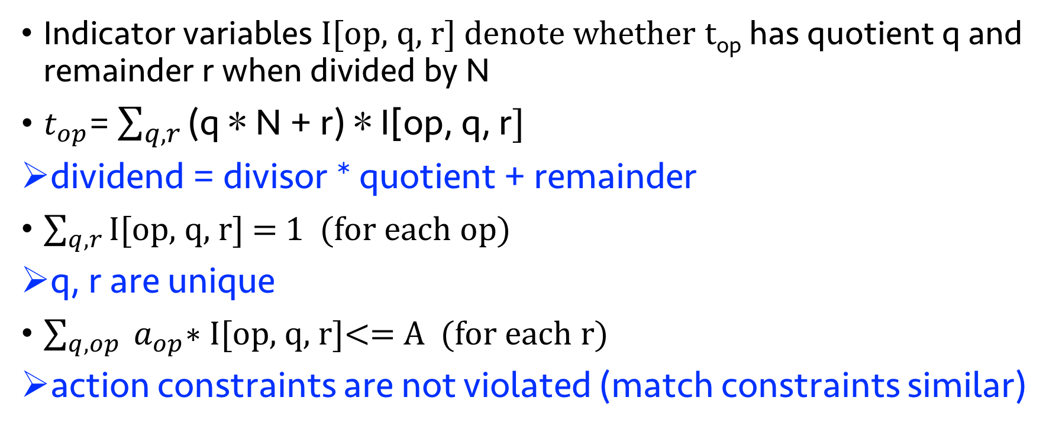
Enforcing periodic resource constraints
Indicator variables I[op, q, r] denote whether t_{op} has quotient q and remainder r when divided by N
$t_{op}$= $\sum_{q, r}{\text{(}\text{q}\text{ ∗ }\text{N}\text{ + }\text{r}\text{) ∗ }\text{I}\text{[}\text{op}\text{, }\text{q}\text{, }\text{r}]}$
dividend = divisor * quotient + remainder
$\sum_{q, r}{\text{I}\text{[}\text{op}\text{, }\text{q}\text{, }\text{r}]}$ = 1 (for each op)
q, r are unique
$\sum_{q, op}{ a_{op}\text{∗ }\text{I}\text{[}\text{op}\text{, }\text{q}\text{, }\text{r}]}$<= A (for each r)
action constraints are not violated (match constraints similar)

