Slide 1



dRMT: Disaggregated Programmable Switching
Sharad Chole, Andrew Fingerhut, Sha Ma, Anirudh Sivaraman, Shay Vargaftik, Alon Berger, Gal Mendelson, Mohammad Alizadeh, Shang-Tse Chuang, Isaac Keslassy, Ariel Orda, and Tom Edsall
Notes:
TODO: Prioritize changes to the compilation part of the talk (compilation + sub-problems + fine-grained deps + proc constraints + animation)

Slide 2
Today’s Programmable Switches (e.g., RMT)
Stage 1
Stage 2
Stage N
Parser
Deparser
Pkt Header
Pkt Header
Queues
Match
Match
Match
In
Action
Action
Action
Out
keys
Memory Cluster 1
Memory Cluster 2
Memory Cluster N
results
Notes:
- Each stage has a local memory cluster
- As a packet enters each stage, the “match unit” extracts search keys from the packet header; sends to the local memory cluster for lookup

Slide 3
Problems with RMT Architecture
Conflates memory allocation with packet processing
Wastes processing and/or memory resources
Example: Large table split over multiple stages
Stage 1
Stage 2
Stage 3
Stage N
Match
Match
Match
Match
Action
Action
Action
Action
Must extract key multiple times
Only last stage executes action
Wastes match/action capacity
Memory Cluster 1
Memory Cluster 2
Memory Cluster 3
Memory Cluster N
Notes:
Large table:
* Each stage has to extract and search for the key
* Action cannot be executed until last stage
→ Wastes key generation and action capacity

Slide 4
Problems with RMT Architecture
Forces rigid order on operations: match→action→match→action→…
Wastes resources for “imbalanced” programs
Example: Tables without a match (default action)
Stage 1
Stage 2
Stage 3
Stage N
Match
Match
Match
Match
Action
Action
Action
Action
Default action
Notes:
Large table:
* Each stage has to extract and search for the key
* Action cannot be executed until last stage
→ Wastes key generation and action capacity

Slide 5
Problems with RMT Architecture
Suffers performance cliff if program doesn’t fit
Recirculate packet to “extend” pipeline → Lowers throughput 2x
Stage 1
Stage 2
Stage 3
Stage N
Match
Match
Match
Match
Action
Action
Action
Action
Recirculate to ingress
Notes:
Large table:
* Each stage has to extract and search for the key
* Action cannot be executed until last stage
→ Wastes key generation and action capacity

Slide 6
Problems with RMT Architecture
Conflates memory allocation with packet processing
Forces rigid order on operations (match→action→match→action→ …)
Suffers performance cliff if program doesn’t fit
The dRMT architecture solves all 3 problems
Key idea:
Disaggregate hardware resources of a programmable switch

Slide 7
The dRMT Architecture
Stage 1
Stage 2
Stage N
Parser
Deparser
Queues
Match
Match
Match
In
Out
Action
Action
Action
Memory Cluster 1
Memory Cluster 2
Memory Cluster N
Notes:
- Each stage has a local memory cluster
- As a packet enters each stage, the “match unit” extracts search keys from the packet header; sends to the local memory cluster for lookup

Slide 8
Stage 1
Stage 2
Stage N
Queues
Parser
Deparser
In
Match
Match
Match
Out
Action
Action
Action
Memory Cluster 1
Memory Cluster 2
Memory Cluster N
Notes:
- Each stage has a local memory cluster
- As a packet enters each stage, the “match unit” extracts search keys from the packet header; sends to the local memory cluster for lookup

Slide 9
Queues
Pkt 1
Parser
Pkt 2
Pkt N
In
Deparser
Distributor
Out
Proc. 1
Proc. 2
Proc. N
Match
Pkt 1
Match
Pkt 2
Match
Pkt N
Action
Action
Action
Memory Cluster 1
Memory Cluster 2
Memory Cluster N
Notes:
- Each stage has a local memory cluster
- As a packet enters each stage, the “match unit” extracts search keys from the packet header; sends to the local memory cluster for lookup

Slide 10
Queues
Parser
In
Deparser
Distributor
Out
Proc. 1
Proc. 2
Proc. N
Match
Pkt 1
Match
Pkt 2
Match
Pkt N
Action
Action
Action
Memory Cluster 1
Memory Cluster 2
Memory Cluster N
Notes:
- Each stage has a local memory cluster
- As a packet enters each stage, the “match unit” extracts search keys from the packet header; sends to the local memory cluster for lookup

Slide 11
Pkt 2
Queues
Parser
In
Deparser
Distributor
Out
Proc. 1
Proc. 2
Proc. N
Match
Pkt 1
Match
Pkt N+2
Match
Pkt N
Pkt 2
Action
Action
Action
Memory Cluster 1
Memory Cluster 2
Memory Cluster N
Notes:
- Each stage has a local memory cluster
- As a packet enters each stage, the “match unit” extracts search keys from the packet header; sends to the local memory cluster for lookup

Slide 12
dRMT solves problems with RMT
RMT Conflates memory allocation with packet processing
dRMT decouples memory and processors via crossbar
RMT forces rigid order on operations
dRMT enables arbitrary order for operations
RMT suffers performance cliff if program doesn’t fit (recirculation)
dRMT’s throughput degrades gracefully as program size grows

Slide 13
Two Key Questions
Can dRMT provide deterministic performance?
Contention at processors, memories, processor/memory interconnect, etc.
Yes! We can preschedule system at compile time to prevent contention entirely.
How much does it cost to build?
Processor and crossbar area, wiring complexity, etc.
Hardware costs are comparable to RMT. (But dRMT utilizes hardware resources more efficiently.)
Notes:
The rest of the talk will look at these questions in more depth.

Slide 14
Compiling a P4 program to dRMT
Proc. 1
Proc. 2
Proc. N
Table Placement
Processor scheduling
Crossbar decouples the two problems
?
?
?
Match
Match
Match
Action
Action
Action
Memory Cluster 1
Memory Cluster 2
Memory Cluster N
Notes:
TODO: Maybe add a figure here.

Slide 15
Scheduling Constraints
Processor resource constraints:
Generate up to M b-bit keys to match on per cycle (M=8, b=80)
Perform actions on up to A packet fields per cycle (A=32)
Perform match/action on IPC packets per cycle (IPC=1 or 2)
Dependency constraints:
Operation depending on a match has to wait d_{M} cycles (d_{M}=22)
Operation depending on an action has to wait d_{A} cycles (d_{A}=2)
Notes:
TODO: Bring back diagram of the processor to explain

Slide 16
Modeling dependencies
Table dependency graph
Operation dependency graph
Routable
Multicast
IGMP
Match
Dep.
Action
Dep.
Routable
Match
Routable
Action
Multicast
Match
Multicast
Action
d_{M}
d_{A}
d_{M}
d_{A}
IGMP
Match
IGMP
Action
d_{M}
Notes:
This leads into the compiler.
Toy example very loosely inspired by L2-L3 with Multicast.

Slide 17
Scheduling Example
Proc. 1
Proc. 2
1
1
1
M0
2
A0
1
M1
Match
Match
Action
Action
1
1
A1
Each match → 1 key
Each action → 1 field
d_{M} (Match latency) = 2 cycles
d_{A} (Action latency) = 1 cycles
N = 2 processors
M (Match capacity) = 1 key per cycle
A (Action capacity) = 1 field per cycle
IPC (Concurrency) = 1 pkt per cycle

Slide 18
Scheduling Example
1
1
1
2
Focus on 1 processor
1 packet arrives every 2 cycles
M0
A0
1
M1
1
1
A1
Cycle | 0 | 1 | 2 | 3 | 4 | 5 | 6 | 7 | 8 | 9 | 10 | 11 | 12 | 13

Slide 19
Scheduling Example
1
1
1
2
Focus on 1 processor
1 packet arrives every 2 cycles
M0
A0
1
M1
1
1
A1
Cycle | 0 | 1 | 2 | 3 | 4 | 5 | 6 | 7 | 8 | 9 | 10 | 11 | 12 | 13
 | M0 |  | A0 | M1 | A1

Slide 20
Scheduling Example
1
1
1
2
Focus on 1 processor
1 packet arrives every 2 cycles
M0
A0
1
M1
1
1
A1
Violates action capacity
Cycle | 0 | 1 | 2 | 3 | 4 | 5 | 6 | 7 | 8 | 9 | 10 | 11 | 12 | 13
 | M0 |  | A0 | M1 | A1
 |  |  | M0 |  | A0 | M1 | A1

Slide 21
Scheduling Example
1
1
1
2
Focus on 1 processor
1 packet arrives every 2 cycles
M0
A0
1
M1
1
1
A1
Cycle | 0 | 1 | 2 | 3 | 4 | 5 | 6 | 7 | 8 | 9 | 10 | 11 | 12 | 13
 | M0 |  | A0 | M1 | X | A1
 |  |  | M0 |  | A0 | M1 | X | A1

Slide 22
Scheduling Example
1
1
1
2
Focus on 1 processor
1 packet arrives every 2 cycles
M0
A0
1
M1
1
1
A1
Cycle | 0 | 1 | 2 | 3 | 4 | 5 | 6 | 7 | 8 | 9 | 10 | 11 | 12 | 13
 | M0 |  | A0 | M1 | X | A1
 |  |  | M0 |  | A0 | M1 | X | A1
 |  |  |  |  | M0 |  | A0 | M1 | X | A1
 |  |  |  |  |  |  | M0 |  | A0 | M1 | X | A1
 |  |  |  |  |  |  |  |  | M0 |  | A0 | M1 | X | A1

Slide 23



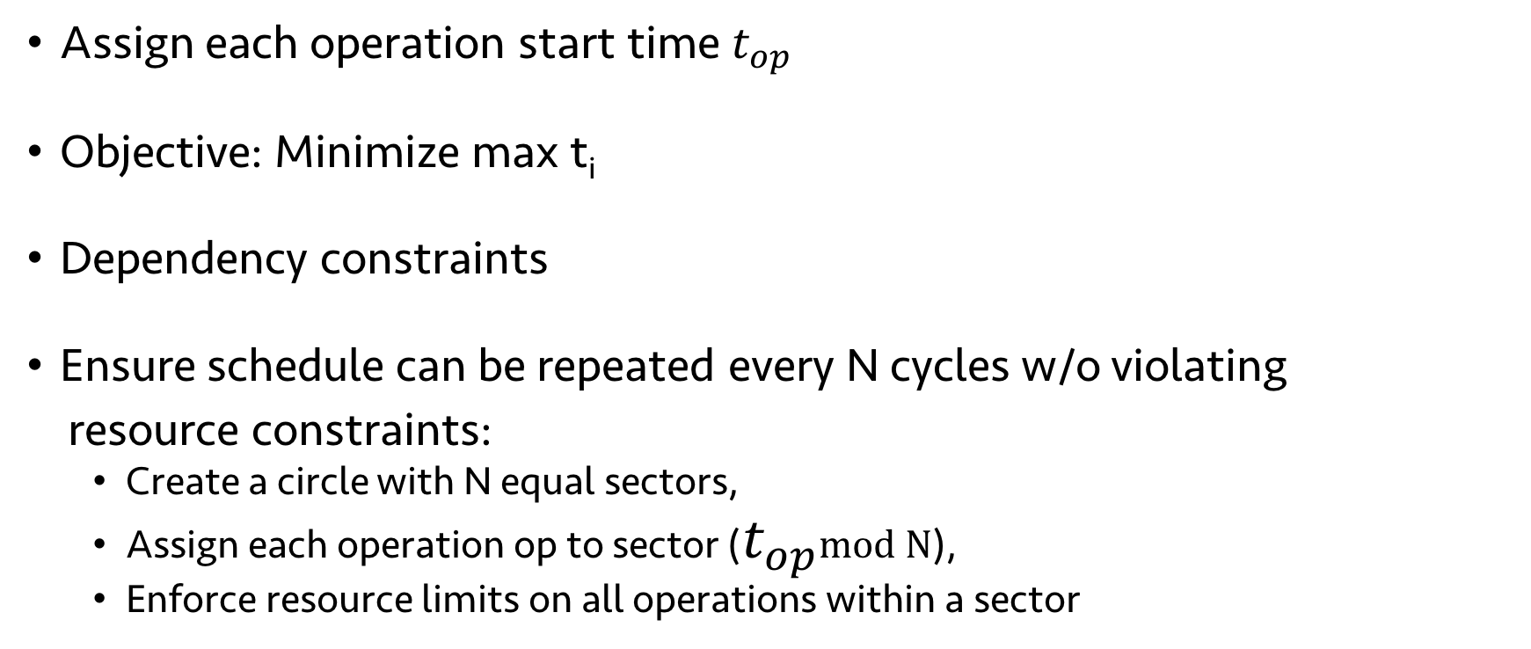





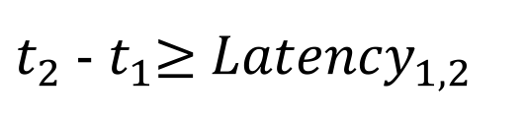

ILP formulation of scheduling problem
$$t_{0}$$
$$t_{1}$$
$$t_{2}$$
$$t_{3}$$
$$t_{4}$$
Assign each operation start time $t_{op}$
Objective: Minimize max t_{i}
Dependency constraints
Ensure schedule can be repeated every N cycles w/o violating
resource constraints:
Create a circle with N equal sectors,
Assign each operation op to sector ($t_{op}$mod N),
Enforce resource limits on all operations within a sector
$t_{2}$ - $t_{1}$≥ ${Latency}_{1, 2}$
$$t_{0}$$
$$t_{4}$$
$$t_{2}$$
$$t_{1}$$
$$t_{3}$$
Notes:
In this example, we introduced a no-op, but that’s a greedy way of solving it. If we want the optimal schedule, need to solve an ILP.

Slide 24
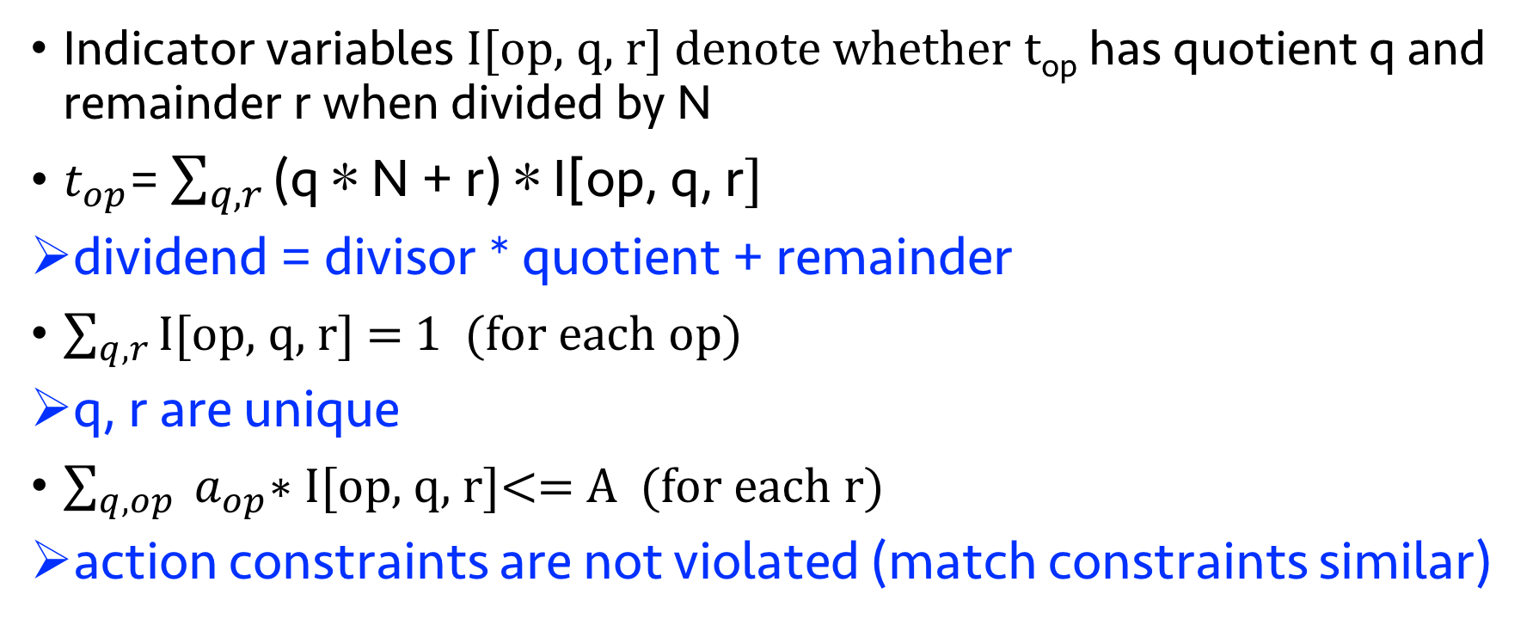
Enforcing periodic resource constraints
Indicator variables I[op, q, r] denote whether t_{op} has quotient q and remainder r when divided by N
$t_{op}$= $\sum_{q, r}{\text{(}\text{q}\text{ ∗ }\text{N}\text{ + }\text{r}\text{) ∗ }\text{I}\text{[}\text{op}\text{, }\text{q}\text{, }\text{r}]}$
dividend = divisor * quotient + remainder
$\sum_{q, r}{\text{I}\text{[}\text{op}\text{, }\text{q}\text{, }\text{r}]}$ = 1 (for each op)
q, r are unique
$\sum_{q, op}{ a_{op}\text{∗ }\text{I}\text{[}\text{op}\text{, }\text{q}\text{, }\text{r}]}$<= A (for each r)
action constraints are not violated (match constraints similar)

Slide 25
Evaluation: switch.p4 on RMT and dRMT
Minimum number of processors to run at 1 packet/cycle
P4 Program | RMT | dRMT (IPC=1) | dRMT (IPC=2) | Lower bound
Ingress (switch.p4) | 18 | 17 | 15 | 15
Egress (switch.p4) | 12 | 11 | 7 | 7
Switch.p4 combined | 22 | 21 | 21 | 21
dRMT is near optimal; to run at line-rate:
Fewest possible processors
Near-ideal (critical path) latency
Minimum number of threads to run at 1 packet/cycle
P4 Program | RMT | dRMT (IPC=1) | dRMT (IPC=2) | Lower bound
Ingress (switch.p4) | 360 | 245 | 243 | 243
Egress (switch.p4) | 240 | 217 | 198 | 197
Switch.p4 combined | 440 | 243 | 243 | 243
Notes:
Switch.p4 is optimized for RMT.

Slide 26
dRMT eliminates performance cliffs
Throughput vs. Processors for switch.p4 egress

Slide 27
dRMT Match Action Processor
Packet Header Vector
(4Kb)
Packet Header Vector
(4Kb)
Packet Header Vector
(4Kb)
ALU
Match Key Generation (crossbar)
Scratch
Pad
Action Input Selector
(crossbar)
Action Output Selector
(crossbar)
… …
8x80b Key
ALU
8x96b Action
Memory
Thread Select
Ctrl
Op code
Config
Table
Crossbar to
Memories
VLIW Instruction Table
Notes:
Key differences with RMT:
-- dRMT processor needs to store full program → Config table & instruction table more expensive
-- Scratchpad (store results for delayed execution
-- VLIW Instructions: 32 ALUs instead of 224

Slide 28
Crossbar designs
Proc. 1
Proc. 2
Proc. 1
Proc. 2
Proc. 1
Proc. 2
Mem. 1
Mem. 2
Mem. 1
Mem. 2
Mem. 1
Mem. 2
Unit Crossbar
(0.561 mm²)
Full Crossbar
(4.464 mm²)
Segment Crossbar
(0.576 mm²)
The segment crossbar is equivalent to full crossbar if tables are not split across clusters! (see paper for details)
dRMT uses One-to-Many Segment Crossbar
Notes:
Area numbers for 32x32 crossbar with 8 80-bit keys on each side

Slide 29
Hardware area estimates (mm²)
Number of Processors | RMT | Crossbar with 32 memory clusters | dRMT(IPC=1) with crossbar | dRMT(IPC=2) with crossbar
16 | 19.9 | 0.857 | 17.7 | 22.7
24 | 29.9 | 1.254 | 26.6 | 34.1
32 | 39.8 | 1.740 | 35.5 | 45.5
dRMT hardware cost is comparable to RMT.

Slide 30
Summary
dRMT: Disaggregated architecture for programmable switches
Paper appearing at SIGCOMM 2017
Ongoing work: Implementation in programmable NIC
Lots of interesting open questions
Scheduling different packet types
Stateful packet processing

Slide 32
Problems with RMT Architecture
Conflates memory allocation with packet processing
Wastes processing and/or memory resources
Example: Parallel table lookups that exceed key gen. capacity of a stage
Stage 1
Stage 2
Stage 3
Stage N
Match
Match
Match
Match
Action
Action
Action
Action
Must spread tables across multiple stages
Wastes memory capacity
Memory Cluster 1
Memory Cluster 2
Memory Cluster 3
Memory Cluster N

Slide 33
Compiling a P4 program to dRMT
Memory: Allocate logical tables to memory clusters
Compute: Schedule processors respecting resource and dependency constraints
Joint optimization problem in general
Crossbar decouples the memory and compute problems
Compute schedule must satisfy crossbar constraints on processor side
Table placement must satisfy crossbar constraints on memory side
Notes:
TODO: Maybe add a figure here.

Slide 34
Evaluation: Key questions
How efficiently can dRMT utilize hardware resources?
Minimum number of processors/threads to run a P4 program at line-rate
What happens when hardware resources are insufficient?
Throughput as a function of the number of processors
Is it feasible?
Area cost of dRMT vs. RMT

Slide 35
Summary
Disaggregated flexible architecture for high speed programmable switching
Higher resource utilization
Lower latency
Lower thread count
Graceful degradation of throughput
Independent scaling of processing/memory capacity
Applications:
Low Latency Switching
SmartNIC
Off-chip buffers/non-deterministic memory latencies

Slide 36
Hardware costs
Hardware area in 16 nm excluding wires and memory
32-stage RMT: 39.8 square mm
32-processor dRMT (32-wide VLIW, segment crossbar): 45.5 square mm
Of the 45.5, 1.74 is due to the crossbar, the rest due to 32 dRMT cores
Tentative analysis is that hardware costs are comparable
Tentative because RMT’s numbers are based on 28 nm
Notes:
TODO: Maybe mention thread count.

Slide 37
Crossbar requirements
Need to connect 32 processors to 32 memory clusters
Each processor can generate up to 8 match keys
Each memory cluster can receive up to 8 match keys
Need multicasting for large tables spread out over multiple memories

Slide 38
Crossbar designs
Three possible crossbars:
Unit crossbar: 32*32 crossbar with width to support 8 keys: too restrictive
Full crossbar: (32 * 8) * (32 * 8) crossbar: too expensive to build
Segment crossbar: 8 parallel (32*32) crossbars: feasible, with little loss in expressiveness (if tables aren’t split across clusters, equivalent to full)
Proc. 1
Proc. 2
Proc. 1
Proc. 2
Proc. 1
Proc. 2
Mem. 1
Mem. 2
Mem. 1
Mem. 2
Mem. 1
Mem. 2
Unit Crossbar
Full Crossbar
Segment Crossbar

Slide 39
Differences in architecture relative to RMT
Unlike RMT, each dRMT processor needs to store full program
Unlike RMT, we need a scratch pad to store action results for delayed execution
Need to optimize hardware design
Reduce the number of parallel action fields in a single VLIW from 224 to 32
Empirically sufficient on switch.p4
Notes:
Hardware analysis takeaways:

Slide 40
dRMT eliminates performance cliffs
dRMT’s performance degrades gracefully

Slide 41
Results: switch.p4 on RMT and dRMT
Number of processors/stages to run switch.p4 at 1 packet/cycle
Program | RMT | dRMT | Lower Bound
Ingress | 18 | 15 | 15
Egress | 12 | 7 | 7
Combined | 22 | 21 | 21
dRMT’s gains are most when the program is imbalanced
Notes:
Switch.p4 is optimized for RMT.

Slide 42
Hardware design for dRMT
Packet Header Vector
(4Kb)
()
ALU
Match Key Generation (crossbar)
Scratch
Pad
Action Input Selector
(crossbar)
Action Output Selector
(crossbar)
… …
640b Key
ALU
8x96b Action
Memory
Thread Select
Ctrl
Op code
Config
Table
Crossbar to
Memories
VLIW Instruction Table

Slide 43
Ongoing and future work
Ongoing work: Implementation in programmable NIC
Future work: State modifications in dRMT
Run-to-completion allows us to spread state modifications over multiple clock cycles

Slide 44
Problems with RMT Architecture
Conflates memory allocation with packet processing
Wastes processing and/or memory resources
Example: Parallel table lookups that exceed key gen. capacity of a stage
Stage 1
Stage 2
Stage 3
Stage N
Match
Match
Match
Match
Action
Action
Action
Action
Must spread tables across multiple stages
Wastes memory capacity
Memory Cluster 1
Memory Cluster 2
Memory Cluster 3
Memory Cluster N

Slide 45
Related Work
Network processors (IXP, Netronome, Quantum Flow)
dRMT
Run-to-completion
Shared memory
X86-like instructions
Caches,
Memory hierarchies,
General-purpose interconnects,
Hard to provide determinism
Run-to-completion
Shared memory
VLIW instructions with more parallelism
No caches
Single level of memory
Custom crossbar
Compiler solves ILP to provide deterministic latency

Slide 46
Hardware Implementation
Key Differences:
Match Action Processor
Packet Contexts
Scratch pad
VLIW Instructions
Crossbar

Slide 47
Match-Action Processor
Packet Header Vector
(4Kb)
Packet Header Vector
(4Kb)
Packet Header Vector
(4Kb)
ALU
Match Key Generation (crossbar)
Scratch
Pad
Action Input Selector
(crossbar)
Action Output Selector
(crossbar)
… …
8x80b Key
ALU
8x96b Action
Memory
Thread Select
Ctrl
Op code
Config
Table
Crossbar to
Memories
VLIW Instruction Table

Slide 48
VLIW Instructions
Action Program
Counter
32 X 96b
ALU Select Table
Bits[95:93]
8:1 mux
1K
SRAM
(for ALU 31)
Instruction Ptr 0 (10b)
… …
Instruction Ptr 7 (10b)
Over 90% of tables require 8 or fewer primitive actions.
dRMT implements 32 of 32-bit ALUs
Instruction memory is implemented as 32 of 1K deep SRAMs
Bits[2:0]
…
Instruction Ptr 0 (10b)
8:1 mux
1K
SRAM
(for ALU 0)
… …
Instruction Ptr 7 (10b)

Slide 49
Crossbar choices
Proc. 1
Proc. 1
Proc. 1
Proc. 1
Proc. 1
Proc. 1
Mem. 1
Mem. 1
Mem. 1
Mem. 1
Mem. 1
Mem. 1
Unit Crossbar
(0.561 mm²)
Segment Crossbar
(0.576 mm²)
Full Crossbar
(4.464 mm²)
The segment crossbar is as powerful as full crossbar if
No tables are split across clusters
Total key-segments per cluster < Max Key Segments per cluster
dRMT uses One-to-Many Segment Crossbar.

Slide 50
Hardware Evaluation
Component | RMT | dRMT(IPC=1) | dRMT(IPC=2)
Key Generation
Config Register | 0.007 | 0.004 | 0.005
Key Crossbar | 0.098 | 0.049 | 0.071
Packet Storage
Header Vector | 0.110 | 0.326 | 0.470
Scratch Pad | N/A | 0.051 | 0.051
Actions
Input Crossbar | 0.486 | 0.171 | 0.315
ALUs | 0.170 | 0.071 | 0.071
Output Crossbar | N/A | 0.048 | 0.048
VLIW Table | 0.372 | 0.336 | 0.336
Total | 1.243 | 1.056 | 1.367
Estimated area per processor (mm²)

Slide 51
Hardware Evaluation
Number of Processors | RMT | Crossbar with 32 memory clusters | dRMT(IPC=1) with crossbar | dRMT(IPC=2) with crossbar
16 | 19.9 | 0.857 | 17.7 | 22.7
24 | 29.9 | 1.254 | 26.6 | 34.1
32 | 39.8 | 1.740 | 35.5 | 45.5
a) Area of all processors plus interconnect (mm²)
Number of Processors | Power for Crossbar with 32 memory clusters
16 | 0.88 W
24 | 1.31 W
32 | 1.75 W
b) Crossbar Power @1.2 GHz 0.9V

