Slide 1



dRMT: Disaggregated Programmable Switching
Sharad Chole, Andrew Fingerhut, Sha Ma, Anirudh Sivaraman, Shay Vargaftik, Alon Berger, Gal Mendelson, Mohammad Alizadeh, Shang-Tse Chuang, Isaac Keslassy, Ariel Orda, and Tom Edsall
Notes:
TODO: Prioritize changes to the compilation part of the talk (compilation + sub-problems + fine-grained deps + proc constraints + animation)

Slide 2
Today’s Programmable Switches (e.g., RMT)
Stage 1
Stage 2
Stage N
Parser
Deparser
Pkt Header
Pkt Header
Queues
Match
Match
Match
In
Action
Action
Action
Out
keys
Memory Cluster 1
Memory Cluster 2
Memory Cluster N
results
Notes:
- Each stage has a local memory cluster
- As a packet enters each stage, the “match unit” extracts search keys from the packet header; sends to the local memory cluster for lookup

Slide 3
Problems with RMT Architecture
Conflates memory allocation with packet processing
Wastes processing and/or memory resources
Example: Large table split over multiple stages
Stage 1
Stage 2
Stage 3
Stage N
Match
Match
Match
Match
Action
Action
Action
Action
Must extract key multiple times
Only last stage executes action
Wastes match/action capacity
Memory Cluster 1
Memory Cluster 2
Memory Cluster 3
Memory Cluster N
Notes:
Large table:
* Each stage has to extract and search for the key
* Action cannot be executed until last stage
→ Wastes key generation and action capacity

Slide 4
Problems with RMT Architecture
Forces rigid order on operations: match→action→match→action→…
Wastes resources for “imbalanced” programs
Example: Tables without a match & default action
Stage 1
Stage 2
Stage 3
Stage N
Match
Match
Match
Match
Action
Action
Action
Action
Default action
Notes:
Large table:
* Each stage has to extract and search for the key
* Action cannot be executed until last stage
→ Wastes key generation and action capacity

Slide 5
Problems with RMT Architecture
Suffers performance cliff if program doesn’t fit
Recirculate packet to “extend” pipeline → Lowers throughput 2x
Stage 1
Stage 2
Stage 3
Stage N
Match
Match
Match
Match
Action
Action
Action
Action
Recirculate to ingress
Notes:
Large table:
* Each stage has to extract and search for the key
* Action cannot be executed until last stage
→ Wastes key generation and action capacity

Slide 6
Problems with RMT Architecture
Conflates memory allocation with packet processing
Forces rigid order on operations (match→action→match→action→ …)
Suffers performance cliff if program doesn’t fit
The dRMT architecture solves all 3 problems
Key idea:
Disaggregate hardware resources of a programmable switch

Slide 7
The dRMT Architecture
Stage 1
Stage 2
Stage N
Parser
Deparser
Queues
Match
Match
Match
In
Out
Action
Action
Action
Memory Cluster 1
Memory Cluster 2
Memory Cluster N
Notes:
- Each stage has a local memory cluster
- As a packet enters each stage, the “match unit” extracts search keys from the packet header; sends to the local memory cluster for lookup

Slide 8
Stage 1
Stage 2
Stage N
Queues
Parser
Deparser
In
Match
Match
Match
Out
Action
Action
Action
Memory Cluster 1
Memory Cluster 2
Memory Cluster N
Notes:
- Each stage has a local memory cluster
- As a packet enters each stage, the “match unit” extracts search keys from the packet header; sends to the local memory cluster for lookup

Slide 9
Queues
Pkt 1
Parser
Pkt 2
Pkt N
In
Deparser
Distributor
Out
Proc. 1
Proc. 2
Proc. N
Match
Pkt 1
Match
Pkt 2
Match
Pkt N
Action
Action
Action
Memory Cluster 1
Memory Cluster 2
Memory Cluster N
Notes:
- Each stage has a local memory cluster
- As a packet enters each stage, the “match unit” extracts search keys from the packet header; sends to the local memory cluster for lookup

Slide 10
Queues
Parser
In
Deparser
Distributor
Out
Proc. 1
Proc. 2
Proc. N
Match
Pkt 1
Match
Pkt 2
Match
Pkt N
Action
Action
Action
Memory Cluster 1
Memory Cluster 2
Memory Cluster N
Notes:
- Each stage has a local memory cluster
- As a packet enters each stage, the “match unit” extracts search keys from the packet header; sends to the local memory cluster for lookup

Slide 11
Pkt 2
Queues
Parser
In
Deparser
Distributor
Out
Proc. 1
Proc. 2
Proc. N
Match
Pkt 1
Match
Pkt N+2
Match
Pkt N
Pkt 2
Action
Action
Action
Memory Cluster 1
Memory Cluster 2
Memory Cluster N
Notes:
- Each stage has a local memory cluster
- As a packet enters each stage, the “match unit” extracts search keys from the packet header; sends to the local memory cluster for lookup

Slide 12
dRMT solves problems with RMT
RMT Conflates memory allocation with packet processing
dRMT decouples memory and processors via crossbar
RMT forces rigid order on operations
dRMT enables arbitrary order for operations
RMT suffers performance cliff if program doesn’t fit (recirculation)
dRMT’s throughput degrades gracefully as program size grows

Slide 13
Two Key Questions
Can dRMT provide deterministic performance?
Contention at processors, memories, processor/memory interconnect, etc.
Yes! We can preschedule system at compile time to prevent contention entirely.
How much does it cost to build?
Processor and crossbar area, wiring complexity, etc.
Hardware costs are comparable to RMT. (But dRMT utilizes hardware resources more efficiently.)
Notes:
The rest of the talk will look at these questions in more depth.

Slide 14
Compiling a P4 program to dRMT
Memory : Allocate logical tables to memory clusters
Compute: Schedule respecting dependency and resource constraints
Joint optimization problem in general
Crossbar decouples the compute and memory problems so long as:
Compute schedule satisfies constraints on crossbar send side
Table placement satisfies constraints on receive side (bin packing)
Notes:
TODO: Maybe add a figure here.

Slide 15
dRMT constraints
Resource constraints:
Each processor can generate up to M b-bit-width keys to match against tables
Each processor can modify up to A packet fields in parallel.
Dependency constraints:
Operation depending on a match has to wait dM clock cycles
Operation depending on an action has to wait dA clock cycles
Notes:
TODO: Bring back diagram of the processor to explain

Slide 16
Capturing dependencies in dRMT
Table dependency graph in RMT
Operation dependency graph in dRMT
Routable
Multicast
IGMP
Match
Dep.
Action
Dep.
Routable
Match
Routable
Action
Multicast
Match
Multicast
Action
dM
dA
dM
dA
IGMP
Match
IGMP
Action
dM
Notes:
This leads into the compiler.
Toy example very loosely inspired by L2-L3 with Multicast.

Slide 17
Animation of scheduling problem
1
1
1
N = 2 processors
Each proc handles a new packet every 2 cycles
M = 1 (1 match key)
A = 1 (1 field)
dM (Match latency) = 2 clock cycles
dA (Action latency) = 1 clock cycles
M0
2
A0
1
M1
1
1
A1

Slide 18
Animation of scheduling problem
1
1
1
M0
2
A0
1
M1
t | 0 | 1 | 2 | 3 | 4 | 5 | 6 | 7 | 8 | 9 | 10 | 11 | 12 | 13
1
1
A1

Slide 19
Animation of scheduling problem
After dependency constraints alone
1
1
1
M0
2
A0
1
M1
t | 0 | 1 | 2 | 3 | 4 | 5 | 6 | 7 | 8 | 9 | 10 | 11 | 12 | 13
 | M0 |  | A0 | M1 | A1
1
1
A1

Slide 20
Animation of scheduling problem
1
1
1
M0
2
A0
1
M1
t | 0 | 1 | 2 | 3 | 4 | 5 | 6 | 7 | 8 | 9 | 10 | 11 | 12 | 13
 | M0 |  | A0 | M1 | A1
 |  |  | M0 |  | A0 | M1 | A1
1
1
A1
Violates
Action
Constraint

Slide 21
Animation of scheduling problem
1
1
1
M0
2
A0
1
M1
t | 0 | 1 | 2 | 3 | 4 | 5 | 6 | 7 | 8 | 9 | 10 | 11 | 12 | 13
 | M0 |  | A0 | M1 | x | A1
 |  |  | M0 |  | A0 | M1 | A1
1
1
A1

Slide 22
Animation of scheduling problem
1
1
1
M0
2
A0
1
M1
t | 0 | 1 | 2 | 3 | 4 | 5 | 6 | 7 | 8 | 9 | 10 | 11 | 12 | 13
 | M0 |  | A0 | M1 | x | A1
 |  |  | M0 |  | A0 | M1 | x | A1
1
1
A1

Slide 23
Animation of scheduling problem
1
1
1
M0
2
A0
1
M1
t | 0 | 1 | 2 | 3 | 4 | 5 | 6 | 7 | 8 | 9 | 10 | 11 | 12 | 13
 | M0 |  | A0 | M1 | x | A1
 |  |  | M0 |  | A0 | M1 | x | A1
 |  |  |  |  | M0 |  | A0 | M1 | x | A1
1
1
A1

Slide 24
Animation of scheduling problem
1
1
1
M0
2
A0
1
M1
t | 0 | 1 | 2 | 3 | 4 | 5 | 6 | 7 | 8 | 9 | 10 | 11 | 12 | 13
 | M0 |  | A0 | M1 | x | A1
 |  |  | M0 |  | A0 | M1 | x | A1
 |  |  |  |  | M0 |  | A0 | M1 | x | A1
 |  |  |  |  |  |  | M0 |  | A0 | M1 | x | A1
1
1
A1

Slide 25
Animation of scheduling problem
1
1
1
M0
2
A0
1
M1
t | 0 | 1 | 2 | 3 | 4 | 5 | 6 | 7 | 8 | 9 | 10 | 11 | 12 | 13
 | M0 |  | A0 | M1 | x | A1
 |  |  | M0 |  | A0 | M1 | x | A1
 |  |  |  |  | M0 |  | A0 | M1 | x | A1
 |  |  |  |  |  |  | M0 |  | A0 | M1 | x | A1
 |  |  |  |  |  |  |  |  | M0 |  | A0 | M1 | x | A1
1
1
A1

Slide 26



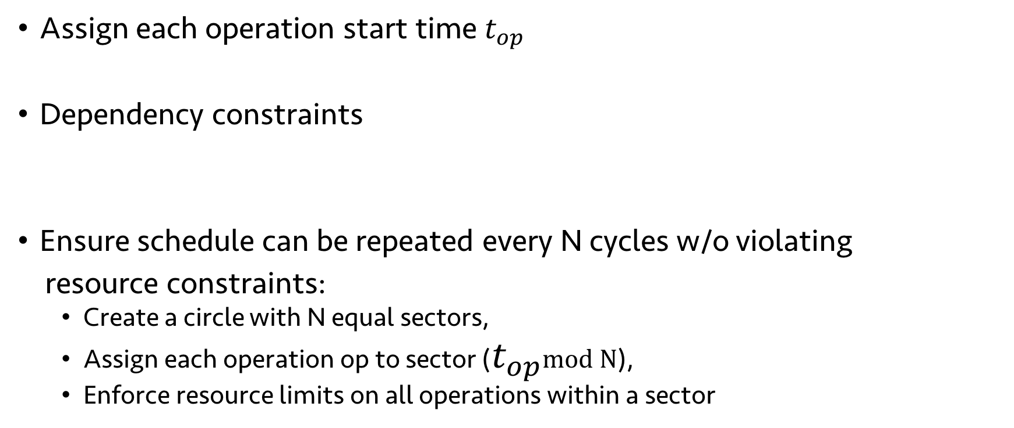





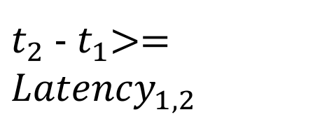

ILP formulation of scheduling problem
$$t_{0}$$
$$t_{1}$$
$$t_{2}$$
$$t_{3}$$
$$t_{4}$$
Assign each operation start time $t_{op}$
Dependency constraints
Ensure schedule can be repeated every N cycles w/o violating
resource constraints:
Create a circle with N equal sectors,
Assign each operation op to sector ($t_{op}$mod N),
Enforce resource limits on all operations within a sector
$t_{2}$ - $t_{1}$>= ${Latency}_{1, 2}$
$$t_{0}$$
$$t_{4}$$
$$t_{2}$$
$$t_{1}$$
$$t_{3}$$
Notes:
In this example, we introduced a no-op, but that’s a greedy way of solving it. If we want the optimal schedule, need to solve an ILP.

Slide 27
Results: switch.p4 on RMT and dRMT
Number of processors/stages to run switch.p4 at 1 packet/cycle
Program | RMT | dRMT | Lower Bound
Ingress | 18 | 15 | 15
Egress | 12 | 7 | 7
Combined | 22 | 21 | 21
dRMT’s gains are most when the program is imbalanced
Notes:
Switch.p4 is optimized for RMT.

Slide 28
dRMT eliminates performance cliffs
dRMT’s performance degrades gracefully

Slide 29
Hardware feasibility analysis
Unlike RMT, each dRMT processor needs to store full program
Need to optimize hardware design
Reduce the number of parallel action fields in a single VLIW from 224 to 32
Empirically sufficient on switch.p4
Hardware area estimates in 16 nm excluding SerDes and memory
32-stage RMT: 39.8 square mm (based on RMT estimates at 28 nm, scaled down to 16 nm)
32-processor dRMT (32-wide VLIW, segment crossbar): 45.5 square mm
Of the 45.5, 1.74 is due to the crossbar, the rest due to 32 dRMT cores
Notes:
TODO: Maybe mention thread count.
Maybe add table from paper.

Slide 30
Ongoing and future work
Paper appearing at SIGCOMM 2017
Ongoing work: Implementation in programmable NIC
Future work: State modifications in dRMT
Run-to-completion allows us to spread state modifications over multiple clock cycles

Slide 31
Evaluation: Key questions
How efficiently can dRMT utilize hardware resources?
Minimum number of processors to run a P4 program
What happens when hardware resources are insufficient?
Throughput as a function of the number of processors
Is it feasible?
Area cost of dRMT vs. RMT

Slide 32
Differences in architecture relative to RMT
Unlike RMT, each dRMT processor needs to store full program
Unlike RMT, we need a scratch pad to store action results for delayed execution
Need to optimize hardware design
Reduce the number of parallel action fields in a single VLIW from 224 to 32
Empirically sufficient on switch.p4
Notes:
Hardware analysis takeaways:

Slide 33
Crossbar requirements
Need to connect 32 processors to 32 memory clusters
Each processor can generate up to 8 match keys
Each memory cluster can receive up to 8 match keys
Need multicasting for large tables spread out over multiple memories

Slide 34
Crossbar designs
Three possible crossbars:
Unit crossbar: 32*32 crossbar with width to support 8 keys: too restrictive
Full crossbar: (32 * 8) * (32 * 8) crossbar: too expensive to build
Segment crossbar: 8 parallel (32*32) crossbars: feasible, with little loss in expressiveness (if tables aren’t split across clusters, equivalent to full)
Proc. 1
Proc. 2
Proc. 1
Proc. 2
Proc. 1
Proc. 2
Mem. 1
Mem. 2
Mem. 1
Mem. 2
Mem. 1
Mem. 2
Unit Crossbar
Full Crossbar
Segment Crossbar

Slide 35
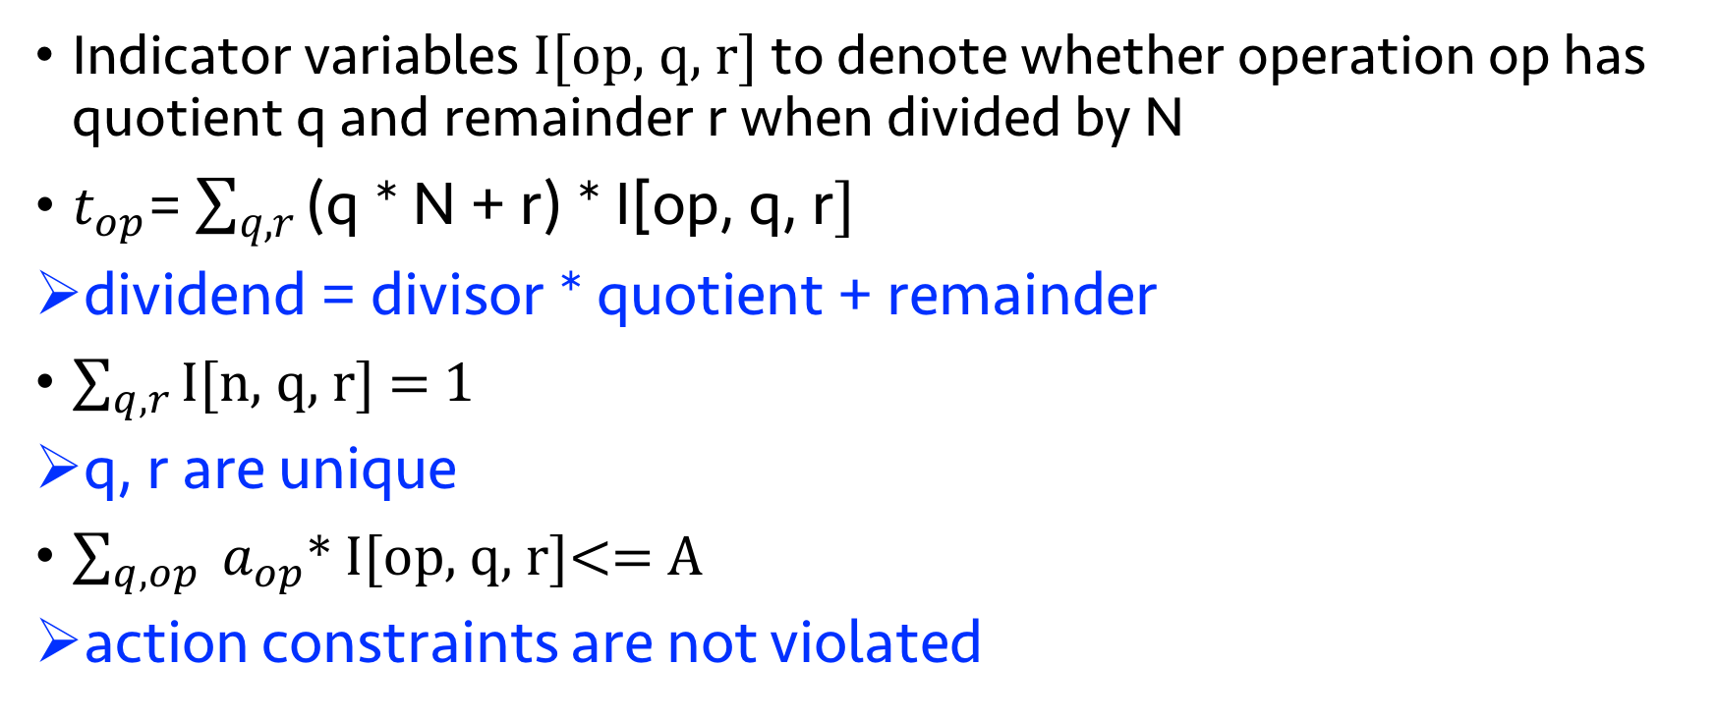
Enforcing periodic resource constraints
Indicator variables I[op, q, r] to denote whether operation op has quotient q and remainder r when divided by N
$t_{op}$= $\sum_{q, r}{\text{(}\text{q}\text{ ∗ }\text{N}\text{ + }\text{r}\text{) ∗ }\text{I}\text{[}\text{op}\text{, }\text{q}\text{, }\text{r}]}$
dividend = divisor * quotient + remainder
$\sum_{q, r}{\text{I}\text{[}\text{n}\text{, }\text{q}\text{, }\text{r}]}$ = 1
q, r are unique
$\sum_{q, op}{ a_{op}\text{∗ }\text{I}\text{[}\text{op}\text{, }\text{q}\text{, }\text{r}]}$<= A
action constraints are not violated

Slide 36
Hardware design for dRMT
Packet Header Vector
(4Kb)
()
ALU
Match Key Generation (crossbar)
Scratch
Pad
Action Input Selector
(crossbar)
Action Output Selector
(crossbar)
… …
640b Key
ALU
8x96b Action
Memory
Thread Select
Ctrl
Op code
Config
Table
Crossbar to
Memories
VLIW Instruction Table

Slide 37
Problems with RMT Architecture
Conflates memory allocation with packet processing
Wastes processing and/or memory resources
Example: Parallel table lookups that exceed key gen. capacity of a stage
Stage 1
Stage 2
Stage 3
Stage N
Match
Match
Match
Match
Action
Action
Action
Action
Must spread tables across multiple stages
Wastes memory capacity
Memory Cluster 1
Memory Cluster 2
Memory Cluster 3
Memory Cluster N

Slide 38
Related Work
Network processors (IXP, Netronome, Quantum Flow)
dRMT
Run-to-completion
Shared memory
X86-like instructions
Caches,
Memory hierarchies,
General-purpose interconnects,
Hard to provide determinism
Run-to-completion
Shared memory
VLIW instructions with more parallelism
No caches
Single level of memory
Custom crossbar
Compiler solves ILP to provide deterministic latency

