Slide 1



dRMT: Disaggregated Programmable Switching
Sharad Chole, Andrew Fingerhut, Sha Ma, Anirudh Sivaraman, Shay Vargaftik, Alon Berger, Gal Mendelson, Mohammad Alizadeh, Shang-Tse Chuang, Isaac Keslassy, Ariel Orda, and Tom Edsall

Slide 2
Today’s Programmable Switches (e.g., RMT)
Stage 1
Stage 2
Stage N
Parser
Deparser
Pkt Header
Pkt Header
Queues
Match
Match
Match
In
Action
Action
Action
Out
keys
Memory Cluster 1
Memory Cluster 2
Memory Cluster N
results
Notes:
- Each stage has a local memory cluster
- As a packet enters each stage, the “match unit” extracts search keys from the packet header; sends to the local memory cluster for lookup

Slide 3
Problems with RMT Architecture
Conflates memory allocation with packet processing
Wastes processing and/or memory resources
Example: Large table split over multiple stages
Stage 1
Stage 2
Stage 3
Stage N
Match
Match
Match
Match
Action
Action
Action
Action
Must extract key multiple times
Only last stage executes action
Wastes match/action capacity
Memory Cluster 1
Memory Cluster 2
Memory Cluster 3
Memory Cluster N
Notes:
Large table:
* Each stage has to extract and search for the key
* Action cannot be executed until last stage
→ Wastes key generation and action capacity

Slide 4
Problems with RMT Architecture
Forces rigid order on operations: match→action→match→action→…
Wastes resources for “imbalanced” programs
Example: Tables without a match (default action)
Stage 1
Stage 2
Stage 3
Stage N
Match
Match
Match
Match
Action
Action
Action
Action
Default action
Notes:
Consider removing slide on tables without a match. Technically, we can pack this with another program that *does* use the match.

Slide 5
Problems with RMT Architecture
Suffers performance cliff if program doesn’t fit
Recirculate packet to “extend” pipeline → Lowers throughput 2x
Stage 1
Stage 2
Stage 3
Stage N
Match
Match
Match
Match
Action
Action
Action
Action
Recirculate to ingress
Notes:
Large table:
* Each stage has to extract and search for the key
* Action cannot be executed until last stage
→ Wastes key generation and action capacity

Slide 6
Problems with RMT Architecture
Conflates memory allocation with packet processing
Forces rigid order on operations (match→action→match→action→ …)
Suffers performance cliff if program doesn’t fit
The dRMT architecture solves all 3 problems
Key idea:
Disaggregate hardware resources of a programmable switch
Notes:
TODO: Need to explain the concept of disaggregation more crisply

Slide 7
The dRMT Architecture
Stage 1
Stage 2
Stage N
Parser
Deparser
Queues
Match
Match
Match
In
Out
Action
Action
Action
Memory Cluster 1
Memory Cluster 2
Memory Cluster N
Notes:
- Each stage has a local memory cluster
- As a packet enters each stage, the “match unit” extracts search keys from the packet header; sends to the local memory cluster for lookup

Slide 8
Stage 1
Stage 2
Stage N
Queues
Parser
Deparser
In
Match
Match
Match
Out
Action
Action
Action
Memory Cluster 1
Memory Cluster 2
Memory Cluster N
Notes:
- Each stage has a local memory cluster
- As a packet enters each stage, the “match unit” extracts search keys from the packet header; sends to the local memory cluster for lookup

Slide 9
Queues
Pkt 1
Parser
Pkt 2
Pkt N
In
Deparser
Distributor
Out
Proc. 1
Proc. 2
Proc. N
Match
Pkt 1
Match
Pkt 2
Match
Pkt N
Action
Action
Action
Memory Cluster 1
Memory Cluster 2
Memory Cluster N
Notes:
- Each stage has a local memory cluster
- As a packet enters each stage, the “match unit” extracts search keys from the packet header; sends to the local memory cluster for lookup

Slide 10
Queues
Parser
In
Deparser
Distributor
Out
Proc. 1
Proc. 2
Proc. N
Match
Pkt 1
Match
Pkt 2
Match
Pkt N
Action
Action
Action
Memory Cluster 1
Memory Cluster 2
Memory Cluster N
Notes:
- Each stage has a local memory cluster
- As a packet enters each stage, the “match unit” extracts search keys from the packet header; sends to the local memory cluster for lookup

Slide 11
Pkt 2
Queues
Parser
In
Deparser
Distributor
Out
Proc. 1
Proc. 2
Proc. N
Match
Pkt 1
Match
Pkt N+2
Match
Pkt N
Pkt 2
Action
Action
Action
Memory Cluster 1
Memory Cluster 2
Memory Cluster N
Notes:
- Each stage has a local memory cluster
- As a packet enters each stage, the “match unit” extracts search keys from the packet header; sends to the local memory cluster for lookup

Slide 12
dRMT solves problems with RMT
RMT conflates memory allocation with packet processing
dRMT decouples memory and processors via crossbar
RMT forces rigid order on operations
dRMT enables arbitrary order for operations
RMT suffers performance cliff if program doesn’t fit (recirculation)
dRMT’s throughput degrades gracefully as program size grows

Slide 13
Two Key Contributions
Can dRMT provide deterministic performance?
Contention at processors, memories, processor/memory interconnect, etc.
We can schedule system at compile time to prevent contention.
How much does it cost to build?
Processor and crossbar area, wiring complexity, etc.
Hardware costs are comparable to RMT.
(But dRMT utilizes hardware resources more efficiently.)
Notes:
The rest of the talk will look at these questions in more depth.

Slide 14
Compiling a program to dRMT
Proc. 1
Proc. 2
Proc. N
Table placement
Processor scheduling
Crossbar decouples the two problems
?
?
?
Match
Match
Match
Action
Action
Action
Memory Cluster 1
Memory Cluster 2
Memory Cluster N
Notes:
TODO: Could provide more intuition for this decoupling.

Slide 15
Scheduling Constraints
Processor resource constraints:
Generate up to M b-bit keys to match on per cycle (M=8, b=80)
Perform actions on up to A packet fields per cycle (A=32)
Perform match/action on different packets every cycle (Inter-packet concurrency (IPC) = 1 or 2)
Dependency constraints:
Operation depending on a match has to wait d_{M} cycles (d_{M}=22)
Operation depending on an action has to wait d_{A} cycles (d_{A}=2)
Notes:
TODO: Bring back diagram of the processor to explain

Slide 16
Modeling dependencies
Table dependency graph
Operation dependency graph
Routable
Multicast
IGMP
Match
Dep.
Action
Dep.
Routable
Match
Routable
Action
Multicast
Match
Multicast
Action
d_{M}
d_{A}
d_{M}
d_{A}
IGMP
Match
IGMP
Action
d_{M}
Notes:
This leads into the compiler.
Toy example very loosely inspired by L2-L3 with Multicast.
TODO: Might be too detailed.

Slide 17
Scheduling Example
Proc. 1
Proc. 2
1
1
1
M0
2
A0
1
M1
Match
Match
Action
Action
1
1
A1
Each match → 1 key
Each action → 1 field
d_{M} (Match latency) = 2 cycles
d_{A} (Action latency) = 1 cycles
N = 2 processors
M (Match capacity) = 1 key per cycle
A (Action capacity) = 1 field per cycle
IPC (Concurrency) = 1 pkt per cycle

Slide 18
Scheduling Example
1
1
1
2
Focus on 1 processor
1 packet arrives every 2 cycles
M0
A0
1
M1
1
1
A1
Cycle | 0 | 1 | 2 | 3 | 4 | 5 | 6 | 7 | 8 | 9 | 10 | 11 | 12 | 13
Notes:
TODO: Talk about why focusing on one processor is sufficient. Maybe bring up single vs. multiple packet types?

Slide 19
Scheduling Example
1
1
1
2
Focus on 1 processor
1 packet arrives every 2 cycles
M0
A0
1
M1
1
1
A1
Cycle | 0 | 1 | 2 | 3 | 4 | 5 | 6 | 7 | 8 | 9 | 10 | 11 | 12 | 13
 | M0 |  | A0 | M1 | A1

Slide 20
Scheduling Example
1
1
1
2
Focus on 1 processor
1 packet arrives every 2 cycles
M0
A0
1
M1
1
1
A1
Violates action capacity
Cycle | 0 | 1 | 2 | 3 | 4 | 5 | 6 | 7 | 8 | 9 | 10 | 11 | 12 | 13
 | M0 |  | A0 | M1 | A1
 |  |  | M0 |  | A0 | M1 | A1

Slide 21
Scheduling Example
1
1
1
2
Focus on 1 processor
1 packet arrives every 2 cycles
M0
A0
1
M1
1
1
A1
Cycle | 0 | 1 | 2 | 3 | 4 | 5 | 6 | 7 | 8 | 9 | 10 | 11 | 12 | 13
 | M0 |  | A0 | M1 | X | A1
 |  |  | M0 |  | A0 | M1 | X | A1

Slide 22
Scheduling Example
1
1
1
2
Focus on 1 processor
1 packet arrives every 2 cycles
M0
A0
1
M1
1
1
A1
Cycle | 0 | 1 | 2 | 3 | 4 | 5 | 6 | 7 | 8 | 9 | 10 | 11 | 12 | 13
 | M0 |  | A0 | M1 | X | A1
 |  |  | M0 |  | A0 | M1 | X | A1
 |  |  |  |  | M0 |  | A0 | M1 | X | A1
 |  |  |  |  |  |  | M0 |  | A0 | M1 | X | A1
 |  |  |  |  |  |  |  |  | M0 |  | A0 | M1 | X | A1

Slide 23



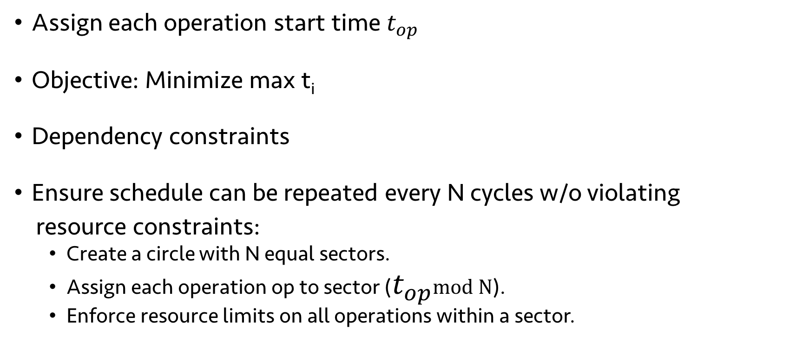





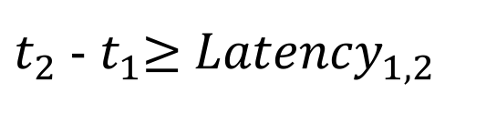

ILP formulation of scheduling problem
$$t_{0}$$
$$t_{1}$$
$$t_{2}$$
$$t_{3}$$
$$t_{4}$$
Assign each operation start time $t_{op}$
Objective: Minimize max t_{i}
Dependency constraints
Ensure schedule can be repeated every N cycles w/o violating
resource constraints:
Create a circle with N equal sectors.
Assign each operation op to sector ($t_{op}$mod N).
Enforce resource limits on all operations within a sector.
$t_{2}$ - $t_{1}$≥ ${Latency}_{1, 2}$
$$t_{0}$$
$$t_{4}$$
$$t_{2}$$
$$t_{1}$$
$$t_{3}$$
Notes:
In this example, we introduced a no-op, but that’s a greedy way of solving it. If we want the optimal schedule, need to solve an ILP.
Packet that arrived this scheduling period, 1 period in the past, 2 in the past, and so on.

Slide 24
Evaluation: switch.p4 on RMT and dRMT
Minimum number of processors to run at 1 packet/cycle
P4 Program | RMT | dRMT (IPC=1) | dRMT (IPC=2) | Lower bound
Ingress (switch.p4) | 18 | 17 | 15 | 15
Egress (switch.p4) | 12 | 11 | 7 | 7
Switch.p4 combined | 22 | 21 | 21 | 21
dRMT is near optimal; to run at line-rate:
Fewest possible processors
Near-ideal (critical path) latency
Minimum number of threads to run at 1 packet/cycle
P4 Program | RMT | dRMT (IPC=1) | dRMT (IPC=2) | Lower bound
Ingress (switch.p4) | 360 | 245 | 243 | 243
Egress (switch.p4) | 240 | 217 | 198 | 197
Switch.p4 combined | 440 | 243 | 243 | 243
Notes:
Switch.p4 is optimized for RMT.

Slide 25
dRMT eliminates performance cliffs
Throughput vs. Processors for switch.p4 egress

Slide 26
dRMT architecture: instruction memory
A dRMT processor executes entire program; an RMT stage only executes a program slice.
Must reduce memory required to encode an instruction.
RMT instructions have 224 parallel ops; we found 32 sufficient

Slide 27
dRMT architecture: crossbar
Requirements: 32 processors, 32 memory clusters, 8 keys
Three designs:
Full crossbar from each processor key to each cluster key
((32 * 8) * (32 * 8) crossbar), very flexible, but very costly
Unit crossbar between each processor and each cluster
Wide 32*32 crossbar, inflexibly, but cheap
Segment crossbar: 8 parallel (32 * 32) crossbars
Compromise between full and unit crossbar
Segment and full are equivalent if tables are not split across clusters. dRMT uses a segment crossbar.
Notes:
TODO: Maybe add a decent figure

Slide 28
Hardware area estimates (mm²)
Number of Processors | RMT | Crossbar with 32 memory clusters | dRMT(IPC=1) with crossbar | dRMT(IPC=2) with crossbar
16 | 19.9 | 0.857 | 17.7 | 22.7
24 | 29.9 | 1.254 | 26.6 | 34.1
32 | 39.8 | 1.740 | 35.5 | 45.5
dRMT hardware cost is comparable to RMT.
Notes:
TODO: Add results on random P4 DAGs as well?

Slide 29
Summary
dRMT: Disaggregated architecture for programmable switches
Ongoing work: Implementation in programmable NIC
Many open questions
Scheduling different packet types
Stateful packet processing
Webpage: http://drmt.technion.ac.il/

Slide 30
Backup slides

Slide 31
dRMT architecture: crossbar
Proc. 1
Proc. 2
Proc. 1
Proc. 2
Proc. 1
Proc. 2
Mem. 1
Mem. 2
Mem. 1
Mem. 2
Mem. 1
Mem. 2
Unit Crossbar
(0.561 mm²)
Full Crossbar
(4.464 mm²)
Segment Crossbar
(0.576 mm²)
The segment crossbar is equivalent to full crossbar if tables are not split across clusters! (see paper for details)
dRMT uses One-to-Many Segment Crossbar
Notes:
Area numbers for 32x32 crossbar with 8 80-bit keys on each side

Slide 32
dRMT Match Action Processor
Packet Header Vector
(4Kb)
Packet Header Vector
(4Kb)
Packet Header Vector
(4Kb)
ALU
Match Key Generation (crossbar)
Scratch
Pad
Action Input Selector
(crossbar)
Action Output Selector
(crossbar)
… …
8x80b Key
ALU
8x96b Action
Memory
Thread Select
Ctrl
Op code
Config
Table
Crossbar to
Memories
VLIW Instruction Table
Notes:
TODO: This diagram might be too detailed.
Maybe just replace it with a high-level overview slide.
Key differences with RMT:
-- dRMT processor needs to store full program → Config table & instruction table more expensive
-- Scratchpad (store results for delayed execution
-- VLIW Instructions: 32 ALUs instead of 224

Slide 33
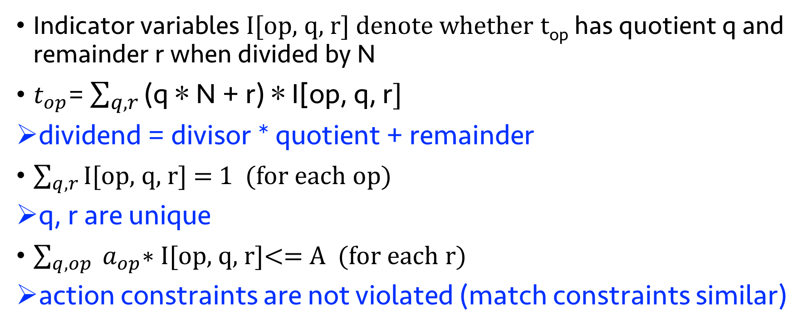
Enforcing periodic resource constraints
Indicator variables I[op, q, r] denote whether t_{op} has quotient q and remainder r when divided by N
$t_{op}$= $\sum_{q, r}{\text{(}\text{q}\text{ ∗ }\text{N}\text{ + }\text{r}\text{) ∗ }\text{I}\text{[}\text{op}\text{, }\text{q}\text{, }\text{r}]}$
dividend = divisor * quotient + remainder
$\sum_{q, r}{\text{I}\text{[}\text{op}\text{, }\text{q}\text{, }\text{r}]}$ = 1 (for each op)
q, r are unique
$\sum_{q, op}{ a_{op}\text{∗ }\text{I}\text{[}\text{op}\text{, }\text{q}\text{, }\text{r}]}$<= A (for each r)
action constraints are not violated (match constraints similar)

