Slide 1
Hardware and software for fast and programmable network monitoring
Srinivas Narayana, Anirudh Sivaraman, Vikram Nathan, Prateesh Goyal, Venkat Arun, Mohammad Alizadeh, Vimal Jeyakumar, and Changhoon Kim
Slides courtesy Srinivas Narayana
Notes:
Thank you for the invitation. I am going to be speaking about work that I did as a grad student on designing hardware and software for fast and programmable network monitoring. This was published at SIGCOMM 2017 and won the best paper award. This is joint work with many excellent collaborators. In particular, I want to mention the lead author on this work, Srinivas Narayana, who is a postdoc at MIT.
So let’s break down the talk’s title: we want both fast and programmable network monitoring. By fast, I mean the ability to run at a switch’s line rate. And by programmable, I mean the ability to express whatever network monitoring question you care about and get accurate results.

Slide 2
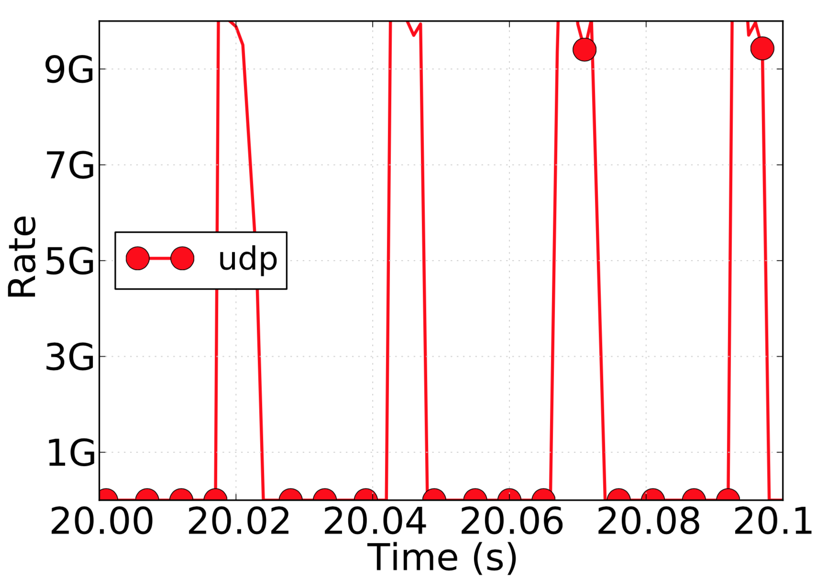




Example: Who caused a microburst?
Queue build-up deep in the network
End-to-end probes
Sampling
Counters & Sketches
Mirror packets
Per-pkt info: challenging in software
6.4Tbit/s switch: Need 100M recs/s
COTS: 100K-1M recs/s/core
Notes:
So what might be an example of a performance monitoring question? One example is a microburst, which is common in many production networks. A microburst is a situation in which you occasionally experience latency spikes in the network. This might be for any number of reasons, but one common reason is that some switch in a network is occasionally seeing bursts of traffic from an ill-behaved flow.
When you see this problem, you want to localize which switch queue is contributing to the high latency, and what traffic is filling up the queue. There are a few ways to tackle this problem, none of which are completely satisfactory.
You can send end-to-end probes, but that only tells you that the end-to-end latency is high. It doesn’t tell you where the latency is building up. You can sample the queue’s latency or packets, but then you need to decide what the sampling frequency is. You can use counters and approximate data structures like sketches, but they are tuned for volume statistics like link utilization and number of packets from a specific flow. They don’t effectively generalize beyond such statistics.
One alternative to this to mirror packets and use emerging technologies like in-band-network telemetry to piggyback queue information on the packet. The problem now is that the packets that transit the problematic queue are now scattered all over the network. They need to be collected together to determine at which switch and when queues build up. And the overhead of doing this in software is quite prohibitive.

Slide 3
Switches should be first-class citizens in performance monitoring.
Notes:
Our focus in this talk will be on seeing if we can use switches as first-class citizens in performance monitoring by augmenting them with a small set of measurement primitives to enable programmable network monitoring. You can think of this as designing a hardware instruction set and a software programming language for network performance monitoring on high-speed switches.

Slide 4
Why monitor from switches?
Already see the queues & concurrent connections
Infeasible to stream all the data out for external processing
Can we filter and aggregate performance on switches directly?
Notes:
But just to reiterate, why would you want to monitor from switches. Here are a couple of reasons. In many cases the problem is localized to a single switch (or a small set of switches), and instrumenting those directly is more convenient than having the data be distributed across end points. The alternative of sending all data to an end point for external processing consumes too much network and compute capacity. So the concrete technical question we try to answer is whether we can perform filtering and aggregation on switches directly.

Slide 5
We want to build “future-proof” hardware:
Language-directed hardware design
Notes:
Now, when you build an instruction set, you want it to be as general as possible. Otherwise, it ends up being overfitted in a sense to your current set of use cases, without any guarantee that it can generalize to other use cases. To avoid this, and to attempt to build somewhat future-proof hardware, we adopt a design methodology called language-directed hardware design where we start with an expressive programming language and then design hardware to efficiently support this programming language.

Slide 6
Performance monitoring use cases
Expressive query language
Line-rate switch hardware primitives
Notes:
In more detail, this is how our workflow looks. We start with an informal description of several performance monitoring use cases similar to our Microburst example before. We then design an expressive query language to capture all of these use cases and future unanticipated use cases that are similar to these use cases. Once we have designed this language, we use it to design switch hardware primitives as well.
While this slide shows this process as mostly one directional from use cases to hardware, there is also a bit of feedback in practice. For instance, we restrict our language to what can be reasonably implemented in line-rate hardware. In particular, our language isn’t Turing complete so you can’t do everything with it that you can do with a CPU. In our minds, this was a reasonable tradeoff because that’s the price you pay for high performance.

Slide 7
Contributions
Marple, a performance query language
Line-rate switch hardware design
Aggregation: Programmable key-value store
Query compiler
Notes:
We made three contributions as part of this work: a query language, a hardware design to support this query language, and a query compiler to compile from this language to this hardware. I’ll discuss the first two as part of this talk. The third is described in our paper.

Slide 8


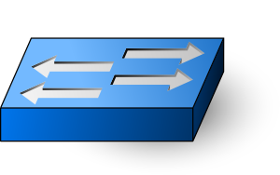
Queries
Marple programs
Results
Query Compiler
Switch programs
To collection servers
Programmable switches
with the key-value store
Notes:
Here’s a bird’s eye view of the entire system. A network operator writes queries in a language that we call Marple and feeds it into a query compiler, which then translates these queries into switch programs that run on the network’s switches. These switch programs carry out filtering and aggregation to execute the queries. They stream out the resulting data to collection servers. The operator can then inspect these results and refine their query if required. When I get to the evaluation, we’ll see how using the switch for filtering and aggregation helps reduce the load on these collection servers significantly relative to the simplistic solution of having the collection server process every packet from the network.

Slide 9
Marple: Performance query language
Notes:
So let’s start with the language that operators use to express their queries. Our goal was to make it easy for operators to express performance questions without worrying about how exactly these get implemented in the underlying programmable switches.

Slide 10
Marple: Performance query language
Stream: For each packet at each queue,
S:= (switch, qid, hdrs, uid, tin, tout, qsize)
Location
Packet identification
Queue entry and exit timestamps
Queue depth seen by packet
Notes:
Since we wanted the language to be as high level as possible, we chose a query language as the format for expressing these queries. Let me describe the query language’s constructs one by one. The first language construct is that of a stream. You can think of the query language as consisting of operators that take streams of tuples as inputs and produce streams of tuples as outputs---like standard stream processing systems. This allows us to easily compose operators in the language.
The original input packet stream consists of a tuple for each appearance of a packet at each queue inside the network. Each tuple consists of the following fields: the switch the packet appeared at, the queue within the switch that the packet appeared at, the packet’s headers, a UID identifying each packet uniquely, the time at which it arrived at this queue, the time at which it departed from this queue, and the queue size at the time at which the packet arrived at this queue.
Right now, I am not discussing exactly how the information required in this tuple is materialized. I’ll get to that when I get to the hardware portion of this talk.

Slide 11
Marple: Performance query language
Stream: For each packet at each queue,
S:= (switch, qid, hdrs, uid, tin, tout, qsize)
Familiar functional operators
filter
map
zip
groupby
Notes:
Let’s see what we can do to these streams. You can operate on these streams using familiar functional operators such as filter, map, zip, and groupby, which allow you to restrict the stream, transform it, and aggregate state across tuples in the stream.

Slide 12
Example: High queue latency packets
R1 = filter(S, tout – tin > 1 ms)
Notes:
The first construct is a filter. In this example, we filter the original input packet stream to only look at packets that have a queueing latency greater than 1 ms.

Slide 13
Example: Per-flow average latency
R1 = filter(S, proto == TCP)
R2 = groupby(R1, 5tuple, ewma)
def ewma([avg],[tin, tout]):
avg = (1-⍺)*avg + ⍺*(tout-tin)
Fold function
Notes:
The next example is to compute a per-flow average latency. The way this works is that you take all packets belonging to a flow, run a moving average filter over some attribute of the packet (such as the queueing latency) on every new packet that you receive. Our construct for this is the groupby, which is present both in SQL and many recent functional programming APIs. The groupby tells you how to partition the original stream into sub-streams. Here, you partition the filtered stream R1 using the packet’s 5 tuple. Then you supply what’s called a fold function that tells you how to maintain and update state across packets in each sub stream. Here, the fold function maintains an exponentially weighted moving average filter over the packets of each sub stream by applying a gain of alpha to the queuing latency of each packet and a gain of 1-alpha to the previous value of the exponentially weight moving average.

Slide 14
Example: Microburst diagnosis
def bursty([last_time, nbursts], [tin]):
if tin - last_time > 800 ms:
nbursts = nbursts + 1
last_time = tin
result = groupby(S, 5tuple, bursty)
Notes:
Here’s a slightly more involved example of using the groupby construct. Again, we divide up the packet stream by 5tuple like the previous example. The fold function is different now and we use the fold function bursty to estimate how bursty each flow is. We do this by maintaining two pieces of state, last_time and nbursts. Last_time tracks the last time at which a packet from this flow was received and nbursts tracks the number of packet bursts so far.
As you can see, the operator can write whatever they want in the fold function. Later, when we get to the hardware section, we’ll see what kinds of fold functions are efficiently implementable on such switch hardware.

Slide 15
Many performance queries (see paper)
Transport protocol diagnoses
Fan-in problems (incast and outcast)
Incidents of reordering and retransmissions
Interference from bursty traffic
Flow-level metrics
Packet drop rates
Queue latency EWMA per connection
Incidence and lengths of flowlets
Network-wide questions
Route flapping
High end to end latencies
Locations of persistently long queues
...
Notes:
To wrap up the language section, here’s a list of queries that we can express using the Marple query language. These include diagnosing problems at the transport level like incast, retransmissions, and microbursts. They also include flow-level metrics and network-level questions that span multiple switches such as high end-to-end latencies. The details of these queries are in our SIGCOMM 2017 paper.

Slide 16
Implementing Marple on switches
Notes:
OK. So far we have discussed the software or language portion of this work. Now let me talk about the hardware portion of the work. In other words, how do you implement Marple on switch hardware?

Slide 17
Implementing Marple on switches
S:= (switch, hdrs, uid, qid, tin, tout, qsize)
Switch telemetry
[INT SOSR’15]
filter
map
zip
groupby
Stateless match-action rules
[RMT SIGCOMM’13]
Notes:
Some of the constructs that Marple supports can be implemented in a straightforward manner using features of recent programmable switches like Barefoot’s Tofino and Cavium’s Xpliant. For instance, the queue ID, enqueue time (tin), dequeue time (tout), and queue size at enqueue are available as part of proposals like in-band network telemetry.
Next, the filter, map, and zip operate on packet headers without touching any state on the switch. They map to match-action rules within emerging programmable switch architectures such as RMT, which is the basis for the Barefoot Tofino switch.

Slide 18
Implementing Marple on switches
S:= (switch, hdrs, uid, qid, tin, tout, qsize)
Switch telemetry
[INT SOSR’15]
filter
map
zip
groupby
Stateless match-action rules
[RMT SIGCOMM’13]
Notes:
So now let’s turn to the Marple language construct groupby. Unlike the previous constructs, the groupby construct _cannot_ be efficiently supported by programmable switches as they stand today. In other words, we need to design a new hardware instruction for this construct. Let’s look at how we do that.

Slide 19
Implementing groupby
ewma_query = groupby(S, 5tuple, ewma)
def ewma([avg], [tin, tout]):
avg = (1-⍺)*avg + ⍺*(tout-tin)
Compute & update values at switch line rate (1 pkt/ns)
Scale to millions of groupby partitions (e.g., 5-tuples)
Notes:
Let’s look at the EWMA groupby query to understand the challenges involved in implementing groupbys efficiently in switch hardware. This query needs to do two things: it needs to be fast so that it can compute and update the ewma value avg every packet, which is roughly every ns on high-end switches today. It also needs to have sufficient space to store a large number of groupby partitions because the groupby can run at very fine granularity such as a 5-tuple. In other words, we need the memory implementing this groupby to be both fast to support quick updates and large to store the average for a large number of flows.

Slide 20
Challenge:
Neither SRAM nor DRAM is both fast and dense
Notes:
But the problem is no existing mainstream memory technology guarantees both fast access and is sufficiently dense to store a large number of flows. SRAM is fast, but you can’t store too many flow entries in SRAM. DRAM is dense and allows you to store many entries, but DRAM is slow.

Slide 21
Caching:
the illusion of fast and large memory
Notes:
The standard systems solution to this is caching, which is used in processors to provide the illusion of both fast and large memory. You essentially use a fast SRAM key-value store as a cache for the larger backing store for the k-v store in DRAM.

Slide 22

Caching
Off-chip backing store (DRAM)
On-chip cache (SRAM)
Key
Value
Key
Value
Notes:
So this is how it looks. There is an on-chip cache that stores keys and values corresponding to groupby partitions and the state maintained by the fold function. In the EWMA case, the key stores the 5-tuple and the value stores the avg.

Slide 23

Caching
Off-chip backing store (DRAM)
On-chip cache (SRAM)
Key
Value
Key
Value
Read value for 5-tuple key K
Modify value using ewma
Write back updated value
Notes:
During normal operation when there is a hit in the cache, this is how things work. You attempt to read the value for a particular 5-tuple key K. You modify the value using the EWMA fold function. You then write back the updated value in the cache. So far so good.

Slide 24
Caching
Off-chip backing store (DRAM)
On-chip cache (SRAM)
Key
Value
Key
Value
Req. key K
Read value for 5-tuple key K
K
V_{back}
Resp. V_{back}
Notes:
Now, let’s look at what happens on a cache miss. You don’t find the key, So you go to the backing store to request it. It sends it back. You insert it into the cache as you would in a processor cache. Then you update it in place.

Slide 25
Caching
Off-chip backing store (DRAM)
On-chip cache (SRAM)
Key
Value
Key
Value
Req. key K
Read value for 5-tuple key K
K
V_{back}
K
V_{back}
Resp. V_{back}

Slide 26
Caching
Off-chip backing store (DRAM)
On-chip cache (SRAM)
Modify and write must wait for DRAM.
Non-deterministic DRAM latencies stall packet pipeline.
Key
Value
Key
Value
Request key K
Read value for 5-tuple key K
K
V’’
K
V’’
Respond K, V’’
Notes:
The problem is that the modify and write must wait for the DRAM access latency to fetch the backing store’s information and insert it into the cache. DRAM access latencies are highly variable depending on the access pattern. This is because DRAMs are typically built for good average case performance and the worst-case performance can be quite bad.

Slide 27
Instead, we treat cache misses as
packets from new flows.
Notes:
Instead, our main design difference in the key-value store is to treat cache misses as packets from new flows.

Slide 28
Cache misses as new keys
Off-chip backing store (DRAM)
On-chip cache (SRAM)
Key
Value
Key
Value
Read value for key K
K
V₀
Notes:
What does this mean? When a key that isn’t present in the key-value store shows up, we treat it like a new key-–even if this key was previously evicted and written to the backing store.

Slide 29
Cache misses as new keys
Off-chip backing store (DRAM)
On-chip cache (SRAM)
Key
Value
Key
Value
Evict K,V_{cache}
Read value for key K
K
V_{back}
K
V₀
Notes:
Then, eventually at some point, this key will be evicted to the backing store to make room for a new key.

Slide 30
Cache misses as new keys
Off-chip backing store (DRAM)
On-chip cache (SRAM)
Key
Value
Key
Value
Evict K,V_{cache}
Read value for key K
K
V_{back}
K
V₀
Merge
Notes:
At this point, we merge the key’s value with the old value for the same key in the backing store. If the key doesn’t already exist in the backing store, we just write the evlcted value into the backing store.

Slide 31
Cache misses as new keys
Off-chip backing store (DRAM)
On-chip cache (SRAM)
Key
Value
Key
Value
Evict K,V_{cache}
Read value for key K
K
V_{back}
K
V₀
Nothing to wait for.
Notes:
The benefit of this design is that there is no waiting on the critical path of packet processing and packet processing can proceed as usual.

Slide 32
How about value accuracy after evictions?
How do we merge evicted statistics value with previous value accurately?
Let’s represent the statistics operation as a function g over a packet sequence p1, p2, …
g([p_{i}])
Action of g over a packet sequence,
e.g, for a counter g([p_{i}]) = p1.len + p2.len + …
Notes:
But how do I merge an old and new value for a given key? What does that even mean? Let’s look at this problem more formally. We want to merge the two values, old and new, so that it is as if the fold function ran over the entire packet stream without any evictions. That way we can retain full accuracy while merging. Let’s introduce some notation for this. Let’s represent the statistics operation as a function g over the packet sequence. For a simple counter, the function is the sum of the packet lengths (or any other packet header).

Slide 33
The Merge operation
V_{cache}
V_{back}
merge(g([q_{j}]), g([p_{i}]))
= g([p1,…,pn,q1,…,qm])
Example: if g is a counter, merge is just addition.
Easy generalization to all associative statistics (min, max, product, set union, intersection, etc.)
Statistics over the entire packet sequence
Notes:
Now what does it formally mean to merge the old and new values of a key?
Mathematically, it means this. That if you computed the statistics over the first sequence of packets (prior to eviction) and computed the statistics over the second sequence of the packets (after the eviction) and then merged them, it is equivalent to computing the statistics over the entire packet sequence.
Let’s take a simple example. If g is a counter, the merge is a simple addition. You can probably see that this is easily generalizable to other associative statistics such as min/max/product, etc. Essentially, you track the minimum in the cache and take the minimum of the new value in the cache and the old value in the backing store.

Slide 34
Mergeability beyond associative statistics
Can merge any statistic g by storing entire pkt sequence in cache
… but that’s a lot of extra state!
Can we merge with “small” extra state?
Small: extra state size ≈ size of the statistics value being tracked
Notes:
But what about operations that are not associative? Let’s think about this for a bit. We can merge any arbitrary statistic g by storing the entire sequence of packets in the cache, sending this sequence of packets to the backing store upon eviction, and merging by simply replaying the statistic computation over this sequence of packets.
But that’s a lot of additional state just for merging and it grows with the number of packets that have been processed so far. In fact, this is no better than just sending a copy of every packet to a collection server, which is what we wanted to avoid in the first place.
So the real question is whether we can merge with a small amount of extra state over and above the state that is being tracked by the statistics function itself? More precisely, we want the extra state to have size similar to the statistic being tracked.

Slide 35
Linear-in-state: Merge w. small extra state
S = A * S + B
Examples: Packet and byte counters, EWMA, functions over a window of packets, …
State maintained by the statistic
Functions of a bounded number of packets in the past
Notes:
One theoretical contribution of this work was identifying a class of fold functions where we could in fact carry out the merge using a small amount of additional state. This class we call the linear-in-state aggregation functions. The reason for this name should be clear from looking at the form of the state update in these fold functions: the updated state is a linear function of the previous state. Here the coefficients A and B can either be constants or functions of a bounded number of packets in the past starting from the current packet. S can also be generalized to a vector and A and B can be matrices.
As a few quick examples, you can imagine a packet counter, where A is 1 and B is 1. You can have a byte counter where A is 1 and B is the packet’s length field. Or you could have the EWMA which we have seen a few times so far, where A is (1 – alpha) and B is alpha times the packet’s queueing latency. You can also have degenerate cases where A is 0 and B is a function of the last k packets like a windowed average.

Slide 36
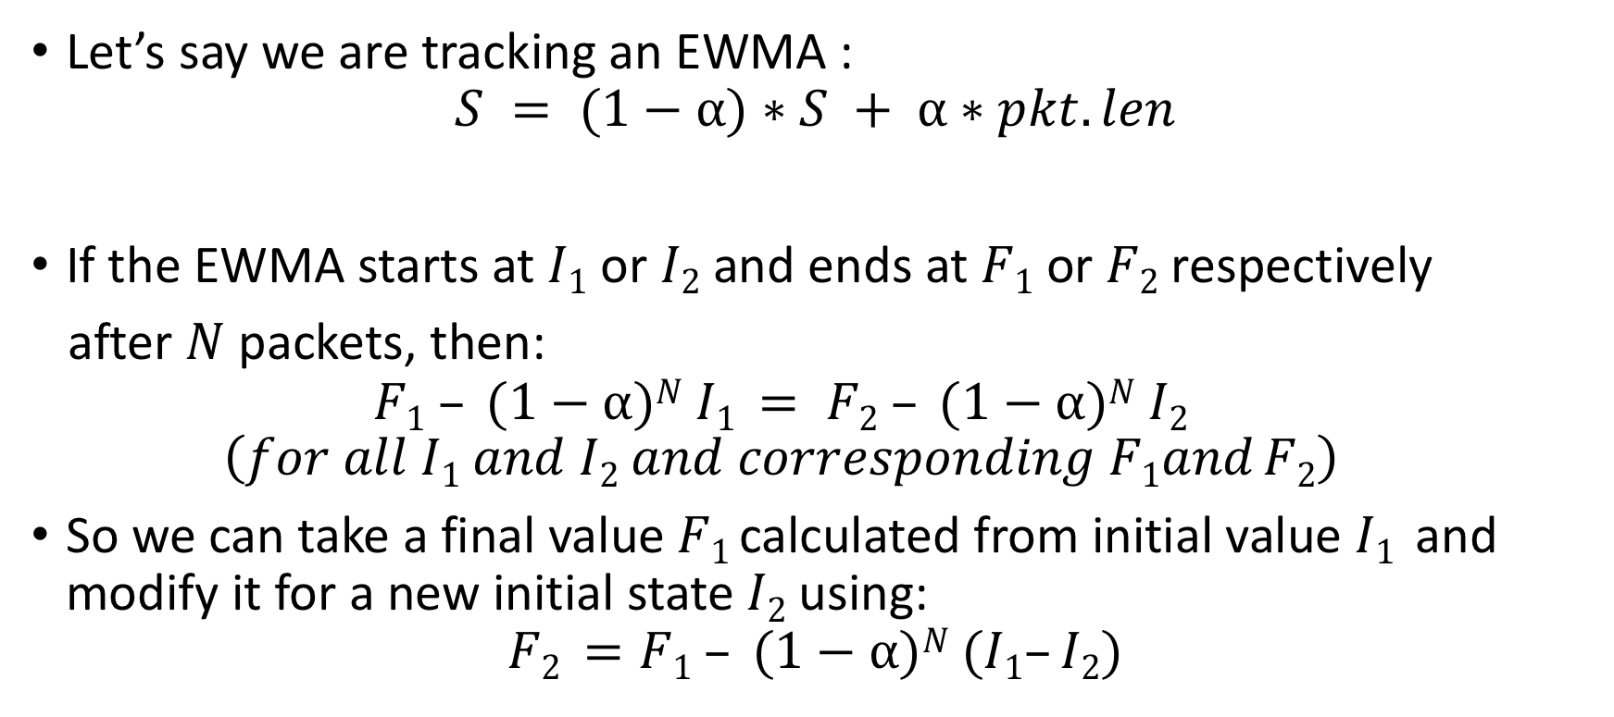
Intuition for linear-in-state
Let’s say we are tracking an EWMA :
$$S = (1−⍺)∗S + ⍺∗pkt.len$$
If the EWMA starts at $I1$ or $I2$ and ends at $F1$ or $F2$ respectively
after $N$ packets, then:
$$F1 – (1−⍺)N I1 = F2 – (1−⍺)N I2$$
$$\left(for all I1 and I2 and corresponding F1and F2\right)$$
So we can take a final value $F1$ calculated from initial value $I1$ and modify it for a new initial state$I2$using:
$$F2 =F1 – (1−⍺)N (I1–I2)$$
I₁
I₂
F₁
F₂
Notes:
Why does this work. Let me provide some intuition for this linear-in-state property. Suppose we are tracking an EWMA that takes the packet’s length, multiplies it by a gain alpha, and adds it to 1 – alpha times the previous value of the EWMA. Now, let’s say the EWMA starts at I1 or I2 and ends at F1 or F2 after N packets, then the following equation holds. You can see why this is true by recursively expanding the equation for the EWMA above where S is written in terms of the previous value of S and the packet’s length.
OK, what does this equation tell us? It tells us that we can take a final value F1 calculate from an initial value I1 and then ask what the final value F2 would have been for an initial state I2 using a very simple computation.

Slide 37
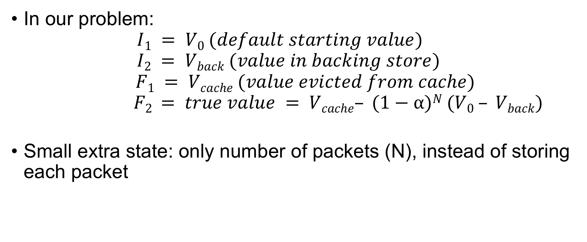
Intuition for linear-in-state
In our problem:
$$I1 = V0 (default starting value)$$
$$I2 = Vback (value in backing store)$$
$$F1 = Vcache (value evicted from cache)$$
$$F2 = true value = Vcache– (1−⍺)N (V0 – Vback)$$
Small extra state: only number of packets (N), instead of storing each packet
I₁
I₂
F₁
F₂
Notes:
How does it help here? Let’s map the initial and final values to our problem setting. The initial value for the EWMA in the cache is V0 and the final value is Vcache. Now we want to calculate what the final value should have been if the initial value was the value in the backing store and the entry had never been evicted. So I2 is Vback. Then what will F2 be. We can just substitute variables in the equation from the last slide and get this equation.
The implication of this is that we have just found our merge function to merge the old value (Vback) and the new value (Vcache) using some additional state: the number of packets seen in the cache.
The key point is that this additional state is small. It is only the number of packets (N), and doesn’t include some value per packet.

Slide 38
Microburst computation is linear-in-state
def bursty([last_time, nbursts], [tin]):
if tin - last_time > 800 ms:
nbursts = nbursts + 1
last_time = tin
result = groupby(S, 5tuple, bursty)
nbursts: S = A * S + B, where
A = 1
B = {1, if current pkt within 800 ms from last;
0 otherwise}
Notes:
The linear-in-state condition is surprisingly broad. The microburst example that we talked about earlier is linear-in-state even though it doesn’t appear so at first brush. Here A is 1. B is a function of the last packets and is defined piece wise as follows: it’s 1 is the current packet is within 800 ms from the last one and 0 otherwise.

Slide 39
Several useful linear-in-state statistics
Counting successive TCP packets that are out of sequence
Histogram of flowlet sizes
Counting number of timeouts in a TCP connection
Micro-burst detection
EWMAs
The linear-in-state operation can also be cheaply implemented using a multiply-accumulate hardware instruction.
Notes:
The paper contains several more examples of linear-in-state statistics. The important thing if you’re a switching chip manufacturer is that you can implement this quite cheaply in hardware using a multiply-accumulate hardware instruction---something that is quite well understood today.

Slide 40
Evaluation: Cache eviction rate
Off-chip backing store (DRAM)
On-chip cache (SRAM)
Key
Value
Key
Value
Evict K’,V’_{cache}
K’
V’_{back}
K
V₀
Notes:
Finally, I’ll talk about some evaluation results. Our main question is how much benefit the cache brings us in terms of reducing the number of key-value-store pairs that are sent to the backing store.

Slide 41
Eviction processing at backing store
Trace-based evaluation:
“Core14”, “Core16”: Core router traces from CAIDA (2014, 16)
“DC”: University data center trace from [Benson et al. IMC ’10]
Each has ~100M packets
Query groups by by 5-tuple (key)
8-way set-associative LRU cache eviction policy
Eviction ratio: % of incoming pkts that result in a cache eviction
Notes:
Here are some relevant experimental setup details for our evaluation of the cache eviction rate. We used trace-based evaluation to evaluate the eviction rate using a core router and a data center trace. Our query was a groupby that partitioned by 5-tuple. The caching eviction policy was 8-way LRU similar to many processor caches simply because it is easy to implement.
We first measure the eviction ratio because this doesn’t depend on the packet rate or the size of keys and values. We then translate this into a concrete eviction rate for some specific packet rates and key+value sizes.

Slide 42
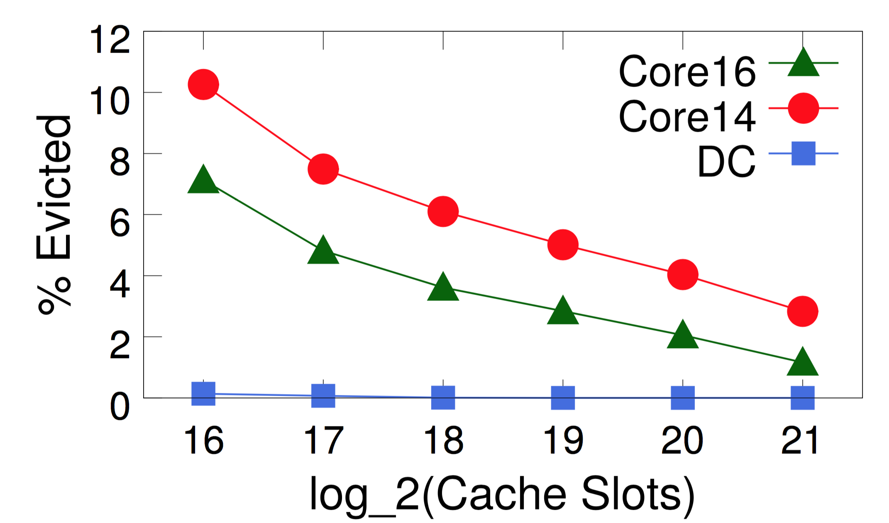
Eviction ratio vs. Cache size
Notes:
So here’s the result. As expected, the eviction ratio goes down as the number of cache slots increases. One other interesting takeaway is that a dc environment has much more locality allowing us to get away with a much smaller size cache.

Slide 43
Eviction ratio vs. Cache size
2¹⁸ keys == 64 Mbits
(256 bits per key+value)
4% pkt eviction ratio
25X reduction from processing each pkt
Notes:
Now, let’s translate this into a concrete number. Let’s pick 2**18 keys. Assuming a combined key and value size of 256 bits, that corresponds to 64 Mbits. That’s a 4% packet eviction ratio, which means it’s 25X smaller than processing every packet at a collection server directly.

Slide 44
Eviction ratio ➔ Eviction rate
Consider 64-port X 100-Gbit/s switch
Memory: 256 Mbits
7.5% area
Eviction rate: 8M records/s
~ 32 cores
Notes:
TO put this into context. For a 64-poort 100-Gbits/switch, if we assume 2**20 slots, that’s a memory requirement of 256 Mbits, which is about 7.5% of the switching chip’s area. Assuming typical traffic patterns for this switch, this translates into an eviction rate of 8M records every second, which we estimate can be handled by a 32-core server. So the way to think about this is that we can service the eviction rate for a 64 server cluster connected to a TOR switch by using a single 32-core server for typical workloads. This is a simplified summary of the results. The paper has many more details on this.

Slide 45
Summary
Query language for network performance monitoring
Hardware design to support query language
Paper and code available at http://web.mit.edu/marple
Notes:
So in summary this talk was about two main ideas: (1) a query language for network performance monitoring that is designed to capture a variety of new and old network monitoring use cases and (2) a hardware design that supports this query language at high speeds. The full paper and supporting code are available at this web site, and I am happy to take questions.

