Slide 1



Language-Directed Hardware Design for Network Performance Monitoring
Srinivas Narayana, Anirudh Sivaraman, Vikram Nathan, Prateesh Goyal, Venkat Arun, Mohammad Alizadeh, Vimal Jeyakumar, and Changhoon Kim

Slide 2
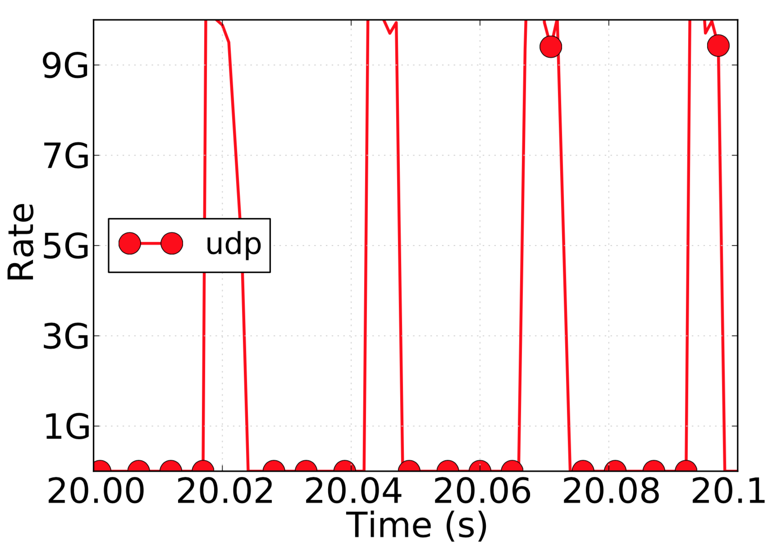




Example: Who caused a microburst?
Queue build-up deep in the network
End-to-end probes
Sampling
Counters & Sketches
Mirror packets
Per-pkt info: challenging in software
6.4Tbit/s switch: Need 100M recs/s
COTS: 100K-1M recs/s/core

Slide 3
Switches should be first-class citizens in performance monitoring.

Slide 4
Why monitor from switches?
Already see the queues & concurrent connections
Infeasible to stream all the data out for external processing
Can we filter and aggregate performance on switches directly?

Slide 5
We want to build “future-proof” hardware:
Language-directed hardware design

Slide 6
Performance monitoring use cases
Expressive query language
Line-rate switch hardware primitives

Slide 7
Contributions
Marple, a performance query language
Line-rate switch hardware design
Aggregation: Programmable key-value store
Query compiler

Slide 8


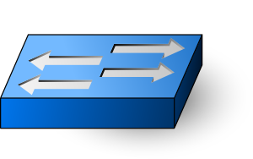
Queries
Marple programs
Results
Query Compiler
Switch programs
To collection servers
Programmable switches
with the key-value store

Slide 9
Marple: Performance query language

Slide 10
Marple: Performance query language
Stream: For each packet at each queue,
S:= (switch, qid, hdrs, uid, tin, tout, qsize)
Location
Packet identification
Queue entry and exit timestamps
Queue depth seen by packet

Slide 11
Marple: Performance query language
Stream: For each packet at each queue,
S:= (switch, qid, hdrs, uid, tin, tout, qsize)
Familiar functional operators
filter
map
zip
groupby

Slide 12
Example: High queue latency packets
R1 = filter(S, tout – tin > 1 ms)

Slide 13
Example: Per-flow average latency
R1 = filter(S, proto == TCP)
R2 = groupby(R1, 5tuple, ewma)
def ewma([avg],[tin, tout]):
avg = (1-⍺)*avg + ⍺*(tout-tin)
Fold function

Slide 14
Example: Microburst diagnosis
def bursty([last_time, nbursts], [tin]):
if tin - last_time > 800 ms:
nbursts = nbursts + 1
last_time = tin
result = groupby(S, 5tuple, bursty)

Slide 15
Many performance queries (see paper)
Transport protocol diagnoses
Fan-in problems (incast and outcast)
Incidents of reordering and retransmissions
Interference from bursty traffic
Flow-level metrics
Packet drop rates
Queue latency EWMA per connection
Incidence and lengths of flowlets
Network-wide questions
Route flapping
High end to end latencies
Locations of persistently long queues
...

Slide 16
Implementing Marple on switches

Slide 17
Implementing Marple on switches
S:= (switch, hdrs, uid, qid, tin, tout, qsize)
Switch telemetry
[INT SOSR’15]
filter
map
zip
groupby
Stateless match-action rules
[RMT SIGCOMM’13]

Slide 18
Implementing Marple on switches
S:= (switch, hdrs, uid, qid, tin, tout, qsize)
Switch telemetry
[INT SOSR’15]
filter
map
zip
groupby
Stateless match-action rules
[RMT SIGCOMM’13]

Slide 19
Implementing aggregation
ewma_query = groupby(S, 5tuple, ewma)
def ewma([avg], [tin, tout]):
avg = (1-⍺)*avg + ⍺*(tout-tin)
Compute & update values at switch line rate (1 pkt/ns)
Scale to millions of aggregation keys (e.g., 5-tuples)

Slide 20
Challenge:
Neither SRAM nor DRAM is both fast and dense

Slide 21
Caching:
the illusion of fast and large memory

Slide 22

Caching
Off-chip backing store (DRAM)
On-chip cache (SRAM)
Key
Value
Key
Value

Slide 23

Caching
Off-chip backing store (DRAM)
On-chip cache (SRAM)
Key
Value
Key
Value
Read value for 5-tuple key K
Modify value using ewma
Write back updated value

Slide 24
Caching
Off-chip backing store (DRAM)
On-chip cache (SRAM)
Key
Value
Key
Value
Req. key K
Read value for 5-tuple key K
K
V_{back}
Resp. V_{back}

Slide 25
Caching
Off-chip backing store (DRAM)
On-chip cache (SRAM)
Key
Value
Key
Value
Req. key K
Read value for 5-tuple key K
K
V_{back}
K
V_{back}
Resp. V_{back}

Slide 26
Caching
Off-chip backing store (DRAM)
On-chip cache (SRAM)
Modify and write must wait for DRAM.
Non-deterministic latencies stall packet pipeline.
Key
Value
Key
Value
Request key K
Read value for 5-tuple key K
K
V’’
K
V’’
Respond K, V’’

Slide 27
Instead, we treat cache misses as
packets from new flows.

Slide 28
Cache misses as new keys
Off-chip backing store (DRAM)
On-chip cache (SRAM)
Key
Value
Key
Value
Read value for key K
K
V₀

Slide 29
Cache misses as new keys
Off-chip backing store (DRAM)
On-chip cache (SRAM)
Key
Value
Key
Value
Evict K’,V’_{cache}
Read value for key K
K’
V’_{back}
K
V₀

Slide 30
Cache misses as new keys
Off-chip backing store (DRAM)
On-chip cache (SRAM)
Key
Value
Key
Value
Evict K’,V’_{cache}
Read value for key K
K’
V’_{back}
K
V₀
Merge

Slide 31
Cache misses as new keys
Off-chip backing store (DRAM)
On-chip cache (SRAM)
Key
Value
Key
Value
Evict K’,V’_{cache}
Read value for key K
K’
V’_{back}
K
V₀
Nothing to wait for.

Slide 32
Cache misses as new keys
Off-chip backing store (DRAM)
On-chip cache (SRAM)
Key
Value
Packet processing doesn’t wait for DRAM.
Retain 1 pkt/ns processing rate!👍
Key
Value
Evict K’,V_{sram}
Read value for key K
K’
V’_{dram}
K
V₀
(nothing returns)

Slide 33
How about value accuracy after evictions?
Merge should “accumulate” results of folds across evictions
Suppose: Fold function g over a packet sequence p1, p2, …
g([p_{i}])
Action of g over a packet sequence, e.g., EWMA

Slide 34
The Merge operation
V_{cache}
V_{back}
merge(g([q_{j}]), g([p_{i}]))
= g([p1,…,pn,q1,…,qm])
Example: if g is a counter, merge is just addition!
Fold over the entire packet sequence

Slide 35
Mergeability
Can merge any fold g by storing entire pkt sequence in cache
… but that’s a lot of extra state!
Can we merge a given fold with “small” extra state?
Small: extra state size ≈ size of the state used by the fold itself

Slide 36
There are useful fold functions that require a large amount of extra state to merge.
(see formal result in paper)

Slide 37
Linear-in-state: Mergeable w. small extra state
S = A * S + B
Examples: Packet and byte counters, EWMA, functions over a window of packets, …
State of the
fold function
Functions of a bounded number of packets in the past

Slide 38
Example: EWMA merge operation
EWMA : S = (1-⍺)*S + ⍺*(func of current packet)
merge(V_{cache}, V_{back}) = V_{cache} + (1-⍺)^{N} * (V_{back} – V₀)
Small extra state
N: # pkts processed by cache

Slide 39
Microbursts: Linear-in-state!
def bursty([last_time, nbursts], [tin]):
if tin - last_time > 800 ms:
nbursts = nbursts + 1
last_time = tin
result = groupby(S, 5tuple, bursty)
nbursts: S = A * S + B, where
A = 1
B = {1, if current pkt within time gap from last;
0 otherwise}

Slide 40
Other linear-in-state queries
Counting successive TCP packets that are out of order
Histogram of flowlet sizes
Counting number of timeouts in a TCP connection
… 7/10 example queries in our paper

Slide 41
Evaluation:
Is processing the evictions feasible?

Slide 42
Eviction processing
Off-chip backing store (DRAM)
On-chip cache (SRAM)
Key
Value
Key
Value
Evict K’,V’_{cache}
K’
V’_{back}
K
V₀

Slide 43
Eviction processing at backing store
Trace-based evaluation:
“Core14”, “Core16”: Core router traces from CAIDA (2014, 16)
“DC”: University data center trace from [Benson et al. IMC ’10]
Each has ~100M packets
Query aggregates by 5-tuple (key)
Show results for key+value size of 256 bits
8-way set-associative LRU cache eviction policy
Eviction ratio: % of incoming pkts that result in a cache eviction

Slide 44
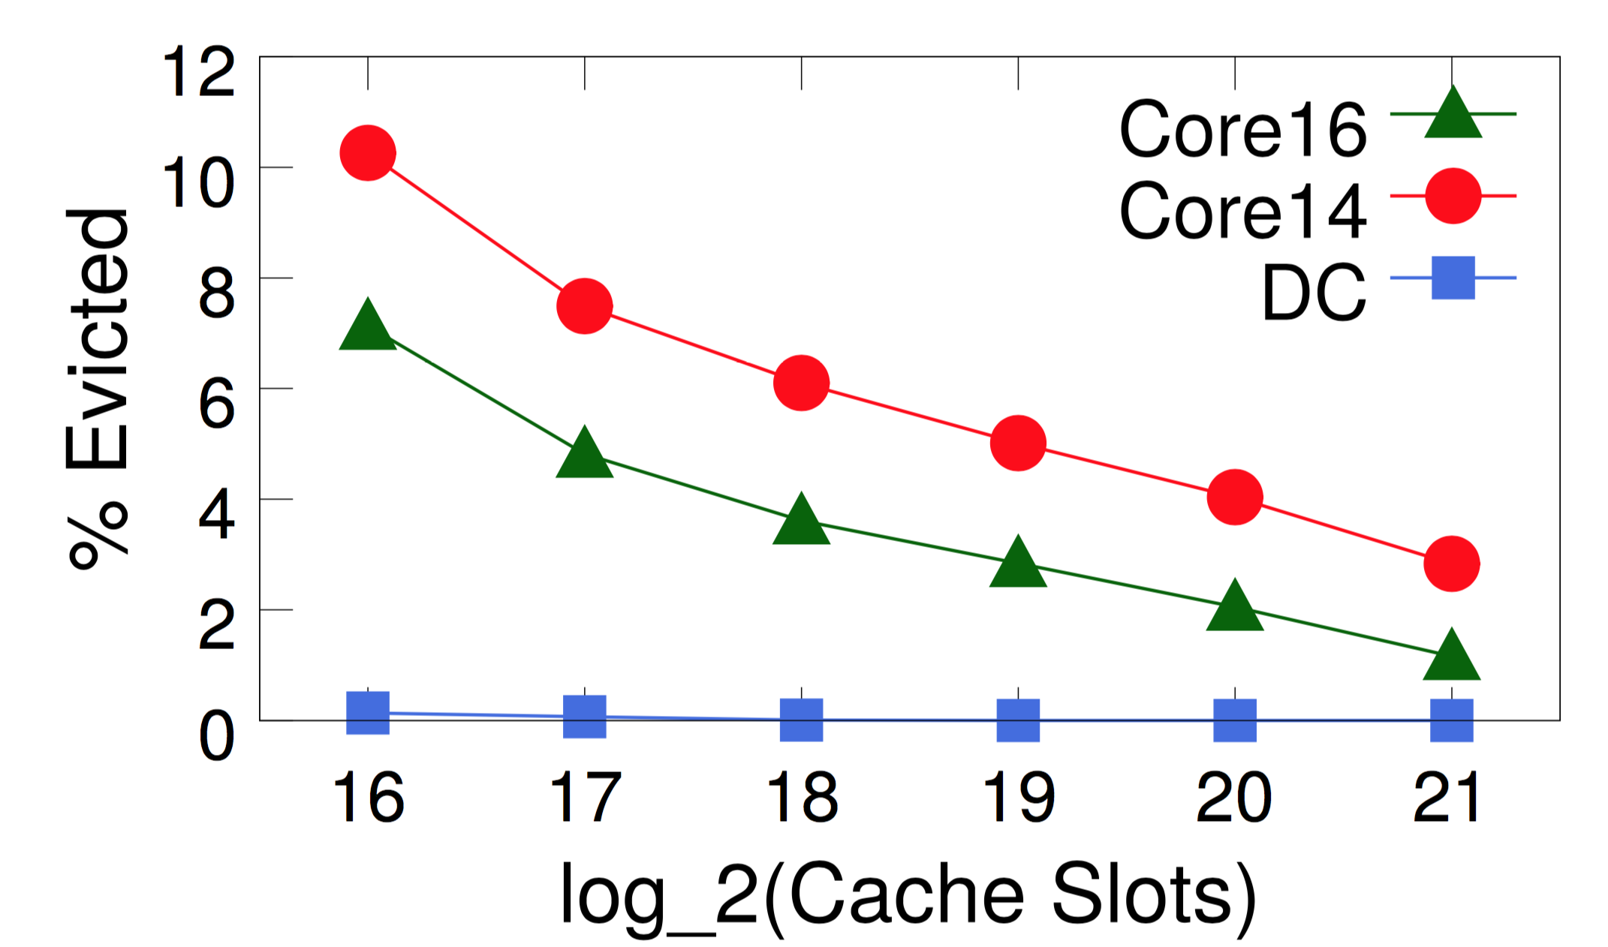
Eviction ratio vs. Cache size

Slide 45
Eviction ratio vs. Cache size
2¹⁸ keys == 64 Mbits
4% pkt eviction ratio
25X reduction from processing each pkt

Slide 46
Eviction ratio ➔ Eviction rate
Consider 64-port X 100-Gbit/s switch
Memory: 256 Mbits
7.5% area
Eviction rate: 8M records/s
~ 32 cores

Slide 47
See more in the paper…
More performance query examples
Query compilation algorithms
Evaluating hardware resources for stateful computations
Implementation & end-to-end walkthroughs on mininet

Slide 48







Summary
Come see our demo!
On-switch aggregation reduces software data processing
Linear in state: fully accurate per-flow aggregation at line rate
alephtwo@csail.mit.edu
http://web.mit.edu/marple

