Slide 1
Hardware and software for fast and programmable network monitoring
Srinivas Narayana, Anirudh Sivaraman, Vikram Nathan, Prateesh Goyal, Venkat Arun, Mohammad Alizadeh, Vimal Jeyakumar, and Changhoon Kim
Slides courtesy Srinivas Narayana
Notes:
Thank you for the invitation. I am going to be speaking about work that I did as a grad student on designing hardware and software for fast and programmable network monitoring. This is joint work with many excellent collaborators. In particular, I want to mention the lead author on this work, Srinivas Narayana, who is a postdoc at MIT.
So let’s break down the talk’s title: we want both fast and programmable network monitoring. By fast, I mean the ability to run at a switch’s line rate. And by programmable, I mean the ability to express whatever network monitoring question you care about and get accurate results.

Slide 2
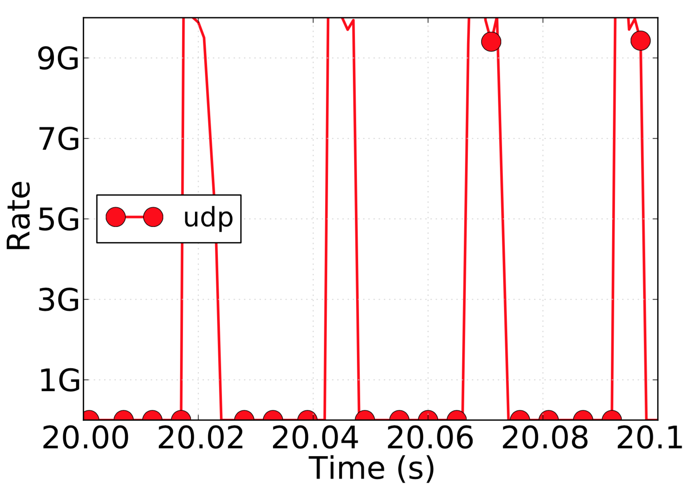




Example: Who caused a microburst?
Queue build-up deep in the network
End-to-end probes
Sampling
Counters & Sketches
Mirror packets
Per-pkt info: challenging in software
6.4Tbit/s switch: Need 100M recs/s
COTS: 100K-1M recs/s/core
Notes:
So what might be an example of a performance monitoring question? One example is a microburst, which is common in many production networks. A microburst is a situation in which you occasionally experience latency spikes in the network. This might be for any number of reasons, but one common reason is that some switch in a network is occasionally seeing bursts of traffic from an ill-behaved flow.
When you see this problem, you want to localize which switch queue is contributing to the high latency, and what traffic is filling up the queue. There are a few ways to tackle this problem, none of which are completely satisfactory.
You can send end-to-end probes, but that only tells you that the end-to-end latency is high. It doesn’t tell you where the latency is building up. You can sample the queue’s latency or packets, but then you need to decide what the sampling frequency is. You can use counters and approximate data structures like sketches, but they are tuned for volume statistics like link utilization and number of packets from a specific flow. They don’t effectively generalize beyond such statistics.
One alternative to this to mirror packets and use emerging technologies like in-band-network telemetry to piggyback queue information on the packet. The problem now is that the packets that transit the problematic queue are now scattered all over the network. They need to be collected together to determine at which switch and when queues build up. And the overhead of doing this in software is quite prohibitive.

Slide 3
Switches should be first-class citizens in performance monitoring.
Notes:
Our focus in this talk will be on seeing if we can use switches as first-class citizens in performance monitoring by augmenting them with a small set of measurement primitives to enable programmable network monitoring. You can think of this as designing a hardware instruction set and a software programming language for network performance monitoring on high-speed switches.

Slide 4
Why monitor from switches?
Already see the queues & concurrent connections
Infeasible to stream all the data out for external processing
Can we filter and aggregate performance on switches directly?
Notes:
But just to reiterate, why would you want to monitor from switches. Here are a couple of reasons. In many cases the problem is localized to a single switch (or a small set of switches), and instrumenting those directly is more convenient than having the data be distributed across end points. The alternative of sending all data to an end point for external processing consumes too much network and compute capacity. So the concrete technical question we try to answer is whether we can perform filtering and aggregation on switches directly.

Slide 5
We want to build “future-proof” hardware:
Language-directed hardware design
Notes:
Now, when you build an instruction set, you want it to be as general as possible. Otherwise, it ends up being overfitted in a sense to your current set of use cases, without any guarantee that it can generalize to other use cases. To avoid this, and to attempt to build somewhat future-proof hardware, we adopt a design methodology called language-directed hardware design where we start with an expressive programming language and then design hardware to efficiently support this programming language.

Slide 6
Performance monitoring use cases
Expressive query language
Line-rate switch hardware primitives
Notes:
In more detail, this is how our workflow looks. We start with an informal description of several performance monitoring use cases similar to our Microburst example before. We then design an expressive query language to capture all of these use cases and future unanticipated use cases that are similar to these use cases. Once we have designed this language, we use it to design switch hardware primitives as well.
While this slide shows this process as mostly one directional from use cases to hardware, there is also a bit of feedback in practice. For instance, we restrict our language to what can be reasonably implemented in line-rate hardware. In particular, our language isn’t Turing complete so you can’t do everything with it that you can do with a CPU. In our minds, this was a reasonable tradeoff because that’s the price you pay for high performance.

Slide 7
Contributions
Marple, a performance query language
Line-rate switch hardware design
Aggregation: Programmable key-value store
Query compiler

Slide 8


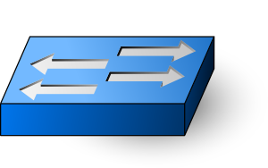
Queries
Marple programs
Results
Query Compiler
Switch programs
To collection servers
Programmable switches
with the key-value store

Slide 9
Marple: Performance query language

Slide 10
Marple: Performance query language
Stream: For each packet at each queue,
S:= (switch, qid, hdrs, uid, tin, tout, qsize)
Location
Packet identification
Queue entry and exit timestamps
Queue depth seen by packet

Slide 11
Marple: Performance query language
Stream: For each packet at each queue,
S:= (switch, qid, hdrs, uid, tin, tout, qsize)
Familiar functional operators
filter
map
zip
groupby

Slide 12
Example: High queue latency packets
R1 = filter(S, tout – tin > 1 ms)

Slide 13
Example: Per-flow average latency
R1 = filter(S, proto == TCP)
R2 = groupby(R1, 5tuple, ewma)
def ewma([avg],[tin, tout]):
avg = (1-⍺)*avg + ⍺*(tout-tin)
Fold function

Slide 14
Example: Microburst diagnosis
def bursty([last_time, nbursts], [tin]):
if tin - last_time > 800 ms:
nbursts = nbursts + 1
last_time = tin
result = groupby(S, 5tuple, bursty)

Slide 15
Many performance queries (see paper)
Transport protocol diagnoses
Fan-in problems (incast and outcast)
Incidents of reordering and retransmissions
Interference from bursty traffic
Flow-level metrics
Packet drop rates
Queue latency EWMA per connection
Incidence and lengths of flowlets
Network-wide questions
Route flapping
High end to end latencies
Locations of persistently long queues
...

Slide 16
Implementing Marple on switches

Slide 17
Implementing Marple on switches
S:= (switch, hdrs, uid, qid, tin, tout, qsize)
Switch telemetry
[INT SOSR’15]
filter
map
zip
groupby
Stateless match-action rules
[RMT SIGCOMM’13]

Slide 18
Implementing Marple on switches
S:= (switch, hdrs, uid, qid, tin, tout, qsize)
Switch telemetry
[INT SOSR’15]
filter
map
zip
groupby
Stateless match-action rules
[RMT SIGCOMM’13]

Slide 19
Implementing aggregation
ewma_query = groupby(S, 5tuple, ewma)
def ewma([avg], [tin, tout]):
avg = (1-⍺)*avg + ⍺*(tout-tin)
Compute & update values at switch line rate (1 pkt/ns)
Scale to millions of aggregation keys (e.g., 5-tuples)

Slide 20
Challenge:
Neither SRAM nor DRAM is both fast and dense

Slide 21
Caching:
the illusion of fast and large memory

Slide 22

Caching
Off-chip backing store (DRAM)
On-chip cache (SRAM)
Key
Value
Key
Value
Notes:
On-chip cache of the key-value store is in SRAM
Off-chip backing store is in DRAM
But: cache misses lead to router pipeline stalls and non-determinism

Slide 23

Caching
Off-chip backing store (DRAM)
On-chip cache (SRAM)
Key
Value
Key
Value
Read value for 5-tuple key K
Modify value using ewma
Write back updated value

Slide 24
Caching
Off-chip backing store (DRAM)
On-chip cache (SRAM)
Key
Value
Key
Value
Req. key K
Read value for 5-tuple key K
K
V_{back}
Resp. V_{back}

Slide 25
Caching
Off-chip backing store (DRAM)
On-chip cache (SRAM)
Key
Value
Key
Value
Req. key K
Read value for 5-tuple key K
K
V_{back}
K
V_{back}
Resp. V_{back}

Slide 26
Caching
Off-chip backing store (DRAM)
On-chip cache (SRAM)
Modify and write must wait for DRAM.
Non-deterministic DRAM latencies stall packet pipeline.
Key
Value
Key
Value
Request key K
Read value for 5-tuple key K
K
V’’
K
V’’
Respond K, V’’
Notes:
Stress that DRAM is built for the average case.

Slide 27
Instead, we treat cache misses as
packets from new flows.

Slide 28
Cache misses as new keys
Off-chip backing store (DRAM)
On-chip cache (SRAM)
Key
Value
Key
Value
Read value for key K
K
V₀

Slide 29
Cache misses as new keys
Off-chip backing store (DRAM)
On-chip cache (SRAM)
Key
Value
Key
Value
Evict K,V_{cache}
Read value for key K
K
V_{back}
K
V₀

Slide 30
Cache misses as new keys
Off-chip backing store (DRAM)
On-chip cache (SRAM)
Key
Value
Key
Value
Evict K,V_{cache}
Read value for key K
K
V_{back}
K
V₀
Merge

Slide 31
Cache misses as new keys
Off-chip backing store (DRAM)
On-chip cache (SRAM)
Key
Value
Key
Value
Evict K,V_{cache}
Read value for key K
K
V_{back}
K
V₀
Nothing to wait for.

Slide 32
How about value accuracy after evictions?
How do we merge evicted statistics value with previous value accurately?
Let’s represent the statistics operation as a function g over a packet sequence p1, p2, …
g([p_{i}])
Action of g over a packet sequence,
e.g, for a counter g([p_{i}]) = p1.len + p2.len + …

Slide 33
The Merge operation
V_{cache}
V_{back}
merge(g([q_{j}]), g([p_{i}]))
= g([p1,…,pn,q1,…,qm])
Example: if g is a counter, merge is just addition.
Easy generalization to all associative statistics (min, max, product, set union, intersection, etc.)
Statistics over the entire packet sequence

Slide 34
Mergeability beyond associative statistics
Can merge any statistic g by storing entire pkt sequence in cache
… but that’s a lot of extra state!
Can we merge with “small” extra state?
Small: extra state size ≈ size of the statistics value being tracked

Slide 35
Linear-in-state: Merge w. small extra state
S = A * S + B
Examples: Packet and byte counters, EWMA, functions over a window of packets, …
State maintained by the statistic
Functions of a bounded number of packets in the past

Slide 36
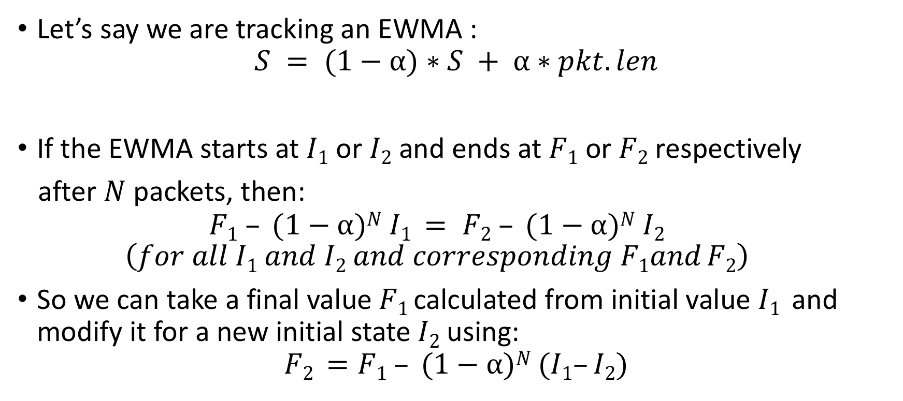
Intuition for linear-in-state
Let’s say we are tracking an EWMA :
$$S = (1−⍺)∗S + ⍺∗pkt.len$$
If the EWMA starts at $I1$ or $I2$ and ends at $F1$ or $F2$ respectively
after $N$ packets, then:
$$F1 – (1−⍺)N I1 = F2 – (1−⍺)N I2$$
$$\left(for all I1 and I2 and corresponding F1and F2\right)$$
So we can take a final value $F1$ calculated from initial value $I1$ and modify it for a new initial state$I2$using:
$$F2 =F1 – (1−⍺)N (I1–I2)$$
I₁
I₂
F₁
F₂

Slide 37
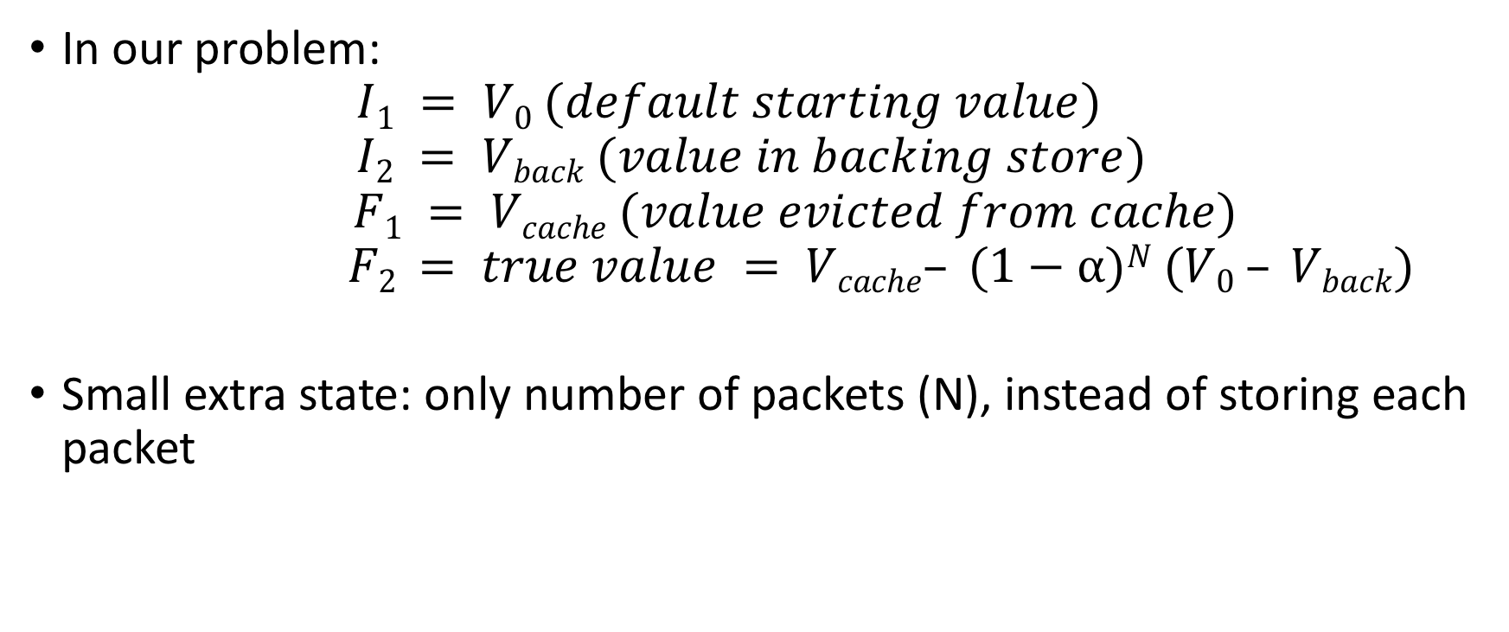
Intuition for linear-in-state
In our problem:
$$I1 = V0 (default starting value)$$
$$I2 = Vback (value in backing store)$$
$$F1 = Vcache (value evicted from cache)$$
$$F2 = true value = Vcache– (1−⍺)N (V0 – Vback)$$
Small extra state: only number of packets (N), instead of storing each packet
I₁
I₂
F₁
F₂
Notes:
Say that the more formal result is in the paper.

Slide 38
Microbursts: Linear-in-state!
def bursty([last_time, nbursts], [tin]):
if tin - last_time > 800 ms:
nbursts = nbursts + 1
last_time = tin
result = groupby(S, 5tuple, bursty)
nbursts: S = A * S + B, where
A = 1
B = {1, if current pkt within time gap from last;
0 otherwise}

Slide 39
Several useful linear-in-state statistics
Counting successive TCP packets that are out of sequence
Histogram of flowlet sizes
Counting number of timeouts in a TCP connection
Micro-burst detection
EWMAs
The linear-in-state operation can also be cheaply implemented using a multiply-accumulate hardware instruction.

Slide 40
Other linear-in-state queries
Counting successive TCP packets that are out of order
Histogram of flowlet sizes
Counting number of timeouts in a TCP connection
… 7/10 example queries in our paper

Slide 41
Evaluation:
Is processing the evictions feasible?

Slide 42
Eviction processing
Off-chip backing store (DRAM)
On-chip cache (SRAM)
Key
Value
Key
Value
Evict K’,V’_{cache}
K’
V’_{back}
K
V₀

Slide 43
Eviction processing at backing store
Trace-based evaluation:
“Core14”, “Core16”: Core router traces from CAIDA (2014, 16)
“DC”: University data center trace from [Benson et al. IMC ’10]
Each has ~100M packets
Query aggregates by 5-tuple (key)
Show results for key+value size of 256 bits
8-way set-associative LRU cache eviction policy
Eviction ratio: % of incoming pkts that result in a cache eviction

Slide 44
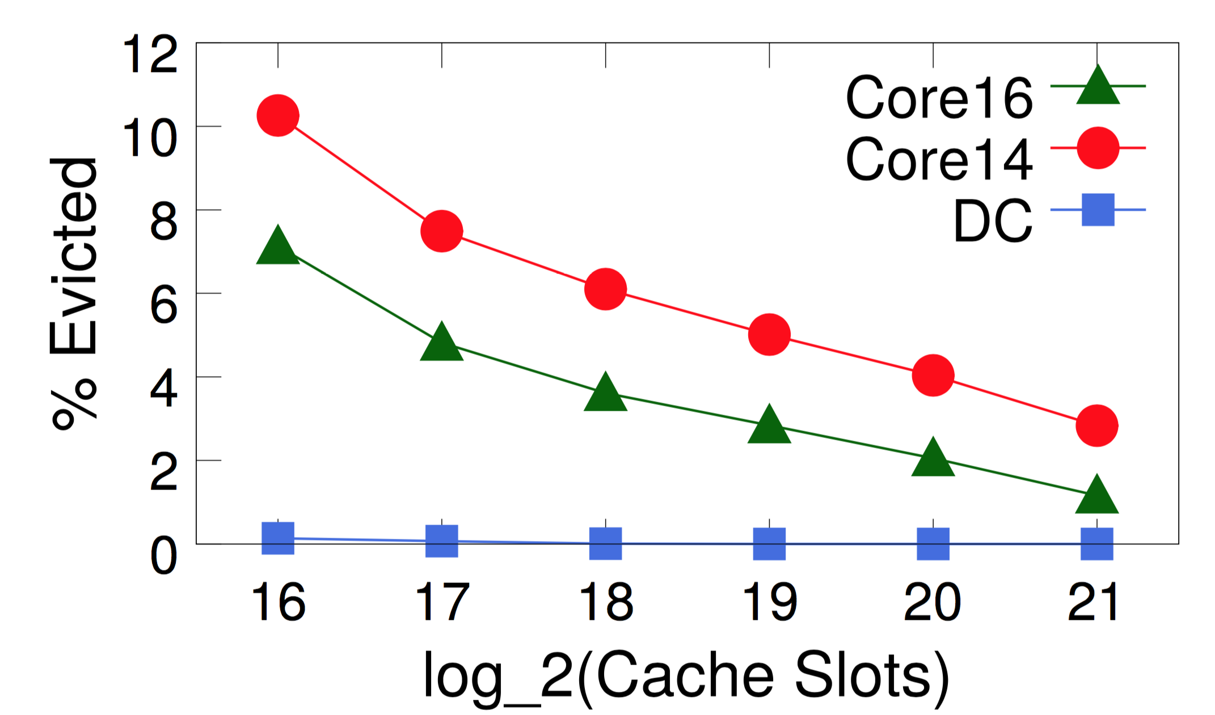
Eviction ratio vs. Cache size

Slide 45
Eviction ratio vs. Cache size
2¹⁸ keys == 64 Mbits
4% pkt eviction ratio
25X reduction from processing each pkt

Slide 46
Eviction ratio ➔ Eviction rate
Consider 64-port X 100-Gbit/s switch
Memory: 256 Mbits
7.5% area
Eviction rate: 8M records/s
~ 32 cores

Slide 47
See more in the paper…
More performance query examples
Query compilation algorithms
Evaluating hardware resources for stateful computations
Implementation & end-to-end walkthroughs on mininet

Slide 48
Summary
On-switch aggregation reduces software data processing
Linear in state: fully accurate per-flow aggregation at line rate
Paper and code available at http://web.mit.edu/marple

