Slide 1


Pressure-Induced Sasando String Vibration via Piezoelectric Mapping: Numerical Modeling and Fourier Analysis
EEE 212 – Numerical Technique Laboratory
Submitted By:
Anirudha Roy Archo-2306175
Monem Tazuar Alve-2306176
Kushal Roy Sondo-2306177
Swapneel Paul-2306180

Slide 2
ABSTRACT
Applies Fourier Synthesis & Audio Visualization
Drives From Piezo-Electric
An Interactive MATLAB GUI
RC Filtering Incorporated
Develops A Music System
Bridges Modern Numerical Techniques

Slide 3

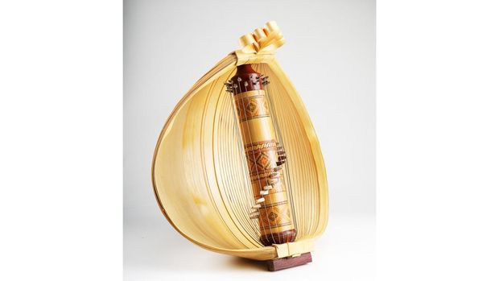
INTRODUCTION
The Sasando is a traditional Indonesian string instrument from Rote Island, known for its unique palm leaf resonator and distinctive ethereal sound. Modeling its vibration behavior presents significant challenges due to the complex wave mechanics and damping characteristics inherent in stringed instruments.

Slide 4
System Decompositon
Input: Pressure(P),Resistance(R), Capacitance(c), Base Frequency
Electrical Mapping
Mechanical mapping
Fequency
Generation
Filtering
Visualisation &
Audio Output
Fourier Synthesis

Slide 5
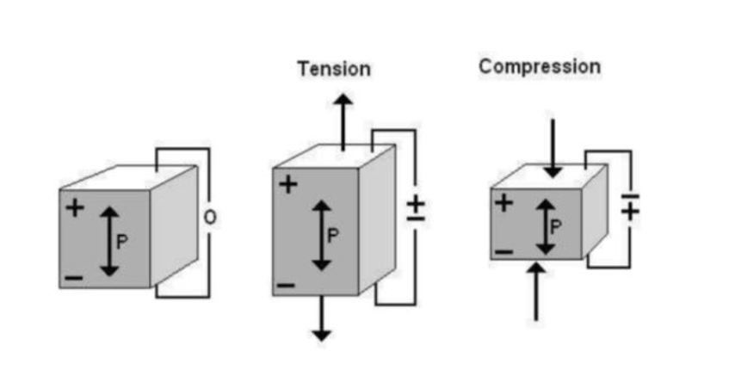
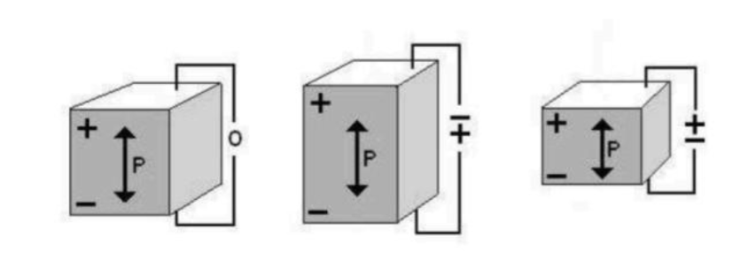
Basic Concept
PiezoElectricity

Slide 6
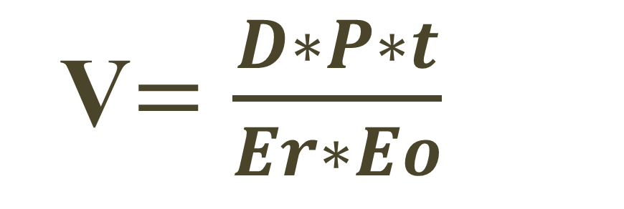
Pressure To Electrical Mapping
Pressure Taken as Input
Pressure Changes To Voltage
D=Piezo-Electric Coefficient
V$=\frac{D∗P∗t}{Er∗Eo}$

Slide 7
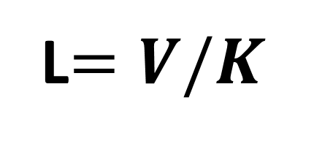
Voltage To Length Mapping
K Taken as Constant
Voltage Changes To Length
L$=V/K$

Slide 8
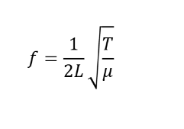
Frequency Generation
T=Tension & u=Linear Mass Density
Frequency Depends On Length
Frequency Adds To Bamboo Frequency 501.6 Hz

Slide 9
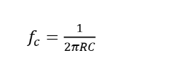
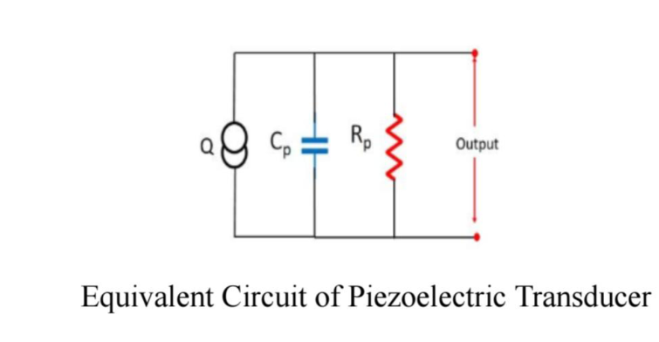
RC Design: FILTERING
FC for High Pass Filter
Low Pass Filter 98Hz

Slide 10
Fourier Series & Signal Construction
$$x(t)=\sum_{k=1}{\left(A_{k}\sin{\frac{2πt}{T}}\right)}$$
1)Done For Fourier Analysis
2) Shows For Fourier Epicycles & Phases

Slide 11
Audio Signal Visualization
Filtered Frequency & Amplitudes Are Transformed
Changes Into Time Domain
Sliding Window Approach Employed

Slide 12
Pressure To Note Mapping For Sound Generation
SARGAM Based System
Providing Real Time Feedback System

Slide 13
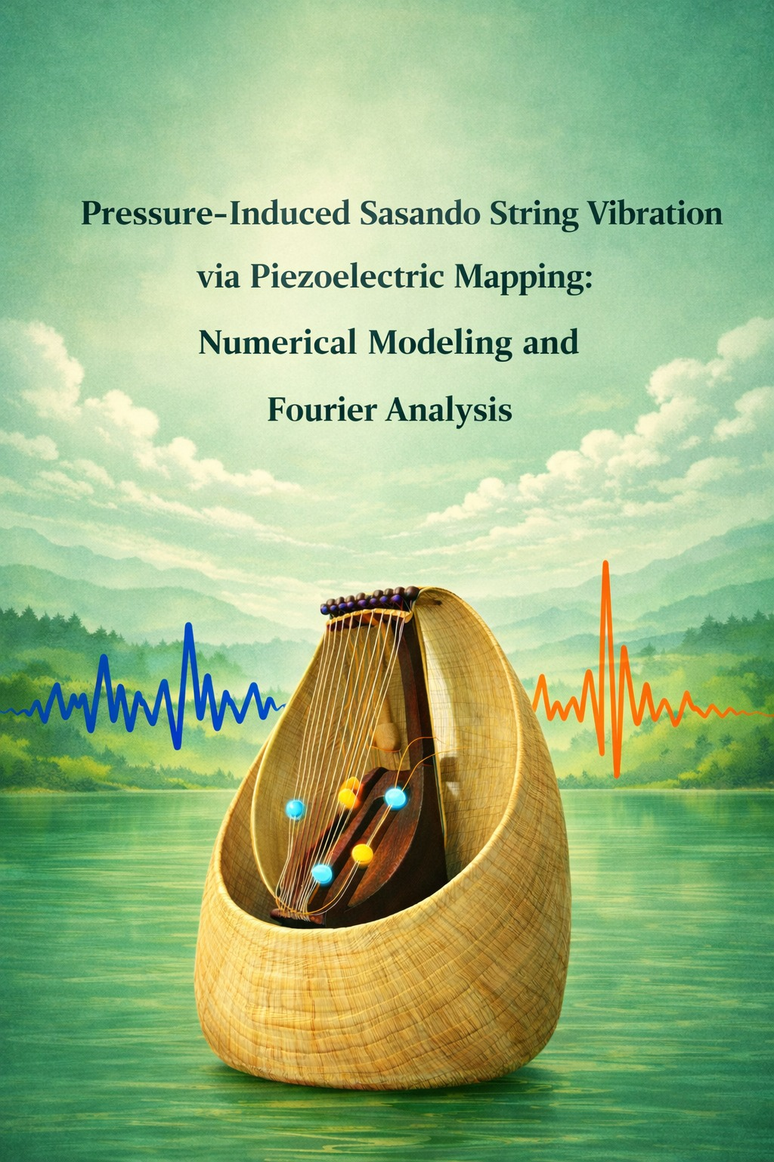
Output Analysis:

Slide 14
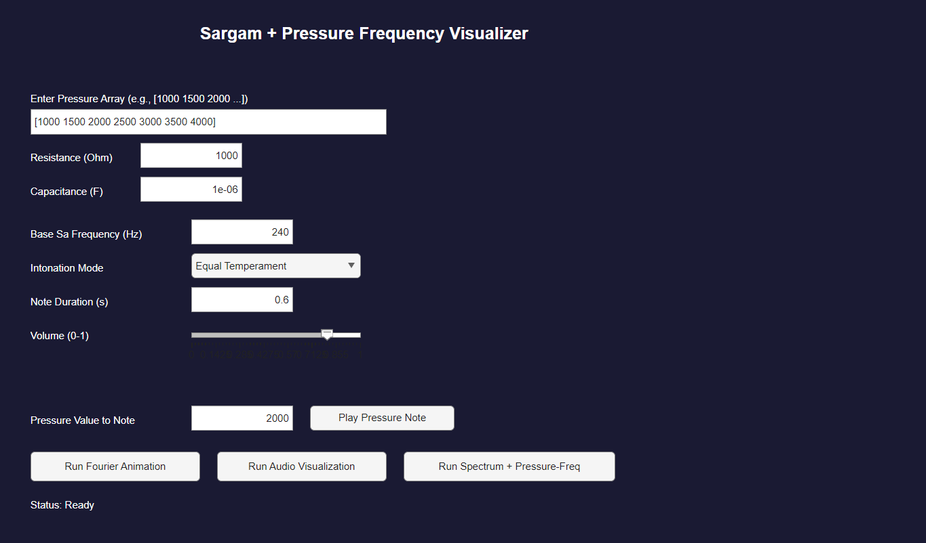
MATLAB GUI :
1)P,R,C & Base Frequency As Input
2)User Can Set Note Duration & Volume
3)Shows Fourier, Audio, Graph
4)Music By Pressure Note & Keyboard

Slide 15
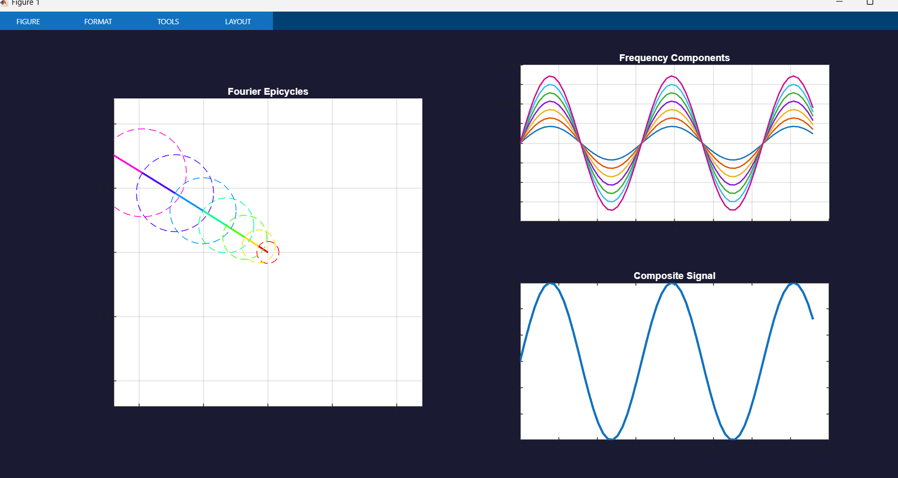
Fourier Synthesis and Signal Construction:

Slide 16
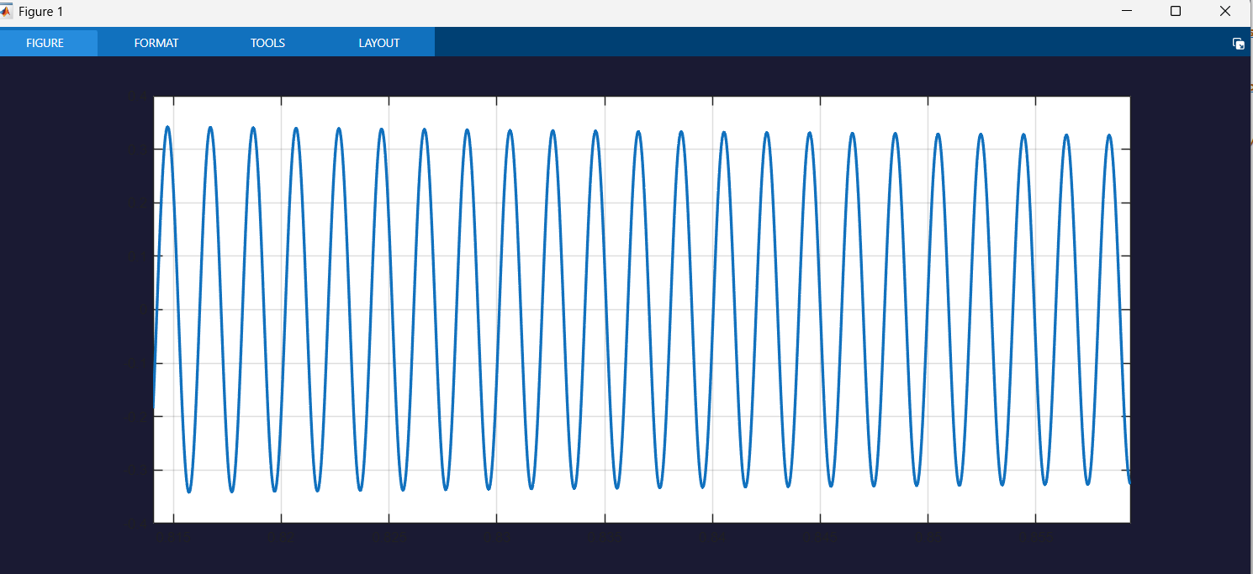
Audio Signal Generation and Visualization:
1)Creates Moving Audio Signal
2)Sliding Window Approach

Slide 17
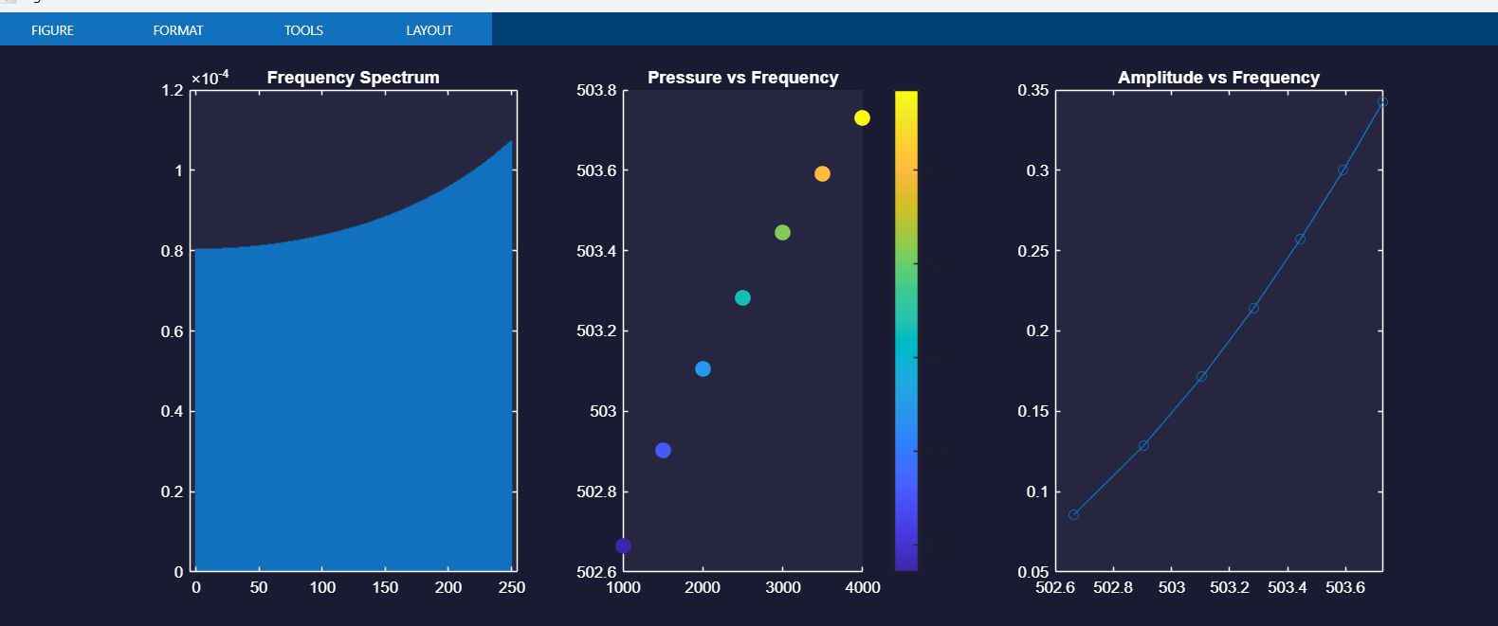
Frequency Spectrum Analysis:
1
Increasing When 200+ Frequency

Slide 18
1
Proportional
2
Tends To Base Frequency
3
Data Coincides More
Pressure vs Frequency Plot:

Slide 19
Amplitude vs Frequency Plot:
Proportional
Increasing

Slide 20
LIMITATIONS
Manual Pressure Input Only
Simplified Linear Damping Model
Idealized RC Filtering Assumptions

Slide 21
Communication to External Stakeholders:
Git-Hub link: https://github.com/anirudha175/Pressure-Induced-Sasando-String-Vibration-via-Piezoelectric-Mapping
YouTube link: https://youtube.com/playlist?list=PL3EaVPxK3BIcc06goMEuOAC87wx65Bq6l&si=yNvdukcXBy2id3qe

Slide 22
References:
1.MIT OpenCourseWare, “Physics III: Vibrations and Waves,” Massachusetts Institute of Technology, 2016. [Online]. Available:
https://ocw.mit.edu/courses/physics/8-03sc-physics-iii-vibrations-and-waves-fall 2016/
2. E. W. Weisstein, “Wave Equation,” Wolfram MathWorld. [Online]. Available:
Wave Equation -- from Wolfram MathWorld
3. R. Nave, “Vibrating String,” HyperPhysics, Georgia State University. [Online]. Available: https://hyperphysics.phy-astr.gsu.edu/hbase/Waves/string.html
4. K. Brown, “An Interactive Guide to the Fourier Transform,” BetterExplained. [Online]. Available: An Interactive Guide To The Fourier Transform – BetterExplained
5. MathWorks, “Fast Fourier Transform (FFT),” MATLAB Documentation. [Online]. Available: fft - Fast Fourier transform – MATLAB
6. MathWorks, “MATLAB Documentation,” The MathWorks, Inc. [Online]. Available: Help Center
7. J. Wolfe, “Music Acoustics,” University of New South Wales. [Online]. Available: https://newt.phys.unsw.edu.au/jw/music.html
8. COMSOL, “Introduction to Partial Differential Equations,” COMSOL Multiphysics. [Online]. Available: https://newt.phys.unsw.edu.au/jw/music.html

Slide 23
THANK YOU

