Slide 1

Python Operators
The operator can be defined as a symbol which is responsible for a particular operation between two operands.
Operators are the pillars of a program on which the logic is built in a specific programming language. Python provides a variety of operators, which are described as follows.
Arithmetic operators
Comparison operators
Assignment Operators
Logical Operators
Bitwise Operators
Membership Operators
Identity Operators

Slide 2
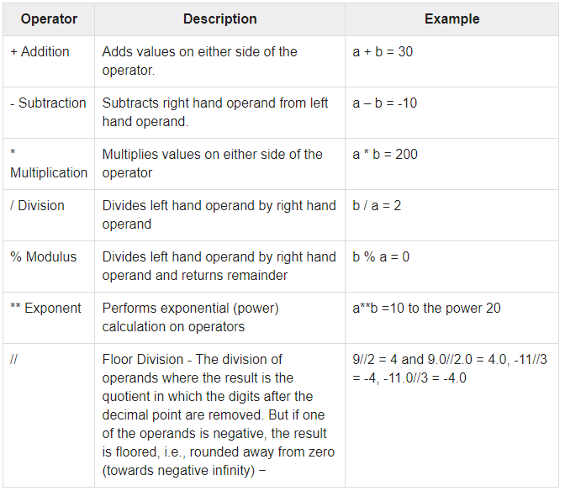
Arithmetic Operators
Ex . a=10, b=20

Slide 3
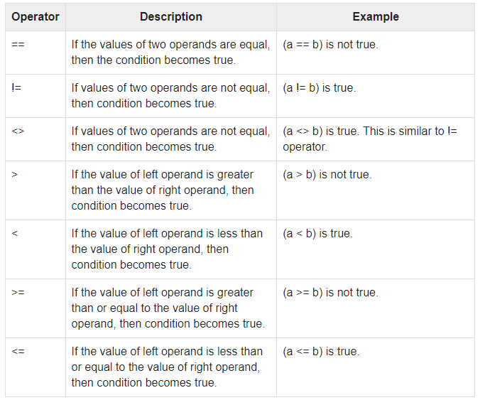
Comparison operator
Ex . a=10, b=20

Slide 4
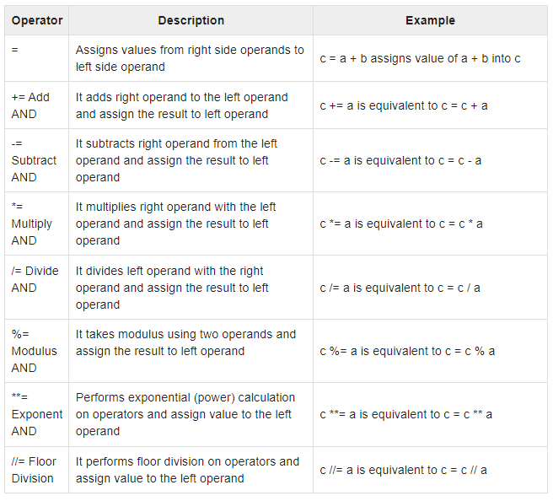
Assignment Operators
Ex . a=10, b=20

Slide 5
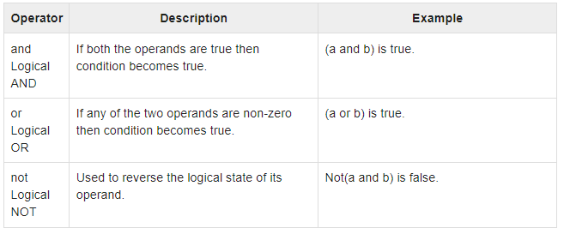
Logical Operators
Ex . a=10, b=20, c=30

Slide 6
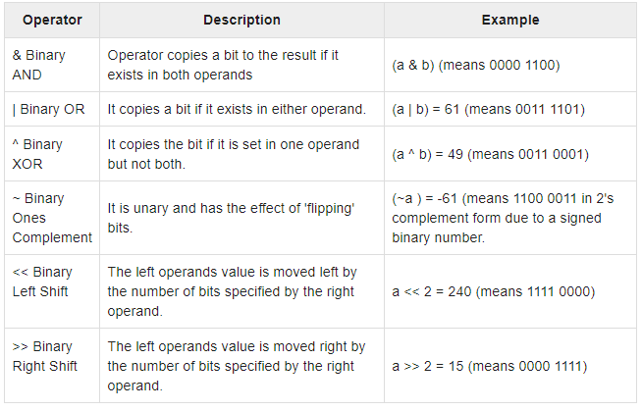
Bitwise Operators
Ex. a=60 b=13

Slide 7
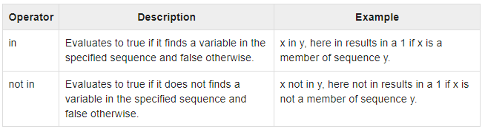
Membership Operators

Slide 8
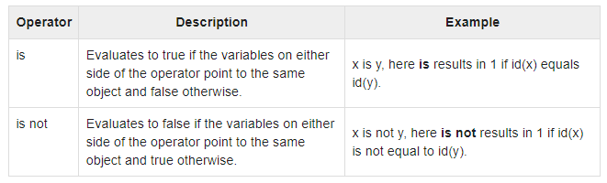
Identity Operators

Slide 9
THANKS
instructor: Anirudha Anil Gaikwad
https://github.com/anirudhagaikwad/AI-ML-Python_11Aug21

