Slide 1

Control statement In Python
Dealing with redundant code and repetitive commands in program. Python makes use of loops, control and conditional statements to overcome this difficulty.
Conditional Statements
Conditional Statements in python support the usual logical conditions from mathematics.
For example:
Equals: a == b
Not Equals: a != b
Less than: a < b
Less than or equal to: a <= b
Greater than: a > b
Greater than or equal to : a >= b
These statements can be used in several ways, most commonly in if statement.

Slide 2
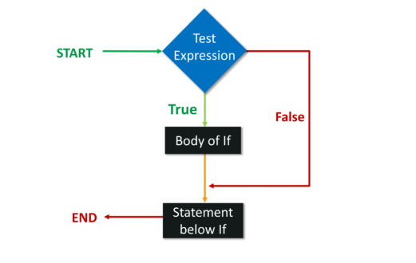
if Statement
An if statement is written using the ‘if’ keyword,
Flowchart

Slide 3
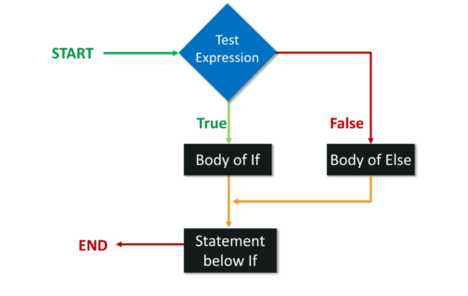
else Statement
The else keyword catches anything that is not caught by the preceding conditions.
When the condition is false for the if statement, the execution will move to the else statement.

Slide 4
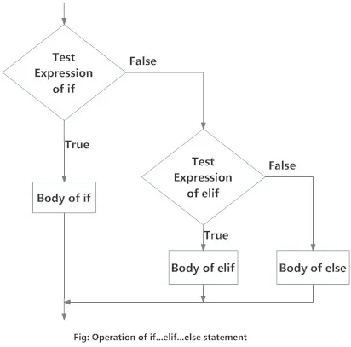
elif Statement

Slide 5
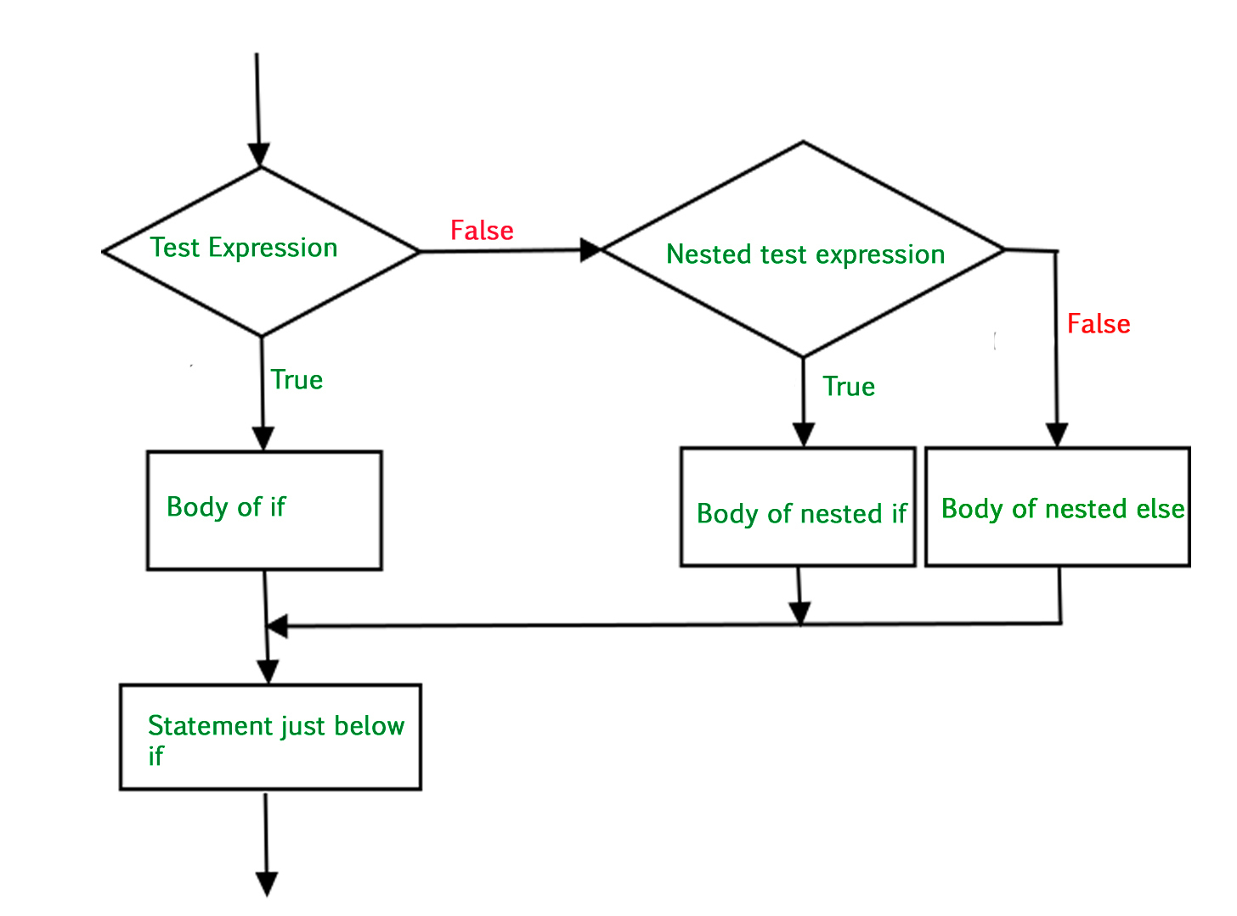
Nested if else

Slide 6
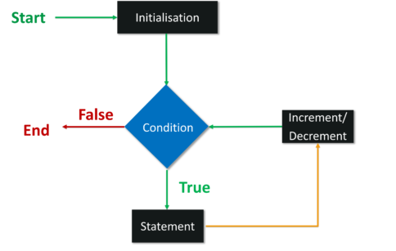
for loop
A for loop is used to execute statements, once for each item in the sequence.
The sequence could be a list, a Dictionary, a set or a string.

Slide 7
Range Function
Range function requires a specific sequence of numbers.
It starts at 0 and then the value increments by 1 until the specified number is reached.
For example:
for x in range(3)
print(x)
Output:0,1,2

Slide 8
THANKS
instructor: Anirudha Anil Gaikwad
https://github.com/anirudhagaikwad/AI-ML-Python_11Aug21

