Slide 1
C++
What you learn ?
C++
Multidimensional Array in C++ | Multidimensional Array initialization
Passing Array to function

Slide 2
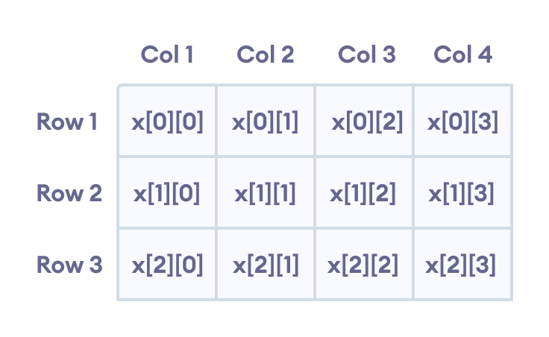
Multidimensional Array in C++
In C++, we can create an array of an array, known as a multidimensional array. For example:
int x[3][4];
Here, x is a two-dimensional array. It can hold a maximum of 12 elements.
We can think of this array as a table with 3 rows and each row has 4 columns as shown below.

Slide 3
3 dimensional array
Three-dimensional arrays also work in a similar way. For example:
float x[2][4][3];
This array x can hold a maximum of 24 elements.
We can find out the total number of elements in the array simply by multiplying its dimensions:
2 x 4 x 3 = 24

Slide 4
Multidimensional Array Initialization
Initialization of two-dimensional array
int test[2][3] = {2, 4, 5, 9, 0, 19};
The above method is not preferred.
A better way to initialize this array with the same array elements is given below:
int test[2][3] = { {2, 4, 5}, {9, 0, 19}};
This array has 2 rows and 3 columns, which is why we have two rows of elements with 3 elements each.

Slide 5
Multidimensional Array Initialization
Initialization of three-dimensional array
int test[2][3][4] = {3, 4, 2, 3, 0, -3, 9, 11, 23, 12, 23,
2, 13, 4, 56, 3, 5, 9, 3, 5, 5, 1, 4, 9};
This is not a good way of initializing a three-dimensional array. A better way to initialize this array is:
int test[2][3][4] = {
{ {3, 4, 2, 3}, {0, -3, 9, 11}, {23, 12, 23, 2} },
{ {13, 4, 56, 3}, {5, 9, 3, 5}, {5, 1, 4, 9} }
};

Slide 6
Passing Array to function
In C++, we can pass arrays as an argument to a function. And, also we can return arrays from a function.
Syntax for Passing Arrays as Function Parameters
The syntax for passing an array to a function is:
returnType functionName(dataType arrayName[arraySize]) {
// code
}
Example,
int total(int marks[5]) {
// code
}
Here, we have passed an int type array named marks to the function total(). The size of the array is 5.

Slide 7
Thanks
Anirudha Gaikwad

