Slide 1
C++
What you learn ?
C++
Types of Inheritance | Single Inheritance
Multiple Inheritance | Multilevel Inheritance
Hierarchical Inheritance | Hybrid Inheritance

Slide 2
Types of Inheritance
Types Of Inheritance:-
Single inheritance
Multilevel inheritance
Multiple inheritance
Hierarchical inheritance
Hybrid inheritance

Slide 3
Types of Inheritance
Types Of Inheritance:-
Single inheritance
Multilevel inheritance
Multiple inheritance
Hierarchical inheritance
Hybrid inheritance

Slide 4
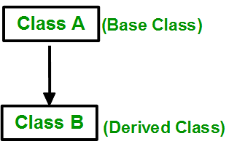
Single Inheritance

Slide 5

Multiple Inheritance

Slide 6
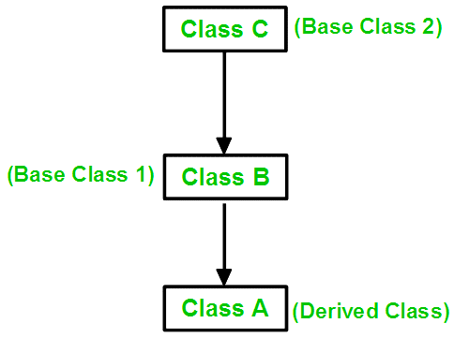
Multilevel Inheritance

Slide 7
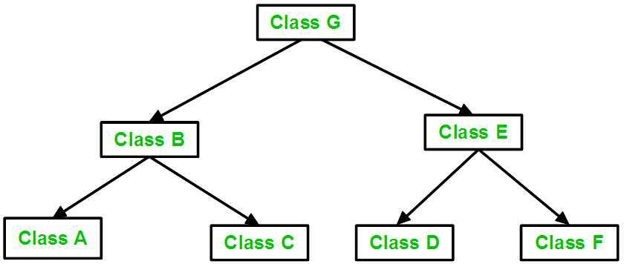
Hierarchical Inheritance

Slide 8
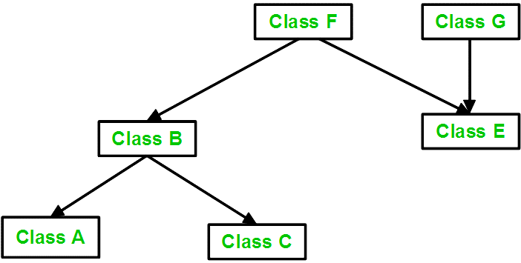
Hybrid Inheritance

Slide 9
Thanks
Anirudha Gaikwad

