Slide 1
Data Structures
What you learn ?
Data Structure
What is Data Structure? | Need Of Data Structure
Types of Data Structure | Major operations on Data Structure
Advantages of Data Structure | Applications of Data Structure
Asymptotic Notations

Slide 2
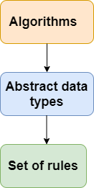
What is Data Structure?
Data Structure is a way to store and organize data so that it can be used efficiently.
The data structure name indicates itself that organizing the data in memory. There are many ways of organizing the data in the memory as we have already seen one of the data structures, i.e., array in C language.
The data structure is not any programming language like C, C++, java, etc. It is a set of algorithms that we can use in any programming language to structure the data in the memory.

Slide 3
Need of Data Structure?
Data Structure is a way to store and organize data so that it can be used efficiently.
The data structure name indicates itself that organizing the data in memory. There are many ways of organizing the data in the memory as we have already seen one of the data structures, i.e., array in C language.
The data structure is not any programming language like C, C++, java, etc. It is a set of algorithms that we can use in any programming language to structure the data in the memory.

Slide 4
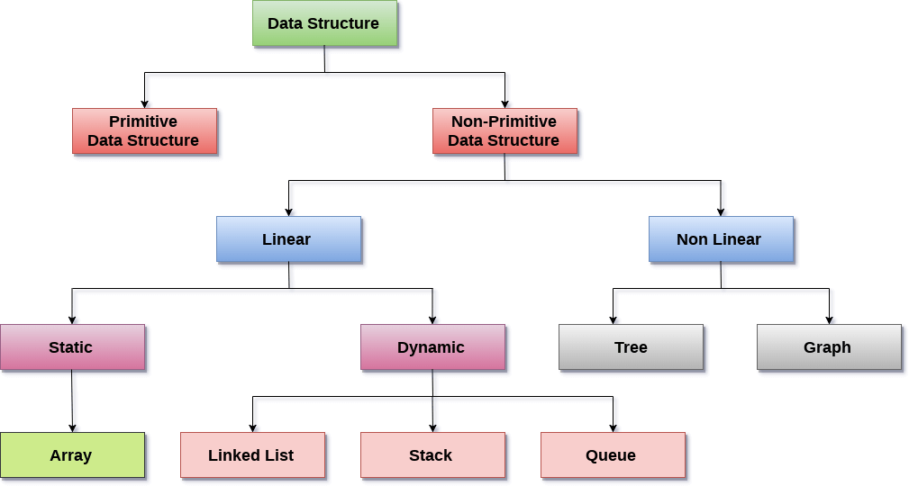
Types of Data Structure

Slide 5
Types of Data Structure
There are two types of data structures:
Primitive data structure
Non-primitive data structure
Primitive Data structure
The primitive data structures are primitive data types. The int, char, float, double, and pointer are the primitive data structures that can hold a single value.
Non-Primitive Data structure
The non-primitive data structure is divided into two types:
Linear data structure
Non-linear data structure
Data structures can also be classified as:
Static data structure: It is a type of data structure where the size is allocated at the compile time. Therefore, the maximum size is fixed.
Dynamic data structure: It is a type of data structure where the size is allocated at the run time. Therefore, the maximum size is flexible.

Slide 6
Major operations on Data Structure
The major or the common operations that can be performed on the data structures are:
Searching: We can search for any element in a data structure.
Sorting: We can sort the elements of a data structure either in an ascending or descending order.
Insertion: We can also insert the new element in a data structure.
Updation: We can also update the element, i.e., we can replace the element with another element.
Deletion: We can also perform the delete operation to remove the element from the data structure.

Slide 7
Advantages Of Data Structure
The following are the advantages of a data structure:
Data structures allow storing the information on hard disks.
An appropriate choice of ADT (Abstract Data Type) makes the program more efficient.
Data Structures are necessary for designing efficient algorithms.
It provides reusability and abstraction.
Using appropriate data structures can help programmers save a good amount of time while performing operations such as storage, retrieval, or processing of data.
Manipulation of large amounts of data is easier.

Slide 8
Applications Of Data Structure
The following are the advantages of a data structure:
Organization of data in a computer’s memory
Representation of information in databases
Algorithms that search through data (such as a search engine)
Algorithms that manipulate data (such as a word processor)
Algorithms that analyse data (such as a data miner)
Algorithms that generate data (such as a random number generator)
Algorithms that compress and decompress data (such as a zip utility)
Algorithms that encrypt and decrypt data (such as a security system)
Software that manages files and directories (such as a file manager)
Software that renders graphics (such as a web browser or 3D rendering software)

Slide 9
Asymptotic Notations
Asymptotic notations are the mathematical notations used to describe the running time of an algorithm when the input tends towards a particular value or a limiting value.
There are mainly three asymptotic notations:
Big-O notation
Omega notation
Theta notation

Slide 10
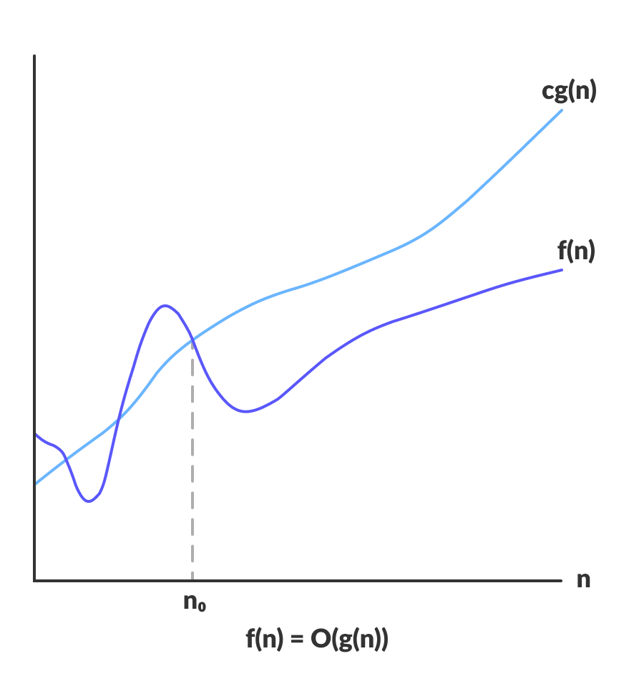
Big-O notation
Big-O notation represents the upper bound of the running time of an algorithm. Thus, it gives the worst-case complexity of an algorithm.
Big-O gives the upper bound of a function
O(g(n)) = { f(n): there exist positive constants c and n0 such that 0 ≤ f(n) ≤ cg(n) for all n ≥ n0 }
The above expression can be described as a function f(n) belongs to the set O(g(n)) if there exists a positive constant c such that it lies between 0 and cg(n), for sufficiently large n.
Since it gives the worst-case running time of an algorithm, it is widely used to analyse an algorithm as we are always interested in the worst-case scenario.

Slide 11
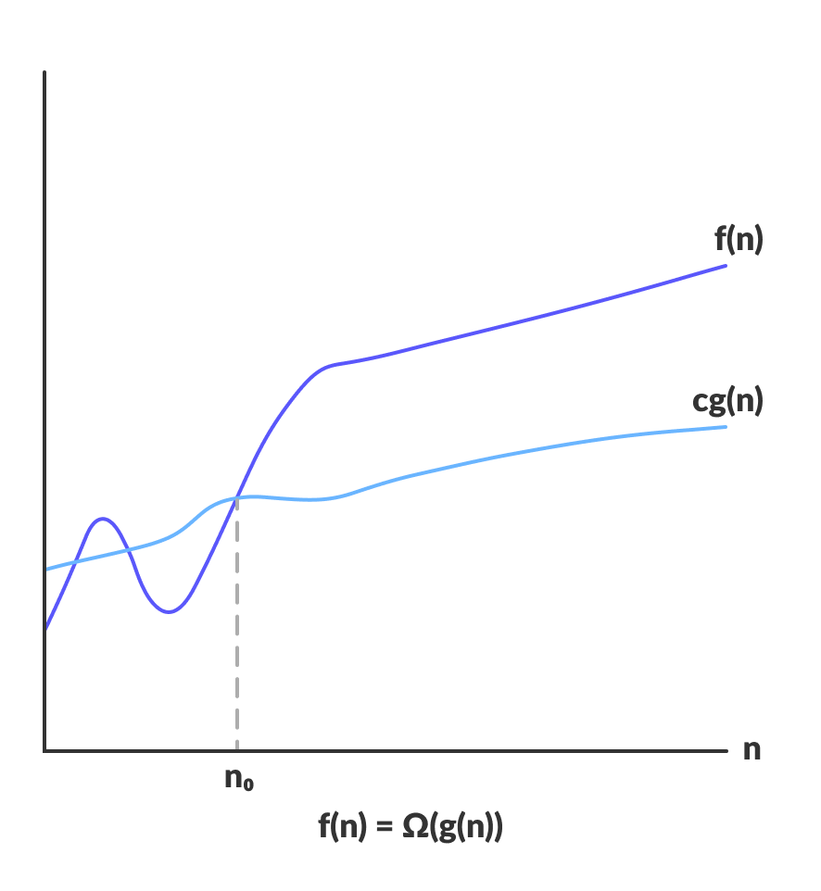
Omega Notation (Ω-notation)
Omega notation represents the lower bound of the running time of an algorithm. Thus, it provides the best case complexity of an algorithm.
Omega gives the lower bound of a function.
Ω(g(n)) = { f(n): there exist positive constants c and n0 such that 0 ≤ cg(n) ≤ f(n) for all n ≥ n0 }
The above expression can be described as a function f(n) belongs to the set Ω(g(n)) if there exists a positive constant c such that it lies above cg(n), for sufficiently large n. For any value of n, the minimum time required by the algorithm is given by Omega Ω(g(n)).

Slide 12
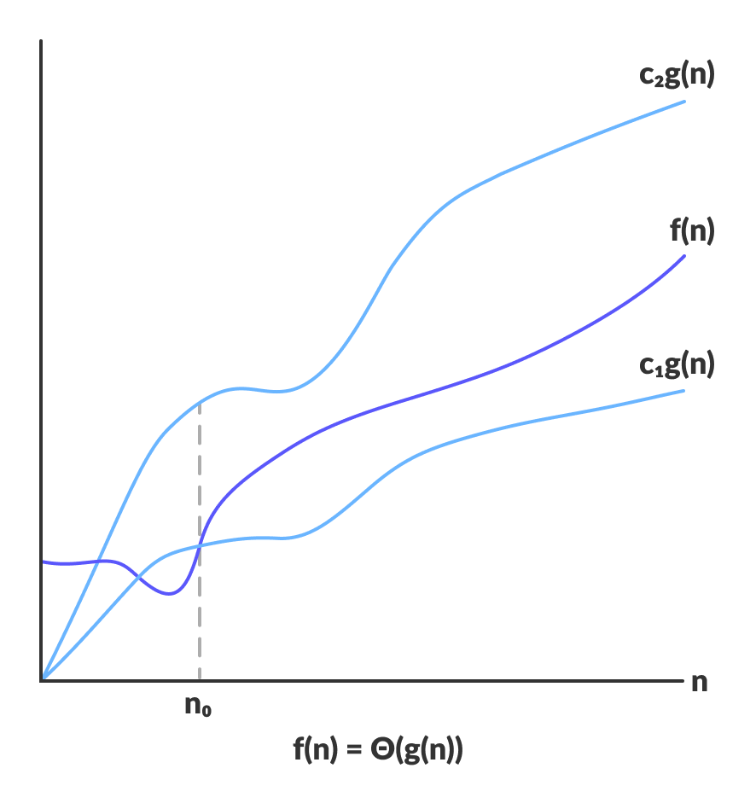
Theta Notation (Θ-notation)
Theta notation encloses the function from above and below. Since it represents the upper and the lower bound of the running time of an algorithm, it is used for analysing the average-case complexity of an algorithm.
Theta bounds the function within constants factors
Θ(g(n)) = { f(n): there exist positive constants c1, c2 and n0 such that 0 ≤ c1g(n) ≤ f(n) ≤ c2g(n) for all n ≥ n0 }
The above expression can be described as a function f(n) belongs to the set Θ(g(n)) if there exist positive constants c1 and c2 such that it can be sandwiched between c1g(n) and c2g(n), for sufficiently large n. If a function f(n) lies anywhere in between c1g(n) and c2g(n) for all n ≥ n0, then f(n) is said to be asymptotically tight bound.

Slide 13
Thanks
Anirudha Gaikwad

