Slide 1
Data Structures
What you learn ?
Array
What is array? | Properties of array –Why array
Memory allocation of array | Basic array operations
Time complexities of array operation | Adv. & Dis. Of array operation

Slide 2
What is array?
Arrays are defined as the collection of similar types of data items stored at contiguous memory locations. It is one of the simplest data structures where each data element can be randomly accessed by using its index number.
In C programming, they are the derived data types that can store the primitive type of data such as int, char, double, float, etc. For example, if we want to store the marks of a student in 6 subjects, then we don't need to define a different variable for the marks in different subjects. Instead, we can define an array that can store the marks in each subject at the contiguous memory locations.

Slide 3
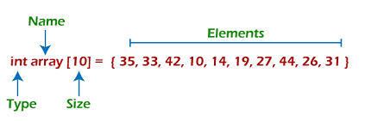
Properties of Array
There are some of the properties of an array that are listed as follows -
Each element in an array is of the same data type and carries the same size that is 4 bytes.
Elements in the array are stored at contiguous memory locations from which the first element is stored at the smallest memory location. Index starts with 0.
Elements of the array can be randomly accessed since we can calculate the address of each element of the array with the given base address and the size of the data element.
Representation of an array

Slide 4
Why array?
Arrays are useful because –
Sorting and searching a value in an array is easier.
Arrays are best to process multiple values quickly and easily.
Arrays are good for storing multiple values in a single variable -
In computer programming, most cases require storing a large number of data of a similar type. To store such an amount of data, we need to define a large number of variables. It would be very difficult to remember the names of all the variables while writing the programs. Instead of naming all the variables with a different name, it is better to define an array and store all the elements into it.

Slide 5
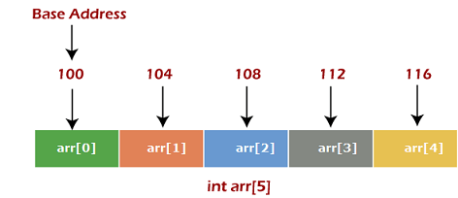
Memory Allocation of Array
As stated above, all the data elements of an array are stored at contiguous locations in the main memory. The name of the array represents the base address or the address of the first element in the main memory. Each element of the array is represented by proper indexing.
We can define the indexing of an array in the below ways -
0 (zero-based indexing): The first element of the array will be arr[0].
1 (one-based indexing): The first element of the array will be arr[1].
n (n - based indexing): The first element of the array can reside at any random index number.

Slide 6
Basic Array Operations
Traversal operation
This operation is performed to traverse through the array elements. It prints all array elements one after another. We can understand it with the below program -
Insertion operation
This operation is performed to insert one or more elements into the array. As per the requirements, an element can be added at the beginning, end, or at any index of the array. Now, let's see the implementation of inserting an element into the array.
Deletion operation
As the name implies, this operation removes an element from the array and then reorganizes all of the array elements.
Search operation
This operation is performed to search an element in the array based on the value or index.
Update operation
This operation is performed to update an existing array element located at the given index.

Slide 7
Complexities of array operations
Operation | Average Case | Worst Case | Operation | Average Case
Access | O(1) | O(1) | Access | O(1)
Search | O(n) | O(n) | Search | O(n)
Insertion | O(n) | O(n) | Insertion | O(n)
Deletion | O(n) | O(n) | Deletion | O(n)

Slide 8
Advantages Of Array
Array provides the single name for the group of variables of the same type. Therefore, it is easy to remember the name of all the elements of an array.
Traversing an array is a very simple process; we just need to increment the base address of the array in order to visit each element one by one.
Any element in the array can be directly accessed by using the index.

Slide 9
Disadvantages Of Array
Array is homogenous. It means that the elements with similar data type can be stored in it.
In array, there is static memory allocation that is size of an array cannot be altered.
There will be wastage of memory if we store less number of elements than the declared size.

Slide 10
Thanks
Anirudha Gaikwad

