Slide 1
Data Structures
What you learn ?
Stack | Expressions
What is stack? | Standard stack operations
Applications of stack | Array implementation of stack
Linked list implementation of stack

Slide 2
What is stack
A Stack is a linear data structure that follows the LIFO (Last-In-First-Out) principle. Stack has one end, whereas the Queue has two ends (front and rear). It contains only one pointer top pointer pointing to the topmost element of the stack. Whenever an element is added in the stack, it is added on the top of the stack, and the element can be deleted only from the stack. In other words, a stack can be defined as a container in which insertion and deletion can be done from the one end known as the top of the stack.
It is a data structure that follows some order to insert and delete the elements, and that order can be LIFO or FILO.

Slide 3
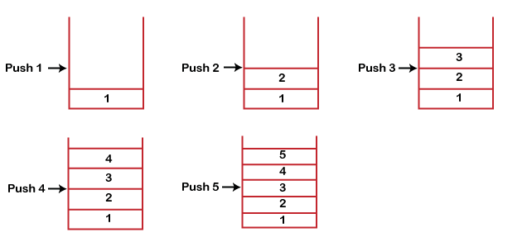
Working of stack
Stack works on the LIFO pattern. As we can observe in the below figure there are five memory blocks in the stack; therefore, the size of the stack is 5.
Suppose we want to store the elements in a stack and let's assume that stack is empty. We have taken the stack of size 5 as shown below in which we are pushing the elements one by one until the stack becomes full.

Slide 4
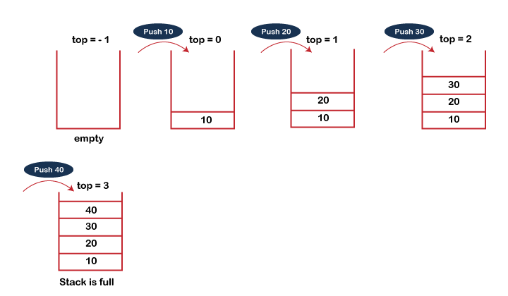
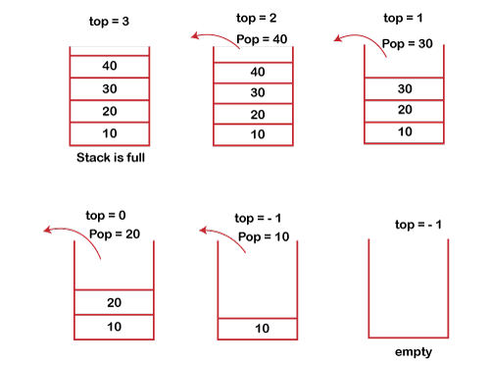
Standard stack operations
push(): When we insert an element in a stack then the operation is known as a push. If the stack is full then the overflow condition occurs.
pop(): When we delete an element from the stack, the operation is known as a pop. If the stack is empty means that no element exists in the stack, this state is known as an underflow state.

Slide 5
Standard stack operations
isEmpty(): It determines whether the stack is empty or not.
isFull(): It determines whether the stack is full or not.'
peek(): It returns the element at the given position.
count(): It returns the total number of elements available in a stack.
change(): It changes the element at the given position.
display(): It prints all the elements available in the stack.

Slide 6
Applications of stack
Balancing of braces in expression
Undo / Redo
Recursion
Depth first search
Backtracking
Expression conversion
Memory Management

Slide 7
Array implementation of stack
In array implementation, the stack is formed by using the array. All the operations regarding the stack are performed using arrays.
Adding an element into the stack-
Adding an element into the top of the stack is referred to as push operation. Push operation involves following two steps-
Increment the variable Top so that it can now refer to the next memory location.
2.Add element at the position of incremented top. This is referred to as adding new element at the top of the stack.
Stack is overflown when we try to insert an element into a completely filled stack therefore, our main function must always avoid stack overflow condition.
Time Complexity is = O(1)

Slide 8
Array implementation of stack
Deletion of an element from the stack-
Deletion of an element from the top of the stack is called pop operation. The value of the variable top will be incremented by 1 whenever an item is deleted from the stack. The top most element of the stack is stored in an another variable and then the top is decremented by 1. the operation returns the deleted value that was stored in another variable as the result.
Time Complexity is = O(1)
Visiting each element of the stack-
Peek operation involves returning the element which is present at the top of the stack without deleting it. Underflow condition can occur if we try to return the top element in an already empty stack.
Time Complexity is = O(n)

Slide 9
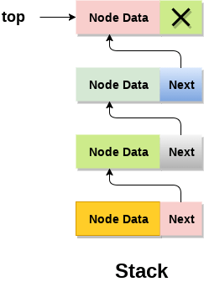
Linked List implementation of stack
Instead of using array, we can also use linked list to implement stack. Linked list allocates the memory dynamically. However, time complexity in both the scenario is same for all the operations i.e. push, pop and peek.

Slide 10
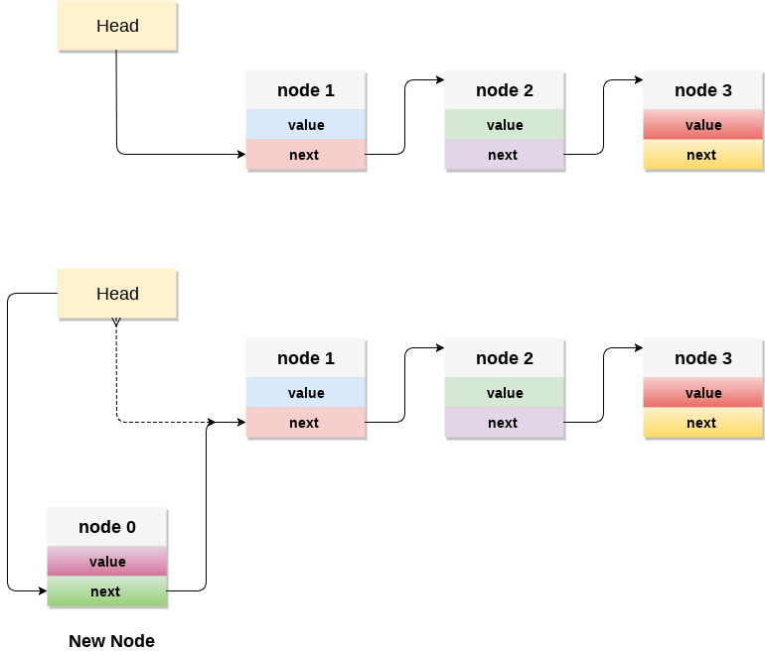
Linked List implementation of stack
Adding node into the stack-
Adding a node into the top of the stack is referred to as push operation.
Create a node first and allocate memory to it.
If the list is empty then the item is to be pushed as the start node of the list. This includes assigning value to the data part of the node and assign null to the address part of the node.
If there are some nodes in the list already, then we have to add the new element in the beginning of the list, assign the address of the starting element to the address field of the new node and make the new node, the starting node of the list.
Time Complexity is = O(1)

Slide 11
Linked List implementation of stack
Deletion of a node from the stack-
Deleting a node from the top of stack is referred to as pop operation. Deleting a node from the linked list implementation of stack is different from that in the array implementation. In order to pop an element from the stack, we need to follow the following steps :
Check for the underflow condition: The underflow condition occurs when we try to pop from an already empty stack. The stack will be empty if the head pointer of the list points to null.
Adjust the head pointer accordingly: In stack, the elements are popped only from one end, therefore, the value stored in the head pointer must be deleted and the node must be freed. The next node of the head node now becomes the head node.

Slide 12
Linked List implementation of stack
Display the nodes (Traversing):
Displaying all the nodes of a stack needs traversing all the nodes of the linked list organized in the form of stack. For this purpose, we need to follow the following steps.
Copy the head pointer into a temporary pointer.
Move the temporary pointer through all the nodes of the list and print the value field attached to every node.
Time Complexity is = O(n)

Slide 13
Thanks
Anirudha Gaikwad

