Slide 1
Data Structures
What you learn ?
Queue | Expressions
What is Queue? | Applications of Queue
Types of Queue | Operations Performed on Queue
Array representation of Queue | Linked List representation of Queue

Slide 2
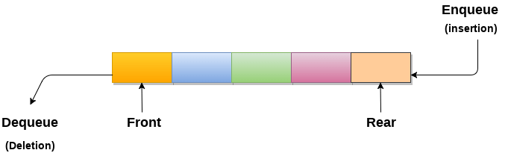
What is Queue ?
A queue can be defined as an ordered list which enables insert operations to be performed at one end called REAR and delete operations to be performed at another end called FRONT.
Queue is referred to be as First In First Out list.
For example, people waiting in line for a rail ticket form a queue.

Slide 3
Applications of Queue
Queues are widely used as waiting lists for a single shared resource like printer, disk, CPU.
Queues are used in asynchronous transfer of data (where data is not being transferred at the same rate between two processes) for eg. pipes, file IO, sockets.
Queues are used as buffers in most of the applications like MP3 media player, CD player, etc.
Queue are used to maintain the play list in media players in order to add and remove the songs from the play-list.
Queues are used in operating systems for handling interrupts.

Slide 4
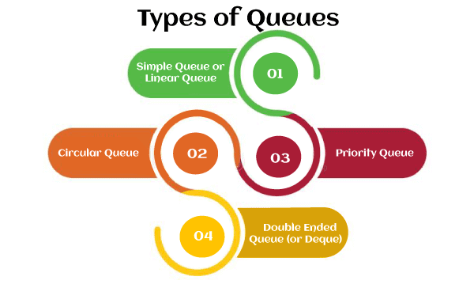
Types of Queue

Slide 5
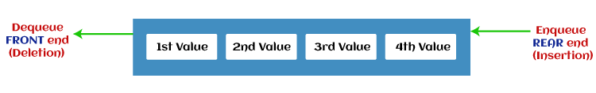
Types of Queue
Simple Queue or Linear Queue
In Linear Queue, an insertion takes place from one end while the deletion occurs from another end. The end at which the insertion takes place is known as the rear end, and the end at which the deletion takes place is known as front end. It strictly follows the FIFO rule.
The major drawback of using a linear Queue is that insertion is done only from the rear end. If the first three elements are deleted from the Queue, we cannot insert more elements even though the space is available in a Linear Queue. In this case, the linear Queue shows the overflow condition as the rear is pointing to the last element of the Queue.

Slide 6
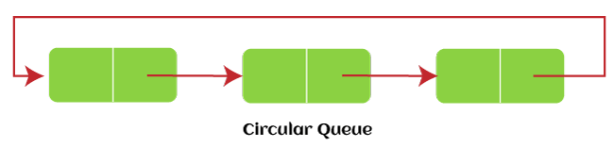
Types of Queue
Circular Queue
In Circular Queue, all the nodes are represented as circular. It is similar to the linear Queue except that the last element of the queue is connected to the first element. It is also known as Ring Buffer, as all the ends are connected to another end. The representation of circular queue is shown in the below image -
The drawback that occurs in a linear queue is overcome by using the circular queue. If the empty space is available in a circular queue, the new element can be added in an empty space by simply incrementing the value of rear. The main advantage of using the circular queue is better memory utilization.

Slide 7
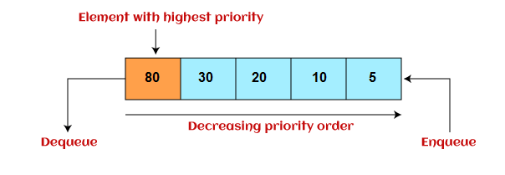
Types of Queue
Priority Queue
It is a special type of queue in which the elements are arranged based on the priority. Every element has a priority associated with it. Suppose some elements occur with the same priority, they will be arranged according to the FIFO principle.
Insertion in priority queue takes place based on the arrival, while deletion in the priority queue occurs based on the priority. Priority queue is mainly used to implement the CPU scheduling algorithms.
There are two types of priority queue that are Ascending Priority Queue and Descending Priority Queue.

Slide 8
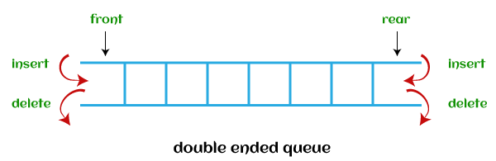
Types of Queue
Deque(Double Ended Queue)
In Deque or Double Ended Queue, insertion and deletion can be done from both ends of the queue either from the front or rear. It means that we can insert and delete elements from both front and rear ends of the queue so, Deque does not follow the FIFO principle.
There are two types of deque that are discussed as follows -
Input restricted deque - Insertion operation can be performed at only one end, while deletion can be performed from both ends.
Output restricted deque – Deletion operation can be performed at only one end, while insertion can be performed from both ends.

Slide 9
Operations Performed on Queue
Enqueue: The Enqueue operation is used to insert the element at the rear end of the queue. It returns void.
Dequeue: It performs the deletion from the front-end of the queue. It also returns the element which has been removed from the front-end. It returns an integer value.
Peek: This is the third operation that returns the element, which is pointed by the front pointer in the queue but does not delete it.
Queue overflow (isfull): It shows the overflow condition when the queue is completely full.
Queue underflow (isempty): It shows the underflow condition when the Queue is empty, i.e., no elements are in the Queue.

Slide 10
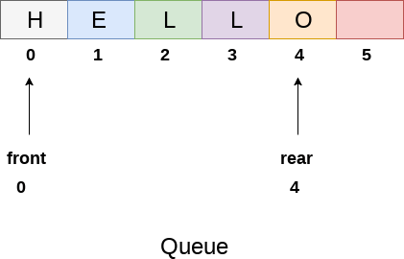
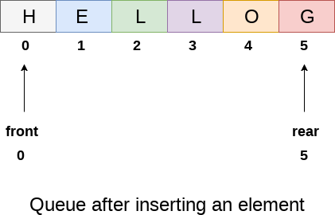
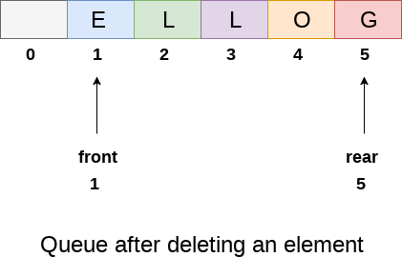
Array representation of Queue
We can easily represent queue by using linear arrays. There are two variables i.e. front and rear, that are implemented in the case of every queue. Front and rear variables point to the position from where insertions and deletions are performed in a queue. Initially, the value of front and queue is -1 which represents an empty queue. Array representation of a queue containing 5 elements along with the respective values of front and rear, is shown in the following figure.

Slide 11
Array representation of Queue
Drawbacks:
Memory wastage : The space of the array, which is used to store queue elements, can never be reused to store the elements of that queue because the elements can only be inserted at front end and the value of front might be so high so that, all the space before that, can never be filled
Deciding the array size: On of the most common problem with array implementation is the size of the array which requires to be declared in advance. we can declare the array large enough so that we can store queue elements as enough as possible but the main problem with this declaration is that, most of the array slots (nearly half) can never be reused. It will again lead to memory wastage.

Slide 12
Linked List representation of Queue
One of the alternative of array implementation is linked list implementation of queue.
The storage requirement of linked representation of a queue with n elements is o(n) while the time requirement for operations is o(1).
In a linked queue, each node of the queue consists of two parts i.e. data part and the link part. Each element of the queue points to its immediate next element in the memory.
In the linked queue, there are two pointers maintained in the memory i.e. front pointer and rear pointer. The front pointer contains the address of the starting element of the queue while the rear pointer contains the address of the last element of the queue.

Slide 13
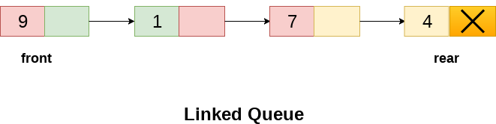
Linked List representation of Queue
Insertion and deletions are performed at rear and front end respectively.
If front and rear both are NULL, it indicates that the queue is empty.
The linked representation of queue is shown in the following figure.

Slide 14
Thanks
Anirudha Gaikwad

