Slide 1
Data Structures
What you learn ?
Tree | Expressions
What is tree? | Basic terms used in tree
Properties of tree | Implementation of tree
Applications of tree | Types of tree
Tree traversal

Slide 2
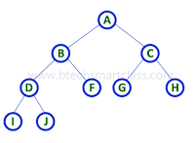
What is Tree?
A tree data structure is defined as a collection of objects or entities known as nodes that are linked together to represent or simulate hierarchy.
A tree data structure is a non-linear data structure because it does not store in a sequential manner. It is a hierarchical structure as elements in a Tree are arranged in multiple levels.
In the Tree data structure, the topmost node is known as a root node. Each node contains some data, and data can be of any type. In the above tree structure, the node contains the name of the employee, so the type of data would be a string.
Each node contains some data and the link or reference of other nodes that can be called children.

Slide 3
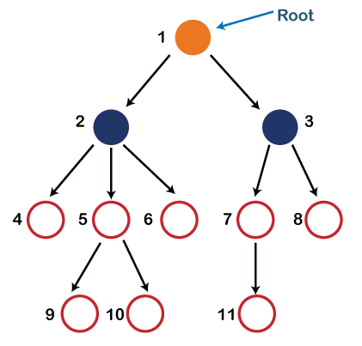
Basic terms used in Tree
In the above structure, each node is labeled with some number. Each arrow shown in the figure is known as a link between the two nodes.
Root: The root node is the topmost node in the tree hierarchy. In other words, the root node is the one that doesn't have any parent. In the above structure, node numbered 1 is the root node of the tree. If a node is directly linked to some other node, it would be called a parent-child relationship.
Child node: If the node is a descendant of any node, then the node is known as a child node.
Parent: If the node contains any sub-node, then that node is said to be the parent of that sub-node.

Slide 4
Basic terms used in Tree
Sibling: The nodes that have the same parent are known as siblings.
Leaf Node:- The node of the tree, which doesn't have any child node, is called a leaf node. A leaf node is the bottom-most node of the tree.
Internal nodes: A node has at least one child node known as an internal
Ancestor node:- An ancestor of a node is any predecessor node on a path from the root to that node. The root node doesn't have any ancestors. In the tree shown in the above image, nodes 1, 2, and 5 are the ancestors of node 10.
Descendant: The immediate successor of the given node is known as a descendant of a node. In the above figure, 10 is the descendant of node 5.

Slide 5
Properties of Tree
Recursive Data Structure: A tree is a recursive data structure because it has a root node, and every node has zero or more child nodes. The root node is the topmost node in the tree, and the child nodes are located below the root node. If each node in the tree has zero or more child nodes, then the tree is said to be an n-ary tree.
Number of Edges: The number of edges in a tree is always one less than the number of nodes. This is because there is always one fewer edge than there are nodes in any given path from the root to any leaf node.
Depth of Node x: The depth of a node is defined as the length of the shortest path from the root to that node. In other words, it is simply the number of edges on the path from the root to that particular node.
Height of Node x: The height of a node is expressed as the length of the longest path from the node to any leaf node. In other words, it is simply the number of edges on the path from that particular node to the deepest leaf node.

Slide 6
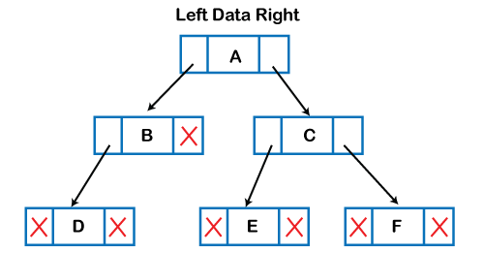
Implementation of Tree
The tree data structure can be created by creating the nodes dynamically with the help of the pointers. The tree in the memory can be represented as shown below:
The above figure shows the representation of the tree data structure in the memory. In the above structure, the node contains three fields. The second field stores the data; the first field stores the address of the left child, and the third field stores the address of the right child.

Slide 7
Applications of Tree
Storing naturally hierarchical data: Trees are used to store the data in the hierarchical structure. For example, the file system. The file system stored on the disc drive, the file and folder are in the form of the naturally hierarchical data and stored in the form of trees.
Organize data: It is used to organize data for efficient insertion, deletion and searching. For example, a binary tree has a logN time for searching an element.
Trie: It is a special kind of tree that is used to store the dictionary. It is a fast and efficient way for dynamic spell checking.
Heap: It is also a tree data structure implemented using arrays. It is used to implement priority queues.
B-Tree and B+Tree: B-Tree and B+Tree are the tree data structures used to implement indexing in databases.
Routing table: The tree data structure is also used to store the data in routing tables in the routers.

Slide 8
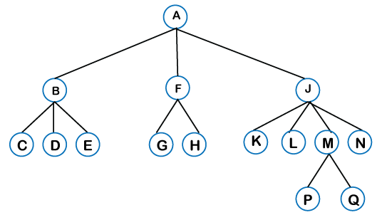
Types of Tree
General tree: The general tree is one of the types of tree data structure. In the general tree, a node can have either 0 or maximum n number of nodes. There is no restriction imposed on the degree of the node (the number of nodes that a node can contain). The topmost node in a general tree is known as a root node. The children of the parent node are known as subtrees.

Slide 9
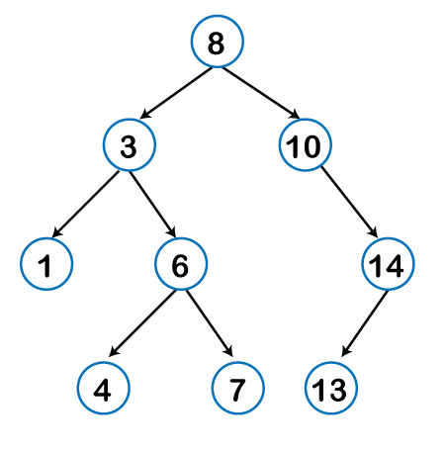
Types of Tree
Binary tree: Here, binary name itself suggests two numbers, i.e., 0 and 1. In a binary tree, each node in a tree can have utmost two child nodes. Here, utmost means whether the node has 0 nodes, 1 node or 2 nodes.

Slide 10
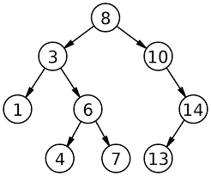
Types of Tree
Binary Search tree: Binary Search Tree (BST) is a binary tree extension with several optional restrictions. The left child value of a node should in BST be less than or equal to the parent value, and the right child value should always be greater than or equal to the parent’s value. This Binary Search Tree property makes it ideal for search operations since we can accurately determine at each node whether the value is in the left or right sub-tree.

Slide 11
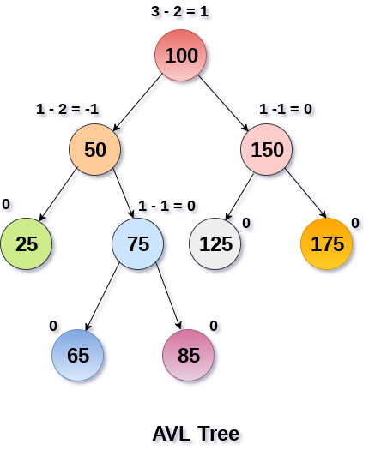
Types of Tree
AVL tree: AVL tree satisfies the property of the binary tree as well as of the binary search tree. It is a self-balancing binary search tree that was invented by Adelson Velsky Lindas. Here, self-balancing means that balancing the heights of left subtree and right subtree. This balancing is measured in terms of the balancing factor. The balancing factor can be defined as the difference between the height of the left subtree and the height of the right subtree. The balancing factor's value must be either 0, -1, or 1; therefore, each node in the AVL tree should have the value of the balancing factor either as 0, -1, or 1.

Slide 12
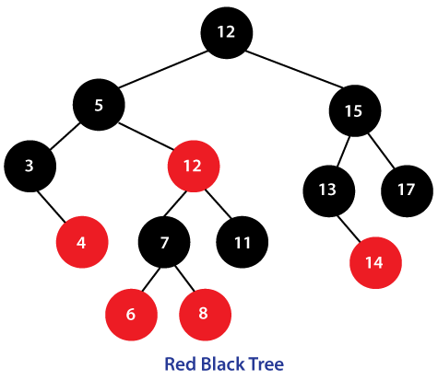
Types of Tree
Red Black Tree: The red-black tree is a self-balancing binary search tree. AVL tree is also a height balancing binary search tree then why do we require a Red-Black tree. In the AVL tree, we do not know how many rotations would be required to balance the tree, but in the Red-black tree, a maximum of 2 rotations are required to balance the tree. It contains one extra bit that represents either the red or black colour of a node to ensure the balancing of the tree.

Slide 13
Tree Traversal
Traversal is a process to visit all the nodes of a tree and may print their values too. Because, all nodes are connected via edges (links) we always start from the root (head) node. That is, we cannot randomly access a node in a tree. There are three ways which we use to traverse a tree −
In-order Traversal
Pre-order Traversal
Post-order Traversal
Generally, we traverse a tree to search or locate a given item or key in the tree or to print all the values it contains.

Slide 14
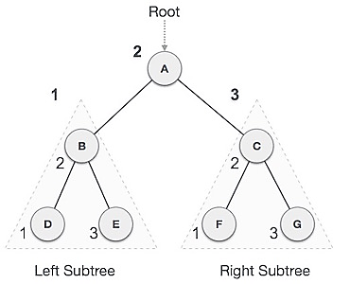
Tree Traversal
Inorder Traversal :
In this traversal method, the left subtree is visited first, then the root and later the right sub-tree. We should always remember that every node may represent a subtree itself.
If a binary tree is traversed in-order, the output will produce sorted key values in an ascending order.
The output of inorder traversal of this tree will be −
D → B → E → A → F → C → G
Algorithm-
Until all nodes are traversed −
Step 1 − Recursively traverse left subtree.
Step 2 − Visit root node.
Step 3 − Recursively traverse right subtree.

Slide 15
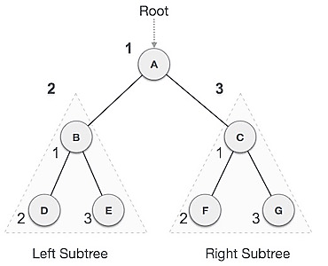
Tree Traversal
Preorder Traversal :
In this traversal method, the root node is visited first, then the left subtree and finally the right subtree.
The output of pre-order traversal of this tree will be −
A → B → D → E → C → F → G
Algorithm-
Until all nodes are traversed −
Step 1 − Visit root node.
Step 2 − Recursively traverse left subtree.
Step 3 − Recursively traverse right subtree.

Slide 16
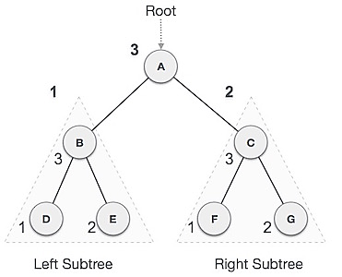
Tree Traversal
Postorder Traversal :
In this traversal method, the root node is visited last, hence the name. First we traverse the left subtree, then the right subtree and finally the root node.The output of pre-order traversal of this tree will be −
D → E → B → F → G → C → A
Algorithm-
Until all nodes are traversed −
Step 1 − Recursively traverse left subtree.
Step 2 − Recursively traverse right subtree.
Step 3 − Visit root node.

Slide 17
Thanks
Anirudha Gaikwad

