Slide 1
Data Structures
What you learn ?
Graph | Expressions
What is Graph? | Directed & Undirected Graph
Graph Terminology | Graph implementation
BFS Algorithm | DFS Algorithm
Spanning Tree

Slide 2
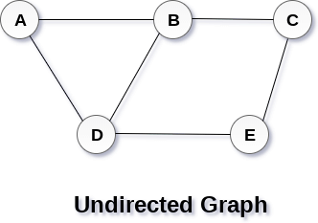
What is Graph?
A graph can be defined as group of vertices and edges that are used to connect these vertices. A graph can be seen as a cyclic tree, where the vertices (Nodes) maintain any complex relationship among them instead of having parent child relationship.
A graph G can be defined as an ordered set G(V, E) where V(G) represents the set of vertices and E(G) represents the set of edges which are used to connect these vertices.
A Graph G(V, E) with 5 vertices (A, B, C, D, E) and six edges ((A,B), (B,C), (C,E), (E,D), (D,B), (D,A)) is shown in the following figure.

Slide 3
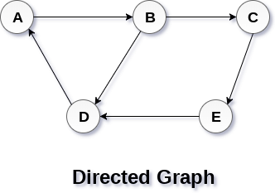
Directed & Undirected Graph
In a directed graph, edges form an ordered pair. Edges represent a specific path from some vertex A to another vertex B. Node A is called initial node while node B is called terminal node.
In an undirected graph, edges are not associated with the directions with them. If an edge exists between vertex A and B then the vertices can be traversed from B to A as well as A to B.

Slide 4
Graph Terminology
Path
A path can be defined as the sequence of nodes that are followed in order to reach some terminal node V from the initial node U.
Closed Path
A path will be called as closed path if the initial node is same as terminal node. A path will be closed path if V₀=V_{N}.
Simple Path
If all the nodes of the graph are distinct with an exception V₀=V_{N}, then such path P is called as closed simple path.

Slide 5
Graph Terminology
Cycle
A cycle can be defined as the path which has no repeated edges or vertices except the first and last vertices.
Connected Graph
A connected graph is the one in which some path exists between every two vertices (u, v) in V. There are no isolated nodes in connected graph.
Complete Graph
A complete graph is the one in which every node is connected with all other nodes. A complete graph contain n(n-1)/2 edges where n is the number of nodes in the graph.

Slide 6
Graph Terminology
Weighted Graph
In a weighted graph, each edge is assigned with some data such as length or weight. The weight of an edge e can be given as w(e) which must be a positive (+) value indicating the cost of traversing the edge.
Digraph
A digraph is a directed graph in which each edge of the graph is associated with some direction and the traversing can be done only in the specified direction.
Loop
An edge that is associated with the similar end points can be called as Loop.

Slide 7
Graph Terminology
Adjacent Nodes
If two nodes u and v are connected via an edge e, then the nodes u and v are called as neighbours or adjacent nodes.
Degree of the Node
A degree of a node is the number of edges that are connected with that node. A node with degree 0 is called as isolated node.

Slide 8
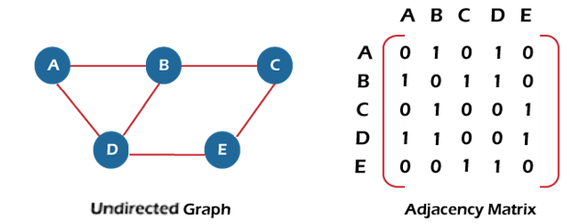
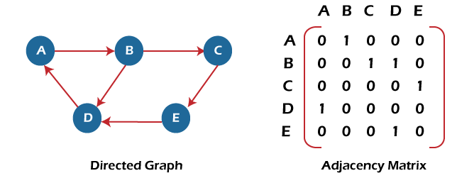

Graph Representation
There are two ways to store Graphs into the computer's memory:
Sequential representation (or, Adjacency matrix representation)
Linked list representation (or, Adjacency list representation)
Sequential representation:
In sequential representation, there is a use of an adjacency matrix to represent the mapping between vertices and edges of the graph. We can use an adjacency matrix to represent the undirected graph, directed graph, weighted directed graph, and weighted undirected graph.

Slide 9
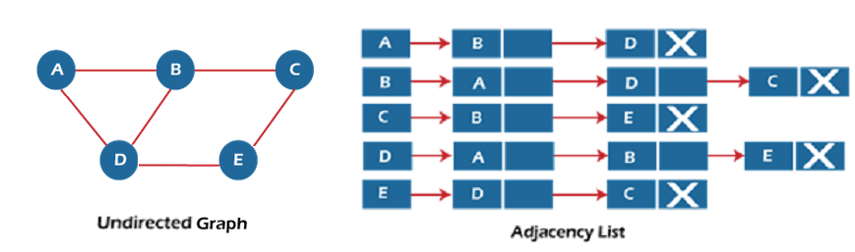
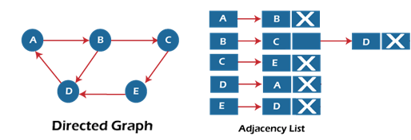
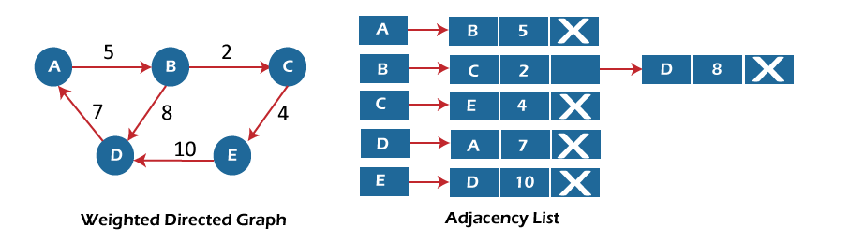
Graph Representation
Linked list representation:
An adjacency list is used in the linked representation to store the Graph in the computer's memory. It is efficient in terms of storage as we only have to store the values for edges.

Slide 10
BFS Algorithm
BFS is an algorithm that is used to graph data or searching tree or traversing structures. The algorithm efficiently visits and marks all the key nodes in a graph in an accurate breadthwise fashion.
This algorithm selects a single node (initial or source point) in a graph and then visits all the nodes adjacent to the selected node. Once the algorithm visits and marks the starting node, then it moves towards the nearest unvisited nodes and analyses them.
Once visited, all nodes are marked. These iterations continue until all the nodes of the graph have been successfully visited and marked. The full form of BFS is the Breadth-first search.

Slide 11
BFS Algorithm
Step 1: SET STATUS = 1 (ready state) for each node in G
Step 2: Enqueue the starting node A and set its STATUS = 2 (waiting state)
Step 3: Repeat Steps 4 and 5 until QUEUE is empty
Step 4: Dequeue a node N. Process it and set its STATUS = 3 (processed state).
Step 5: Enqueue all the neighbours of N that are in the ready state (whose STATUS = 1) and set their STATUS = 2(waiting state)
[END OF LOOP]
Step 5: Exit

Slide 12
DFS Algorithm
DFS is an algorithm for finding or traversing graphs or trees in depth-ward direction. The execution of the algorithm begins at the root node and explores each branch before backtracking. It uses a stack data structure to remember, to get the subsequent vertex, and to start a search, whenever a dead-end appears in any iteration. The full form of DFS is Depth-first search.

Slide 13
DFS Algorithm
Step 1: SET STATUS = 1 (ready state) for each node in G
Step 2: Push the starting node A on the stack and set its STATUS = 2 (waiting state)
Step 3: Repeat Steps 4 and 5 until STACK is empty
Step 4: Pop the top node N. Process it and set its STATUS = 3 (processed state)
Step 5: Push on the stack all the neighbours of N that are in the ready state (whose STATUS = 1) and set their STATUS = 2 (waiting state)
[END OF LOOP]
Step 6: EXIT

Slide 14
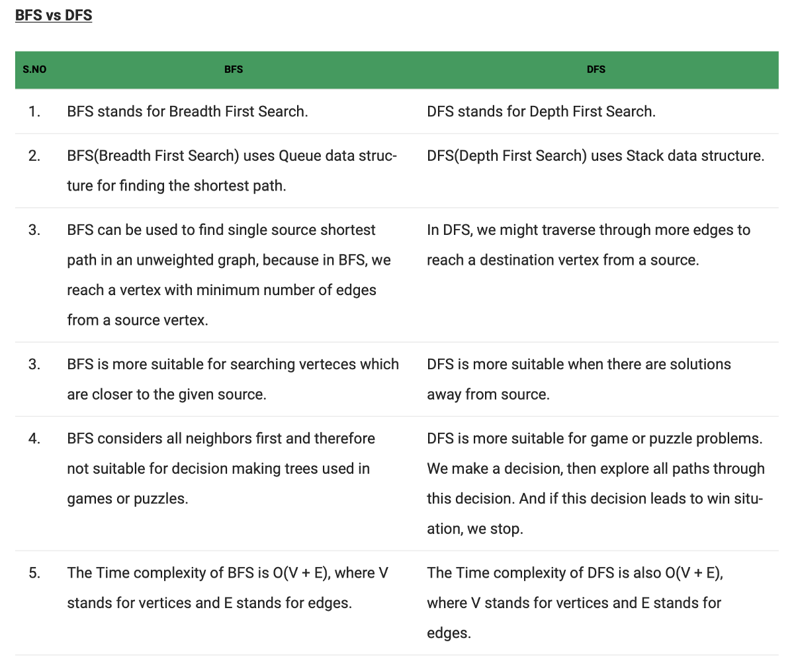
BFS VS DFS

Slide 15
Spanning Tree
A spanning tree can be defined as the subgraph of an undirected connected graph. It includes all the vertices along with the least possible number of edges. If any vertex is missed, it is not a spanning tree. A spanning tree is a subset of the graph that does not have cycles, and it also cannot be disconnected.
A spanning tree consists of (n-1) edges, where 'n' is the number of vertices (or nodes). Edges of the spanning tree may or may not have weights assigned to them. All the possible spanning trees created from the given graph G would have the same number of vertices, but the number of edges in the spanning tree would be equal to the number of vertices in the given graph minus 1.

Slide 16
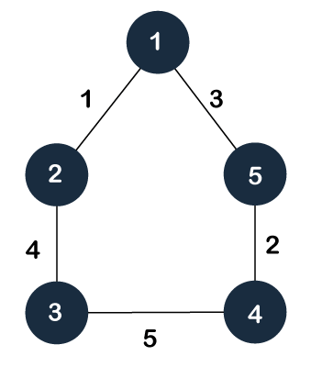
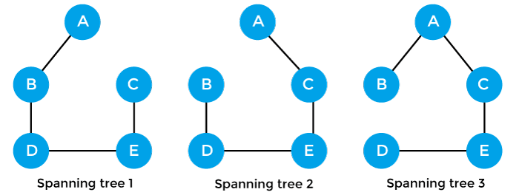
Spanning Tree
Example of Spanning tree
Suppose the graph be -
Some of the possible spanning trees that will be created from the above graph are -

Slide 17
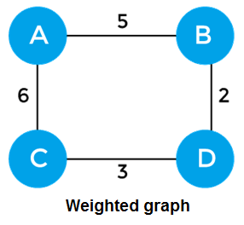
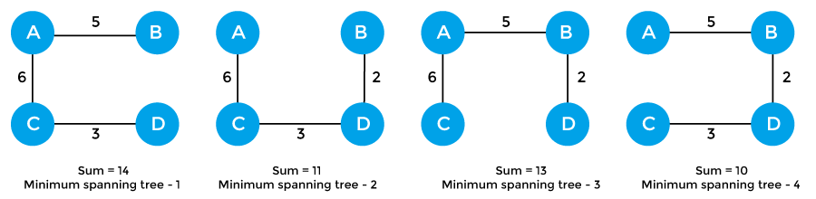
Spanning Tree
Minimum Spanning tree
A minimum spanning tree can be defined as the spanning tree in which the sum of the weights of the edge is minimum. The weight of the spanning tree is the sum of the weights given to the edges of the spanning tree. In the real world, this weight can be considered as the distance, traffic load, congestion, or any random value.
Example of minimum spanning tree:

Slide 18
Algorithms for Minimal Spanning Tree
Algorithms for Minimum spanning tree
A minimum spanning tree can be found from a weighted graph by using the algorithms given below –
Prim's algorithm - It is a greedy algorithm that starts with an empty spanning tree. It is used to find the minimum spanning tree from the graph. This algorithm finds the subset of edges that includes every vertex of the graph such that the sum of the weights of the edges can be minimized.
Kruskal's algorithm - This algorithm is also used to find the minimum spanning tree for a connected weighted graph. Kruskal's algorithm also follows greedy approach, which finds an optimum solution at every stage instead of focusing on a global optimum.

Slide 19
Thanks
Anirudha Gaikwad

