Slide 1
Data Structures
What you learn ?
Sorting | Expressions
Bubble Sort | Selection Sort
Insertion Sort | Merge Sort
Quick Sort | Radix Sort
Heap Sort | Shell Sort

Slide 2
Bubble Sort
Bubble sort is a sorting algorithm that compares two adjacent elements and swaps them until they are in the intended order.
Just like the movement of air bubbles in the water that rise up to the surface, each element of the array move to the end in each iteration. Therefore, it is called a bubble sort.
Time Complexity
Best | O(n)
Worst | O(n²)
Average | O(n²)
Space Complexity | O(1)
Stability | Yes

Slide 3
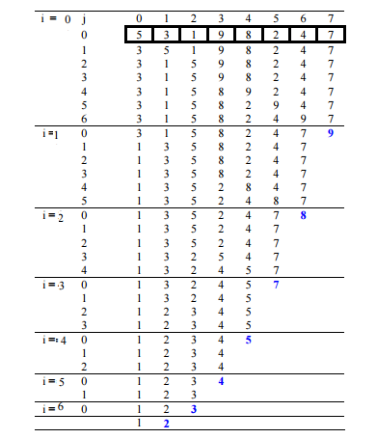
Bubble Sort
Example:

Slide 4
Bubble Sort
Algorithm:
begin BubbleSort(list)
for all elements of list
if list[i] > list[i+1]
swap(list[i], list[i+1])
end if
end for
return list
end BubbleSort

Slide 5
Selection Sort
Selection sort is a sorting algorithm that selects the smallest element from an unsorted list in each iteration and places that element at the beginning of the unsorted list.
Time Complexity
Best | O(n²)
Worst | O(n²)
Average | O(n²)
Space Complexity | O(1)
Stability | No

Slide 6
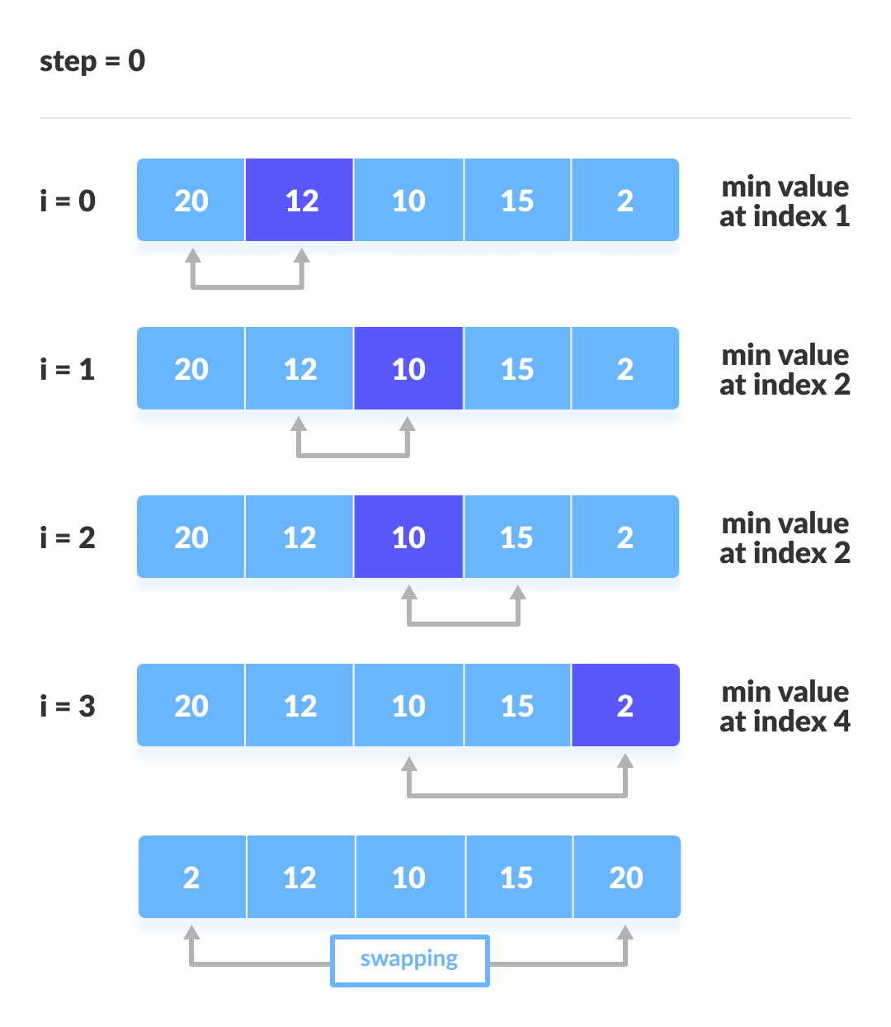
Selection Sort
Example:

Slide 7
Selection Sort
Algorithm:
selectionSort(array, size)
repeat (size - 1) times
set the first unsorted element as the minimum
for each of the unsorted elements
If element < currentMinimum
set element as new minimum
swap minimum with first unsorted position
end selectionSort

Slide 8
Insertion Sort
Insertion sort is a sorting algorithm that places an unsorted element at its suitable place in each iteration. Insertion sort works similarly as we sort cards in our hand in a card game
Time Complexity
Best | O(n)
Worst | O(n²)
Average | O(n²)
Space Complexity | O(1)
Stability | Yes

Slide 9
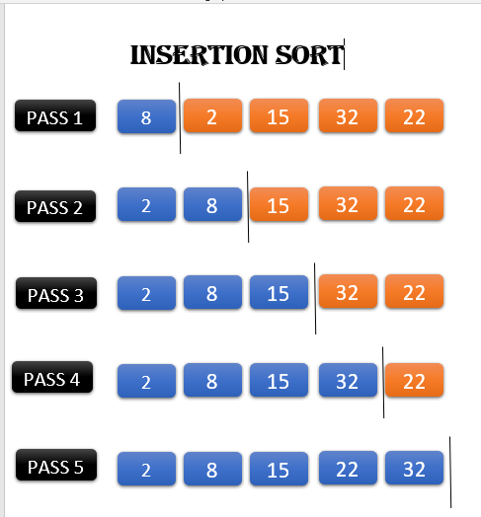
Insertion Sort
Example:

Slide 10
Insertion Sort
Algorithm:
insertionSort(array)
mark first element as sorted
for each unsorted element X
'extract' the element X
for j <- lastSortedIndex down to 0
if current element j > X
move sorted element to the right by 1
break loop and insert X here
end insertionSort

Slide 11
Merge Sort
Merge Sort is one of the most popular sorting algorithms that is based on the principle of Divide and Conquer Algorithm. Here, a problem is divided into multiple sub-problems. Each sub-problem is solved individually. Finally, sub-problems are combined to form the final solution.
Time Complexity
Best | O(n*log n)
Worst | O(n*log n)
Average | O(n*log n)
Space Complexity | O(n)
Stability | Yes

Slide 12
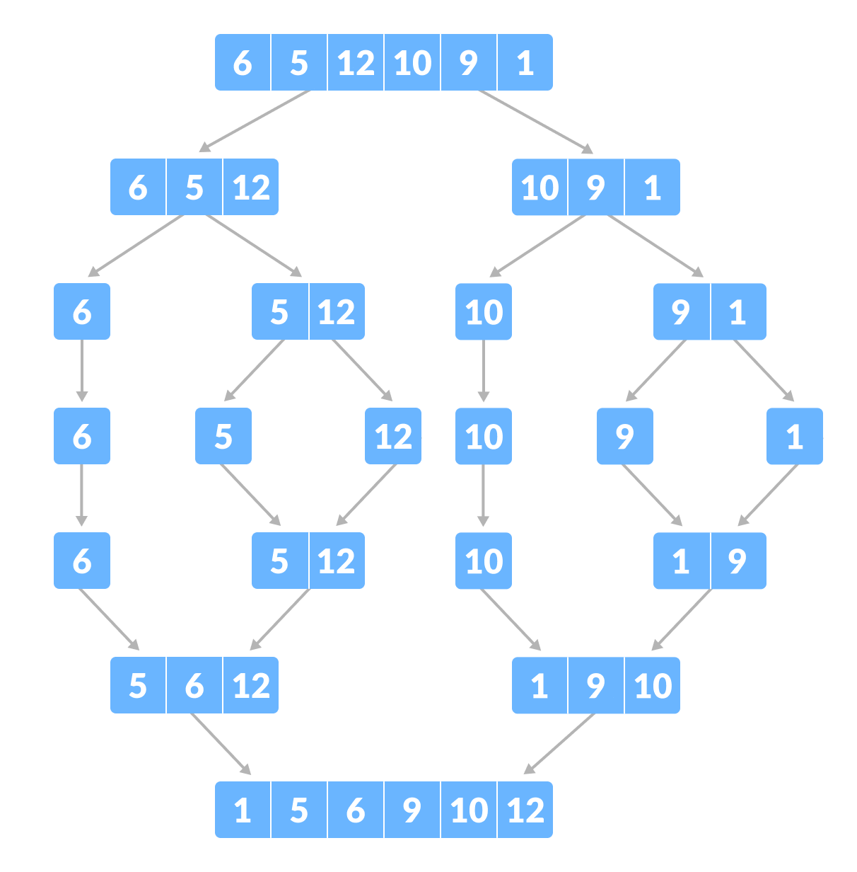
Merge Sort
Example:

Slide 13
Merge Sort
Algorithm:
MERGE_SORT(arr, beg, end)
if beg < end
set mid = (beg + end)/2
MERGE_SORT(arr, beg, mid)
MERGE_SORT(arr, mid + 1, end)
MERGE (arr, beg, mid, end)
end of if
END MERGE_SORT

Slide 14
Quick Sort
Quicksort is a sorting algorithm based on the divide and conquer approach where
An array is divided into subarrays by selecting a pivot element (element selected from the array).
While dividing the array, the pivot element should be positioned in such a way that elements less than pivot are kept on the left side and elements greater than pivot are on the right side of the pivot.
Time Complexity
Best | O(n*log n)
Worst | O(n²)
Average | O(n*log n)
Space Complexity | O(log n)
Stability | No

Slide 15
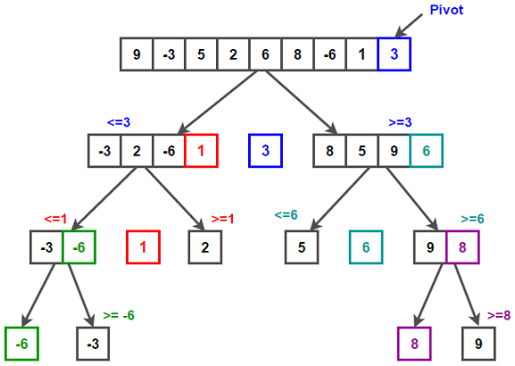
Quick Sort
Example:

Slide 16
Quick Sort
Algorithm:
quickSort(array, leftmostIndex, rightmostIndex)
if (leftmostIndex < rightmostIndex)
pivotIndex <- partition(array,leftmostIndex, rightmostIndex)
quickSort(array, leftmostIndex, pivotIndex - 1)
quickSort(array, pivotIndex, rightmostIndex)
partition(array, leftmostIndex, rightmostIndex)
set rightmostIndex as pivotIndex
storeIndex <- leftmostIndex - 1
for i <- leftmostIndex + 1 to rightmostIndex
if element[i] < pivotElement
swap element[i] and element[storeIndex]
storeIndex++
swap pivotElement and element[storeIndex+1]
return storeIndex + 1

Slide 17
Radix Sort
Radix sort is a sorting algorithm that sorts the elements by first grouping the individual digits of the same place value. Then, sort the elements according to their increasing/decreasing order.
Time Complexity
Best | O(n+k)
Worst | O(n+k)
Average | O(n+k)
Space Complexity | O(max)
Stability | Yes

Slide 18
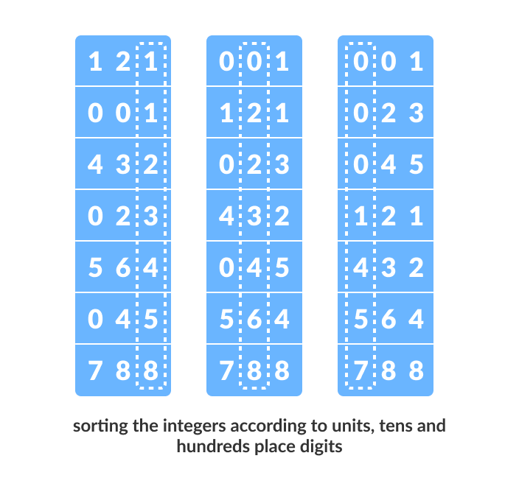
Radix Sort
Example:

Slide 19
Radix Sort
Algorithm:
radixSort(array)
d <- maximum number of digits in the largest element
create d buckets of size 0-9
for i <- 0 to d
sort the elements according to ith place digits using countingSort
countingSort(array, d)
max <- find largest element among dth place elements
initialize count array with all zeros
for j <- 0 to size
find the total count of each unique digit in dth place of elements and
store the count at jth index in count array
for i <- 1 to max
find the cumulative sum and store it in count array itself
for j <- size down to 1
restore the elements to array
decrease count of each element restored by 1

Slide 20
Heap Sort
Heap sort processes the elements by creating the min-heap or max-heap using the elements of the given array. Min-heap or max-heap represents the ordering of array in which the root element represents the minimum or maximum element of the array.
Heap sort basically recursively performs two main operations -
Build a heap H, using the elements of array.
Repeatedly delete the root element of the heap formed in 1st phase.
Time Complexity
Best | O(nlog n)
Worst | O(nlog n)
Average | O(nlog n)
Space Complexity | O(1)
Stability | No

Slide 21
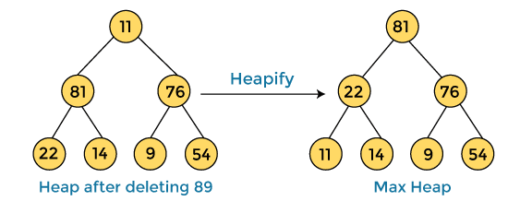


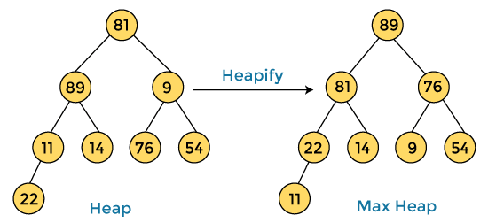

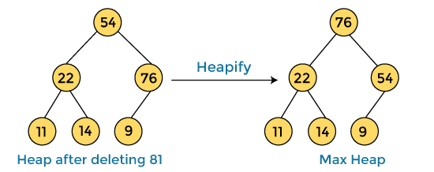
Heap Sort
Example:
After swapping the array element 89 with 11, and converting the heap into max-heap, the elements of array are -
First, we have to construct a heap from the given array and convert it into max heap.
In the next step, again, we have to delete the root element (81) from the max heap. To delete this node, we have to swap it with the last node, i.e. (54). After deleting the root element, we again have to heapify it to convert it into max heap.
After converting the given heap into max heap, the array elements are -
Next, we have to delete the root element (89) from the max heap. To delete this node, we have to swap it with the last node, i.e. (11). After deleting the root element, we again have to heapify it to convert it into max heap.

Slide 22


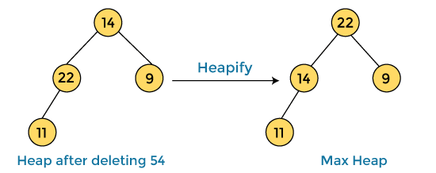
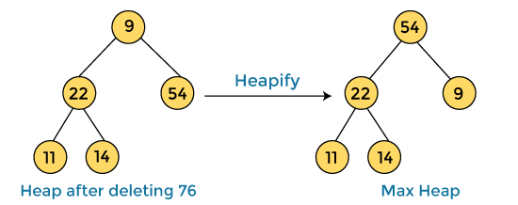

Heap Sort
Heap Sort
After swapping the array element 76 with 9 and converting the heap into max-heap, the elements of array are -
Example Continued…:
After swapping the array element 81 with 54 and converting the heap into max-heap, the elements of array are -
In the next step, again we have to delete the root element (54) from the max heap. To delete this node, we have to swap it with the last node, i.e. (14). After deleting the root element, we again have to heapify it to convert it into max heap.
In the next step, we have to delete the root element (76) from the max heap again. To delete this node, we have to swap it with the last node, i.e. (9). After deleting the root element, we again have to heapify it to convert it into max heap.
After swapping the array element 54 with 14 and converting the heap into max-heap, the elements of array are -

Slide 23
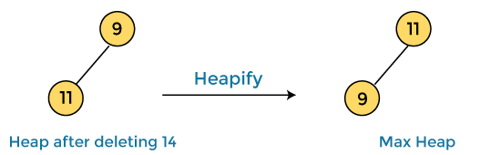

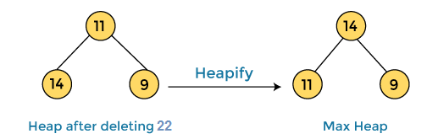
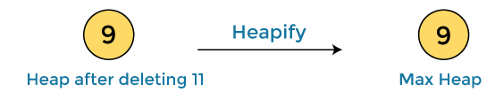



Heap Sort
Heap Sort
Example Continued…:
In the next step, again we have to delete the root element (22) from the max heap. To delete this node, we have to swap it with the last node, i.e. (11). After deleting the root element, we again have to heapify it to convert it into max heap.
After swapping the array element 14 with 9 and converting the heap into max-heap, the elements of array are -
In the next step, again we have to delete the root element (11) from the max heap. To delete this node, we have to swap it with the last node, i.e. (9). After deleting the root element, we again have to heapify it to convert it into max heap.
After swapping the array element 22 with 11 and converting the heap into max-heap, the elements of array are -
After swapping the array element 11 with 9, the elements of array are -
In the next step, again we have to delete the root element (14) from the max heap. To delete this node, we have to swap it with the last node, i.e. (9). After deleting the root element, we again have to heapify it to convert it into max heap.
Now, heap has only one element left. After deleting it, heap will be empty. Sorted array is-

Slide 24
Heap Sort
Algorithm:
HeapSort(arr)
BuildMaxHeap(arr)
for i = length(arr) to 2
swap arr[1] with arr[i]
heap_size[arr] = heap_size[arr] ? 1
MaxHeapify(arr,1)
End
BuildMaxHeap(arr)
BuildMaxHeap(arr)
heap_size(arr) = length(arr)
for i = length(arr)/2 to 1
MaxHeapify(arr,i)
End
MaxHeapify(arr,i)
MaxHeapify(arr,i)
L = left(i)
R = right(i)
if L ? heap_size[arr] and arr[L] > arr[i]
largest = L
else
largest = i
if R ? heap_size[arr] and arr[R] > arr[largest]
largest = R
if largest != i
swap arr[i] with arr[largest]
MaxHeapify(arr,largest)
End

Slide 25
Shell Sort
Shell sort is a generalized version of the insertion sort algorithm. It first sorts elements that are far apart from each other and successively reduces the interval between the elements to be sorted.
The interval between the elements is reduced based on the sequence used.
Time Complexity
Best | O(nlog n)
Worst | O(n²)
Average | O(nlog n)
Space Complexity | O(1)
Stability | No

Slide 26
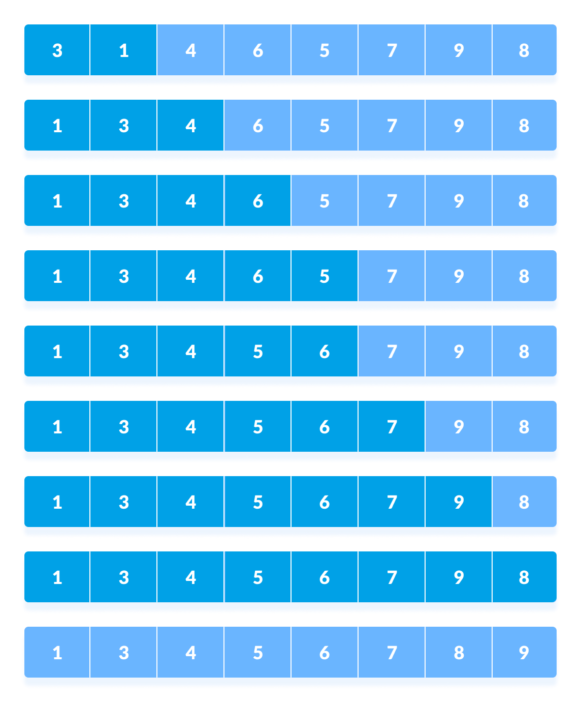
Shell Sort
Example:

Slide 27
Shell Sort
Algorithm:
shellSort(array, size)
for interval i <- size/2n down to 1
for each interval "i" in array
sort all the elements at interval "i"
end shellSort

Slide 28
Thanks
Anirudha Gaikwad

