Slide 1
C Programming
What you learn ?
Array and Array Operations
What is Array | Array Initialization
Access Array Element | Multidimensional Array
Arrays Pros & Cons | Arrays Operations

Slide 2
Array
Arrays are referred to as structured data types. An array is defined as finite ordered collection of homogenous data, stored in contiguous memory locations.
finite means data range must be defined.
ordered means data must be stored in continuous memory addresses.
homogenous means data must be of similar data type.

Slide 3
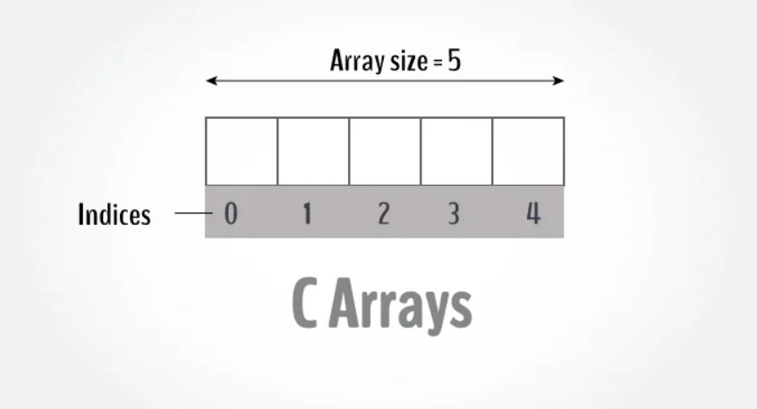
dataType arrayName[arraySize];
Example of array declaration
char a[5]; /* char type array */
float ar[9]; /* float type array */
int arr[10]; /* int type array */
The index of an array starts from 0 to size-1
first element of any array will be stored at array[0] address and the last element will be at array[size - 1].

Slide 4
Array initialization
An array can be initialized at either compile time or at runtime. That means, either we can provide values to the array in the code itself, or we can add user input value into the array.
Compile time initialization of array means we provide the value for the array in the code, when we create the array,
data-type array-name[size] = { list of values };
Runtime Array initialization : array can also be initialized at runtime using scanf() function. This approach is usually used for initializing large arrays, or to initialize arrays with user specified values.
for(int i = 0; i < 10; i++)
scanf("%d", &Arr[i]);

Slide 5
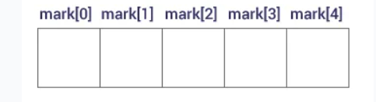
Accessing Array elements
Accessing Array elements of array by index
printf("%d", mark[0]); //prints first element of the array
printf("%d", mark[4]); //prints fourth element of the array

Slide 6
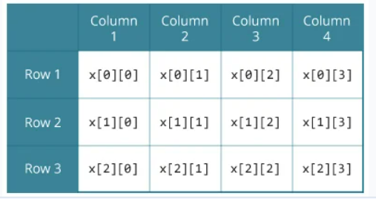
Multidimensional Arrays
int c[2][3] = {{1, 3, 0}, {-1, 5, 9}};
The simplest form of a multidimensional array is the two-dimensional array
data-type array-name[row-size][column-size]

Slide 7
Arrays Pros & Cons
Advantages of Arrays
In one go, we can initialize storage for more than one value. Because you can create an array of 10, 100 or 1000 values.
They make accessing elements easier by providing random access. By random access we mean you can directly access any element in an array if you know its index.
Sorting and searching operations are easy on arrays.
Disadvantages of Arrays
Due to its fixed size, we cannot increase the size of an array during runtime. That means once you have created an array, then it's size cannot be changed.
Insertion and deletion of elements can be costly, in terms of time taken.

Slide 8
Thanks
Anirudha Gaikwad

