Slide 1
C Programming
What you learn ?
Strings
What is String | Declare and initialize strings
String Input and output | String Handling Functions

Slide 2
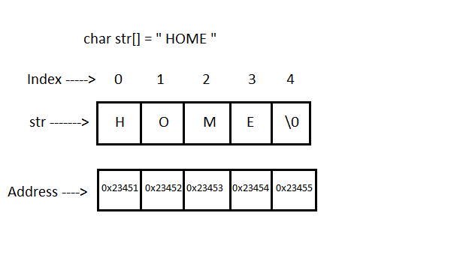
What is String
String is a sequence of characters that are treated as a single data item and terminated by a null character '\0’.
Remember that the C language does not support strings as a data type. A string is actually a one-dimensional array of characters in C language.
For Example:
The string "home" contains 5 characters
including the '\0' character which is
automatically added by the compiler
at the end of the string.

Slide 3
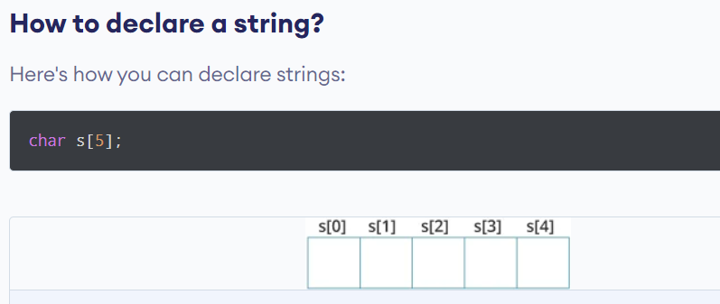
Declare strings

Slide 4
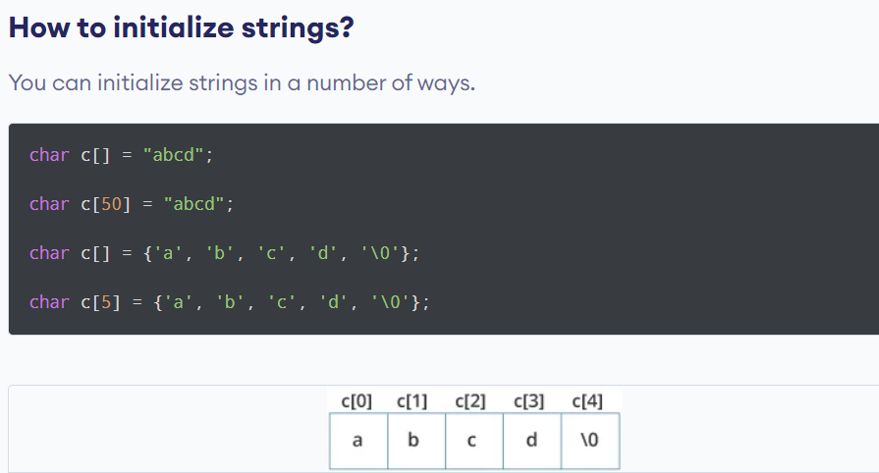
Iinitialize strings

Slide 5
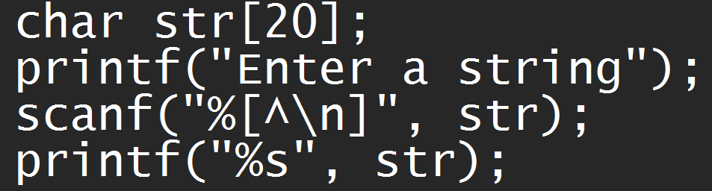
String Input and output
%s format specifier to read a string input from the terminal.
But scanf() function, terminates its input on the first white space it encounters.
edit set conversion code %[..] that can be used to read a line containing a variety of characters, including white spaces.

Slide 6
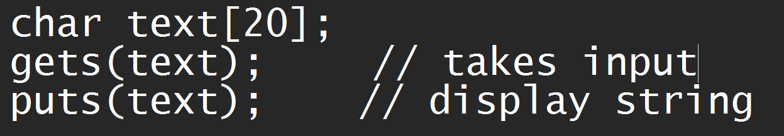
String Input and output
The gets() function can also be used to read character string with white spaces.
The puts() function is used to print string.

Slide 7
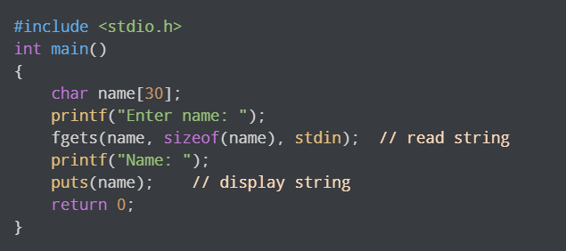
String Input and output
The gets() function can also be to take input from the user. However, it is removed from the C standard.
It's because gets() allows you to input any length of characters. Hence, there might be a buffer overflow.

Slide 8
String Handling Functions
C language supports a large number of string handling functions that can be used to carry out many of the string manipulations.
These functions are packaged in the string.h library. Hence, you must include string.h header file in your programs to use these functions
Function
strcmp() | strcat()
strcpy() | strrev()
strlen() | strupr()
strlwr()

Slide 9
Strcmp()
The strcmp() compares two strings character by character. If the strings are equal, the function returns 0.
Return Value | Description
0 | if strings are equal
>0 | if the first non-matching character in str1 is greater (in ASCII) than that of str2
<0 | if the first non-matching character in str1 is lower (in ASCII) than that of str2

Slide 10
Thanks
Anirudha Gaikwad

