Slide 1
C Programming
What you learn ?
Pointer
What is Pointer | Declare and initialize pointer
Pointer to Pointer variable | Pointer Applications & Dynamic Memory Allocations

Slide 2
What is Pointer
A pointer is a variable that contains the address of a variable.
Pointers are used to access memory of a variable and manipulate the value stored in it.
Pointers are one of the most distinct and exciting features of C language. It provides power and flexibility to the language.
Whenever a variable is declared in a program, system allocates a location i.e an address to that variable in the memory, to hold the assigned value. This location has its own address number

Slide 3

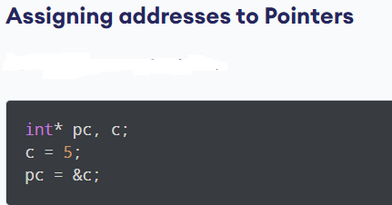
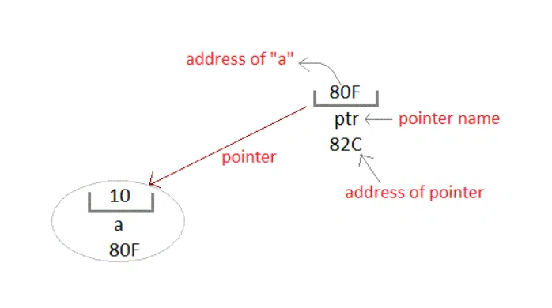
Declare & Initialization Pointer

Slide 4
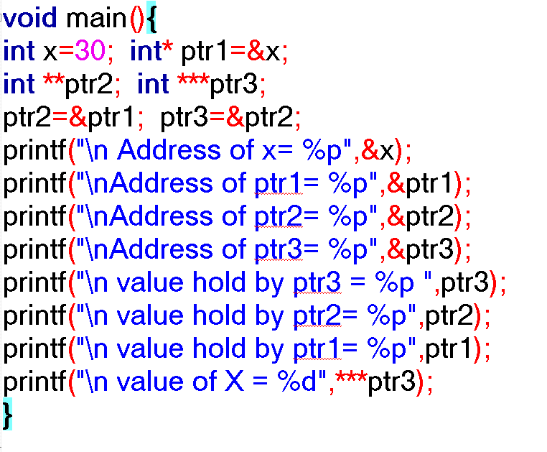
Pointer to Pointer variable
Pointers are used to store the address of other variables of similar datatype. But if you want to store the address of a pointer variable, then you again need a pointer to store it. Thus, when one pointer variable stores the address of another pointer variable, it is known as Pointer to Pointer variable

Slide 5
Benefits of using pointers in C
Pointers are more efficient in handling Arrays in C and Structures in C.
Pointers allow references to function and thereby helps in passing of function as arguments to other functions.
Pointers also provide means by which a function in C can change its calling arguments.
It reduces length of the program and its execution time as well.
It allows C language to support Dynamic Memory management.

Slide 6
Points to Remember while using Pointers
A pointer variable stores the address of a variable. We use * to declare and identify a pointer.
We can find the address of any variable using the & (ampersand) operator.
The declaration int *a doesn't mean that a is going to contain an integer value. It means that a is going to contain the address of a variable of int type.
We can dereference a pointer variable using a * operator. Here, the * can be read as 'value at'.

Slide 7
Dynamic Memory Allocations
Dynamic memory allocation means to allocate the memory at run time.
Dynamic memory allocation is possible by 4 functions of stdlib.h header file.
Function
malloc() | Allocates single block of requested memory.
calloc() | Allocates multiple block of requested memory.
realloc() | Reallocates the memory occupied by malloc() or calloc() functions.
free() | Frees the dynamically allocated memory.

Slide 8
Thanks
Anirudha Gaikwad

