Slide 1
C Programming
What you learn ?
Structure
What is Structure | Declare and initialize structure
Access Structure Member | Typedef Keyword

Slide 2
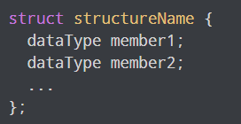
Structure
Structure is a user-defined datatype in C language which allows us to combine data of different types together.
Structure helps to construct a complex data type which is more meaningful.
struct keyword is used to define a structure. struct defines a new data type which is a collection of primary and derived data types.

Slide 3
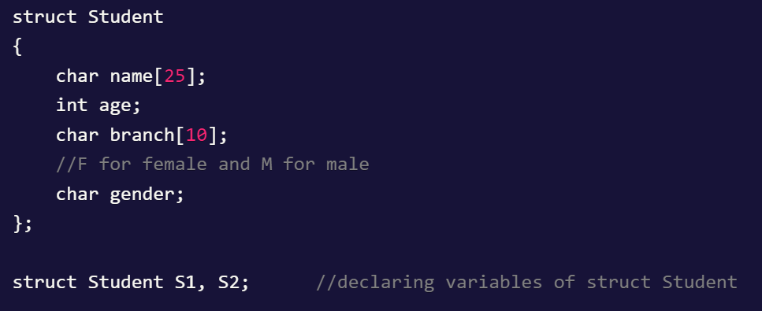
Declare & Create Structure Variable

Slide 4
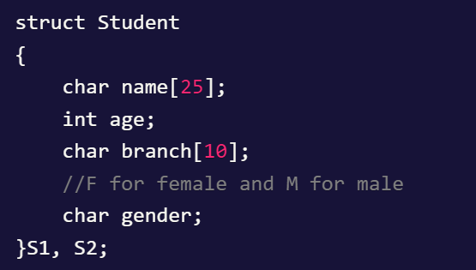
Declaring Structure variables with structure
definition

Slide 5
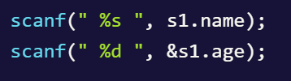
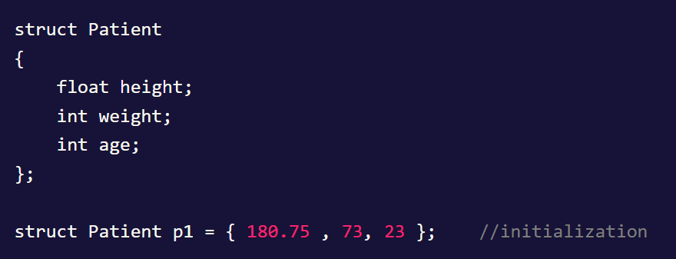
Initialize Structure Members

Slide 6
Accessing Structure Members
Structure members can be accessed and assigned values in a number of ways.
In order to assign a value to any structure member, the member name must be linked with the structure variable using a dot . operator also called period or member access operator.
S1.name

Slide 7

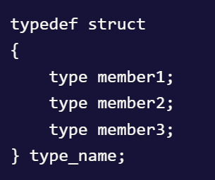
Keyword typedef
typedef keyword to create an alias name for data types. It is commonly used with structures to simplify the syntax of declaring variables.

Slide 8
Thanks
Anirudha Gaikwad

