Slide 1
C Programming
What you learn ?
Union
What is Union | Declare and initialize Union
Access Union member | Differences between Structure & Union

Slide 2
What is Union
A union is a user-defined type similar to structs in C except for one key difference.
The only differences is in terms of storage.
In structure each member has its own storage location, whereas all members of union uses a single shared memory location which is equal to the size of its largest data member.

Slide 3
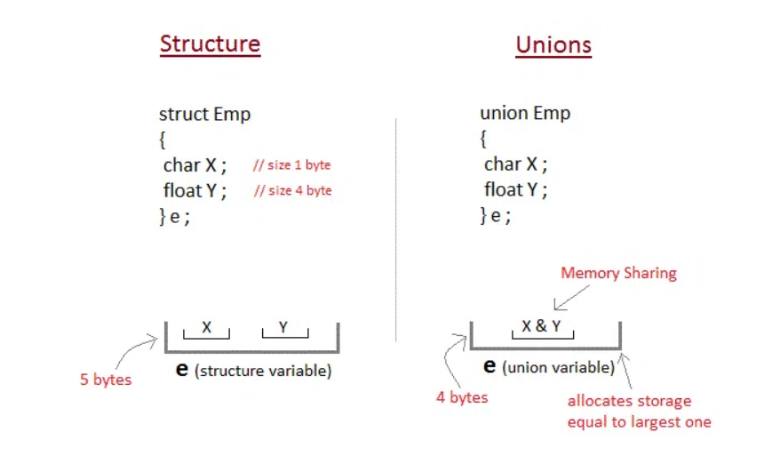
Define a union

Slide 4
Initialize union
Emp.x=‘A’;
Emp.y=5.5;

Slide 5
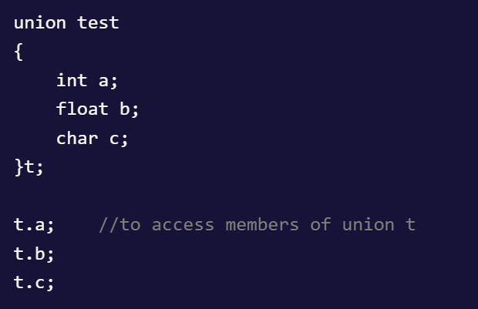
Accessing a Union Member
We use member access operator (.) to access members of a union in C. It is used between the union variable name and the union member that we want to access.

Slide 6
Difference Between Structure and Union
In union, we can only initialize a the first data member whereas in a structure, we can initialize many data members at once.
Compiler allocates memory for each member of a structure while for a union, it allocates memory equal to the size of the largest data member.
Union members share a memory location while structure members have a unique storage location each.
In a structure, we can access individual members simultaneously while in a union, we can only access one member at a time.
If we change the value of a member in a structure, it won't affect its other members but in a union, changing the value of one member will affect the others.

Slide 7
Thanks
Anirudha Gaikwad

