Slide 1
C Programming
What you learn ?
C Programming Language Introduction
What is GCC | What is MinGW
How to install GCC | How to set MinGW Environment
What is IDE | How to install IDE CodeBlocks

Slide 2
What is GCC
GCC stands for GNU Compiler Collections which is used to compile mainly C and C++ language. It can also be used to compile Objective C and Objective C++.
GNU is an operating system that GNU’s not Unix. GNU stands for Gnu’s Not Unix, and it is pronounced as “g-noo”. It is a recursive acronym, and it stands for “Gnu’s Not Unix”. GNU is a free and open-source operating system that was started in 1984 by Richard Stallman. GNU is based on the Unix operating system, but it has been greatly modified over the years.

Slide 3
What is MinGW
A native Windows port of the GNU Compiler Collection (GCC) with freely distributable import libraries and header files for building native Windows applications.
All of MinGW's software will execute on the 64bit Windows platforms.

Slide 4
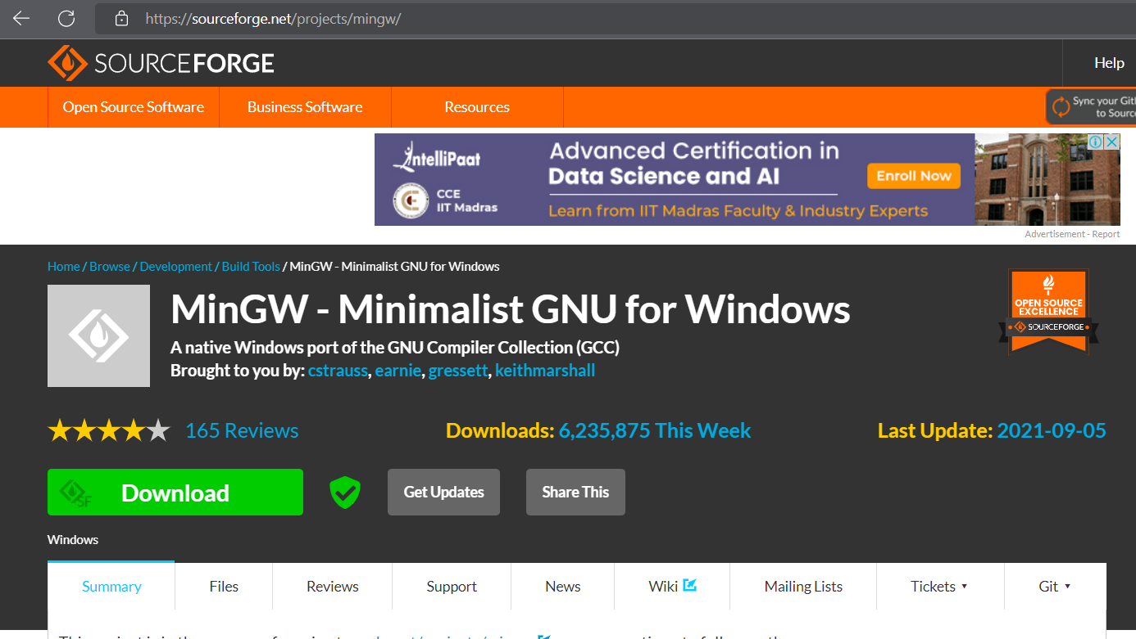
How to install GCC
Download the MinGW-w64 Compiler
Go to the MinGW - Minimalist GNU for Windows download | SourceForge.net We land on the following page.

Slide 5
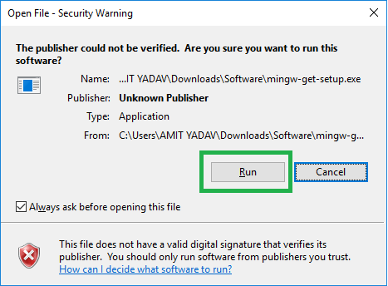
How to install GCC
Double-click on the MinGW set up to install the compiler

Slide 6
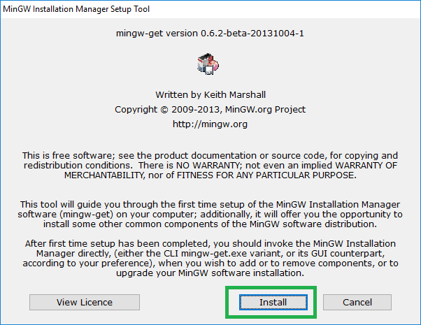
How to install GCC

Slide 7
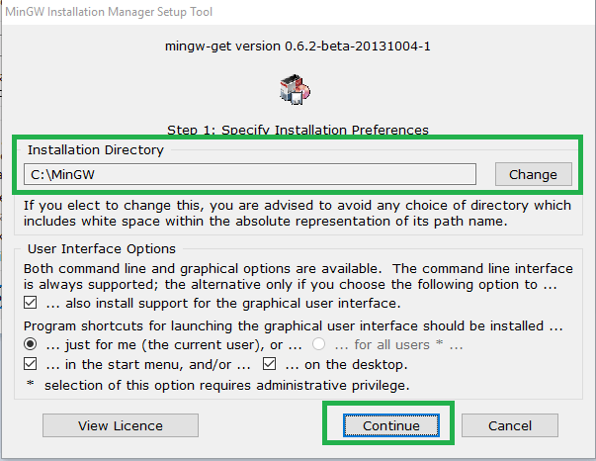
How to install GCC

Slide 8
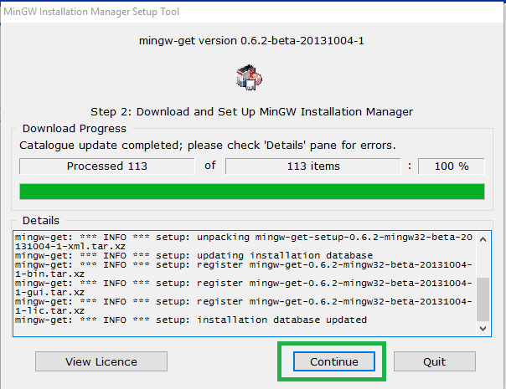
How to install GCC

Slide 9
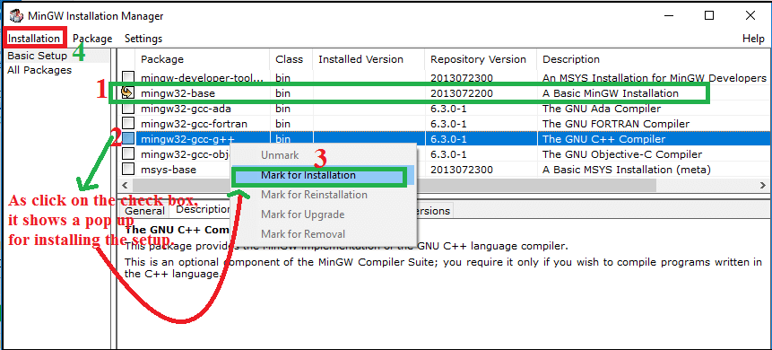
How to install GCC

Slide 10
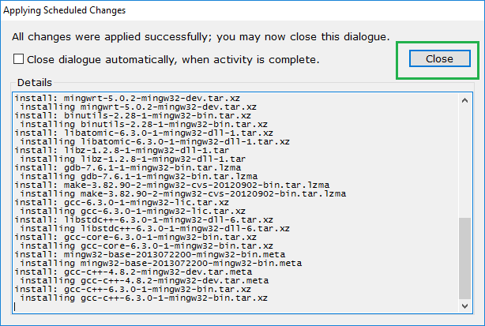
How to install GCC

Slide 11
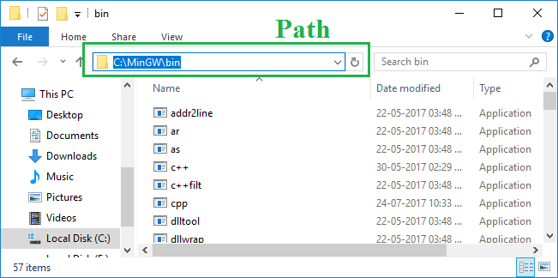
Environment Path for the MinGW
Go to the installation directory of the MinGW & copy the directory path

Slide 12
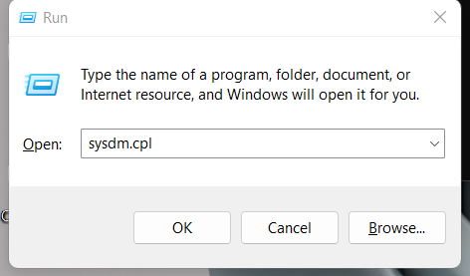
Environment Path for the MinGW
Open Run Utility and enter sysdm.cpl

Slide 13
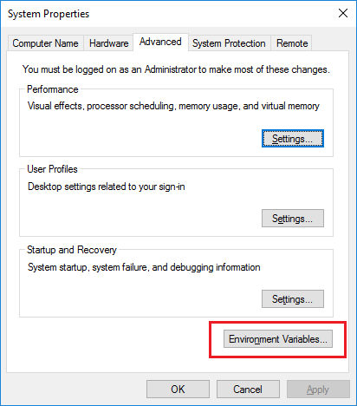
Environment Path for the MinGW

Slide 14
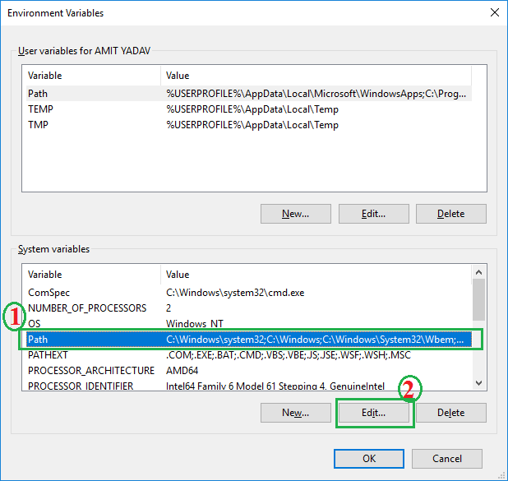
Environment Path for the MinGW

Slide 15
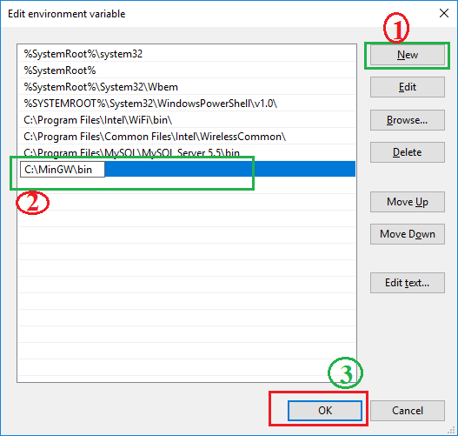
Environment Path for the MinGW

Slide 16
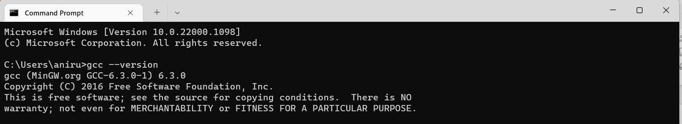
Check GCC Version

Slide 17
What is IDE
An integrated development environment (IDE) is a software application that provides comprehensive facilities to computer programmers for software development.

Slide 18
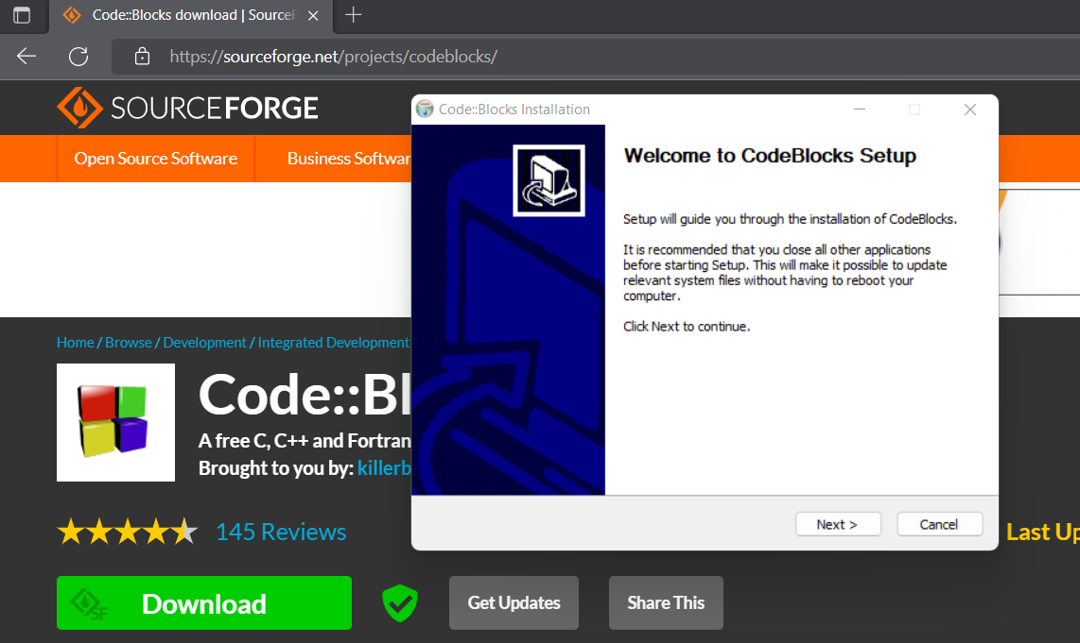
How to install IDE - CodeBlocks
Download the CodeBlocks IDE

Slide 19
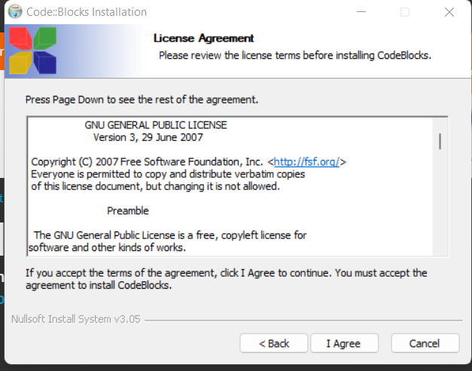
How to install IDE - CodeBlocks

Slide 20
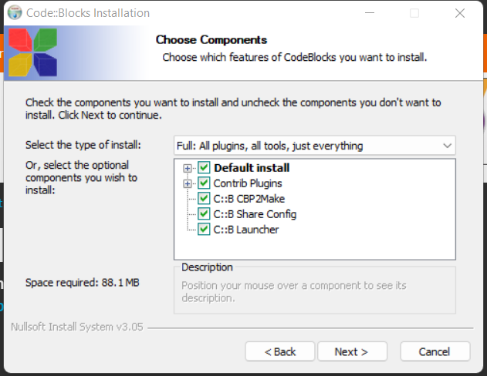
How to install IDE - CodeBlocks

Slide 21
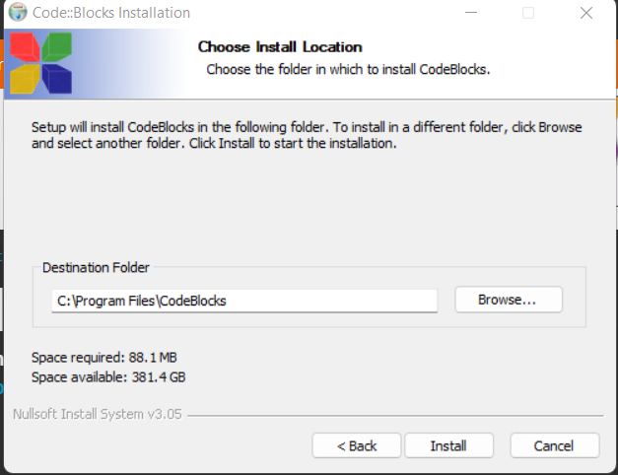
How to install IDE - CodeBlocks

Slide 22
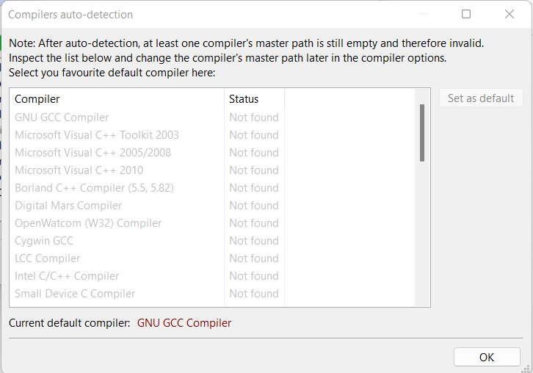
How to install IDE - CodeBlocks

Slide 23
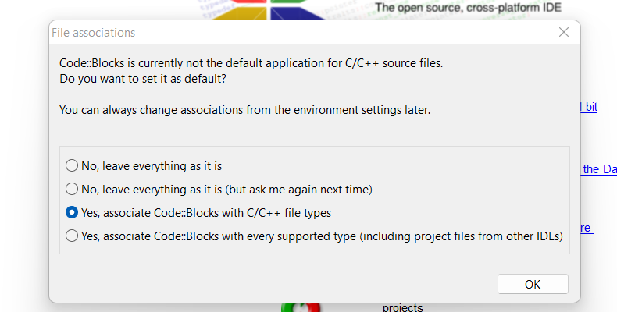
How to install IDE - CodeBlocks

Slide 24
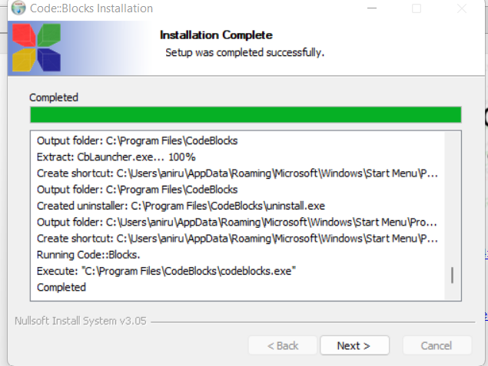
How to install IDE - CodeBlocks

Slide 25
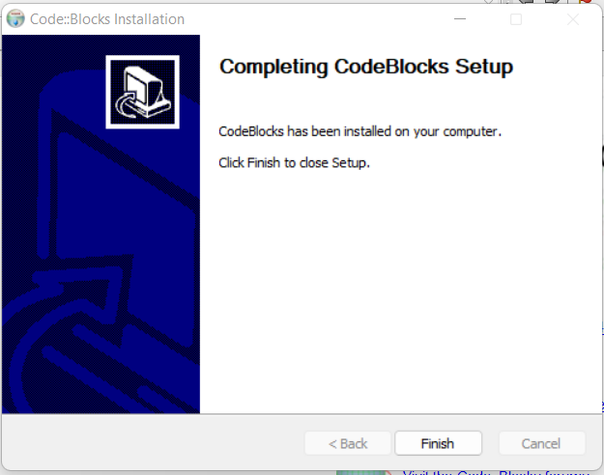
How to install IDE - CodeBlocks

Slide 26
Thanks
Anirudha Gaikwad

