Slide 1
C Programming
What you learn ?
Data Types and Constants
Tokens & Keywords | Identifiers
Character Set | Data types
Placeholders & Datatype Range | Variables
Constants

Slide 2
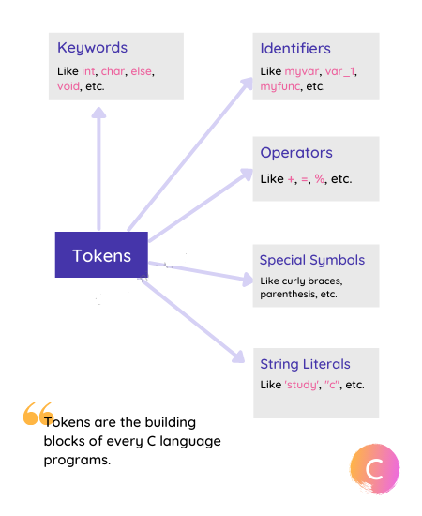
Tokens
The smallest individual unit in the C program is known as C Token. Tokens are either keywords or identifiers, constants, variables, or any other symbol which has some meaning in C language. The C program can also be called a collection of various tokens.

Slide 3
Keywords
Keywords are the words whose meaning has already been explained to the C compiler. There are only 32 keywords available in C. The keywords are also called ‘Reserved words’.
Keywords
auto | double | int | struct
break | else | long | switch
case | enum | register | typedef
const | extern | return | union
char | float | short | unsigned
continue | for | signed | volatile
default | goto | sizeof | void
do | if | static | while

Slide 4
Identifiers
Identifiers are words or texts used to identify anything in the C language.
Identifiers refer to the names of variable, functions ,etc. created by the programmer
An identifier is a long sequence of letters(a-z & A-Z) and numbers(0-9).
No special character except underscore ( _ ) can be used as an identifier.
Keyword should not be used as an identifier name.
C is case sensitive. So using case is significant.
First character of an identifier can be letter, underscore ( _ ) but not digit

Slide 5
Character Set
A character denotes any alphabet, digit or special symbol used to represent information
Alphabets - A, B, ….., Y, Z a, b, ……, y, z
Digits - 0, 1, 2, 3, 4, 5, 6, 7, 8, 9
Special symbols - ~ ‘ ! @ # % ^ & * ( ) _ - + = | \ { }[ ] : ; " ‘
< > , . ? /

Slide 6
Data types
Datatype defines the type of data being used. Whenever we define a variable or use any data in the C language program, we have to specify the type of the data, so that the compiler knows what type of data to expect.
Common data types
int - integer | char - character
long - long integer | float - float number
double - long float
eg. -> int a = 5550;float a = 0.05;double a = 10.09;char b = 'A';
The size for different data types depends on the compiler and processor types, in short, it depends on the Computer on which you are running the C language and the version of the C compiler that you have installed.

Slide 7
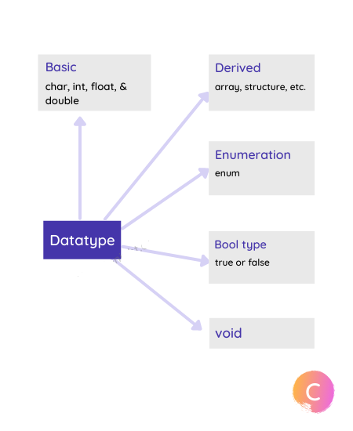
Data types

Slide 8
Data type Modifiers
In the C language datatype modifiers are available for numeric value, that are used along with the basic data types
signed | unsigned
Negative and Positive value represent by signed | Only Positive value represented by unsigned
%i %d | %u

Slide 9
Datatype Size-Range
Datatype | Size in Byte | Minimum Value | Maximum Value
Character ( char) | 1 | -128 | 127
Unsigned Character | 1 | 1 | 255
Short Integer ( short) | 2 | -32768 | 32767
Unsigned Short Int | 2 | 1 | 65535
Integer ( int ) | 4 | -2147483648 | 2147483647
Unsigned Integer | 4 | 1 | 4294967295
Long Integer ( long ) | 8 | -9223372036854775808 | 9223372036854775807
Unsigned Long Int | 8 | 1 | 18446744073709551615

Slide 10
Datatype Size-Range
Datatype | Size in Byte | Minimum Value | Maximum Value
Float | 4 | 1.175494e-38 | 3.402823e+38
Double | 8 | 2.225074e-308 | 1.797693e+308
Long Double | 16 | 3.362103e-4932 | 1.189731e+4932

Slide 11
Placeholders
Type | Placeholders
float | %f
double | %lf
long double | %Lf
char | %c
int | %d
long | %ld

Slide 12
Control characters (Escape sequences)
Certain non printing characters can be expressed in terms of escape sequence.
Escape sequences | Size in Bits | Range | Placeholders
\a Bell | \n New line | \r Carriage return | \b Backspace
\f Formfeed | \t Horizontal tab | \v Vertical tab | \" Quotation mark
\’ Apostrophe | \\ Backslash | \? Question mark | \0 Null

Slide 13
Variable
Variable is like a container (storage space) with a name in which you can store data.
Once a variable is created, we can store value in it. We can change the value stored in a variable as many times as we want, but we should make sure we store the correct data type value.
data_type var_name;
int x=10;
We can even declare a variable outside the main() function, using the extern keyword.
extern int a;extern float b;extern double c, d;

Slide 14
Literals
If we want to use some data value in a C program, we can also directly use a value, instead of creating a variable to store the value. When we use a value directly in C program without creating a variable, it is known as a Literal
A literal is used when we want to use a fixed value in the program, hence literals are also called Constants.
literals types
Integer Literal 100
Character Literal ‘A’
Floating-point Literal 55.8
String Literals “ABCD”
Escape Sequences \n \t

Slide 15
Constant
If you want to create a variable whose value cannot be changed, then you can use the const keyword to create a constant value variable.
The variables which have type const, cannot be changed by the program. We can provide a value while defining the variable, and then, throughout the program, that variable will hold the same value.
const int marks =90;

Slide 16
Thanks
Anirudha Gaikwad

