Slide 1
C Programming
What you learn ?
Decision Making
What is Decision making | if statement
Switch statement | goto statement

Slide 2
What is Decision making
Decision making is about deciding the order of execution of statements based on certain conditions or repeat a group of statements until certain specified conditions are met.
if statement
switch statement
conditional operator statement (? : operator)
goto statement

Slide 3
Simple if statement
The general form of a simple if statement is
if(expression)
{
statement inside;
}
statement outside;
If the expression returns true, then the statement-inside will be executed, otherwise statement-inside is skipped and only the statement-outside is executed.

Slide 4
if...else statement
The general form of a simple if...else statement is
if(expression)
{ statement block1; }
else
{ statement block2; }
If the expression is true, the statement-block1 is executed, else statement-block1 is skipped and statement-block2 is executed..

Slide 5
Nested if....else statement
The general form of nested if...else statement is
if( expression ){ if( expression1 )
{ statement block1; }
else
{ statement block2; }
}
else
{ statement block3; }
if expression is false then statement-block3 will be executed, otherwise the execution continues and enters inside the first if to perform the check for the next if block, where if expression 1 is true the statement-block1 is executed otherwise statement-block2 is executed.

Slide 6
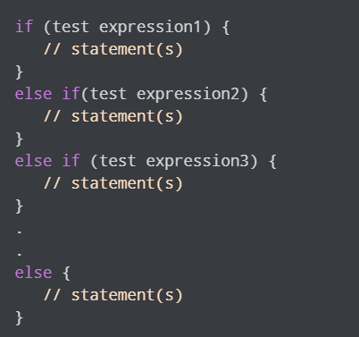
if else if ladder
The if...else ladder allows you to check between multiple test expressions and execute different statements..

Slide 7
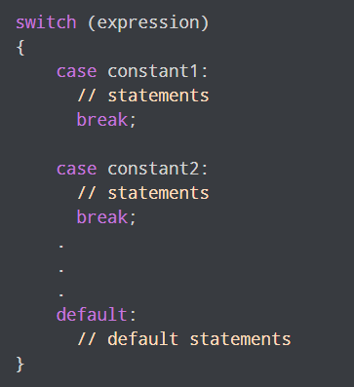
Switch statement
The switch statement allows us to execute one code block among many alternatives.
You can do the same thing with the if...else..if ladder. However, the syntax of the switch statement is much easier to read and write.

Slide 8
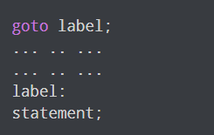
goto statement
The goto statement allows us to transfer control of the program to the specified label.
The label is an identifier. When the goto statement is encountered, the control of the program jumps to label: and starts executing the code

Slide 9
Thanks
Anirudha Gaikwad

