Slide 1
C Programming
What you learn ?
Control Statements
For Loop | While Loop
Do-While Loop | Break
Continue

Slide 2
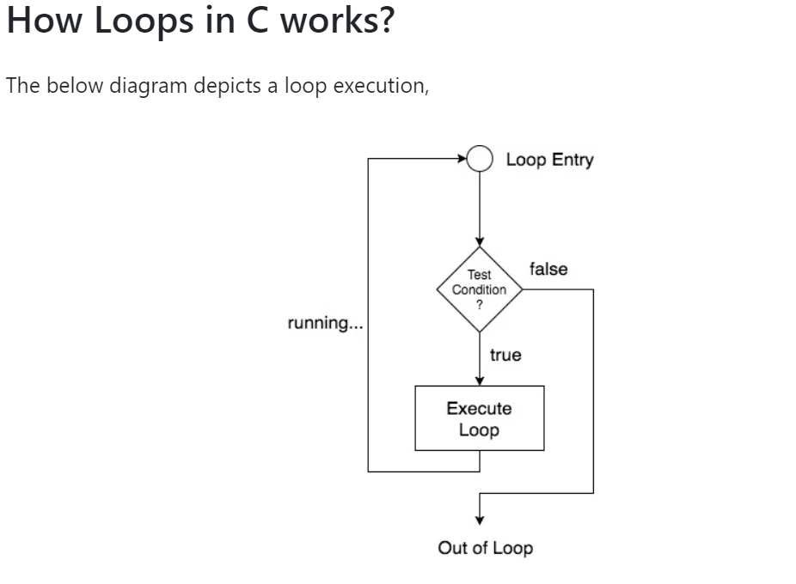
Loop
loops are used to execute a single statement or a set of statements, repeatedly, until a particular condition is satisfied.

Slide 3
Loop
Loops are broadly classified into two types:
Entry controlled loops
In this kind of loop, the condition is checked before executing the loop's body. So, if the condition is never true, it won't execute even once. For example, for and while loop.
Exit controlled loops
In this kind of loop, the condition is checked after the loop's body is executed, i.e., in the end. Hence, even if the condition is not fulfilled, this loop will execute one time. The do-while loop is an example of exit controlled loop
There are 3 types of Loop in C language:
while loop
for loop
do while loop

Slide 4
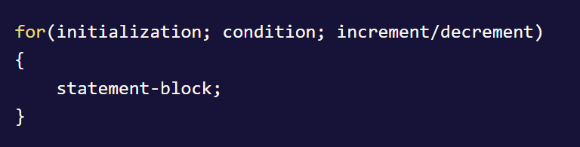
For Loop
The for loop in C is used to execute a set of statements repeatedly until a particular condition is satisfied.
The for loop is executed as follows:
It first evaluates the initialization code.
Then it checks the condition expression.
If it is true, it executes the for-loop body
Then it evaluate the increment/decrement condition and again follows from step 2.
When the condition expression becomes false, it exits the loop.

Slide 5
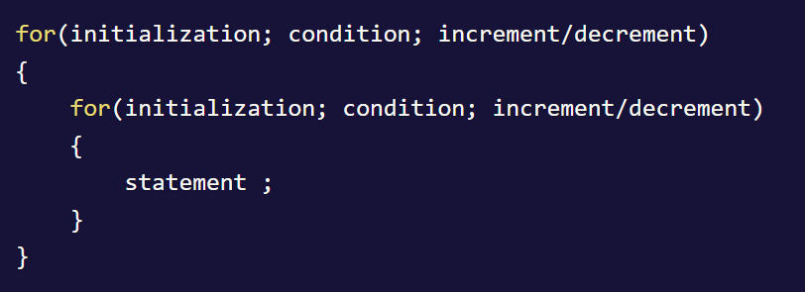
Nested For Loop
We can also have nested for loops, i.e one for loop inside another for loop in C language.
This type of loop is generally used while working with multi-dimensional arrays

Slide 6
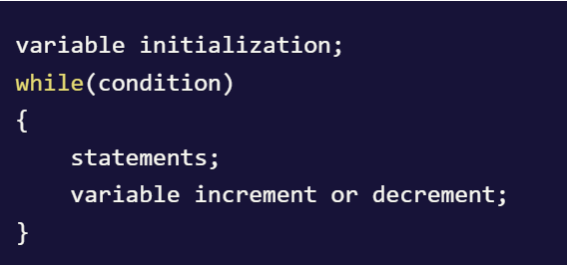
While Loop
How while loop works?
The while loop evaluates the testExpression(condition) inside the parentheses ().
If testExpression is true, statements inside the body of while loop are executed. Then, testExpression is evaluated again.
The process goes on until testExpression is evaluated to false.
If testExpression is false, the loop terminates (ends).

Slide 7
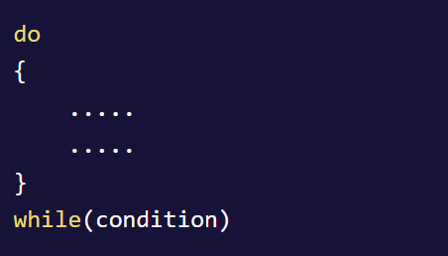
Do-While Loop
In some situations it is necessary to execute body of the loop once before testing the condition.
Such situations can be handled with the help of do-while loop.
The do statement evaluates the body of the loop first and at the end, the condition is checked using while statement.
It means that the body of the loop will be executed at least once, even though the starting condition inside while is initialized to be false.

Slide 8
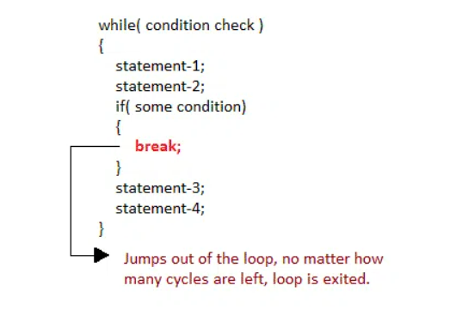
Break
Sometimes, while executing a loop, it becomes necessary to skip a part of the loop or to leave the loop as soon as certain condition becomes true. This is known as jumping out of loop.
When break statement is encountered inside a loop, the loop is immediately exited and the program continues to execute with the statements after the loop.

Slide 9
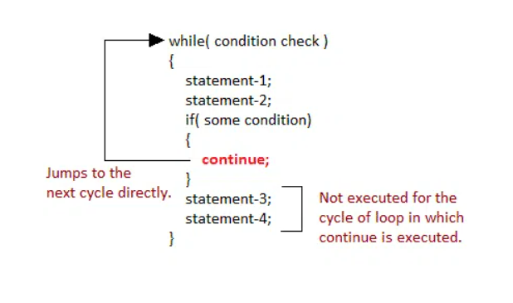
Continue
It causes the control to go directly to the test-condition and then continue the loop execution.
On encountering continue, the execution leaves the current cycle of loop, and starts with the next cycle.

Slide 10
Thanks
Anirudha Gaikwad

