Slide 1
C Programming
What you learn ?
Functions
What is Function | Types of Function
Types of user define function | Recursion

Slide 2
What is Function
A function is a block of code that performs a specific task.
C language provides an approach in which you can declare and define a group of statements once in the form of a function and it can be called and used whenever required.
It makes your code reusable. You just have to call the function by its name to use it, wherever required.

Slide 3
Function
Benefits of Using Functions
It provides modularity to your program's structure.
It makes your code reusable. You just have to call the function by its name to use it, wherever required.
In case of large programs with thousands of code lines, debugging and editing becomes easier if you use functions.
It makes the program more readable and easy to understand.

Slide 4
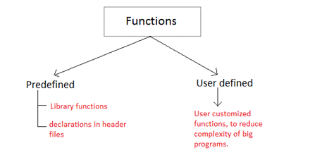

Types of Function
Library functions
Library functions are those functions which are already defined in C library, example printf(), scanf(), strcat() etc. You just need to include appropriate header files to use these functions. These are already declared and defined in C libraries.
User-defined functions
A User-defined functions on the other hand, are those functions which are defined by the user at the time of writing program. These functions are made for code reusability and for saving time and space.

Slide 5
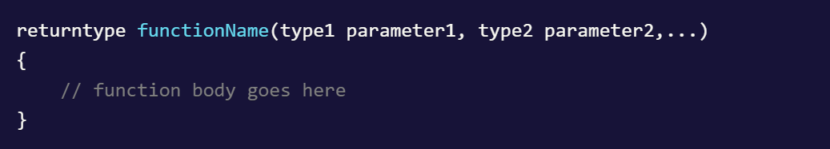
How we write user define function
Function Declaration (Function Prototyping)
Like any variable a function must also be declared before its used. Function declaration informs the compiler about the function name, parameters is accept, and its return type.
Function definition
The first line returntype functionName(type1 parameter1, type2 parameter2,...) is known as function header and the statement(s) within curly braces is called function body.

Slide 6
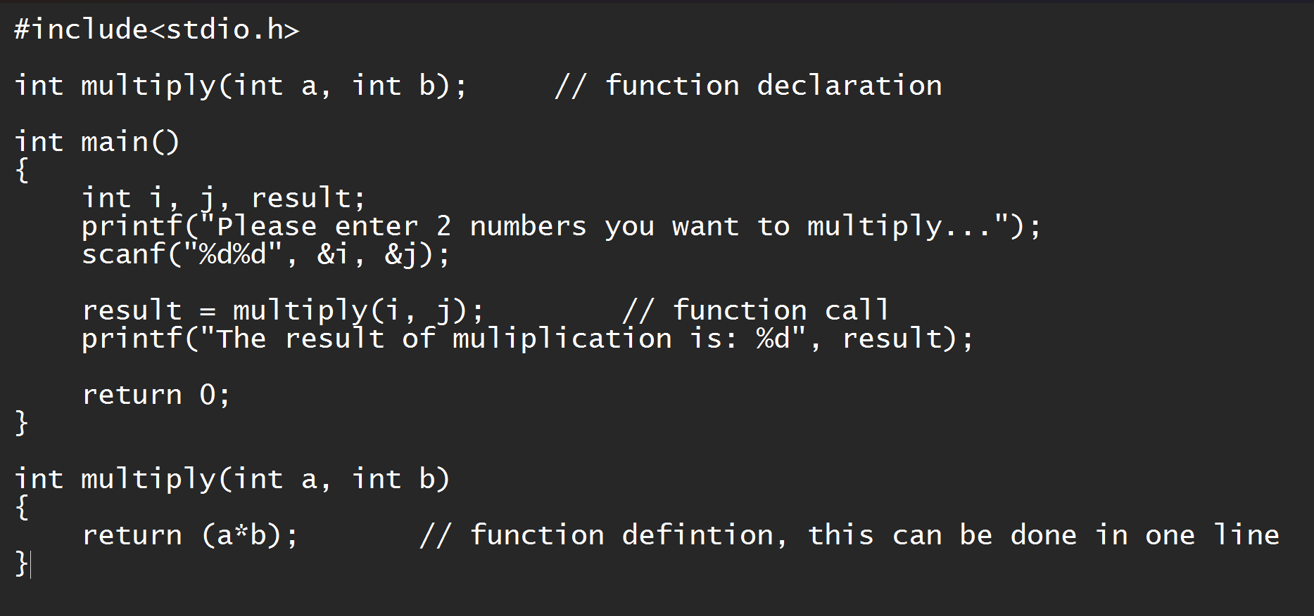
How we write user define function
Calling a function
When a function is called, control of the program gets transferred to the function.
Example of Function:

Slide 7
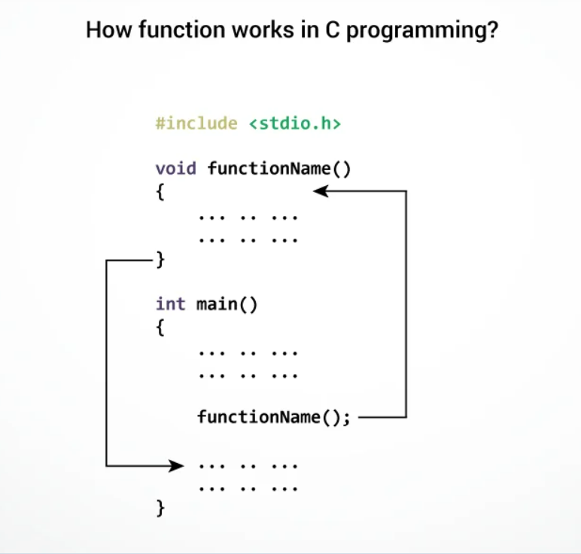

Slide 8
Types of user define function
Function with no arguments and no return value
Function with no arguments and a return value
Function with arguments and no return value
Function with arguments and a return value

Slide 9
What is recursion
Recursion is the process of defining something in terms of itself.
We must have certain conditions in the function to break out of the recursion, otherwise recursion will occur infinite times.
Advantages of Recursion
Recursive functions make the code look clean and elegant.
A complex task can be broken down into simpler sub-problems using recursion.
Sequence generation is easier with recursion than using some nested iteration.
Limitations of Recursion
Sometimes the logic behind recursion is hard to follow through.
Recursive calls are expensive (inefficient) as they take up a lot of memory and time.
Recursive functions are hard to debug.

Slide 10
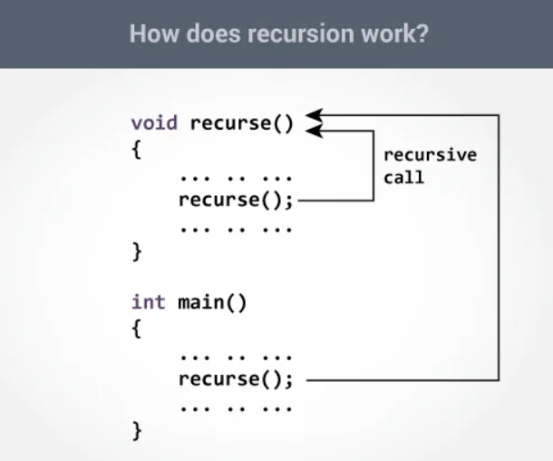
Recursion

Slide 11
Thanks
Anirudha Gaikwad

