Slide 1
COMPUTER NETWORK
(21CSC302J)
UNIT-1
Introduction to Networks

Slide 2
UNIT CONTENTS
Network Types: LAN, MAN, PAN, WAN
Network Topology : BUS, STAR, RING, MESH, HYBRID
Switching : Circuit Switching, Packet Switching
OSI Layered Architecture
TCP/IP Model
Physical Layer Overview
Latency, Bandwidth, Delay
Guided Media : Twisted pair, Coaxial cable, Fiber optic cable
Unguided Media : Radio waves, Microwaves, Infrared

Slide 3
COURSE OUTCOME
Apply the knowledge of communication

Slide 4
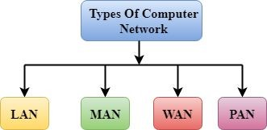
NETWORK TYPES
A computer network is a combination of two or more computers, network devices, like hub, routers, and switches, that are linked in order to share resources or allow electronic communication.

Slide 5
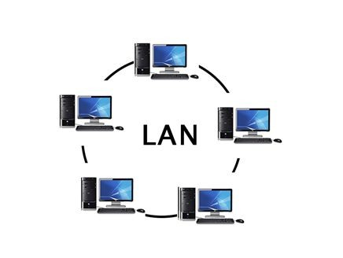
LAN (LOCAL AREA NETWORK)
A group of computers connected to each other in a small area such as building, office.
Used for connecting two or more personal computers.
Built with inexpensive hardware such as Hubs,
Network Adapters, and Ethernet Cables.
Data is transferred at an extremely faster rate.
Provides higher security
Ex- Home Wi-Fi networks and Small business networks

Slide 6
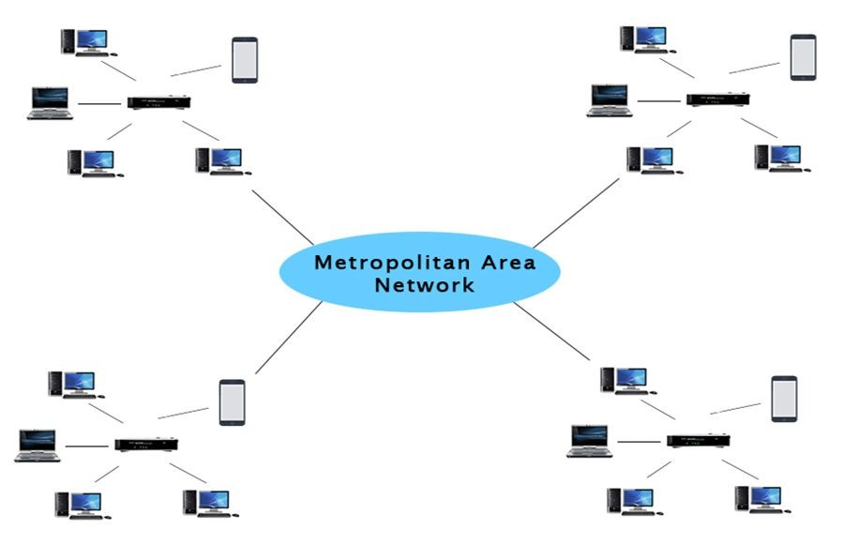
MAN (METROPOLITAN AREA NETWORK)
Covers a larger geographic area by interconnecting a different LAN to form a larger network.
Various LANs are connected to each other through a telephone exchange line.
The most widely used protocols are RS-232, FRAME RELAY, ATM, ISDN, OC-3, ADSL,
etc.
Ex- Government agencies, Campus network, Citywide WI-FI network.

Slide 7
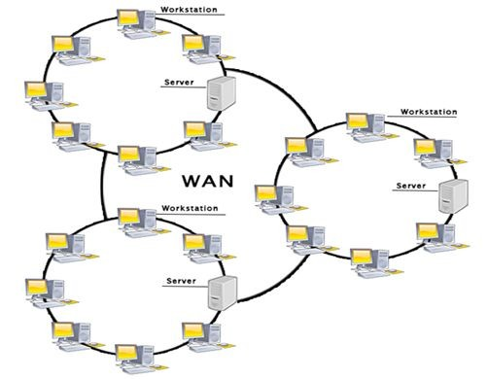
WAN (WIDE AREA NETWORK)
A network that extends over a large geographical area such as states or countries.
Not limited to a single location.
Spans over a large geographical area
through a telephone line, fiber optic
cable or satellite links.
Internet is one of the biggest WAN in the world.

Slide 8
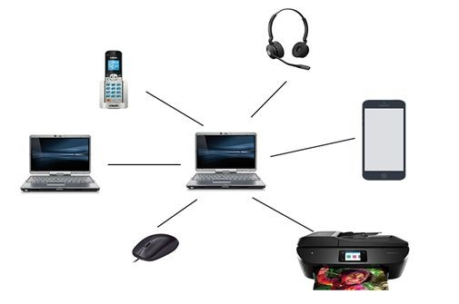
PAN (PERSONAL AREA NETWORK)
A network arranged within an individual person, typically within a range of 10 meters.
Used for connecting the computer devices of personal use.
THOMAS ZIMMERMAN was the first research scientist to bring the idea of the personal area network.
Personal computer devices are used to develop the PAN like laptop, mobile phones, media player and play stations etc.

Slide 9
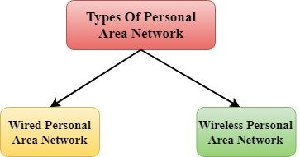
TYPES OF PERSONAL AREA NETWORK
Wired Personal Area Network: Created by using the USB.
Wireless Personal
Developed by simply
Area
using
Network:
wireless
technologies such as WiFi, Bluetooth. It is a low range network.

Slide 10
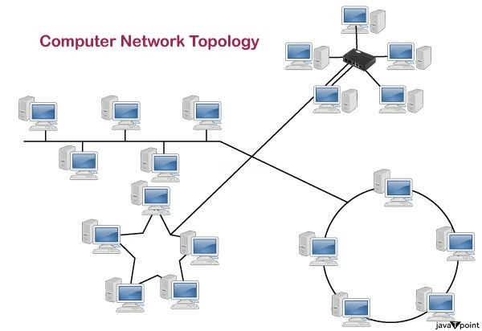
NETWORK TOPOLOGY
Defines the structure of the network of how all the components are interconnected to each other.
Two types of topology:
Physical topology: The geometric representation of all the nodes in a network.
Logical topology: Refers to the abstract representation of how data flows and is transmitted within a network, independent of its physical layout.

Slide 11
TYPES OF PHYSICAL TOPOLOGY
Bus Topology
Ring Topology
Star Topology
Mesh Topology
Tree Topology
Hybrid Topology

Slide 12
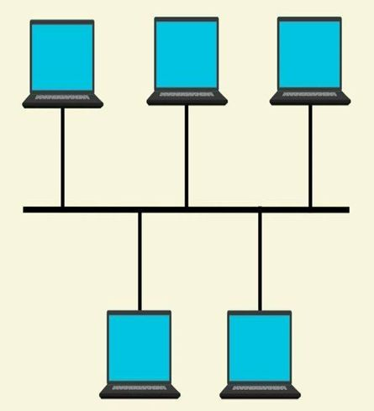
BUS TOPOLOGY
Designed in such a way that all the stations are
connected through a single cable known as a
backbone cable.
The backbone cable is considered as a "single lane" through which the message is broadcast to all the stations.
When a node wants to send a message over the network, it puts a message over the network. All the stations available in the network will receive the message whether it has been addressed or not.
Mainly used in 802.3 (Ethernet) and 802.4 standard networks.
Quite simpler as compared to other topologies.

Slide 13
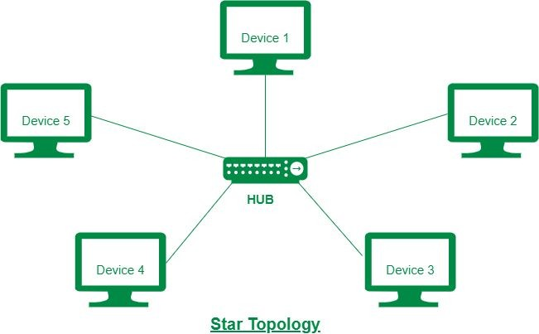
STAR TOPOLOGY
Most popular in network implementation.
An arrangement of the network in which every node is connected to the central hub, switch or a central computer.
The central a server, and attached to as clients.
computer is known as
the peripheral devices
the server are known
Coaxial cable or RJ-45 cables are used to connect the computers.
Hubs or switches are mainly used as connection devices.

Slide 14
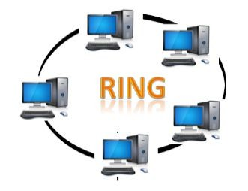
RING TOPOLOGY
Like a bus topology, but with connected ends.
The node that receives the message from the
previous computer will retransmit to the next node.
Unidirectional
No terminated ends
Data flow in a clockwise direction.
Data flows in a single loop continuously known as an endless loop.
The most common access method is token passing.

Slide 15
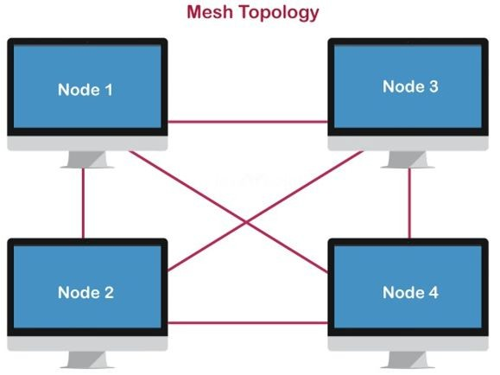
MESH TOPOLOGY
Multiple paths from one computer to another computer.
Mainly used for WAN implementations and wireless networks.
Internet is an example of the mesh topology.
Can be formed by using the formula:
Number of cables = (n*(n-1))/2;
Where n is the number of nodes that represents the network.

Slide 16
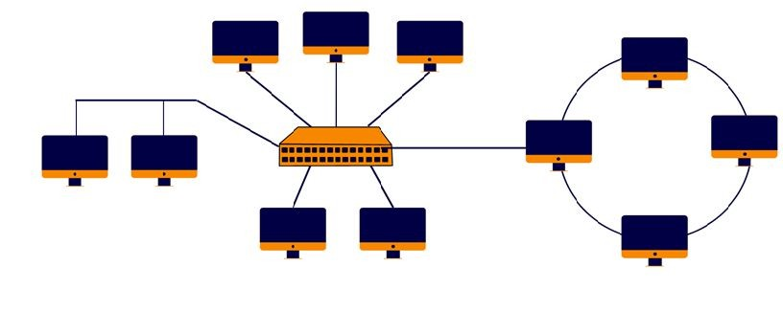
HYBRID TOPOLOGY
Combination of various different topologies
If similar topologies are connected with each other will not result in hybrid topology.
A connection between different links and nodes to transfer the data.
For example, if there exist a ring topology in one branch of ICICI bank and bus topology in another branch of ICICI bank

Slide 17
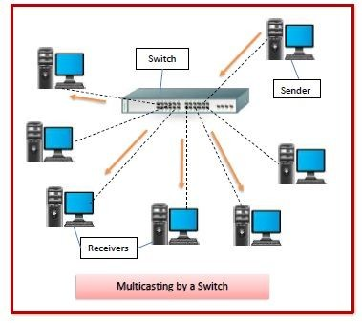
SWITCHING
Takes place at the Data Link layer.
The process to forward packets coming in from one port to a port leading towards the destination using specific devices called switches.
When data comes on a port it is called ingress, and when data leaves a port or goes out it is called egress.
Provide one-to-one communication. Can be divided into two major categories:
Connection Oriented: Need to pre-establish circuit along the path between both endpoints.
Connection Less: The data is forwarded on behalf of forwarding tables. No previous handshaking is required, and acknowledgements are optional.

Slide 18
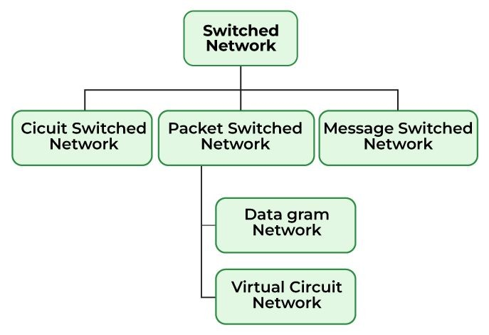
TYPES OF SWITCHING
There are three types of switching methods:
Message Switching
Circuit Switching
Packet Switching
  Datagram Packet Switching
  Virtual Circuit Packet Switching

Slide 19
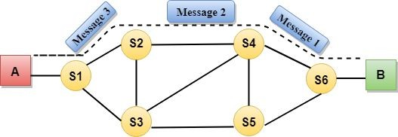
CIRCUIT SWITCHING
It is a transmission mode that involved setting up a dedicated end to end connection.
Commonly used in Telephone systems.
Connection Oriented
No delay in data flow.
Establishes a dedicated path between sender and receiver.
Path will remain to exist until the connection is terminated.
After receiving the acknowledgment, dedicated path transfers the data.
Used in public telephone network for voice transmission.
More bandwidth is required.
Connection establish time is more.

Slide 20
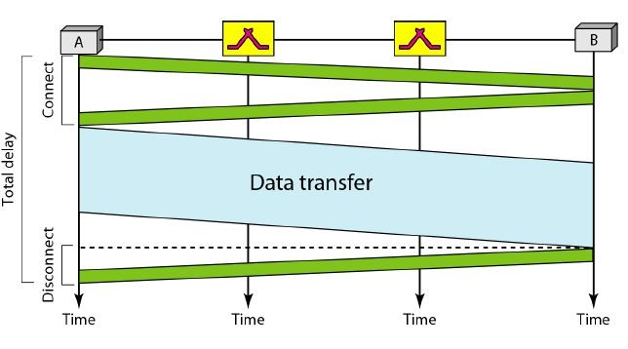
PHASES OF CIRCUIT SWITCHING
1. Circuit Establishment
2. Data Transfer
3. Circuit Disconnection

Slide 21
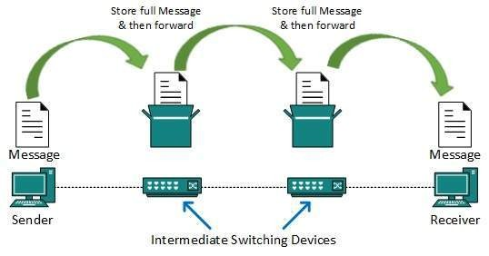
MESSAGE SWITCHING
There is no dedicated path between two communicating devices.
Used commonly in Emails and Messeges.
Based on store-and-forward technique.
The whole message is treated as a data unit and transferred in its entirety.
First receives the whole message and buffers it until there are resources available.
If the next hop is not having enough resource to accommodate large size message, the message is stored and switch waits.
Very slow due to storing and forwarding.
Not a solution for streaming media and real-time applications.

Slide 22
PACKET SWITCHING
Short comings of message switching gave birth to an idea of packet switching.
Commonly used in OSI Model.
The message splits into smaller pieces known as packets and packets are given a unique number to identify their order at the receiving end.
Every packet contains some information in its headers such as source address, destination address and sequence number.
Packets will travel across the network, taking the shortest path as possible.
All the packets are reassembled at the receiving end in correct order.
If any packet is missing or corrupted, then the message will be sent to resend the message.
If the correct order of the packets is reached, then the acknowledgment message will be sent.

Slide 23
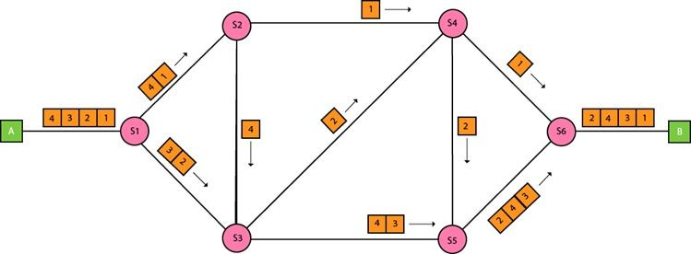
DATAGRAM PACKET SWITCHING
Also known as connectionless switching.
Packet is known as a datagram.
Considered as an independent entity.
Each packet contains the information about the destination and switch uses this information to forward the packet to the correct destination.
Path is not fixed.
Intermediate nodes take the routing decisions to forward the packets.

Slide 24
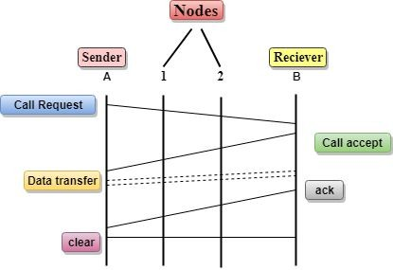
VIRTUAL CIRCUIT SWITCHING
Also known as connection-oriented switching.
A preplanned route is established before the messages are sent.
Call request and Call accept packets are used to establish the connection between sender and receiver.
The path is fixed for the duration of a logical connection.

Slide 25
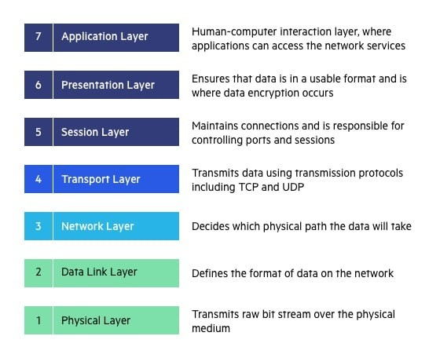
OSI LAYERED ARCHITECTURE
Developed by ISO – ‘international organization for standardization‘, in the year 1984.
A conceptual framework that divides network communications functions into seven layers.
Divided into two groups: Media Layers and Host Layers
Each layer having specific functionality to perform.

Slide 26
PHYSICAL LAYER OVERVIEW
Responsible for sending computer bits from one device to another along the network.
Determine how physical connections to the network are set up.
Consists of various network components such as power plugs, connectors, receivers, cable types, etc.
Defines the types of encoding (that is how the 0’s and 1’s are encoded in a signal).
Helps in physical topology (mesh, star, bus, ring) decisions
Provides two types of configuration point point configuration and multi-point configuration.
Provides an interface between devices and transmission medium.
Takes Switching decisions.

Slide 27
Functions of a Physical layer
Line Configuration: It defines the way how two or more devices can be connected physically.
Data Transmission: It defines the transmission mode whether it is simplex, half-duplex or full-duplex mode between the two devices on the network.
Topology: It defines the way how network devices are arranged.
Signals: It determines the type of the signal used for transmitting the information.

Slide 28
DATALINK LAYER OVERVIEW
This layer is responsible for the error-free transfer of data frames.
It defines the format of the data on the network.
It provides a reliable and efficient communication between two or more devices.
It is mainly responsible for the unique identification of each device that resides on a local network. It contains two sub-layers:
Logical Link Control Layer
  It is responsible for transferring the packets to the Network layer of the receiver that is receiving.
  It identifies the address of the network layer protocol from the header.
  It also provides flow control.
Media Access Control Layer
  A Media access control layer is a link between the Logical Link Control layer and the network's physical layer.
  It is used for transferring the packets over the network.

Slide 29
Functions of the Data-link layer
Framing: The data link layer translates the physical's raw bit stream into packets known as Frames. The Data link layer adds the header and trailer to the frame. The header which is added to the frame contains the hardware destination and source address.
Physical Addressing: The Data link layer adds a header to the frame that contains a destination address. The frame is transmitted to the destination address mentioned in the header.
Flow Control: Flow control is the main functionality of the Data-link layer. It is the technique through which the constant data rate is maintained on both the sides so that no data get corrupted. It ensures that the transmitting station such as a server with higher processing speed does not exceed the receiving station, with lower processing speed.
Error Control: Error control is achieved by adding a calculated value CRC (Cyclic Redundancy Check) that is placed to the Data link layer's trailer which is added to the message frame before it is sent to the physical layer. If any error seems to occur, then the receiver sends the acknowledgment for the retransmission of the corrupted frames.
Access Control: When two or more devices are connected to the same communication channel, then the data link layer protocols are used to determine which device has control over the link at a given time.

Slide 30
NETWORK LAYER OVERVIEW
It is a layer 3 that manages device addressing, tracks the location of devices on the network.
It determines the best path to move data from source to the destination based on the network conditions, the priority of service, and other factors.
The Data link layer is responsible for routing and forwarding the packets.
Routers are the layer 3 devices, they are specified in this layer and used to provide the routing services within an internetwork.
The protocols used to route the network traffic are known as Network layer protocols. Examples of protocols are IP and Ipv6.

Slide 31
Functions of Network Layer
Internetworking: An internetworking is the main responsibility of the network layer. It provides a logical connection between different devices.
Addressing: A Network layer adds the source and destination address to the header of the frame. Addressing is used to identify the device on the internet.
Routing: Routing is the major component of the network layer, and it determines the best optimal path out of the multiple paths from source to the destination.
Packetizing: A Network Layer receives the packets from the upper layer and converts them into packets. This process is known as Packetizing. It is achieved by internet protocol (IP).

Slide 32
TRANSPORT LAYER OVERVIEW
The Transport layer is a Layer 4 ensures that messages are transmitted in the order in which they are sent and there is no duplication of data.
The main responsibility of the transport layer is to transfer the data completely.
It receives the data from the upper layer and converts them into smaller units known as segments.
This layer can be termed as an end-to-end layer as it provides a point-to-point connection between source and destination to deliver the data reliably.
The two protocols used in this layer are:
  Transmission Control Protocol
  User Datagram Protocol

Slide 33
Cont.
Transmission Control Protocol
  It is a standard protocol that allows the systems to communicate over the internet.
  It establishes and maintains a connection between hosts.
  When data is sent over the TCP connection, then the TCP protocol divides the data into smaller units known as segments. Each segment travels over the internet using multiple routes, and they arrive in different orders at the destination. The transmission control protocol reorders the packets in the correct order at the receiving end.
User Datagram Protocol
  User Datagram Protocol is a transport layer protocol.
  It is an unreliable transport protocol as in this case receiver does not send any acknowledgment when the packet is received, the sender does not wait for any acknowledgment. Therefore, this makes a protocol unreliable.

Slide 34
Functions of Transport Layer
Service-point addressing: Computers run several programs simultaneously due to this reason, the transmission of data from source to the destination not only from one computer to another computer but also from one process to another process. The transport layer adds the header that contains the address known as a service-point address or port address. The responsibility of the network layer is to transmit the data from one computer to another computer and the responsibility of the transport layer is to transmit the message to the correct process.
Segmentation and reassembly: When the transport layer receives the message from the upper layer, it divides the message into multiple segments, and each segment is assigned with a sequence number that uniquely identifies each segment. When the message has arrived at the destination, then the transport layer reassembles the message based on their sequence numbers.

Slide 35
Cont.
Connection control: Transport layer provides two services Connection-oriented service and connectionless service. A connectionless service treats each segment as an individual packet, and they all travel in different routes to reach the destination. A connection-oriented service makes a connection with the transport layer at the destination machine before delivering the packets. In connection-oriented service, all the packets travel in the single route.
Flow control: The transport layer also responsible for flow control but it is performed end-to-end rather than across a single link.
Error control: The transport layer is also responsible for Error control. Error control is performed end-to-end rather than across the single link. The sender transport layer ensures that message reach at the destination without any error.

Slide 36
SESSION LAYER OVERVIEW
It is a layer 3 in the OSI model.
The Session layer is used to establish, maintain and synchronizes the interaction between communicating devices.
Functions of Session layer:
Dialog control: Session layer acts as a dialog controller that creates a dialog between two processes, or we can say that it allows the communication between two processes which can be either half-duplex or full-duplex.
Synchronization: Session layer adds some checkpoints when transmitting the data in a sequence. If some error occurs in the middle of the transmission of data, then the transmission will take place again from the checkpoint. This process is known as Synchronization and recovery.

Slide 37
PRESENTATION LAYER OVERVIEW
A Presentation layer is mainly concerned with the syntax and semantics of the information exchanged between the two systems.
It acts as a data translator for a network.
This layer is a part of the operating system that converts the data from one presentation format to another format.
The Presentation layer is also known as the syntax layer.

Slide 38
Functions of Presentation layer
Translation: The processes in two systems exchange the information in the form of character strings, numbers and so on. Different computers use different encoding methods, the presentation layer handles the interoperability between the different encoding methods. It converts the data from sender-dependent format into a common format and changes the common format into receiver-dependent format at the receiving end.
Encryption: Encryption is needed to maintain privacy. Encryption is a process of converting the sender-transmitted information into another form and sends the resulting message over the network.
Compression: Data compression is a process of compressing the data, i.e., it reduces the number of bits to be transmitted. Data compression is very important in multimedia such as text, audio, video.

Slide 39
APPLICATION LAYER OVERVIEW
An application layer serves as a window for users and application processes to access network service.
It handles issues such as network transparency, resource allocation, etc.
An application layer is not an application, but it performs the application layer functions.
This layer provides the network services to the end-users.

Slide 40
Functions of Application layer
File transfer, access, and management (FTAM): An application layer allows a user to access the files in a remote computer, to retrieve the files from a computer and to manage the files in a remote computer.
Mail services: An application layer provides the facility for email forwarding and storage.
Directory services: An application provides the distributed database sources and is used to provide that global information about various objects.

Slide 41
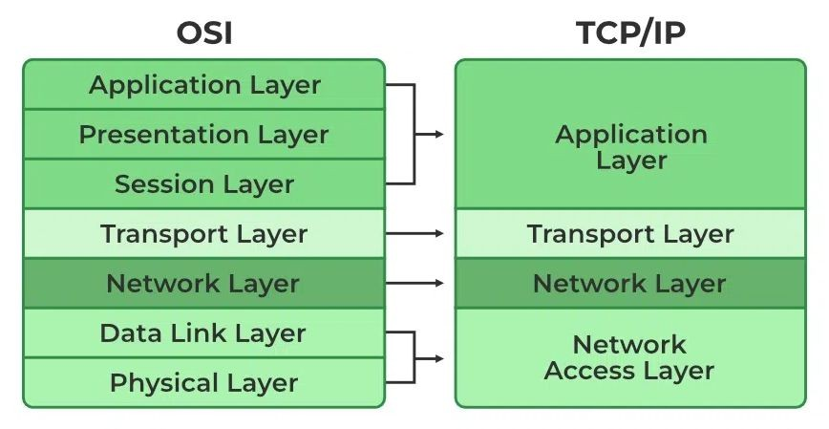
TCP/IP Model
Developed prior to the OSI model.
TCP/IP was designed and developed by the Department of Defense (DoD) in the 1960s and is based on standard
protocols. The TCP/IP model is a
concise version of the OSI model.
A hierarchical protocol made up of interactive modules, and each of them provides specific functionality.
The first four layers provide physical
standards, network
interface, transport
internetworking, and
functions that correspond to the first four layers of the OSI model.

Slide 42
NETWORK ACCESS LAYER
It is a group of applications requiring network communications. This layer is responsible for generating the data and requesting connections. It acts on behalf of the sender and the Network Access layer on the behalf of the receiver. During this article, we will be talking on the behalf of the receiver.
The packet’s network protocol type, in this case, TCP/IP, is identified by network access layer. Error prevention and “framing” are also provided by this layer. Point-to-Point Protocol (PPP) framing and Ethernet IEEE 802.2 framing are two examples of data-link layer protocols.

Slide 43
INTERNET LAYER
This layer parallels the functions of OSI’s Network layer. It defines the protocols which are responsible for the logical transmission of data over the entire network. The main protocols residing at this layer are as follows:
IP: IP stands for Internet Protocol and it is responsible for delivering packets from the source host to the destination host by looking at the IP addresses in the packet headers. IP has 2 versions: IPv4 and IPv6. IPv4 is the one that most websites are using currently. But IPv6 is growing as the number of IPv4 addresses is limited in number when compared to the number of users.
ICMP: ICMP stands for Internet Control Message Protocol. It is encapsulated within IP datagrams and is responsible for providing hosts with information about network problems.
ARP: ARP stands for Address Resolution Protocol. Its job is to find the hardware address of a host from a known IP address.
The Internet Layer is a layer in the Internet Protocol (IP) suite, which is the set of protocols that define the Internet. The Internet Layer is responsible for routing packets of data from one device to another across a network. It does this by assigning each device a unique IP address, which is used to identify the device and determine the route that packets should take to reach it.

Slide 44
TRANSPORT LAYER
The TCP/IP transport layer protocols exchange data receipt acknowledgments and retransmit missing packets to ensure that packets arrive in order and without error. End-to-end communication is referred to as such. Transmission Control Protocol (TCP) and User Datagram Protocol are transport layer protocols at this level (UDP).
TCP: Applications can interact with one another using TCP as though they were physically connected by a circuit. TCP transmits data in a way that resembles character-by-character transmission rather than separate packets. A starting point that establishes the connection, the whole transmission in byte order, and an ending point that closes the connection make up this transmission.
UDP: The datagram delivery service is provided by UDP, the other transport layer protocol. Connections between receiving and sending hosts are not verified by UDP. Applications that transport little amounts of data use UDP rather than TCP because it eliminates the processes of establishing and validating connections.

Slide 45
APPLICATION LAYER
This layer is analogous to the transport layer of the OSI model. It is responsible for end-to-end communication and error-free delivery of data. It shields the upper-layer applications from the complexities of data. The three main protocols present in this layer are:
HTTP and HTTPS: HTTP stands for Hypertext transfer protocol. It is used by the World Wide Web to manage communications between web browsers and servers. HTTPS stands for HTTP-Secure. It is a combination of HTTP with SSL(Secure Socket Layer). It is efficient in cases where the browser needs to fill out forms, sign in, authenticate, and carry out bank transactions.
SSH: SSH stands for Secure Shell. It is a terminal emulations software similar to Telnet. The reason SSH is preferred is because of its ability to maintain the encrypted connection. It sets up a secure session over a TCP/IP connection.
NTP: NTP stands for Network Time Protocol. It is used to synchronize the clocks on our computer to one standard time source. It is very useful in situations like bank transactions. Assume the following situation without the presence of NTP. Suppose you carry out a transaction, where your computer reads the time at 2:30 PM while the server records it at 2:28 PM. The server can crash very badly if it’s out of sync.

Slide 46

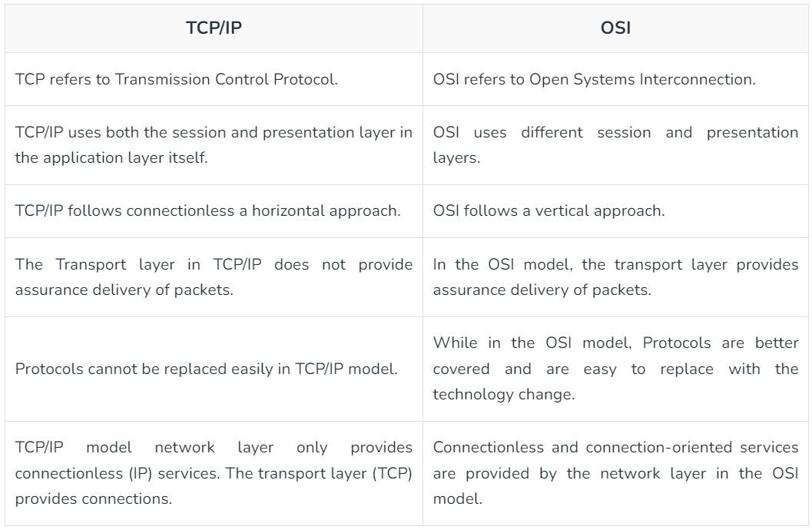

Difference between TCP/IP and OSI Model

Slide 47
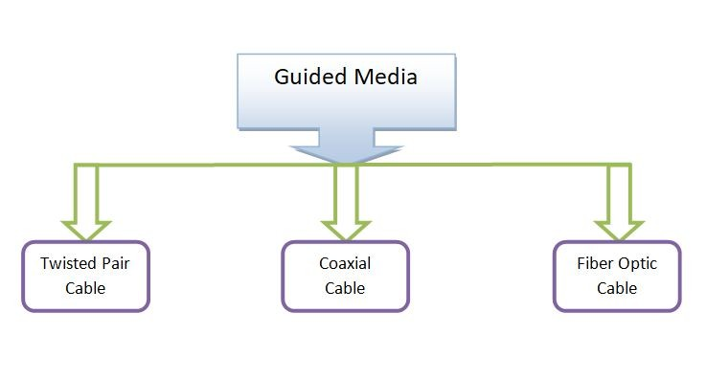
GUIDED MEDIA
Also referred to as Wired or
Bounded transmission media.
Defined as the physical medium
through which the signals are
transmitted.
Features:
High Speed
Secure
Used for comparatively shorter distances

Slide 48
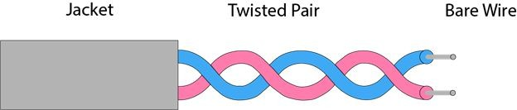
TWISTED PAIR CABLE
A type of guided media.
Invented by Alexander Graham Bell
Have two conductors that are generally made up of copper and each conductor has insulation.
These two conductors are twisted together, thus giving the name twisted pair cables.

Slide 49
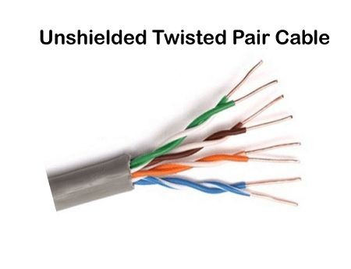
UNSHIELDED TWISTED PAIR (UTP)
CABLE
A pair of insulated copper wires twisted
together to reduce noise generated by
external interference.
Widely used in the telephone, computers, etc.
Less expensive.
Installation of the UTP is easier
Limited bandwidth for transmitting the data

Slide 50
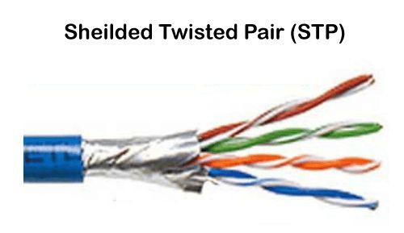
SHIELDED TWISTED PAIR (STP) CABLE
Contains an extra wrapping foil or copper braid jacket to protect the cable
Usually used underground
Costly than UTP
Supports the higher data transmission rates across the long distance
Installation of the shielded wire is more difficult than the UTP (Unshielded Twisted Pair) cable.

Slide 51
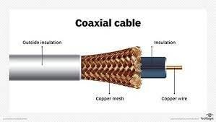
COAXIAL CABLE (COAX)
An electrical cable with a copper conductor and an insulator shielding around it and a braided metal mesh that prevents signal interference and cross talk
A type of copper cable specially built with a metal shield.
Used by cable TV companies to
connect their satellite antenna facilities to
customer homes and
businesses.

Slide 52

FIBER OPTIC CABLE
Consists of a center glass core surrounded by several layers of protective materials.
Transmits light rather than electronic signals eliminating the problem of electrical interference.
Has the capability to carry information at vastly greater speeds
Broadens communication possibilities to include services such as video conferencing and interactive services.
Provide high bandwidth at high speeds.

Slide 53
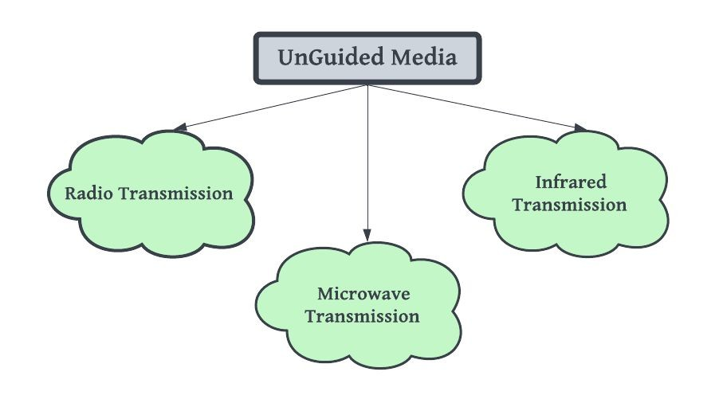
UNGUIDED MEDIA
Also known as wireless transmission.
Transmits the electromagnetic
waves without using any
physical medium.
Air is the media through which the electromagnetic energy can flow easily.

Slide 54
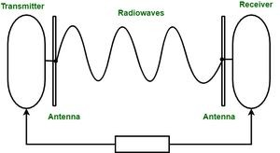
RADIO WAVES
The electromagnetic waves that are transmitted in all the directions of free space.
Omnidirectional, i.e., the signals are propagated in all the directions.
Frequencies range is from 3Khz to 1Khz.
The sending and receiving antenna are not aligned, i.e., the wave sent by the sending antenna can be received by any receiving antenna.
Useful for multicasting.
Example: FM radio, Television, cordless phones.

Slide 55
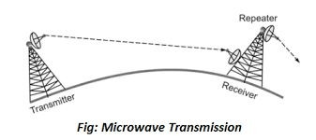
MICROWAVES
A line of sight transmission
The sending and receiving antennas need to be properly aligned with each other.
The distance covered by the signal is directly proportional to the height of the antenna.
Frequency range: 1GHZ – 300GHZ.
Majorly used for mobile phone communication and television distribution.

Slide 56
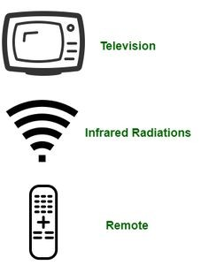
INFRAED
A wireless technology used for communication over short ranges.
Cannot penetrate through obstacles.
Prevents interference between systems.
The frequency range is from 300 GHz to 400 THz.
Used in TV remotes, wireless mouse, keyboard, printer,
Used in data transfer between two cell phones, TV remote operation, data transfer between a computer and cell phone resides in the same closed area

Slide 57


THANKS

