Slide 1
COMPUTER NETWORKS (21CSC302J)
UNIT - II

Slide 2
Unit-II Syllabus
IPV4 Addressing
Address space
Classful addressing
Subnet mask
FLSM
Classless Addressing
VLSM
NAT
Super netting
Network Devices
Hub
Repeaters
Switch
Bridge
Router

Slide 3
IPv4 ADDRESSING
An IPv4 address is a unique number assigned to every device that connects to the internet or a computer network. It’s like a home address for your computer, smartphone, or any other device, allowing it to communicate with other devices.
Format: An IPv4 address is written as four numbers separated by periods, like this: 192.168.1.1. Each number can range from 0 to 255.
The IPv4 address is divided into two parts: Network ID and Host ID.
Purpose: The main purpose of an IPv4 address is to identify devices on a network and ensure that data sent from one device reaches the correct destination.
Example: When you type a website address into your browser, your device uses the IPv4 address to find and connect to the server where the website is hosted.
Host ID
Think of an IPv4 address as a phone number for your device. Just as you dial a specific number to reach a particular person, devices use IPv4 addresses to connect and share information.

Slide 4
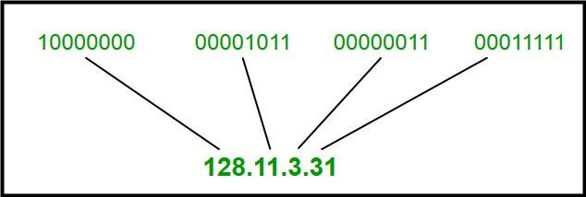
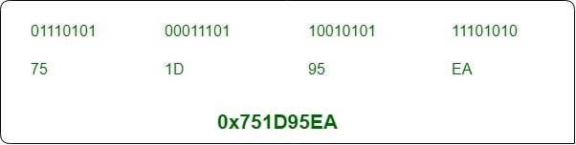
There are two notations in which the IP address is written, dotted decimal and hexadecimal notation.
Dotted Decimal Notation
Some points to be noted about dotted decimal notation:
  The value of any segment (byte) is between 0 and 255 (both included).
  No zeroes are preceding the value in any segment (054 is wrong, 54 is correct).
Hexadecimal Notation

Slide 5
Address Space
An IP address space is a pool of IP addresses that are available for assignment to devices and machines that access the internet. The size of the IP address space depends on the version of IP address, IPv4 or IPv6:
IPv4 Address Space : IPv4 addresses are 32 bits long, which means the IPv4 address space is 4,294,967,296 addresses in size. However, some IP addresses are reserved for special purposes, such as private networks and multicast addressing, so the total number of available addresses is less than the total number in the pool.
IPv6 Address Space : IPv6 addresses are 128 bits long, which means the IPv6 address space is 340,282,366,920,938,463,463,374,607,431,768,211,456 addresses in size.

Slide 6
IPv4 Address Space
The address space of IPv4 (Internet Protocol version 4) is 4,294,967,296 IP addresses, or 2³². This is because IPv4 addresses are 32-bit integers, and a bit is a digit in the binary numeral system. IPv4 addresses are often represented in dotted quad or dotted decimal notation, which is x.x.x.x, where each x can be any value between 0 and 255. For example, 192.0.2.146 is a valid IPv4 address. In each part of the address, the numbers represent a group of 8 bits, or an octet.
IPv4 reserves some addresses for special purposes, such as private networks and multicast addressing:
Private networks: Around 18 million addresses, reserved from the 224, 220, and 216 ranges
Multicast addressing: Around 268 million addresses, reserved from the 228 range

Slide 7
IPv6 & IPv6 Address Space
The address space of IPv4 (Internet Protocol version 4) is 4,294,967,296 IP addresses, or 2³². This is because IPv4 addresses are 32-bit integers, and a bit is a digit in the binary numeral system. IPv4 addresses are often represented in dotted quad or dotted decimal notation, which is x.x.x.x, where each x can be any value between 0 and 255. For example, 192.0.2.146 is a valid IPv4 address. In each part of the address, the numbers represent a group of 8 bits, or an octet.
IPv4 reserves some addresses for special purposes, such as private networks and multicast addressing:
Private networks: Around 18 million addresses, reserved from the 224, 220, and 216 ranges
Multicast addressing: Around 268 million addresses, reserved from the 228 range
₍₂128₎
The IPv6 address space is 128-bits in size, containing
340,282,366,920,938,463,463,374,607,431,768,211,456 IPv6 addresses.

Slide 8
Classful Addressing
Classful IP addressing is a way of organizing and managing IP addresses, which are used to identify devices on a network. Think of IP addresses like street addresses for houses; each device on a network needs its unique address to communicate with other devices.
Need For Classful Addressing
Initially in 1980’s IP address was divided into two fixed part i.e., NID(Network ID) = 8bit, and HID(Host ID) = 24bit. So, there are 28 that is 256 total network are created and 224 that is 16M Host per network.
There are one 256 Networks and even a small organization must buy 16M computer(Host) to purchase one network. That’s why we need classfull addressing.
Classful Addressing
The 32-bit IP address is divided into five sub-classes. These are given below:
  Class A
  Class B
  Class C
  Class D
  Class E

Slide 9
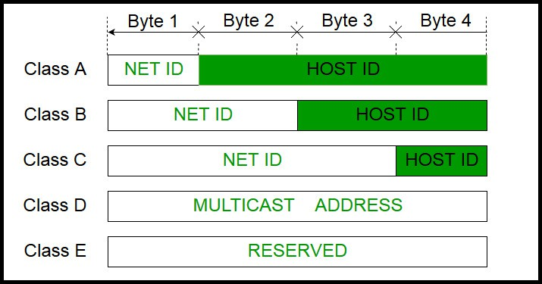
Cont.
Each of these classes has a valid range of IP addresses. Classes D and E are reserved for multicast and experimental purposes, respectively. The order of bits in the first octet determines the classes of the IP address.
The class of IP address is used to determine the bits used for network ID and host ID and the number of total networks and hosts possible in that class. Each ISP or network administrator assigns an IP address to each device that is connected to its network.

Slide 10
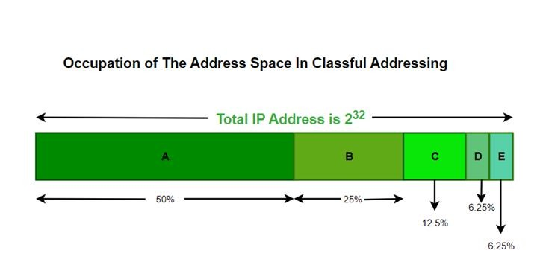
Cont.
IP addresses are globally managed by Internet Assigned Numbers Authority(IANA) and Regional Internet Registries(RIR).
While finding the total number of host IP addresses, 2 IP addresses are not counted and are therefore, decreased from the total count because the first IP address of any network is the network number and whereas the last IP address is reserved for broadcast IP.

Slide 11
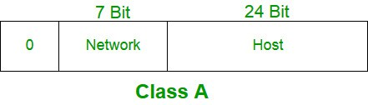
Class A IP Address
IP addresses belonging to class A are assigned to the networks that contain a large number of hosts. The network ID is 8 bits long.
The host ID is 24 bits long.
The higher-order bit of the first octet in class A is always set to 0. The remaining 7 bits in the first octet are used to determine network ID. The 24 bits of host ID are used to determine the host in any network. The default subnet mask for Class A is 255.x.x.x. Therefore, class A has a total of:
2^24 – 2 = 16,777,214 host ID
IP addresses belonging to class A ranges from 0.0.0.0 – 127.255.255.255.

Slide 12
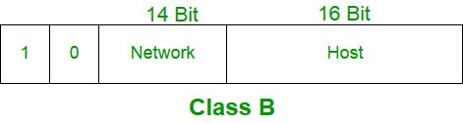
Class B IP Address
IP address belonging to class B is assigned to networks that range from medium-sized to large-sized networks.
The network ID is 14 bits long. The host ID is 16 bits long.
The higher-order bits of the first octet of IP addresses of class B are always set to 10. The remaining 14 bits are used to determine the network ID. The 16 bits of host ID are used to determine the host in any network. The default subnet mask for class B is 255.255.x.x. Class B has a total of:
2^14 = 16384 network address 2^16 – 2 = 65534 host address
IP addresses belonging to class B ranges from 128.0.0.0 – 191.255.255.255.

Slide 13
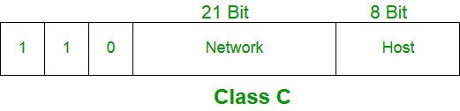
Class C IP Address
IP addresses belonging to class C are assigned to small-sized networks. The network ID is 24 bits long.
The host ID is 8 bits long.
The higher-order bits of the first octet of IP addresses of class C is always set to 110. The remaining 21 bits are used to determine the network ID. The 8 bits of host ID are used to determine the host in any network. The default subnet mask for class C is 255.255.255.x. Class C has a total of:
2^21 = 2097152 network address 2^8 – 2 = 254 host address
IP addresses belonging to class C range from 192.0.0.0 – 223.255.255.255.

Slide 14
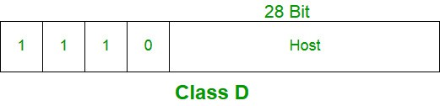

Class D & E IP Address
IP address belonging to class D is reserved for multi-casting. The higher-order bits of the first octet of IP addresses belonging to class D is always set to 1110. The remaining bits are for the address that interested hosts recognize.
Class D does not possess any subnet mask. IP addresses belonging to class D range from 224.0.0.0 – 239.255.255.255.
IP addresses belonging to class E are reserved for experimental and research purposes. IP addresses of class E range from 240.0.0.0 – 255.255.255.255. This class doesn’t have any subnet mask. The higher-order bits of the first octet of class E are always set to 1111.

Slide 15

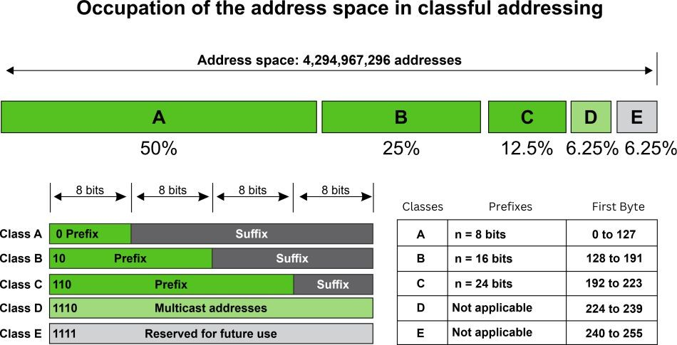

Cont.

Slide 16
Rules for Assigning Host ID
Host IDs are used to identify a host within a network. The host ID is assigned based on the following rules:
Within any network, the host ID must be unique to that network.
A host ID in which all bits are set to 0 cannot be assigned because this host ID is used to represent the network ID of the IP address.
Host ID in which all bits are set to 1 cannot be assigned because this host ID is reserved as a broadcast address to send packets to all the hosts present on that network.

Slide 17
Rules for Assigning Network ID
Hosts that are located on the same physical network are identified by the network ID, as all host on the same physical network is assigned the same network ID. The network ID is assigned based on the following rules:
The network ID cannot start with 127 because 127 belongs to the class A address and is reserved for internal loopback functions.
All bits of network ID set to 1 are reserved for use as an IP broadcast address and therefore, cannot be used.
All bits of network ID set to 0 are used to denote a specific host on the local network and are not routed and therefore, aren’t used.

Slide 18
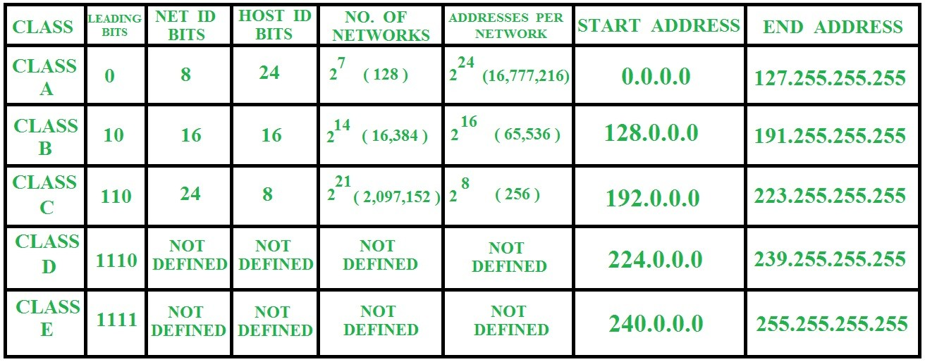
Summary of Classful Addressing
In the above table No. of networks for class A should be
127. (Network ID with all 0 s is not considered)

Slide 19
Problems With Classful Addressing
The problem with this classful addressing method is that millions of class A addresses are wasted, many of the class B addresses are wasted, whereas the number of addresses available in class C is so small that it cannot cater to the needs of organizations. Class D addresses are used for multicast routing and are therefore available as a single block only. Class E addresses are reserved.
Since there are these problems, Classful networking was replaced by Classless Inter-Domain Routing (CIDR) in 1993. We will be discussing Classless addressing in the next post.
The network ID is 24 bits long.
The host ID is 8 bits long.
2^21 = 2097152 network address
2^8 – 2 = 254 host address
Within any network, the host ID must be unique to that network.
Host ID in which all bits are set to 0 cannot be assigned because this host ID is used to represent the network ID of the IP address.

Slide 20
Problems With Classful Addressing
Host ID in which all bits are set to 1 cannot be assigned because this host ID is reserved as a broadcast address to send packets to all the hosts present on that network.
The network ID cannot start with 127 because 127 belongs to the class A address and is reserved for internal loopback functions.
All bits of network ID set to 1 are reserved for use as an IP broadcast address and therefore, cannot be used.
All bits of network ID set to 0 are used to denote a specific host on the local network and are not routed and therefore, aren’t used.

Slide 21
Classless Addressing
The address depletion issue was not fully resolved by classful addressing's subnetting and supernetting techniques. As the Internet expanded, it became obvious that a bigger address space was required as a long-term fix. However, the expanded address space necessitates that IP addresses should be longer as well, necessitating a change in IP packet syntax. The short-term solution, which uses the same address space but modifies the distribution of addresses to deliver a fair amount to each business, was developed even though the long-term solution, known as IPv6, has already been developed. Classless addressing is the temporary fix, which nevertheless makes use of IPv4 addresses. To make up for address depletion, the class privilege was taken out of the distribution.
The entire address space is partitioned into blocks of varying lengths with classless addressing. An address's prefix designates the block (network); its suffix designates the node (device). We can have a block of 20, 21, 22 ,..., 232 addresses, theoretically. One of the limitations is that a block of addresses must have a power of two addresses. One address block may be given to an organization. The given figure demonstrates the non-overlapping block segmentation of the entire address space.
The Network address identifies a network on the internet. Using this, we can find a range of addresses in the network and total possible number of hosts in the network.
Mask is a 32-bit binary number that gives the network address in the address block when AND operation is bitwise applied on the mask and any IP address of the block.

Slide 22
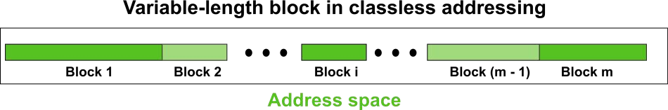
Classless Addressing
The default masks in different classes are :
  Class A – 255.0.0.0
  Class B – 255.255.0.0
  Class C – 255.255.255.0
In contrast to classful addressing, classless addressing allows for varying prefix lengths. Prefix lengths that vary from 0 to 32 are possible. The length of the prefix has an inverse relationship with network size. A smaller network has a large prefix; a larger one has a small prefix.
We must stress that classful addressing is just as easily adaptable to the concept of classless addressing. Consider an address in class A as a classless address with a prefix length of 8. Class B addresses can be viewed as classless addresses with the prefix 16 and so on. Putting it another way, classless addressing is a specific instance of classful addressing.

Slide 23
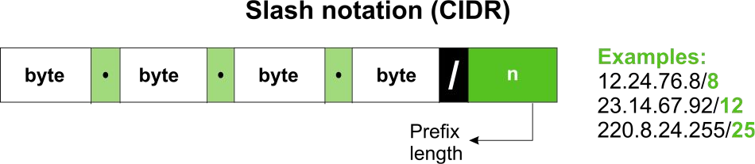
Prefix Length - Slash Notation
In classless addressing, the first issue that needs to be resolved is how to determine the prefix length if an address is provided. We must individually provide the prefix length because it is not a property of the address. The address is inserted in this scenario, followed by a slash, and the prefix length, n. Slash notation is the colloquial name for the notation, while classless interdomain routing, or CIDR (pronounced cider) method, is the official name. An address in classless addressing can thus be expressed as illustrated in the figure below.
To put it another way, we must also provide the prefix length in classless addressing because an address does not automatically define the block or network to which it belongs.

Slide 24
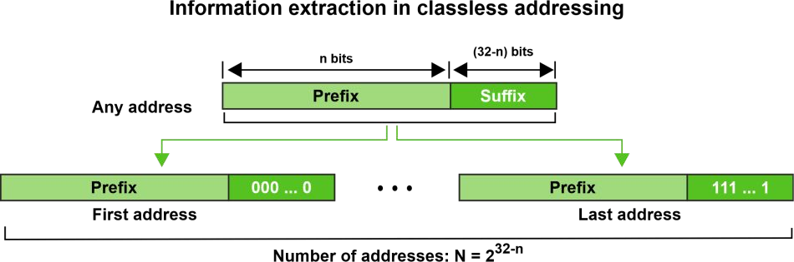
Extracting Information from an Address
With respect to any given address in the block, we typically like to know three things: the number of addresses in the block, the start address in the block, and the last address. These three pieces of information, which are depicted in the picture below, are simple to locate because the prefix length, n, is known.
The block has N = 232n addresses, according to the calculation.
The n leftmost bits are kept, and the (32 - n) rightmost bits are all set to zeroes to determine the first address. The n leftmost bits are kept, while the (32 - n) rightmost bits are all set to 1s to determine the last address.

Slide 25
Difference Between Classful and Classless Addressing
IP addresses are divided into five groups using the classful addressing approach when they are assigned. In order to prevent the depletion of IP addresses, classless addressing is used. It is a method of IP address allocation that will eventually replace classful addressing.
A further distinction is the usefulness of classful and classless addressing. Comparatively speaking, classless addressing is more beneficial and useful than classful addressing.
In classful addressing, the network ID and host ID are adjusted according to the classes. However, the distinction between network ID and host ID does not exist with classless addressing. This opens up the possibility of making yet another contrast between both addressing.

Slide 26
Subnet Mask
A subnet mask is a 32-bit binary number that's used to determine the destination of a network packet. It's part of a network address and is always used with an Internet Protocol (IP) address. The subnet mask separates the network address from the host address, allowing a router to quickly determine where to forward the packet.
A subnet mask tells the computer which part of the IP address serves as the network portion of the address and which part identifies the host address range. The ones indicate bits in the address used for the network prefix and the trailing block of zeros designates that part as being the host identifier. For example, the typical IPv4 subnet mask is designated 255.255.255.0.
Subnet masks play an important role in ensuring that traffic is contained within the defined subnet. This helps to avoid network congestion, reduce the network load, and boost overall network performance and speed.
Subnet masks are also expressed in dot-decimal notation like an IP address. For example, the prefix 198.51.100.0/24 would have the subnet mask 255.255.255.0. Traffic is exchanged between subnets through routers when the routing prefixes of the source address and the destination address differ.

Slide 27
Function of Subnet Mask
A 32-bit address that distinguishes the network address from the host address makes up the subnet mask. This indicates which part of the IP address belongs in the host section and which part belongs in the network section. The number of hosts that can be on the subnet depends on the values of the subnet mask. This comprises bits that are initialized to 1 for the network and 0 for the host. Routers and switches use it internally to send packets to the destination node along the associated local network connection.
Suppose we have a Class A network which means we have 16 million hosts in a network. The task we must do is:
Maintenance of such a huge network
Security for the network – For example, we have 4 departments in a company and all of the 4 departments need not access the whole network.
For this, we need Subnetting

Slide 28
Subnetting
A subnet, or subnetwork, is a network inside a network. Subnets make networks more efficient. Through subnetting, network traffic can travel a shorter distance without passing through unnecessary routers to reach its destination.
When a bigger network is divided into smaller networks, to maintain security, then that is known as Subnetting. So, maintenance is easier for smaller networks. For example, if we consider a class A address, the possible number of hosts is 224 for each network, it is obvious that it is difficult to maintain such a huge number of hosts, but it would be quite easier to maintain if we divide the network into small parts.
Uses of Subnetting
Subnetting helps in organizing the network in an efficient way which helps in expanding the technology for large firms and companies.
Subnetting is used for specific staffing structures to reduce traffic and maintain order and efficiency.
Subnetting divides domains of the broadcast so that traffic is routed efficiently, which helps in improving network performance.
Subnetting is used in increasing network security.

Slide 29
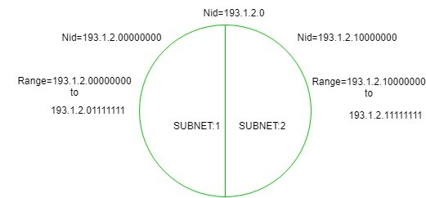
Subnetting
The network can be divided into two parts: To divide a network into two parts, you need to choose one bit for each Subnet from the host ID part.
In this diagram, there are two Subnets.
It is a class C IP so, there are 24 bits in the network id part and 8 bits in the host id part.

Slide 30
Fixed-Length Subnet Mask (FLSM)
When a block of addresses is divided into subnets all having an equal number of addresses, the type of subnetting is said to be Fixed Length Subnetting. The subnet masks used here will be the same for all the subnets as the number of addresses is equal for each subnet.
A fixed-length subnet mask (FLSM) refers to a type of enterprise or provider networking where a block of IP addresses is divided into multiple subnets of equal length, i.e., an equal number of IP addresses. FLSM streamlines packet routing within the subnets of a proprietary network.
A subnet can be a geographically defined local area network (LAN). Alternatively, it may define security boundaries, departmental boundaries, multicast zones or hardware security parameters. One benefit is to create locally significant subnet identification addresses
Subnetting means dividing a network into multiple smaller subnetworks by using a subnetting mask. In FLSM, the number of IP addresses is the same in each subnet. Another way of saying this is that the same number of IP addresses are allocated to each subnet. Therefore, the subnet mask used will be the same for all the subnets.

Slide 31
Virtual Length Subnet Mask (VLSM )
VLSM stands for Variable Length Subnet Mask. VLSM is a subnetting technique that allows network admins to allocate IP addresses more efficiently using different subnet masks for different network segments.
Variable Length Subnet Mask (VLSM) is a technique used in IP network design to create subnets with different subnet masks. VLSM allows network administrators to allocate IP addresses more efficiently and effectively, by using smaller subnet masks for subnets with fewer hosts and larger subnet masks for subnets with more hosts.
VLSM is an IP routing technique that is applied for optimal use of the available Internet Protocol address space. Specifically, with the virtue of CIDR (Classless Inter-domain Routing), the IP address space is segmented into variable-size subnets against the obscured of the actual number of hosts within each subnet. Typically, such a strategy causes consumption of IP addresses in an inefficient manner, the more so the more distinct within sub-nets is the number of hosts. VLSM enables you to subnet a subnet, that is to turn it into a subnet that has variable sizes. Subnetting in this case means that you can separate a large network into smaller networks so that their size will meet the number of network devices on each network. Thus, subnetting’s ability to provide restrictions allows more efficient use of IP address space in IPv4 networking and helps economize on IP address requirements.

Slide 32
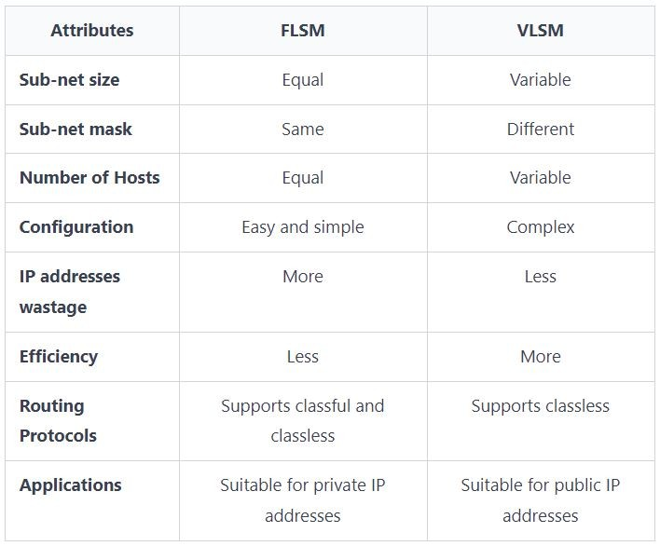
Differences Between FLSM and VLSM

Slide 33
Network Address Translation (NAT)
Network Address Translation (NAT) is a process in which one or more local IP addresses are translated into one or more Global IP addresses and vice versa to provide Internet access to the local hosts. It also does the translation of port numbers, i.e., masks the port number of the host with another port number in the packet that will be routed to the destination. It then makes the corresponding entries of IP address and port number in the NAT table. NAT generally operates on a router or firewall.
One public IP address is needed to access the Internet, but we can use a private IP address in our private network. The idea of NAT is to allow multiple devices to access the Internet through a single public address. To achieve this, a private IP address must be translated into a public IP address.
Generally, the border router is configured for NAT i.e., the router which has one interface in the local (inside) network and one interface in the global (outside) network. When a packet traverse outside the local (inside) network, then NAT converts that local (private) IP address to a global (public) IP address. When a packet enters the local network, the global (public) IP address is converted to a local (private) IP address.
If NAT runs out of addresses, i.e., no address is left in the pool configured then the packets will be dropped and an Internet Control Message Protocol (ICMP) host unreachable packet to the destination is sent.

Slide 34
Types of NAT
There are 3 ways to configure NAT-
Static NAT: In this, a single unregistered (Private) IP address is mapped with a legally registered (Public) IP address i.e. one-to-one mapping between local and global addresses. This is generally used for Web hosting. These are not used in organizations as there are many devices that will need Internet access and to provide Internet access, a public IP address is needed.
Dynamic NAT: In this type of NAT, an unregistered IP address is translated into a registered (Public) IP address from a pool of public IP addresses. If the IP address of the pool is not free, then the packet will be dropped as only a fixed number of private IP addresses can be translated to public addresses.
Port Address Translation (PAT): This is also known as NAT overload. In this, many local (private) IP addresses can be translated to a single registered IP address. Port numbers are used to distinguish the traffic i.e., which traffic belongs to which IP address. This is most frequently used as it is cost-effective as thousands of users can be connected to the Internet by using only one real global (public) IP address.

Slide 35
Network Devices
Hardware devices that are used to connect computers, printers, fax machines and other electronic devices to a network are called network devices. These devices transfer data in a fast, secure and correct way over same or different networks. Network devices may be inter-network or intra-network. Some devices are installed on the device.
Network devices, also known as networking hardware, are physical devices that allow hardware on a computer network to communicate and interact with one another.
For example-
Hub
Repeater
Switch
Bridge
Routers

Slide 36
Hub
A hub is a basically multi-port repeater. A hub connects multiple wires coming from different branches, for example, the connector in star topology which connects different stations. Hubs cannot filter data, so data packets are sent to all connected devices. In other words, the collision domain of all hosts connected through Hub remains one. Also, they do not have the intelligence to find out the best path for data packets which leads to inefficiencies and wastage.
Types of Hub
Active Hub:- These are the hubs that have their power supply and can clean, boost, and relay the signal along with the network. It serves both as a repeater as well as a wiring center. These are used to extend the maximum distance between nodes.
Passive Hub:- These are the hubs that collect wiring from nodes and power supply from the active hub. These hubs relay signals onto the network without cleaning and boosting them and can’t be used to extend the distance between nodes.
Intelligent Hub:- It works like an active hub and includes remote management capabilities. They also provide flexible data rates to network devices. It also enables an administrator to monitor the traffic passing through the hub and to configure each port in the hub.

Slide 37
Repeater
A repeater operates at the physical layer. Its job is to amplifies (i.e., regenerates) the signal over the same network before the signal becomes too weak or corrupted to extend the length to which the signal can be transmitted over the same network. When the signal becomes weak, they copy it bit by bit and regenerate it at its star topology connectors connecting following the original strength. It is a 2-port device.
A repeater is a component in computer networks that amplifies and regenerates signals as they go through the system. A repeater's main function is to increase signal strength and quality over vast distances or dense blocks to increase a network's range. Repeaters are frequently employed in LANs and WANs to increase the network's performance and dependability. They can aid in preventing data loss, minimizing mistakes, and ensuring that the signal is strong and of high enough quality when it reaches its intended location.
Repeaters are devices that computer networks employ to increase the range of network signals beyond their typical range restrictions. Organizations may get over the restrictions of physical cabling and ensure that data can travel farther distances without losing quality by integrating repeaters into a network.

Slide 38
Switch
Switch is a network device that connects other devices to Ethernet networks through twisted pair cables. It uses packet switching technique to receive, store and forward data packets on the network. The switch maintains a list of network addresses of all the devices connected to it.
On receiving a packet, it checks the destination address and transmits the packet to the correct port. Before forwarding, the packets are checked for collision and other network errors. The data is transmitted in full duplex mode.
Data transmission speed in switches can be double that of other network devices like hubs used for networking. This is because switch shares its maximum speed with all the devices connected to it. This helps in maintaining network speed even during high traffic. In fact, higher data speeds are achieved on networks through use of multiple switches.

Slide 39
Bridge
A bridge operates at the data link layer. A bridge is a repeater, with add on the functionality of filtering content by reading the MAC addresses of the source and destination. It is also used for interconnecting two LANs working on the same protocol. It has a single input and single output port, thus making it a 2-port device.
Types of Bridges
Transparent Bridges:- These are the bridge in which the stations are completely unaware of the bridge’s existence i.e., whether or not a bridge is added or deleted from the network, reconfiguration of the stations is unnecessary. These bridges make use of two processes i.e., bridge forwarding and bridge learning.
Source Routing Bridges:- In these bridges, routing operation is performed by the source station and the frame specifies which route to follow. The host can discover the frame by sending a special frame called the discovery frame, which spreads through the entire network using all possible paths to the destination.

Slide 40
Router
A router is a device like a switch that routes data packets based on their IP addresses. The router is mainly a Network Layer device. Routers normally connect LANs and WANs and have a dynamically updating routing table based on which they make decisions on routing the data packets. The router divides the broadcast domains of hosts connected through it.
The router is a physical or virtual internetworking device that is designed to receive, analyze, and forward data packets between computer networks. A router examines a destination IP address of a given data packet, and it uses the headers and forwarding tables to decide the best way to transfer the packets.
A router is used in LAN (Local Area Network) and WAN (Wide Area Network) environments. For example, it is used in offices for connectivity, and you can also establish the connection between distant networks.
It shares information with other routers in networking.
It uses the routing protocol to transfer the data across a network.
Furthermore, it is more expensive than other networking devices like switches and hubs.

Slide 41


Thank You

