Slide 1

NETWORKING FUNDAMENTALS
IP Address
For Beginners: Understanding IPv4 & IPv6 Addressing
A foundational concept every DevOps engineer, SRE, and developer needs to master — essential for cloud networking, Kubernetes, and infrastructure design.

Slide 2


What Is an IP Address?
A unique address that identifies every device on a computer network — either a 32-bit IPv4 address or a 128-bit IPv6 address.
IPv4
IPv6
32-bit address
128-bit address
192.168.1.1
1050:0000:0000:0000:0005:0600:300c:326a
Four octets (0-255), separated by dots
Range: 0.0.0.0 to 255.255.255.255
~4.3 billion possible addresses (4,294,967,296)
Eight groups of 16 bits (hextets), separated by colons
Created in 1998 to solve IPv4 exhaustion
340 trillion trillion trillion possible addresses

Slide 3


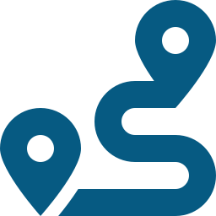

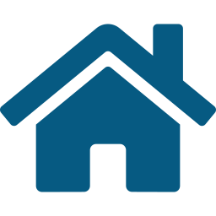
IPv4 Addressing: The Basics
Divided into 5 classes
Classes A through E, each covering a distinct range for different network sizes.
TOTAL IPv4 ADDRESS SPACE
4.3
0.0.0.0/8 reserved
Used historically for device auto-configuration before DHCP existed.
BILLION ADDRESSES
Private ranges carved out
IETF/IANA reserved blocks for internal, non-internet-facing networks.
Exactly 4,294,967,296 unique addresses — the theoretical maximum of a 32-bit address space.
127.0.0.0/8 = loopback
Reserved for local network testing — 127.0.0.1 is the classic example.
Range: 0.0.0.0 – 255.255.255.255

Slide 4

IP Address Classes
IPv4's 4.3 billion addresses are divided into five classes, each spanning a defined range.
A
Class A
0.0.0.0 – 127.255.255.255
B
Class B
128.0.0.0 – 191.255.255.255
C
Class C
192.0.0.0 – 223.255.255.255
D
Class D
224.0.0.0 – 239.255.255.255
E
Class E
240.0.0.0 – 255.255.255.255
Note: 0.0.0.0/8 is reserved for auto-configuration — today only 0.0.0.0 itself is used, meaning “this host on this network.”

Slide 5
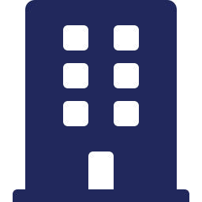



Private IP Ranges
IANA and IETF reserved these ranges so organizations can build internal networks — connecting to the internet via NAT-enabled devices.
Class A
Class B (APIPA)
10.0.0.0 – 10.255.255.255
169.254.0.0 – 169.254.255.255
Largest private block — common for big corporate & cloud networks
Automatic Private IP Addressing — self-assigned when DHCP fails
Class B
Class C
172.16.0.0 – 172.31.255.255
192.168.0.0 – 192.168.255.255
Widely used for container & orchestration networks (e.g. Docker)
Most common on home routers and small office networks

Slide 6

Special-Purpose IPv4 Ranges
Beyond public and private ranges, a few blocks serve specific technical purposes.
IPv4 Shared Address Space
100.64.0.0/10
Used by ISPs implementing carrier-grade NAT — every ISP can reuse this address space. Also usable inside your own infrastructure, e.g. as a Pod CIDR range in Kubernetes (verify cloud-provider support first, as misconfiguration can cause routing issues).
Loopback Addresses
127.0.0.1 – 127.255.255.255
Used for local network testing — the classic 127.0.0.1

Slide 7



IPv6 Addressing: The Basics
Example Address
1050:0000:0000:0000:0005:0600:300c:326a
TOTAL IPv6 ADDRESS SPACE
340
fc00::/7 — Unique Local Address
The IPv6 block reserved for private networks, equivalent to IPv4's private ranges.
TRILLION TRILLION TRILLION
Purpose-built for scale
Addresses — enough to assign a unique IP to every atom on the surface of the earth many times over.
8 groups of 16 bits each replace IPv4's 4 octets, massively expanding the address space.
128-bit address · 8 hextets
Created in 1998 by the IETF to solve IPv4 exhaustion

Slide 8
Why Do We Need IPv6?
The growth of internet-connected devices made IPv4's 4.3 billion addresses insufficient.
1980s
Jun 6, 2012
The Warning Signs
Official Rollout
IETF realizes 4.3 billion IPv4 addresses won't be enough as more devices connect to the internet.
IPv6 officially begins deployment across the global internet — World IPv6 Launch Day.
1998
Today
IPv6 Is Created
37% Global Adoption
The IETF finalizes IPv6, expanding the address space to 340 trillion trillion trillion addresses.
Adoption continues to climb as ISPs and cloud providers roll out IPv6-enabled infrastructure.

Slide 9

Global IPv6 Adoption
Despite being deployed since 2012, global rollout is still underway.
Slow, steady climb
Adoption has grown gradually since the official 2012 launch, driven by mobile carriers and major cloud platforms.
37%
Address exhaustion pressure
IPv4 exhaustion continues to push ISPs and enterprises toward dual-stack and IPv6-only deployments.
GLOBAL ADOPTION
Why it matters for DevOps
Engineers working in cloud-native environments increasingly need to design for both protocols.
Source: Google IPv6 Adoption Statistics

Slide 10

Frequently Asked Questions
How do I purchase a static public IP?
Purchase public IP ranges from a Regional Internet Registry (RIR) and own them for a set period, or acquire one through your Internet Service Provider.
Who owns public IP addresses?
IANA and the five Regional Internet Registries (RIRs) maintain them and assign IPs to local registries, ISPs, and end users — once purchased, you're the owner.
Do DevOps engineers need to know IP addressing?
Yes. Working with CIDR ranges and public/private IPs in cloud environments makes IP address concepts essential knowledge.

Slide 11



Key Takeaways
Understanding IPv4 and IPv6 is essential for any DevOps engineer working in cloud networking.
Two protocols, one job
Public vs. private ranges
IPv4 (32-bit, ~4.3B addresses) and IPv6 (128-bit, 340 trillion trillion trillion) both uniquely identify devices on a network.
Private ranges (10.x, 172.16-31.x, 192.168.x) power internal networks; NAT connects them to the public internet.
Special-purpose blocks matter
IPv6 adoption is still growing
Loopback (127.0.0.0/8), shared address space (100.64.0.0/10), and IPv6's fc00::/7 each serve a specific technical role.
At ~37% global adoption, dual-stack thinking is increasingly a core DevOps and cloud networking skill.

