Slide 1
JAVA
What you learn ?
Java
String | String Pool
String methods | StringBuffer
StringBuilder | String VS StringBuffer Vs StringBuilder
Regular Expression

Slide 2
String
In Java, string is basically an object that represents sequence of char values. An array of characters works same as Java string.
The java.lang.String class implements Serializable, Comparable and CharSequence interfaces.
The Java String is immutable which means it cannot be changed. Whenever we change any string, a new instance is created. For mutable strings, you can use StringBuffer and StringBuilder classes.

Slide 3
String in JAVA vs String in C++
In Java strings are immutable reference types.
In C++ strings are mutable and employ value semantics.
Two strings in C++ will evaluate true to a “==” operation if they contain the same value, regardless of whether they are the same object or not.
In Java comparing two String variables with ‘==’ does a reference equality test. Surprisingly you might declare the same two Strings and initialize them with the same string literal — then you’d expect them not to have reference equality — but they might still because of string interning.

Slide 4
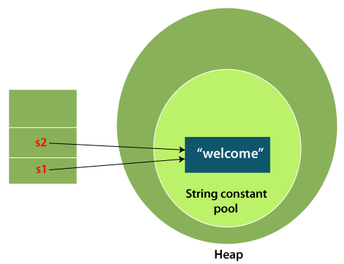
String
There are two ways to create String object:
By string literal
By new keyword
String Literal
Java String literal is created by using double quotes.
Each time you create a string literal, the JVM checks the "string constant pool" first. If the string already exists in the pool, a reference to the pooled instance is returned. If the string doesn't exist in the pool, a new string instance is created and placed in the pool.
For example:
String s1="Welcome";
String s2="Welcome";//It doesn't create a new instance

Slide 5
String
2) By new keyword
String s=new String("Welcome"); //creates two objects and one reference variable
In such case, JVM will create a new string object in normal (non-pool) heap memory, and the literal "Welcome" will be placed in the string constant pool. The variable s will refer to the object in a heap (non-pool).

Slide 6
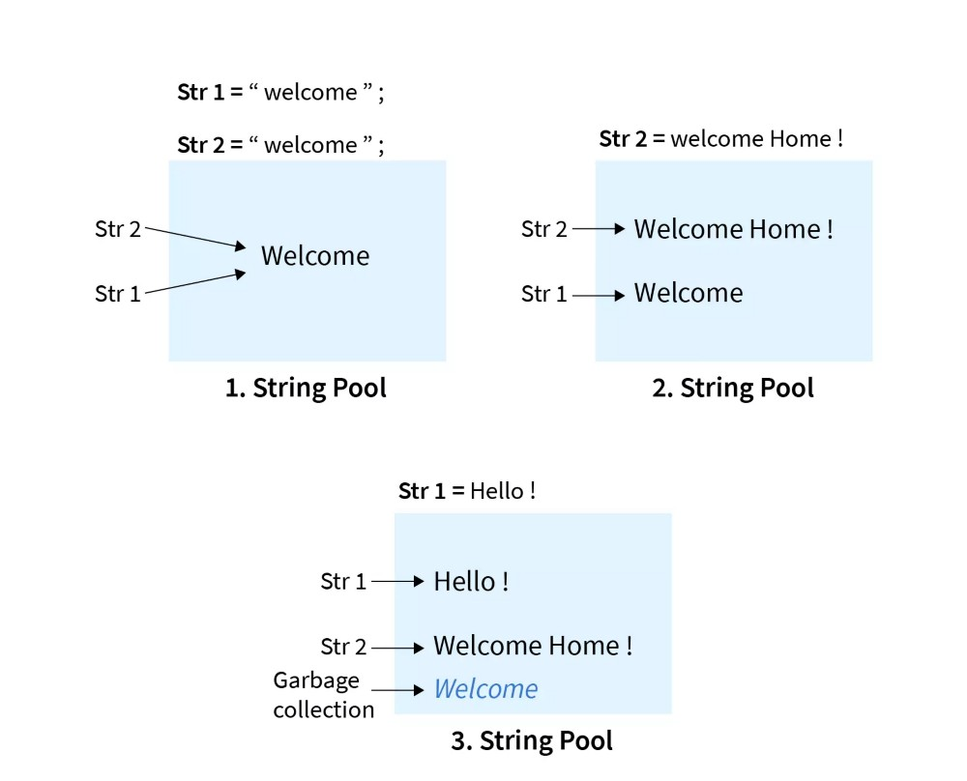
String Pool

Slide 7
String methods
Method | Description | Return Type
charAt() | Returns the character at the specified index (position) | char
codePointAt() | Returns the Unicode of the character at the specified index | int
codePointBefore() | Returns the Unicode of the character before the specified index | int
codePointCount() | Returns the number of Unicode values found in a string. | int
compareTo() | Compares two strings lexicographically | int
compareToIgnoreCase() | Compares two strings lexicographically, ignoring case differences | int

Slide 8
String methods
Method | Description | Return Type
concat() | Appends a string to the end of another string | String
contains() | Checks whether a string contains a sequence of characters | boolean
contentEquals() | Checks whether a string contains the exact same sequence of characters of the specified CharSequence or StringBuffer | boolean
copyValueOf() | Returns a String that represents the characters of the character array | String
endsWith() | Checks whether a string ends with the specified character(s) | boolean
equals() | Compares two strings. Returns true if the strings are equal, and false if not | boolean

Slide 9
String methods
Method | Description | Return Type
equalsIgnoreCase() | Compares two strings, ignoring case considerations | boolean
format() | Returns a formatted string using the specified locale, format string, and arguments | String
getBytes() | Encodes this String into a sequence of bytes using the named charset, storing the result into a new byte array | byte[]
getChars() | Copies characters from a string to an array of chars | void
hashCode() | Returns the hash code of a string | int
indexOf() | Returns the position of the first found occurrence of specified characters in a string | int

Slide 10
String methods
Method | Description | Return Type
intern() | Returns the canonical representation for the string object | String
isEmpty() | Checks whether a string is empty or not | boolean
lastIndexOf() | Returns the position of the last found occurrence of specified characters in a string | int
length() | Returns the length of a specified string | int
matches() | Searches a string for a match against a regular expression, and returns the matches | boolean
offsetByCodePoints() | Returns the index within this String that is offset from the given index by codePointOffset code points | int
regionMatches() | Tests if two string regions are equal | boolean

Slide 11
String methods
Method | Description | Return Type
replace() | Searches a string for a specified value, and returns a new string where the specified values are replaced | String
replaceFirst() | Replaces the first occurrence of a substring that matches the given regular expression with the given replacement | String
replaceAll() | Replaces each substring of this string that matches the given regular expression with the given replacement | String
split() | Splits a string into an array of substrings | String[]
startsWith() | Checks whether a string starts with specified characters | boolean
substring() | Returns a new string which is the substring of a specified string | String

Slide 12
String methods
Method | Description | Return Type
toCharArray() | Converts this string to a new character array | char[]
toLowerCase() | Converts a string to lower case letters | String
toString() | Returns the value of a String object | String
toUpperCase() | Converts a string to upper case letters | String
trim() | Removes whitespace from both ends of a string | String
valueOf() | Returns the string representation of the specified value | String
substring() | Returns a new string which is the substring of a specified string | String
subSequence() | Returns a new character sequence that is a subsequence of this sequence | CharSequence

Slide 13
StringBuffer
StringBuffer is a peer class of String that provides much of the functionality of strings. The string represents fixed-length, immutable character sequences while StringBuffer represents growable and writable character sequences.
StringBuffer may have characters and substrings inserted in the middle or appended to the end. It will automatically grow to make room for such additions and often has more characters preallocated than are actually needed, to allow room for growth.
StringBuffer class is used to create mutable (modifiable) string. The StringBuffer class in java is same as String class except it is mutable i.e. it can be changed.

Slide 14
StringBuffer
Important constructors of StringBuffer class:
Constructor | Description
StringBuffer() | It creates an empty String buffer with the initial capacity of 16.
StringBuffer(String str) | It creates a String buffer with the specified string..
StringBuffer(int capacity) | It creates an empty String buffer with the specified capacity as length.

Slide 15
StringBuffer
Methods of StringBuffer class:
Methods | Action Performed
append() | Used to add text at the end of the existing text.
length() | The length of a StringBuffer can be found by the length( ) method
capacity() | the total allocated capacity can be found by the capacity( ) method
charAt() | This method returns the char value in this sequence at the specified index.
delete() | Deletes a sequence of characters from the invoking object
deleteCharAt() | Deletes the character at the index specified by loc
ensureCapacity() | Ensures capacity is at least equals to the given minimum.
insert() | Inserts text at the specified index position
length() | Returns length of the string
reverse() | Reverse the characters within a StringBuffer object
replace() | Replace one set of characters with another set inside a StringBuffer object

Slide 16
StringBuilder
StringBuilder in Java represents a mutable sequence of characters.
Since the String Class in Java creates an immutable sequence of characters, the StringBuilder class provides an alternative to String Class, as it creates a mutable sequence of characters.
The function of StringBuilder is very much similar to the StringBuffer class, as both of them provide an alternative to String Class by making a mutable sequence of characters.
However, the StringBuilder class differs from the StringBuffer class on the basis of synchronization. The StringBuilder class provides no guarantee of synchronization whereas the StringBuffer class does.

Slide 17
StringBuilder
Important constructors of StringBuilder class:
Constructor | Description
StringBuilder() | It creates an empty String Builder with the initial capacity of 16.
StringBuilder(String str) | It creates a String Builder with the specified string.
StringBuilder(int length) | It creates an empty String Builder with the specified capacity as length.

Slide 18
StringBuilder
Methods of StringBuilder class:
Methods | Action Performed
public StringBuilder append(String s) | It is used to append the specified string with this string. The append() method is overloaded like append(char), append(boolean), append(int), append(float), append(double) etc.
public StringBuilder insert(int offset, String s) | It is used to insert the specified string with this string at the specified position. The insert() method is overloaded like insert(int, char), insert(int, boolean), insert(int, int), insert(int, float), insert(int, double) etc.
public StringBuilder replace(int startIndex, int endIndex, String str) | It is used to replace the string from specified startIndex and endIndex.
public StringBuilder delete(int startIndex, int endIndex) | It is used to delete the string from specified startIndex and endIndex.
public StringBuilder reverse() | It is used to reverse the string.

Slide 19
StringBuilder
Methods of StringBuilder class:
Methods | Action Performed
public int capacity() | It is used to return the current capacity.
public void ensureCapacity(int minimumCapacity) | It is used to ensure the capacity at least equal to the given minimum.
public char charAt(int index) | It is used to return the character at the specified position.
public int length() | It is used to return the length of the string i.e. total number of characters.
public String substring(int beginIndex) | It is used to return the substring from the specified beginIndex.
public String substring(int beginIndex, int endIndex) | It is used to return the substring from the specified beginIndex and endIndex.

Slide 20
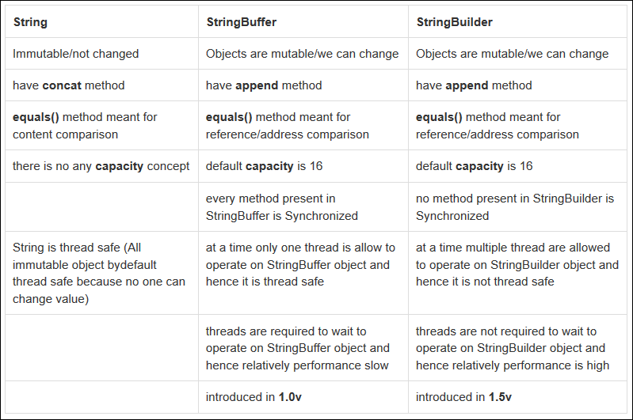
String VS StringBuffer VS StringBuilder

Slide 21
String VS StringBuffer VS StringBuilder

Slide 22
Regular Expression
Regular Expressions or Regex (in short) in Java is an API for defining String patterns that can be used for searching, manipulating, and editing a string in Java.
Email validation and passwords are a few areas of strings where Regex is widely used to define the constraints.
Regular Expressions are provided under java.util.regex package.
This consists of 3 classes and 1 interface.
S. No. | Class/Interface | Description
1. | Pattern Class | Used for defining patterns
2. | Matcher Class | Used for performing match operations on text using patterns
3. | PatternSyntaxException Class | Used for indicating syntax error in a regular expression pattern
4. | MatchResult Interface | Used for representing the result of a match operation

Slide 23
A Regular Expression (RegEx) is a sequence of characters that defines a search pattern.
A pattern defined using RegEx can be used to match against a string.
Expression | String | Matched?
^a...s$ | abs | No match
 | alias | Match
 | abyss | Match
 | Alias | No match
 | An abacus | No match
The pattern is: any five letter string starting with ‘a’ and ending with ‘s’

Slide 24
^ Caret
The caret symbol ^ is used to check if a string starts with a certain character.
Expression | String | Matched?
^a | a | 1 match
 | abc | 1 match
 | bac | No match
^ab | abc | 1 match
 | acb | No match (starts with a but not followed by b)

Slide 25
. Period
A period matches any single character (except newline '\n').
Expression | String | Matched?
.. | a | No match
 | ac | 1 match
 | acd | 1 match
 | acde | 2 matches (contains 4 characters)

Slide 26
MetaCharacters
Metacharacters are characters that are interpreted in a special way by a RegEx engine. Here's a list of metacharacters:
[] . ^ $ * + ? {} () \ |
[] - Square brackets
Square brackets specifies a set of characters you wish to match
Expression | String | Matched?
[abc] | a | 1 match
 | ac | 2 matches
 | Hey Juderr | No match
 | abc de caty | 5 matches

Slide 27
[] - Square brackets
[abc] will match if the string you are trying to match contains any of the a, b or c.
You can also specify a range of characters using - inside square brackets.
[a-e] is the same as [abcde].
[1-4] is the same as [1234].
[0-39] is the same as [01239].
You can complement (invert) the character set by using caret ^ symbol at the start of a square-bracket.
[^abc] means any character except a or b or c.
[^0-9] means any non-digit character.

Slide 28
$ Dollar
The dollar symbol $ is used to check if a string ends with a certain character.
Expression | String | Matched?
a$ | a | 1 match
 | formula | 1 match
 | cab | No match

Slide 29
* Star
The star symbol * matches zero or more occurrences of the pattern left to it.
Expression | String | Matched?
ma*n | mn | 1 match
 | man | 1 match
 | maaan | 1 match
 | main | No match (a is not followed by n)
 | woman | 1 match

Slide 30
+ Plus
The plus symbol + matches one or more occurrences of the pattern left to it.
Expression | String | Matched?
ma+n | mn | No match (no a character)
 | man | 1 match
 | maaan | 1 match
 | main | No match (a is not followed by n)
 | woman | 1 match

Slide 31
? Question Mark
The question mark symbol ? matches zero or one occurrence of the pattern left to it.
Expression | String | Matched?
ma?n | mn | 1 match
 | man | 1 match
 | maaan | No match (more than one a character)
 | main | No match (a is not followed by n)
 | woman | 1 match

Slide 32
{} Braces
Consider this code: {n,m}. This means at least n, and at most m repetitions of the pattern left to it.
Expression | String | Matched?
a{2,3} | abc dat | No match
 | abc daat | 1 match (at daat)
 | aabc daaat | 2 matches (at aabc and daaat)
 | aabc daaaat | 2 matches (at aabc and daaaat)
Expression | String | Matched?
[0-9]{2,4} | ab123csde | 1 match (match at ab123csde)
 | 12 and 345673 | 3 matches (12, 3456, 73)
 | 1 and 2 | No match

Slide 33
| Alternation
Vertical bar | is used for alternation (or operator).
Expression | String | Matched?
a|b | cde | No match
 | ade | 1 match (match at ade)
 | acdbea | 3 matches (at acdbea)
Here, a|b match any string that contains either a or b

Slide 34
() Group
Parentheses () is used to group sub-patterns. For example, (a|b|c)xz match any string that matches either a or b or c followed by xz
Expression | String | Matched?
(a|b|c)xz | ab xz | No match
 | abxz | 1 match (match at abxz)
 | axz cabxz | 2 matches (at axzbc cabxz)

Slide 35
\ Backslash
Backlash \ is used to escape various characters including all metacharacters. For example,
\$a match if a string contains $ followed by a. Here, $ is not interpreted by a RegEx engine in a special way.
If you are unsure if a character has special meaning or not, you can put \ in front of it. This makes sure the character is not treated in a special way.
\A - Matches if the specified characters are at the start of a string.
\b - Matches if the specified characters are at the beginning or end of a word.
\B - Opposite of \b. Matches if the specified characters are not at the beginning or end of a word.
\d - Matches any decimal digit. Equivalent to [0-9]

Slide 36
\ Backslash
\D - Matches any non-decimal digit. Equivalent to [^0-9]
\s - Matches where a string contains any whitespace character. Equivalent to [ \t\n\r\f\v].
\S - Matches where a string contains any non-whitespace character. Equivalent to
[^ \t\n\r\f\v].
\w - Matches any alphanumeric character (digits and alphabets). Equivalent to
[a-zA-Z0-9_]. By the way, underscore _ is also considered an alphanumeric character.
\W - Matches any non-alphanumeric character. Equivalent to [^a-zA-Z0-9_]
\Z - Matches if the specified characters are at the end of a string.

Slide 37
\ Backslash
In many programming languages, the backslash character (\) is used to indicate an escape sequence, which allows special characters to be interpreted in a specific way. For example, \n is an escape sequence that represents a newline character, and \t represents a tab character.
However, the backslash character itself also needs to be escaped when it is used as a literal character. So if you want to match a backslash character in a regular expression, you would need to use two backslashes in a row (\\).

Slide 38
Thanks
Anirudha Gaikwad

