Slide 1
JAVA
What you learn ?
Java | Expressions
Abstract class | Interface
Abstract class vs Interface | Data hiding VS Abstraction

Slide 2
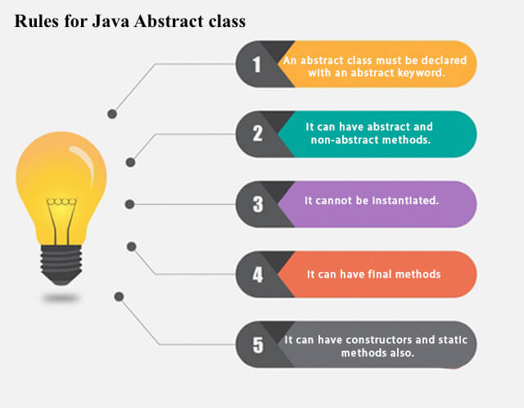
Abstract class
A class which is declared with the abstract keyword is known as an abstract class in Java. It can have abstract and non-abstract methods (method with the body).
Abstraction lets you focus on what the object does instead of how it does it.
Ways to achieve Abstraction
Abstract class (0 to 100%)
Interface (100%)

Slide 3
Abstract class
abstract class Bike{
abstract void run();
}
class Honda4 extends Bike{
void run(){
System.out.println("running safely");
}
public static void main(String args[]){
Bike obj = new Honda4();
obj.run();
}
}
Output:
Running safely
Rule: If you are extending an abstract class that has an abstract method, you must either provide the implementation of the method or make this class abstract.

Slide 4
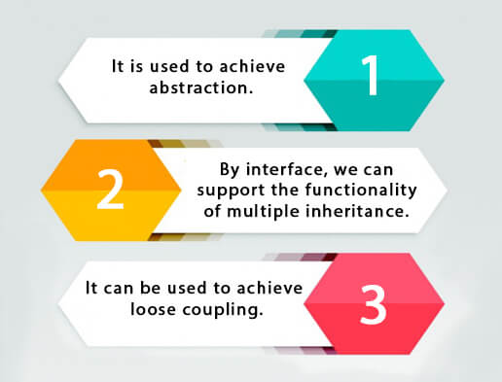
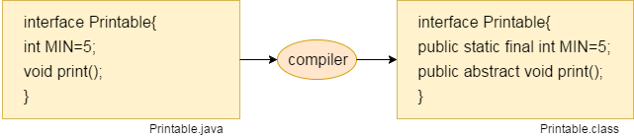
Interface
An interface in Java is a blueprint of a class. It has static constants and abstract methods.
The interface in Java is a mechanism to achieve abstraction.
Syntax:
interface <interface_name>{
// declare constant fields
// declare methods that abstract by default.
}
Why use Java interface?
Interface fields are public, static and final by default, and the methods are public and abstract.

Slide 5
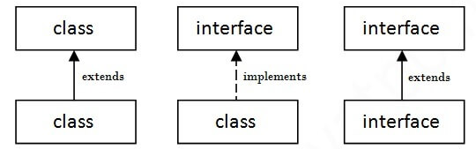
Interface
Example:
interface printable{
void print();
}
class A6 implements printable{
public void print()
{
System.out.println("Hello");
}
public static void main(String args[]){
A6 obj = new A6();
obj.print();
}
}
Output:
Hello
The relation between class & interface:

Slide 6
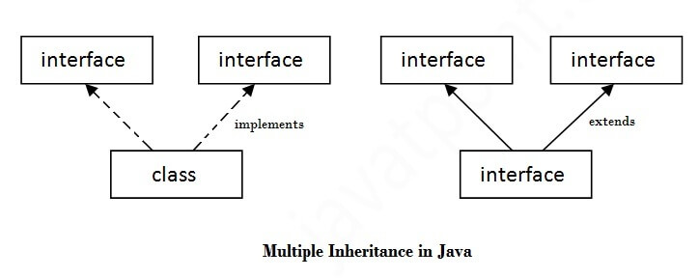
Multiple inheritance in JAVA using interface
If a class implements multiple interfaces, or an interface extends multiple interfaces, it is known as multiple inheritance.
interface Printable{
void print();
}
interface Showable{
void print();
}
class TestInterface3 implements Printable, Showable
{
public void print(){
System.out.println("Hello");
}
public static void main(String args[]){
TestInterface3 obj = new TestInterface3();
obj.print(); //Hello printed
}
}

Slide 7
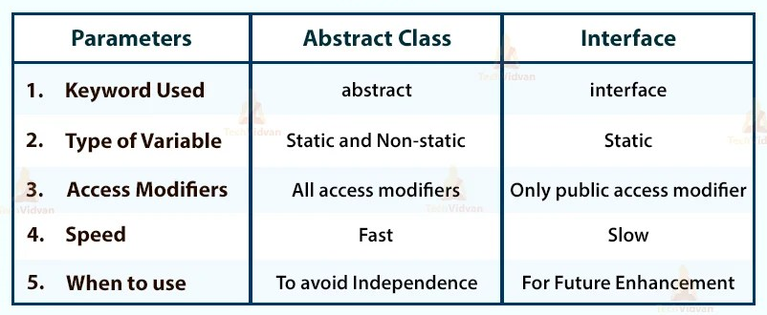
Abstract class VS Interface

Slide 8
Data hiding VS Abstraction
S.No. | Abstraction | Data Hiding
1. | The process of hiding the implantation details and showing only the functionality of program is referred to as abstraction. | The process of hiding important and sensitive data from any unintended access is known as data hiding.
2. | Abstraction helps in extracting relevant information from a larger set of information. | Data hiding helps to increase safety by preventing outside attacks.
3. | Abstraction focuses on reducing the complexity of code. | The purpose of data hiding is to achieve data encapsulation.
4. | Abstraction solves the design level problems. | Data hiding solves the implementation level problems.
5. | There are three types of data abstractions namely, procedural abstraction, data abstraction, and control abstraction. | Data hiding is not divided into subtypes.

Slide 9
Thanks
Anirudha Gaikwad

