Slide 1
JAVA
What you learn ?
Java | Expressions
Exceptions | Exception Hierarchy
try catch & finally | User defined exceptions
throws vs throw | Methods to print the Exception information

Slide 2
Exceptions
When executing Java code, different errors can occur: coding errors made by the programmer, errors due to wrong input, or other unforeseeable things.
When an error occurs, Java will normally stop and generate an error message. The technical term for this is: Java will throw an exception (throw an error).
Exception is an unwanted or unexpected event, which occurs during the execution of a program, i.e. at run time, that disrupts the normal flow of the program’s instructions. Exceptions can be caught and handled by the program. When an exception occurs within a method, it creates an object. This object is called the exception object. It contains information about the exception, such as the name and description of the exception and the state of the program when the exception occurred.

Slide 3
Exception VS Errors
Errors | Exceptions
Recovering from Error is not possible. | We can recover from exceptions by either using try-catch block or throwing exceptions back to the caller.
All errors in java are unchecked type. | Exceptions include both checked as well as unchecked type.
Errors are mostly caused by the environment in which program is running. | Program itself is responsible for causing exceptions.
Errors can occur at compile time as well as run time. Compile Time: eg Syntax Error Run Time: Logical Error. | All exceptions occurs at runtime but checked exceptions are known to the compiler while unchecked are not.
They are defined in java.lang.Error package. | They are defined in java.lang.Exception package
Examples : java.lang.StackOverflowError, java.lang.OutOfMemoryError | Examples : Checked Exceptions : SQLException, IOException Unchecked Exceptions : ArrayIndexOutOfBoundException, NullPointerException, ArithmeticException.

Slide 4
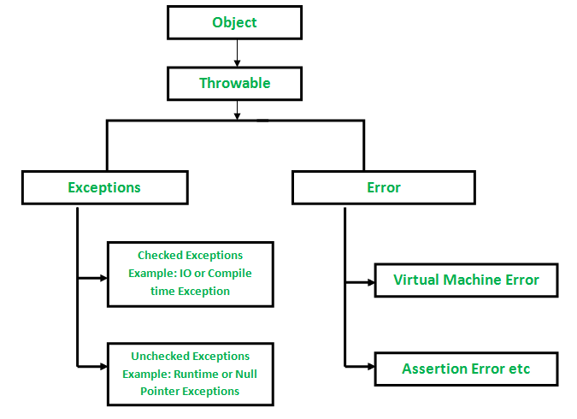
Exception Hierarchy

Slide 5
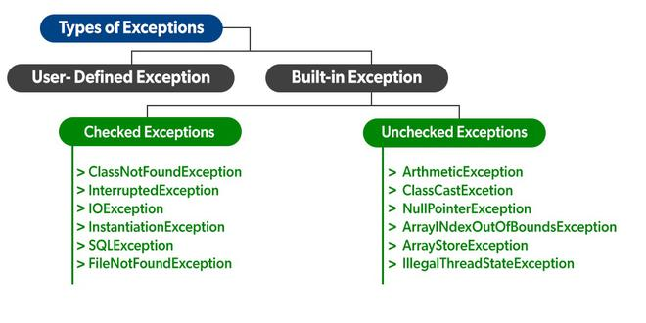
Types of Exception

Slide 6
try, catch & finally
The try statement allows you to define a block of code to be tested for errors while it is being executed.
The catch statement allows you to define a block of code to be executed, if an error occurs in the try block.
The try and catch keywords come in pairs:
finally:The finally statement lets you execute code, after try...catch, regardless of the result.
try {
// Block of code to try
}
catch(Exception e) {
// Block of code to handle errors
}

Slide 7
try-with-resources Statement
In many situations, we want that some part of our code should be executed regardless of whether some exceptions occurred or not. For example: if we open a file in the try, no matter if an exception occurs or not, we have to close it. Here, try-with-resources comes in handy.
Syntax:
try( <initialise the objects that will be used in the try> )
{
// Code with possible Exceptions
}
catch(Exception e)
{
// Code for handling the Exceptions (if occurred)
}

Slide 8
User defined Exceptions
Sometimes, the built-in exceptions in Java are not able to describe a certain situation. In such cases, users can also create exceptions, which are called ‘user-defined Exceptions’.
The advantages of Exception Handling in Java are as follows:
Provision to Complete Program Execution
Easy Identification of Program Code and Error-Handling Code
Propagation of Errors
Meaningful Error Reporting
Identifying Error Types

Slide 9
User defined Exceptions
In order to create a custom exception, we need to extend the Exception class that belongs to java.lang package.
// A Class that uses above MyException
public class Main {
public static void main(String args[])
{
try {
// Throw an object of user defined exception
throw new MyException("Exp");
}
catch (MyException ex) {
System.out.println("Caught");
// Print the message from MyException object
System.out.println(ex.getMessage());
}
}
}
// user-defined exception
class MyException extends Exception {
public MyException(String s)
{
// Call constructor of parent Exception
super(s);
}
}

Slide 10
throws keyword
throws is a keyword in Java which is used in the signature of method to indicate that this method might throw one of the listed type exceptions. The caller to these methods has to handle the exception using a try-catch block.
Syntax:
type method_name(parameters) throws exception_list
Here, exception_list is a comma separated list of all the
exceptions which a method might throw.
To prevent this compile time error we can handle the exception in two ways:
By using try catch
By using throws keyword

Slide 11
throws keyword
Important points to remember about throws keyword:
throws keyword is required only for checked exception and usage of throws keyword for unchecked exception is meaningless.
throws keyword is required only to convince compiler and usage of throws keyword does not prevent abnormal termination of program.
By the help of throws keyword we can provide information to the caller of the method about the exception.

Slide 12
throws keyword
// demonstrate working of throws
static void fun() throws IllegalAccessException
{
System.out.println("Inside fun(). ");
throw new IllegalAccessException("demo");
}
While calling above method consider below:
try
{
fun();
}
catch(IllegalAccessException e)
{
System.out.println("caught in main.");
}

Slide 13
throw VS throws
throw keyword | throws keyword
Java throw keyword is used throw an exception explicitly in the code, inside the function or the block of code. | Java throws keyword is used in the method signature to declare an exception which might be thrown by the function while the execution of the code.
Using throws keyword, we can declare both checked and unchecked exceptions. | However, the throws keyword can be used to propagate checked exceptions only.
The throw keyword is followed by an instance of Exception to be thrown. | The throws keyword is followed by class names of Exceptions to be thrown.
throw is used within the method. | throws is used with the method signature.
We are allowed to throw only one exception at a time i.e. we cannot throw multiple exceptions. | We can declare multiple exceptions using throws keyword that can be thrown by the method. For example, main() throws IOException, SQLException.

Slide 14
Methods to print the Exception information
1) printStackTrace()– This method prints exception information in the format of Name of the exception: description of the exception, stack.
Example:
java.lang.ArithmeticException: / by zero
at ABC.main(File.java:10)
2) toString() – This method prints exception information in the format of Name of the exception: description of the exception.
Example :
java.lang.ArithmeticException: / by zero
3) getMessage() -This method prints only the description of the exception.
Example:
/ by zero

Slide 15
Thanks
Anirudha Gaikwad

