Slide 1
JAVA
What you learn ?
Java | Expressions
Collection framework | Methods of Collection Interface
List interface | ArrayList
Vector | Stack
Queue , Deque | Map
Set | Choosing collection framework
Algorithms | Comparable VS Comparator
Iterator Interface | Iterable Interface

Slide 2
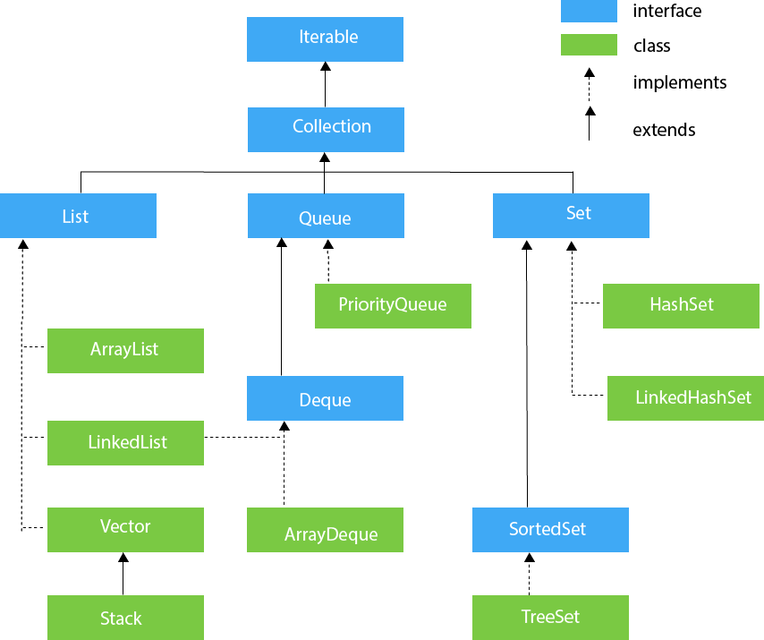
Collection Framework
The Collection in Java is a framework that provides an architecture to store and manipulate the group of objects.
Java Collections can achieve all the operations that you perform on a data such as searching, sorting, insertion, manipulation, and deletion.
The java.util package contains the powerful tool of Collections Framework
The Collection framework has:
Interfaces and its implementations, i.e., classes
Algorithm

Slide 3
Collection Interface
The Collection Interface is the root or the foundation on which the Collections Framework is built.
It is a general interface that has the declaration:
interface Collection<E>
Here, E is the type of object that the collection will hold.
It provides the basic operations like adding, removing, clearing the elements in a collection, checking whether the collection is empty etc.
List, Queue and Set are the components that extend the Collection Interface.

Slide 4
Methods of Collection Interface
Method | Description
public boolean add(E e) | It is used to insert an element in this collection.
public boolean addAll(Collection<? extends E> c) | It is used to insert the specified collection elements in the invoking collection.
public boolean remove(Object element) | It is used to delete an element from the collection.
public boolean removeAll(Collection<?> c) | It is used to delete all the elements of the specified collection from the invoking collection.
default boolean removeIf(Predicate<? super E> filter) | It is used to delete all the elements of the collection that satisfy the specified predicate.
public boolean retainAll(Collection<?> c) | It is used to delete all the elements of invoking collection except the specified collection.
public int size() | It returns the total number of elements in the collection.
public void clear() | It removes the total number of elements from the collection.
public boolean contains(Object element) | It is used to search an element.
public boolean containsAll(Collection<?> c) | It is used to search the specified collection in the collection.

Slide 5
Methods of Collection Interface
Method | Description
public Iterator iterator() | It returns an iterator.
public Object[] toArray() | It converts collection into array.
public <T> T[] toArray(T[] a) | It converts collection into array. Here, the runtime type of the returned array is that of the specified array.
public boolean isEmpty() | It checks if collection is empty.
default Stream<E> parallelStream() | It returns a possibly parallel Stream with the collection as its source.
default Stream<E> stream() | It returns a sequential Stream with the collection as its source.
default Spliterator<E> spliterator() | It generates a Spliterator over the specified elements in the collection.
public boolean equals(Object element) | It matches two collections.
public int hashCode() | It returns the hash code number of the collection.

Slide 6
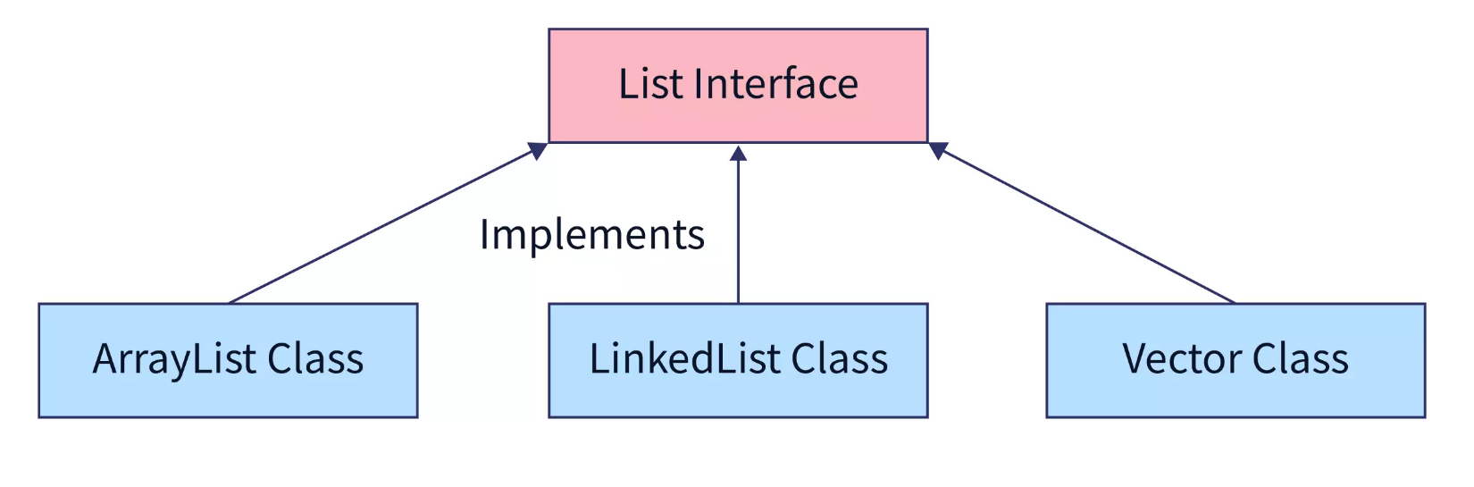
List interface
This is a child interface of the collection interface.
This interface is dedicated to the data of the list type in which we can store all the ordered collection of the objects.
This also allows duplicate data to be present in it.
For example,
List <T> al = new ArrayList<> (); List <T> ll = new LinkedList<> (); List <T> v = new Vector<> (); Where T is the type of the object

Slide 7
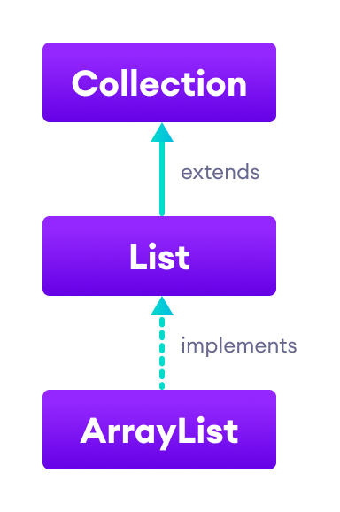
ArrayList
ArrayList provides us with dynamic arrays in Java.
Though, it may be slower than standard arrays but can be helpful in programs where lots of manipulation in the array is needed.
The size of an ArrayList is increased automatically if the collection grows or shrinks if the objects are removed from the collection.

Slide 8
ArrayList
In order to initialize an ArrayList, there are 3 ways.
1. Using the add Keyword
// create an ArrayList of String type
ArrayList<String> str = new ArrayList<String>();
// Initialize an ArrayList with add()
str.add("Java");
str.add("Language");
2. Using asList() AsList() method in Java is used to return a fixed-size list backed by the given array
// create an ArrayList of String type
// and Initialize an ArrayList with asList()
ArrayList<String> scaler = new ArrayList<String>(Arrays.asList("I","love","Java"));
3. Using list.of() Method It is used to return immutable lists containing the specified elements.
// create an ArrayList of String type and Initialize an ArrayList with List.of()
List<String> str = new ArrayList<>(List.of("Coding","is","Fun"));

Slide 9
Methods of ArrayList
Methods | Descriptions
size() | Returns the length of the arraylist.
sort() | Sort the arraylist elements.
clone() | Creates a new arraylist with the same element, size, and capacity.
contains() | Searches the arraylist for the specified element and returns a boolean result.
ensureCapacity() | Specifies the total element the arraylist can contain.
isEmpty() | Checks if the arraylist is empty.
indexOf() | Searches a specified element in an arraylist and returns the index of the element.

Slide 10
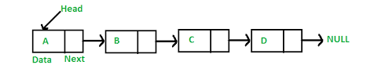
Linked List
Linked List is a linear data structure where the elements are called as nodes.
Here, each node has two fields- data and next. Data stores the actual piece of information and next points to the next node. 'Next' field is actually the address of the next node.
The LinkedList class extends the AbstractSequentialList and it also extends the List, Deque and Queue interface.

Slide 11
Linked List
There are two ways in which we can create a linked list using constructors.
1. Creating an empty Linked List
LinkedList list=new LinkedList();
2. Creating a Linked List from Collection
It will create a Linked List with all the elements of Collection C. We will use the LinkedList class and new keyword to create a constructor which contains the elements of collection.
LinkedList list=new LinkedList(C);

Slide 12
Vector
A vector provides us with dynamic arrays in Java. Though, it may be slower than standard arrays but can be helpful in programs where lots of manipulation in the array is needed.
This is identical to ArrayList in terms of implementation.
However, the primary difference between a vector and an ArrayList is that a Vector is synchronized and an ArrayList is non-synchronized.
Syntax:
Vector<Type> vector = new Vector<>();

Slide 13
Vector
Methods to create the constructor of Vectors
1. Using the default method
In this method, the size is not specified so the default size of Vectors is 10.
Vector<Data-type> v = new Vector<Data-Type>();
2. By specifying the desired size
Vector<Data-type> v = new Vector<Data-Type>(int size);
3. Using size and increment attributes
Here, the increment is the value that specifies the number of elements to allocate each time that vector gets resized upward.
Vector<Data-type> v = new Vector<Data-Type>(int size,int incr);
4. Creating a Vector from Collection
It is used to create a vector which contains all the elements of a collection.
Vector<Data-type> v = new Vector<Data-Type>(Collection C);

Slide 14
Methods of Vector
Methods | Descriptions
add(element) | adds an element to vectors
add(index, element) | adds an element to the specified position
addAll(vector) | adds all elements of a vector to another vector
get(index) | returns an element specified by the index
iterator() | returns an iterator object to sequentially access vector elements
remove(index) | removes an element from specified position
removeAll() | removes all the elements
clear() | removes all elements. It is more efficient than removeAll()

Slide 15
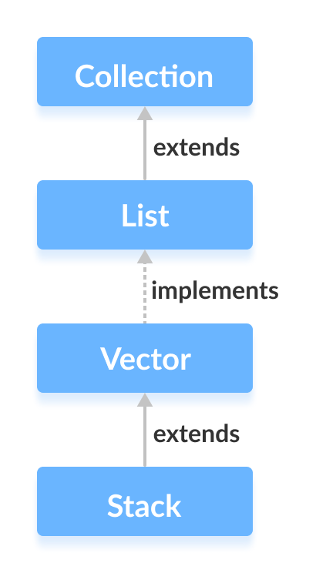
Stack
In stack, elements are stored and accessed in Last In First Out manner. That is, elements are added to the top of the stack and removed from the top of the stack.
Syntax:
Stack<Type> stacks = new Stack<>();

Slide 16
Methods of Stack
Method | Description
empty() | The method checks the stack is empty or not.
push(E item) | The method pushes (insert) an element onto the top of the stack.
pop() | The method removes an element from the top of the stack and returns the same element as the value of that function.
peek() | The method looks at the top element of the stack without removing it.
search(Object o) | The method searches the specified object and returns the position of the object.

Slide 17
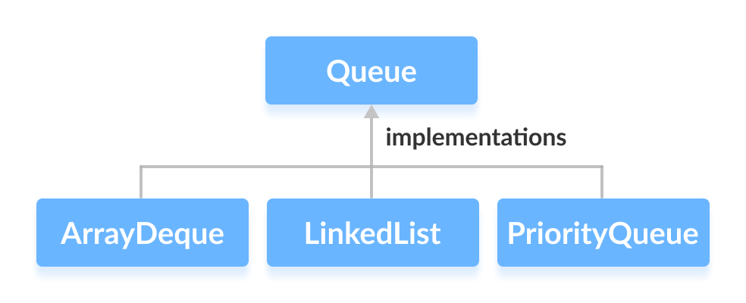
Queue
In queues, elements are stored and accessed in First In, First Out manner. That is, elements are added from the behind and removed from the front.
In Java, we must import java.util.Queue package in order to use Queue.
// LinkedList implementation of Queue
Queue<String> animal1 = new LinkedList<>();
// Array implementation of Queue
Queue<String> animal2 = new ArrayDeque<>();
// Priority Queue implementation of Queue
Queue<String> animal 3 = new PriorityQueue<>();

Slide 18
Methods of Queue
Method | Description
add() | Inserts the specified element into the queue. If the task is successful, add() returns true, if not it throws an exception.
offer() | Inserts the specified element into the queue. If the task is successful, offer() returns true, if not it returns false.
element() | Returns the head of the queue. Throws an exception if the queue is empty.
peek() | Returns the head of the queue. Returns null if the queue is empty.
remove() | Returns and removes the head of the queue. Throws an exception if the queue is empty.
poll() | Returns and removes the head of the queue. Returns null if the queue is empty.

Slide 19
PriorityQueue
The PriorityQueue class extends AbstractQueue and implements the Queue Interface.
As the name suggests, they follow the principle of priority of the elements.
We know that we follow First-In,First-Out for queues, but at times, the elements needs to be processed in terms of their priority. This is where the PriorityQueue comes into play.
It does not allow null values to be stored inside it.
The add() method is used to add an element
The poll() method is used to remove the top-most element.
The peek() is used to display the top-most element.

Slide 20
PriorityQueue
Methods to initialise a PriorityQueue using constructors
1. Creating an empty PriorityQueue
PriorityQueue<Data-Type> pq = new PriorityQueue<Data-Type>();
2. Creating a PriorityQueue with the specified size
PriorityQueue<Data-Type> pq = new PriorityQueue<Data-Type>(int size);
3. Creating a PriorityQueue from Collection
It will create a PriorityQueue with all the elements of Collection C.
PriorityQueue<Data-Type> pq = new PriorityQueue<Data-Type>(Collection<Data-Type> C);

Slide 21
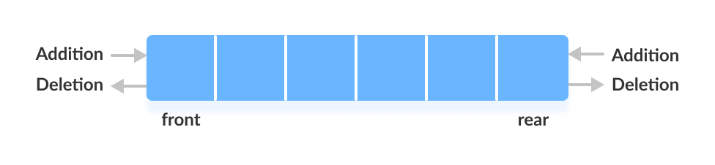
Dequeue
In a regular queue, elements are added from the rear and removed from the front. However, in a deque, we can insert and remove elements from both front and rear.
In Java, we must import the java.util.Deque package to use Deque.
// Array implementation of Deque
Deque<String> animal1 = new ArrayDeque<>();
// LinkedList implementation of Deque
Deque<String> animal2 = new LinkedList<>();

Slide 22
ArrayDequeue
ArrayDeque is a deque implementation in Java that belongs to the java.util package. It is the resizeable array implementation of the Deque interface.
ArrayDeque doesn't have any capacity constraints and grows based on the requirement. null values cannot be stored in an ArrayDeque. The initial capacity of an ArrayDeque object is 16.
Syntax
Creates an empty deque with the initial capacity of 16.
Deque<T> arrayDeque = new ArrayDeque<T>();
Creates an empty deque with the capacity provided via initialCapacity.
Deque<T> arrayDeque = new ArrayDeque<T>(int initialCapacity);
Creates a deque with the elements present in the collection.
Deque<T> arrayDeque = new ArrayDeque<T>(Collection collection);

Slide 23
LinkedList Dequeue
LinkedList is a deque implementation in Java that belongs to the java.util package. It uses a doubly linked list to store the elements. The elements are stored in nodes and linked together via pointers i.e the address of the next node will be stored in the previous node.
LinkedList doesn't require the size to be specified while creating. The size of the list is automatically increased or decreased when an element is added or removed respectively.
Syntax
Creates a empty list without any values in it.
Deque<T> linkedList = new LinkedList<T>();
Creates a list with the values of the collection passed as the parameter.
Deque<T> linkedList = new LinkedList<T>(Collection collection);

Slide 24
Deque
Besides methods available in the Queue interface, the Deque interface also includes the following methods:
addFirst() - Adds the specified element at the beginning of the deque. Throws an exception if the deque is full.
addLast() - Adds the specified element at the end of the deque. Throws an exception if the deque is full.
offerFirst() - Adds the specified element at the beginning of the deque. Returns false if the deque is full.
offerLast() - Adds the specified element at the end of the deque. Returns false if the deque is full.
getFirst() - Returns the first element of the deque. Throws an exception if the deque is empty.
getLast() - Returns the last element of the deque. Throws an exception if the deque is empty.
peekFirst() - Returns the first element of the deque. Returns null if the deque is empty.
peekLast() - Returns the last element of the deque. Returns null if the deque is empty.
removeFirst() - Returns and removes the first element of the deque. Throws an exception if the deque is empty.
removeLast() - Returns and removes the last element of the deque. Throws an exception if the deque is empty.
pollFirst() - Returns and removes the first element of the deque. Returns null if the deque is empty.
pollLast() - Returns and removes the last element of the deque. Returns null if the deque is empty.

Slide 25

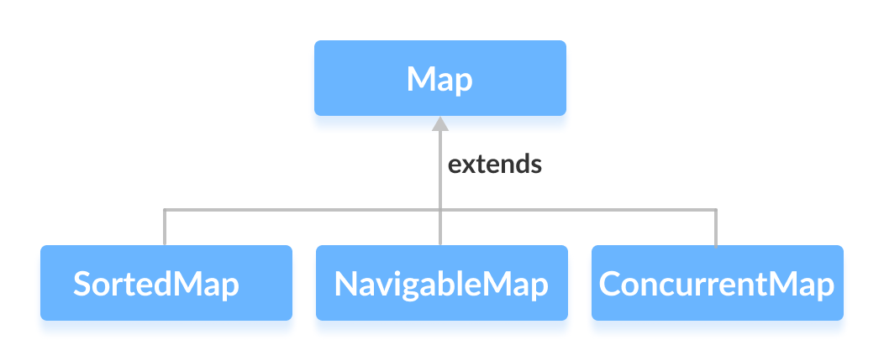
Map
In Java, elements of Map are stored in key/value pairs. Keys are unique values associated with individual Values.
// Map implementation using HashMap
Map<Key, Value> numbers = new HashMap<>();

Slide 26
Methods of Map
Method | Description
V put(Object key, Object value) | It is used to insert an entry in the map.
void putAll(Map map) | It is used to insert the specified map in the map.
V putIfAbsent(K key, V value) | It inserts the specified value with the specified key in the map only if it is not already specified.
V remove(Object key) | It is used to delete an entry for the specified key.
boolean remove(Object key, Object value) | It removes the specified values with the associated specified keys from the map.
Set keySet() | It returns the Set view containing all the keys.
Set<Map.Entry<K,V>> entrySet() | It returns the Set view containing all the keys and values.
void clear() | It is used to reset the map.

Slide 27
Methods of Map
Method | Description
boolean containsValue(Object value) | This method returns true if some value equal to the value exists within the map, else return false.
boolean containsKey(Object key) | This method returns true if some key equal to the key exists within the map, else return false.
boolean equals(Object o) | It is used to compare the specified Object with the Map.
int size() | This method returns the number of entries in the map.
V get(Object key) | This method returns the object that contains the value associated with the key.
V getOrDefault(Object key, V defaultValue) | It returns the value to which the specified key is mapped, or defaultValue if the map contains no mapping for the key.

Slide 28
HashMap
The HashMap class extends AbstractMap and implements the Map interface.
It uses a hash table for storing key-value pairs.
If we want to access a value in a** hash map**, we must know its key.
Example:
// Creating a HashMap
HashMap<Integer, Double> hm = new HashMap<Integer, Double>();
//adding key value pairs using put()
hm.put(1, 1.9);
hm.put(2, 2.8);
hm.put(3, 3.7);
// Finding the value for a key using get()
System.out.println("The Value for 1 is " + hm.get(1));

Slide 29
Set Interface
The Set interface defines an unordered collection.
It extends the Collection Interface.
We cannot store duplicate values in this.
The Set Interface is implemented by popular classes like HashedSet, LinkedHashSet and TreeSet.
Method to instantiate the Set Interface:
Set<Data-Type> hs = new HashSet<Data-Type>();
Set<Data-Type> lhs = new LinkedHashSet<Data-Type>();
Set<Data-Type> ts = new TreeSet<Data-Type>();

Slide 30
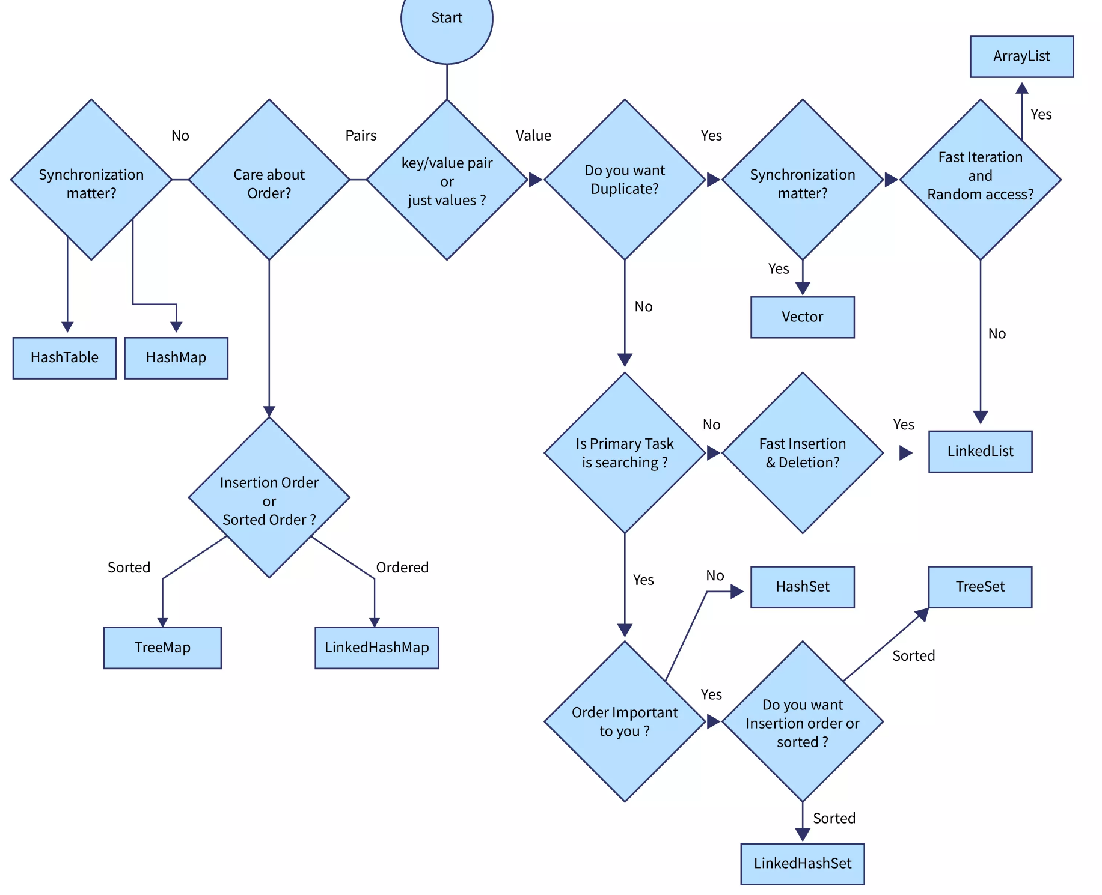
When to choose which collection framework

Slide 31
Algorithms in Collection Framework
The collections framework provides several high-performance algorithms for manipulating collection elements.
These algorithms are implemented as static methods of class Collections
Algorithms sort, binarySearch, reverse, shuffle, fill and copy operate on Lists.
Algorithms min, max, addAll, frequency and disjoint operate on Collections.

Slide 32
Algorithms
Sr.No. | Method & Description
1 | static int binarySearch(List list, Object value, Comparator c) Searches for value in the list ordered according to c. Returns the position of value in list, or -1 if value is not found.
2 | static int binarySearch(List list, Object value) Searches for value in the list. The list must be sorted. Returns the position of value in list, or -1 if value is not found.
3 | static void copy(List list1, List list2) Copies the elements of list2 to list1.
4 | static Enumeration enumeration(Collection c) Returns an enumeration over c.
5 | static void fill(List list, Object obj) Assigns obj to each element of the list.
6 | static int indexOfSubList(List list, List subList) Searches list for the first occurrence of subList. Returns the index of the first match, or .1 if no match is found.

Slide 33
Algorithms
Sr.No. | Method & Description
7 | static int lastIndexOfSubList(List list, List subList) Searches list for the last occurrence of subList. Returns the index of the last match, or .1 if no match is found.
8 | static ArrayList list(Enumeration enum) Returns an ArrayList that contains the elements of enum.
9 | static Object max(Collection c, Comparator comp) Returns the maximum element in c as determined by comp.
10 | static Object max(Collection c) Returns the maximum element in c as determined by natural ordering. The collection need not be sorted.
11 | static Object min(Collection c, Comparator comp) Returns the minimum element in c as determined by comp. The collection need not be sorted.
12 | static Object min(Collection c) Returns the minimum element in c as determined by natural ordering.

Slide 34
Algorithms
Sr.No. | Method & Description
13 | static List nCopies(int num, Object obj) Returns num copies of obj contained in an immutable list. num must be greater than or equal to zero.
14 | static boolean replaceAll(List list, Object old, Object new) Replaces all occurrences of old with new in the list. Returns true if at least one replacement occurred. Returns false, otherwise.
15 | static void reverse(List list) Reverses the sequence in list.
16 | static Comparator reverseOrder( ) Returns a reverse comparator.
17 | static void rotate(List list, int n) Rotates list by n places to the right. To rotate left, use a negative value for n.
18 | static void shuffle(List list, Random r) Shuffles (i.e., randomizes) the elements in the list by using r as a source of random numbers.

Slide 35
Algorithms
Sr.No. | Method & Description
19 | static void shuffle(List list) Shuffles (i.e., randomizes) the elements in list.
20 | static Set singleton(Object obj) Returns obj as an immutable set. This is an easy way to convert a single object into a set.
21 | static List singletonList(Object obj) Returns obj as an immutable list. This is an easy way to convert a single object into a list.
22 | static Map singletonMap(Object k, Object v) Returns the key/value pair k/v as an immutable map. This is an easy way to convert a single key/value pair into a map.
23 | static void sort(List list, Comparator comp) Sorts the elements of list as determined by comp.
24 | static void sort(List list) Sorts the elements of the list as determined by their natural ordering.
25 | static void swap(List list, int idx1, int idx2) Exchanges the elements in the list at the indices specified by idx1 and idx2.

Slide 36
Algorithms
Sr.No. | Method & Description
26 | static Collection synchronizedCollection(Collection c) Returns a thread-safe collection backed by c.
27 | static List synchronizedList(List list) Returns a thread-safe list backed by list.
28 | static Map synchronizedMap(Map m) Returns a thread-safe map backed by m.
29 | static Set synchronizedSet(Set s) Returns a thread-safe set backed by s.
30 | static SortedMap synchronizedSortedMap(SortedMap sm) Returns a thread-safe sorted set backed by sm.
31 | static SortedSet synchronizedSortedSet(SortedSet ss) Returns a thread-safe set backed by ss.
32 | static Collection unmodifiableCollection(Collection c) Returns an unmodifiable collection backed by c.

Slide 37
Algorithms
Sr.No. | Method & Description
33 | static List unmodifiableList(List list) Returns an unmodifiable list backed by the list.
34 | static Map unmodifiableMap(Map m) Returns an unmodifiable map backed by m.
35 | static Set unmodifiableSet(Set s) Returns an unmodifiable set backed by s.
36 | static SortedMap unmodifiableSortedMap(SortedMap sm) Returns an unmodifiable sorted map backed by sm.
37 | static SortedSet unmodifiableSortedSet(SortedSet ss) Returns an unmodifiable sorted set backed by ss.

Slide 38
Comparable Interface
Java provides two interfaces to sort objects using data members of the class:
Comparable
Comparator
Using Comparable Interface
A comparable object is capable of comparing itself with another object.
The class itself must implements the java.lang.Comparable interface to compare its instances.
Example:
Consider a Movie class that has members like, rating, name, year.
Suppose we wish to sort a list of Movies based on year of release.
We can implement the Comparable interface with the Movie class, and we override the method compareTo() of Comparable interface.

Slide 39
Comparator Interface
Using Comparator
Unlike Comparable, Comparator is external to the element type we are comparing. It’s a separate class. We create multiple separate classes (that implement Comparator) to compare by different members.
Collections class has a second sort() method and it takes Comparator. The sort() method invokes the compare() to sort objects.
To compare objects:
Create a class that implements Comparator (and thus the compare() method that does the work previously done by compareTo()).
Make an instance of the Comparator class.
Call the overloaded sort() method, giving it both the list and the instance of the class that implements Comparator.

Slide 40
Comparable VS Comparator
Comparable and Comparator both are interfaces and can be used to sort collection elements.
Comparable | Comparator
1) Comparable provides a single sorting sequence. In other words, we can sort the collection on the basis of a single element such as id, name, and price. | The Comparator provides multiple sorting sequences. In other words, we can sort the collection on the basis of multiple elements such as id, name, and price etc.
2) Comparable affects the original class, i.e., the actual class is modified. | Comparator doesn't affect the original class, i.e., the actual class is not modified.
3) Comparable provides compareTo() method to sort elements. | Comparator provides compare() method to sort elements.
4) Comparable is present in java.lang package. | A Comparator is present in the java.util package.
5) We can sort the list elements of Comparable type by Collections.sort(List) method. | We can sort the list elements of Comparator type by Collections.sort(List, Comparator) method.

Slide 41
Iterator interface
Iterator is an object that can be used to loop through collections.
As the name suggests, it is used to iterate over the elements.
It is used to modify and iterate over the elements in a collection.
There are 3 methods in the Iterator interface:
public Object next()- It returns the next element in the collection. It throws the exception of NoSuchElementException if there is no next element.
public void remove()- It removes the current element from the collection.
public boolean hasNext()- It returns true if there are more elements in the collection. Else, returns false.

Slide 42
Iterable interface
The Iterable interface was introduced in JDK 1.5. It belongs to java.lang package.
In general, an object Implementing Iterable allows it to be iterated. An iterable interface allows an object to be the target of enhanced for loop(for-each loop).
Definition of Iterable
public interface Iterable<T>
{
Iterator<T> iterator();
Spliterator<T> spliterator();
void forEach(Consumer<? super T> action);
}
Here, T is the type of element returned by the Iterator.

Slide 43
Iterable interface
There are three ways in which objects of Iterable can be iterated.
1) Using enhanced for loop(for-each loop)
for( String element : list ){
System.out.println( element );
}
2) Using Iterable forEach loop
list.forEach(
(element) -> { System.out.println(element); });
3) Using Iterator<T> interface
Iterator<String> iterator = list.iterator();
while (iterator.hasNext()) {
String element = iterator.next();
System.out.println(element);
}

Slide 44
Iterable interface
Methods of iterable:
METHOD | DESCRIPTION
forEach​(Consumer<? super T> action) | Performs the given action for each element of the Iterable until all elements have been processed or the action throws an exception.
iterator() | Returns an iterator over elements of type T.
spliterator() | Creates a Spliterator over the elements described by this Iterable.

Slide 45
Thanks
Anirudha Gaikwad

