Slide 1
JAVA
What you learn ?
Java | Expressions
Binary Search Tree | Heaps
Hashing | Use cases of hashing

Slide 2
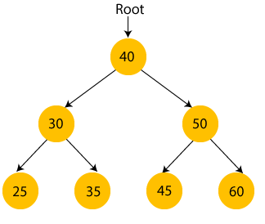
Binary Search Tree
What is a tree?
A tree is a kind of data structure that is used to represent the data in hierarchical form. It can be defined as a collection of objects or entities called as nodes that are linked together to simulate a hierarchy.
What is a Binary Search tree?
A binary search tree follows some order to arrange the elements.
In a Binary search tree, the value of left node must be smaller than the parent node, and the value of right node must be greater than the parent node.
This rule is applied recursively to the left and right subtrees of the root.

Slide 3
Advantages of Binary search tree
Searching an element in the Binary search tree is easy as we always have a hint that which subtree has the desired element.
As compared to array and linked lists, insertion and deletion operations are faster in BST.

Slide 4
Complexity of Binary Search Tree
Time Complexity
Operations | Best case time complexity | Average case time complexity | Worst case time complexity
Insertion | O(log n) | O(log n) | O(n)
Deletion | O(log n) | O(log n) | O(n)
Search | O(log n) | O(log n) | O(n)
Space Complexity
Operations | Space complexity
Insertion | O(n)
Deletion | O(n)
Search | O(n)

Slide 5
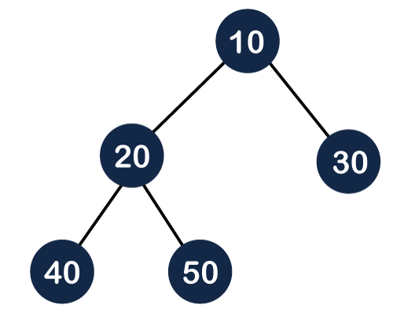
Heap
What is Heap?
A heap is a complete binary tree, and the binary tree is a tree in which the node can have utmost two children. Before knowing more about the heap data structure, we should know about the complete binary tree.
What is a complete binary tree?
A complete binary tree is a binary tree in which all the levels except the last level, i.e., leaf node should be completely filled, and all the nodes should be left-justified.

Slide 6
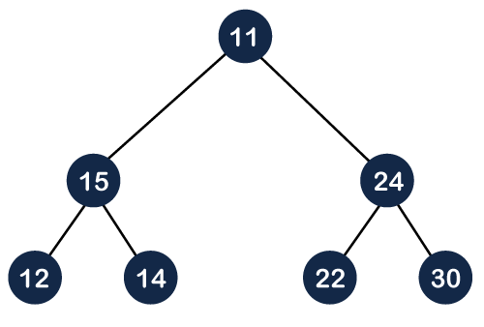

Types of Heap
How can we arrange the nodes in the Tree?
There are two types of the heap:
Min Heap
Max heap
Max Heap:
Max heap can be defined as for every node i; the value of node i is less than or equal to its parent value except the root node.
Mathematically, it can be defined as:
A[Parent(i)] >= A[i]
Min Heap:
The min-heap can be defined as, for every node i, the value of node i is greater than or equal to its parent value except the root node. Mathematically, it can be defined as:
A[Parent(i)] <= A[i]

Slide 7
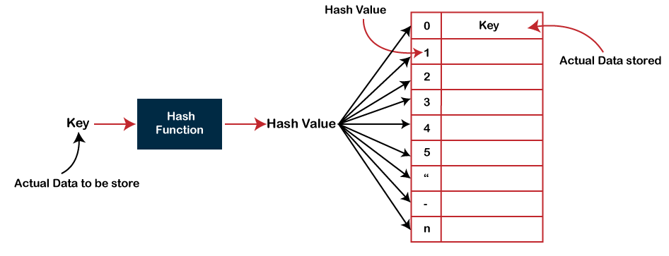
Hashing
Hashing
Hashing is one of the searching techniques that uses a constant time. The time complexity in hashing is O(1).
In Hashing technique, the hash table and hash function are used. Using the hash function, we can calculate the address at which the value can be stored.
The main idea behind the hashing is to create the (key/value) pairs. If the key is given, then the algorithm computes the index at which the value would be stored. It can be written as:
Index = hash(key)

Slide 8
Hashtables
Hash Table is a data structure which stores data in an associative manner. In a hash table, data is stored in an array format, where each data value has its own unique index value. Access of data becomes very fast if we know the index of the desired data.
Thus, it becomes a data structure in which insertion and search operations are very fast irrespective of the size of the data. Hash Table uses an array as a storage medium and uses hash technique to generate an index where an element is to be inserted or is to be located from.

Slide 9
Ways of calculating the hash function
1. Division Method:
This is the most simple and easiest method to generate a hash value. The hash function divides the value k by M and then uses the remainder obtained.
Formula:
h(K) = k mod M
Here,
k is the key value, and
M is the size of the hash table.

Slide 10
Ways of calculating the hash function
2. Mid Square Method:
The mid-square method is a very good hashing method. It involves two steps to compute the hash value-
Square the value of the key k i.e. k2
Extract the middle r digits as the hash value.
Formula:
h(K) = h(k x k)
Here,
k is the key value.
The value of r can be decided based on the size of the table.

Slide 11
Ways of calculating the hash function
3. Digit Folding Method:
This method involves two steps:
Divide the key-value k into a number of parts i.e. k1, k2, k3,….,kn, where each part has the same number of digits except for the last part that can have lesser digits than the other parts.
Add the individual parts. The hash value is obtained by ignoring the last carry if any.
Formula:
k = k1, k2, k3, k4, ….., kn
s = k1+ k2 + k3 + k4 +….+ kn
h(K)= s
Here,
s is obtained by adding the parts of the key k

Slide 12
Ways of calculating the hash function
4. Multiplication Method
This method involves the following steps:
Choose a constant value A such that 0 < A < 1.
Multiply the key value with A.
Extract the fractional part of kA.
Multiply the result of the above step by the size of the hash table i.e. M.
The resulting hash value is obtained by taking the floor of the result obtained in step 4.
Formula:
h(K) = floor (M (kA mod 1))
Here,
M is the size of the hash table.
k is the key value.
A is a constant value.

Slide 13
Use case of hashing
Database indexing: Hashing is used to index and retrieve data efficiently in databases and other data storage systems.
Password storage: Hashing is used to store passwords securely by applying a hash function to the password and storing the hashed result, rather than the plain text password.
Data compression: Hashing is used in data compression algorithms, such as the Huffman coding algorithm, to encode data efficiently.
Search algorithms: Hashing is used to implement search algorithms, such as hash tables and bloom filters, for fast lookups and queries.
Cryptography: Hashing is used in cryptography to generate digital signatures, message authentication codes (MACs), and key derivation functions.

Slide 14
Use case of hashing
Load balancing: Hashing is used in load-balancing algorithms, such as consistent hashing, to distribute requests to servers in a network.
Blockchain: Hashing is used in blockchain technology, such as the proof-of-work algorithm, to secure the integrity and consensus of the blockchain.
Image processing: Hashing is used in image processing applications, such as perceptual hashing, to detect and prevent image duplicates and modifications.
File comparison: Hashing is used in file comparison algorithms, such as the MD5 and SHA-1 hash functions, to compare and verify the integrity of files.
Fraud detection: Hashing is used in fraud detection and cybersecurity applications, such as intrusion detection and antivirus software, to detect and prevent malicious activities.

Slide 15
Thanks
Anirudha Gaikwad

