Slide 1
JAVA
What you learn ?
Java | Expressions
What is JDBC? | JDBC Drivers
JAVA Database Connectivity | JDBC Architecture
JDBC Components

Slide 2
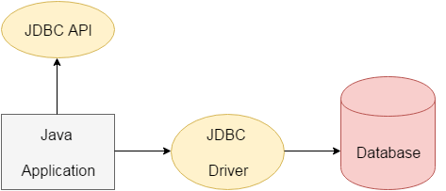
What is JDBC?
JDBC stands for Java Database Connectivity. JDBC is a Java API to connect and execute the query with the database. It is a part of JavaSE (Java Standard Edition).
We can use JDBC API to access tabular data stored in any relational database. By the help of JDBC API, we can save, update, delete and fetch data from the database. It is like Open Database Connectivity (ODBC) provided by Microsoft.

Slide 3
JDBC Drivers
JDBC API uses JDBC drivers to connect with the database.
There are four types of JDBC drivers:
JDBC-ODBC bridge driver
Native-API driver (partially java driver)
Network Protocol driver (fully java driver)
Thin driver (fully java driver)

Slide 4
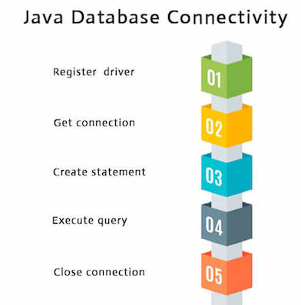
Java Database Connectivity

Slide 5
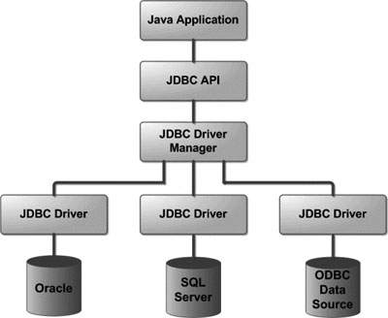
JDBC Architecture

Slide 6
Java Database Connectivity with MYSQL
import java.sql.*;
class MysqlCon{
public static void main(String args[]){
try{
Class.forName("com.mysql.jdbc.Driver");
Connection con=DriverManager.getConnection(
"jdbc:mysql://localhost:3306/sonoo","root","root");
//here sonoo is database name, root is username and password
Statement stmt=con.createStatement();
ResultSet rs=stmt.executeQuery("select * from emp");
while(rs.next()) {
System.out.println(rs.getInt(1)+" "+rs.getString(2)+" "+rs.getString(3));
}
con.close();
}catch(Exception e){ System.out.println(e);}
}
}
We need to know following informations for the mysql database:
Driver class: The driver class for the mysql database is com.mysql.jdbc.Driver.
Connection URL: The connection URL for the mysql database is jdbc:mysql://localhost:3306/dbname.
Username: The default username for the mysql database is root.
Password: It is the password given by the user at the time of installing the mysql database.

Slide 7
JDBC Components
The JDBC API provides the following interfaces and classes −
DriverManager − This class manages a list of database drivers. Matches connection requests from the java application with the proper database driver using communication sub protocol. The first driver that recognizes a certain subprotocol under JDBC will be used to establish a database Connection.
Driver − This interface handles the communications with the database server. You will interact directly with Driver objects very rarely. Instead, you use DriverManager objects, which manages objects of this type. It also abstracts the details associated with working with Driver objects.
RDBMS | JDBC driver name | URL format
MySQL | com.mysql.jdbc.Driver | jdbc:mysql://hostname/ databaseName
ORACLE | oracle.jdbc.driver.OracleDriver | jdbc:oracle:thin:@hostname:port Number:databaseName
DB2 | COM.ibm.db2.jdbc.net.DB2Driver | jdbc:db2:hostname:port Number/databaseName
Sybase | com.sybase.jdbc.SybDriver | jdbc:sybase:Tds:hostname: port Number/databaseName

Slide 8
JDBC Components
Connection − This interface with all methods for contacting a database. The connection object represents communication context, i.e., all communication with database is through connection object only.
Connection conn = DriverManager.getConnection(URL)
Statement − You use objects created from this interface to submit the SQL statements to the database. Some derived interfaces accept parameters in addition to executing stored procedures.
Interfaces | Recommended Use
Statement | Use this for general-purpose access to your database. Useful when you are using static SQL statements at runtime. The Statement interface cannot accept parameters.
PreparedStatement | Use this when you plan to use the SQL statements many times. The PreparedStatement interface accepts input parameters at runtime.
CallableStatement | Use this when you want to access the database stored procedures. The CallableStatement interface can also accept runtime input parameters.

Slide 9
JDBC Components
ResultSet − These objects hold data retrieved from a database after you execute an SQL query using Statement objects. It acts as an iterator to allow you to move through its data.
The object of ResultSet maintains a cursor pointing to a row of a table. Initially, cursor points to before the first row.
SQLException − This class handles any errors that occur in a database application.

Slide 10
Thanks
Anirudha Gaikwad

