Slide 1
JAVA
What you learn ?
Java | Expressions
What is JSP? | Lifecycle of JSP
JSP Directory Structure | JSP Scripting Elements
JSP Request | JSP Response
JSP Session | JSP Directives

Slide 2
What is JSP?
JSP technology is used to create web application just like Servlet technology. It can be thought of as an extension to Servlet because it provides more functionality than servlet such as expression language, JSTL, etc.
A JSP page consists of HTML tags and JSP tags. The JSP pages are easier to maintain than Servlet because we can separate designing and development.
Advantages of JSP over Servlet
Extension to Servlet
Easy to maintain
Fast Development: No need to recompile and redeploy
Less code than Servlet

Slide 3
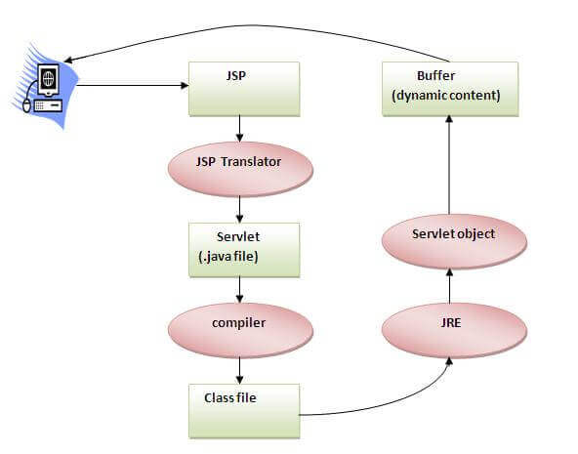
Lifecycle of JSP
The JSP pages follow these phases:
Translation of JSP Page
Compilation of JSP Page
Classloading (the classloader loads class file)
Instantiation (Object of the Generated Servlet is created).
Initialization ( the container invokes jspInit() method).
Request processing ( the container invokes _jspService() method).
Destroy ( the container invokes jspDestroy() method).

Slide 4
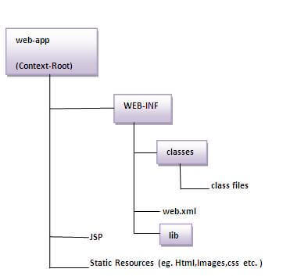
JSP Directory Structure
Follow the following steps to execute this JSP page:
Start the server
Put the JSP file in a folder and deploy on the server
Visit the browser by the URL http://localhost:portno/contextRoot/jspfile, for example, http://localhost:8888/myapplication/index.jsp

Slide 5
JSP Scripting elements
The scripting elements provides the ability to insert java code inside the jsp. There are three types of scripting elements:
scriptlet tag
expression tag
declaration tag

Slide 6
JSP Scripting elements
A scriptlet tag is used to execute java source code in JSP.
Syntax is as follows:
<% java source code %>
Example:
<html>
<body>
<% out.print("welcome to jsp"); %>
</body>
</html>

Slide 7
JSP Scripting elements
The code placed within JSP expression tag is written to the output stream of the response. So you need not write out.print() to write data. It is mainly used to print the values of variable or method.
Syntax is as follows:
<%= statement %>
Example:
<html>
<body>
<%= "welcome to jsp" %>
</body>
</html>

Slide 8
JSP Scripting elements
The JSP declaration tag is used to declare fields and methods.
The code written inside the jsp declaration tag is placed outside the service() method of auto generated servlet.
So it doesn't get memory at each request.
Syntax is as follows:
<%! field or method declaration %>
Example:
<html>
<body>
<%! int data=50; %>
<%= "Value of the variable is:"+data %>
</body>
</html>

Slide 9
JSP Request
The JSP request is an implicit object of type HttpServletRequest i.e. created for each jsp request by the web container. It can be used to get request information such as parameter, header information, remote address, server name, server port, content type, character encoding etc.
It can also be used to set, get and remove attributes from the jsp request scope.
Example:
<%
String name=request.getParameter("uname");
out.print("welcome "+name);
%>

Slide 10
JSP Response
In JSP, response is an implicit object of type HttpServletResponse. The instance of HttpServletResponse is created by the web container for each jsp request.
It can be used to add or manipulate response such as redirect response to another resource, send error etc.
Example:
<%
response.sendRedirect("http://www.google.com");
%>

Slide 11
JSP Session
In JSP, session is an implicit object of type HttpSession. The Java developer can use this object to set, get or remove attribute or to get session information.
Example:
second.jsp
<html>
<body>
<%
String name=(String)session.getAttribute("user");
out.print("Hello "+name);
%>
</body>
</html>
welcome.jsp
<html>
<body>
<%
String name=request.getParameter("uname");
out.print("Welcome "+name);
session.setAttribute("user",name);
<a href="second.jsp">second jsp page</a>
%>
</body>
</html>

Slide 12
JSP PageContext
<html>
<body>
<%
String name=request.getParameter("uname");
out.print("Welcome "+name);
pageContext.setAttribute("user",name,PageContext.SESSION_SCOPE);
<a href="second.jsp">second jsp page</a>
%>
</body>
</html>
In JSP, pageContext is an implicit object of type PageContext class.The pageContext object can be used to set,get or remove attribute from one of the following scopes:
page
request
session
Application
In JSP, page scope is the default scope.

Slide 13
JSP directives
The jsp directives are messages that tells the web container how to translate a JSP page into the corresponding servlet.
There are three types of directives:
page directive
include directive
taglib directive
Syntax of JSP Directive:
<%@ directive attribute="value" %>

Slide 14
JSP directives
Attributes of JSP page directive:
import
contentType
extends
info
buffer
language
isELIgnored
isThreadSafe
autoFlush
session
pageEncoding
errorPage
isErrorPage
JSP page directive:
The page directive defines attributes that apply to an entire JSP page.
Syntax of JSP page directive-
<%@ page attribute="value" %>

Slide 15
JSP directives
include directive:
The include directive is used to include the contents of any resource it may be jsp file, html file or text file. The include directive includes the original content of the included resource at page translation time (the jsp page is translated only once so it will be better to include static resource).
Advantage of Include directive:
Code Reusability
Syntax of include directive:
<%@ include file="resourceName" %>

Slide 16
JSP directives
taglib directive:
The JSP taglib directive is used to define a tag library that defines many tags. We use the TLD (Tag Library Descriptor) file to define the tags. In the custom tag section we will use this tag so it will be better to learn it in custom tag.
Syntax JSP Taglib directive:
<%@ taglib uri="uriofthetaglibrary" prefix="prefixoftaglibrary" %>
Example:
<%@ taglib uri="http://www.google.com/tags" prefix="mytag" %>

Slide 17
Thanks
Anirudha Gaikwad

