Slide 1
JAVA
What you learn ?
Java | Expressions
About version control | What is Git?
Git workflow | Git Installation on Windows
What is Github? | Features of Github
How to use Git & Github?

Slide 2
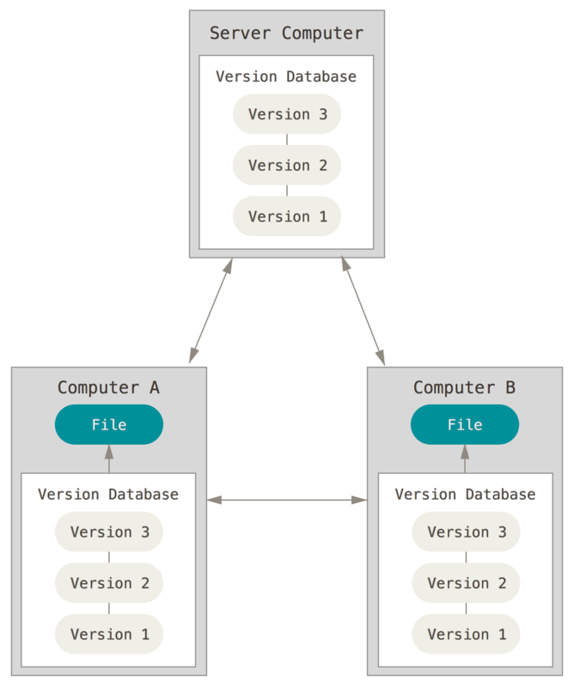

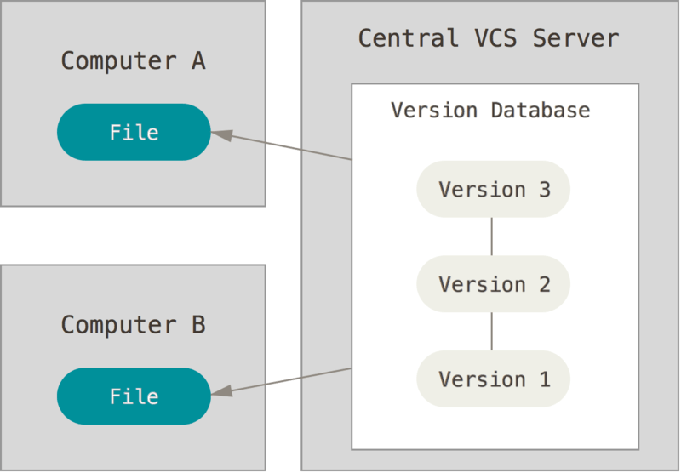
About Version Control
Version control is a system that records changes to a file or set of files over time so that you can recall specific versions later.
If you are a graphic or web designer and want to keep every version of an image or layout (which you would most certainly want to), a Version Control System (VCS) is a very wise thing to use.
Local Version Control Systems
Centralized Version Control Systems
Distributed Version Control Systems

Slide 3
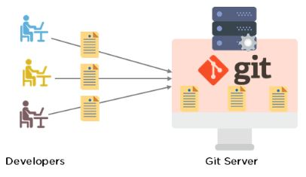
What is Git?
Git is a version control system used for tracking changes in computer files. It is generally used for source code management in software development.
Git is used to tracking changes in the source code
The distributed version control tool is used for source code management
It allows multiple developers to work together
It supports non-linear development through its thousands of parallel branches
Features of Git:
Tracks history
Free and open source
Supports non-linear development
Creates backups
Scalable
Supports collaboration
Branching is easier
Distributed development

Slide 4
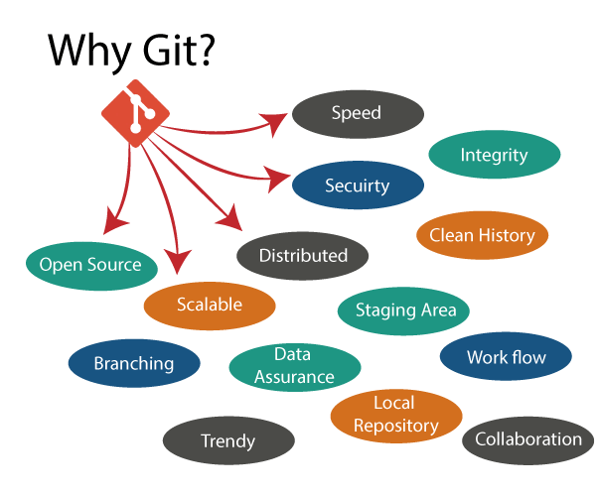
Why Git?

Slide 5
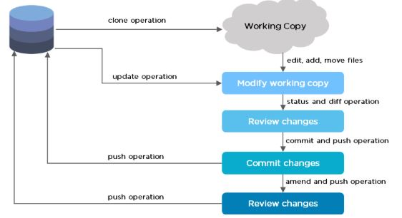
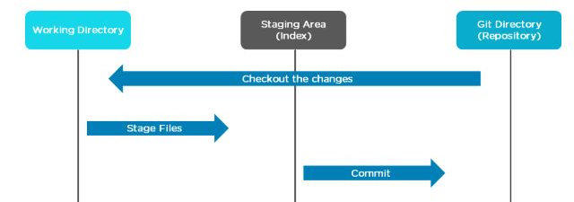
Git Workflow
The Git workflow is divided into three states:
Working directory - Modify files in your working directory
Staging area (Index) - Stage the files and add snapshots of them to your staging area
Git directory (Repository) - Perform a commit that stores the snapshots permanently to your Git directory. Checkout any existing version, make changes, stage them and commit.

Slide 6
Git Installation on Windows
Step 1:
Download the latest version of Git and choose the 64/32 bit version. After the file is downloaded, install it in the system. Once installed, select Launch the Git Bash, then click on finish. The Git Bash is now launched.
Step 2:
Check the Git version:
$ git –version
Step 3:
For any help, use the following command:
$ git help config
This command will lead you to a browser of config commands. Basically, the help the command provides a manual from the help page for the command just following it (here, it's config).
Another way to use the same command is as follows:
$ git config --help

Slide 7
Git Installation on Windows
Step 4:
Create a local directory using the following command:
$ mkdir test
$ cd test
Step 5:
The next step is to initialize the directory:
$ git init
Step 6:
Go to the folder where "test" is created and create a text document named "demo." Open "demo" and put any content, like "Hello" Save and close the file.
Step 7:
Enter the Git bash interface and type in the following command to check the status:
$ git status

Slide 8
Git Installation on Windows
Step 8:
Add the "demo" to the current directory using the following command:
$ git add demo.txt
Step 9:
Next, make a commit using the following command:
$ git commit -m "committing a text file“
Step 10:
Link the Git to a Github Account:
$ git config --global user.username
Step 11:
Open your Github account and create a new repository with the name "test_demo" and click on "Create repository." This is the remote repository. Next, copy the link of "test_demo."

Slide 9
Git Installation on Windows
Step 12:
Go back to Git bash and link the remote and local repository using the following command:
$ git remote add origin <link>
Here, <link> is the link copied in the previous step.
Step 13:
Push the local file onto the remote repository using the following command:
$ git push origin master
Step 14:
Move back to Github and click on "test_demo" and check if the local file "demo.txt" is pushed to this repository.

Slide 10
What is Github?
GitHub is a Git repository hosting service that provides a web-based graphical interface. It is the world’s largest coding community.
Putting a code or a project into GitHub brings it increased, widespread exposure.
Programmers can find source codes in many different languages and use the command-line interface, Git, to make and keep track of any changes.
GitHub helps every team member work together on a project from any location while facilitating collaboration.
You can also review previous versions created at an earlier point in time.

Slide 11
Features of Github
1. Easy Project Management
Developers come together to coordinate, track, and update their work so that projects are transparent and stay on schedule.
2. Increased Safety With Packages
Packages can be published privately, within the team, or publicly to the open-source community.
3. Effective Team Management
GitHub helps all the team members stay on the same page and organized.
4. Improved Code Writing
Pull requests help the organizations to review, develop, and propose new code.
5. Increased Code Safety
GitHub uses dedicated tools to identify and analyze vulnerabilities to the code.
6. Easy Code Hosting
All the code and documentation are in one place. There are millions of repositories on GitHub, and each repository has its own tools to help you host and release code.

Slide 12
How to use Git & Github?
Create your GitHub account.
Create a repository or “repo” for short. This is where you store your code.
Build a file.
Make a commit. Whenever you create a file or change it, you create a Git commit to store the new version.
Connect your repo with your computer system.

Slide 13
Thanks
Anirudha Gaikwad

