Slide 1
JAVA
What you learn ?
Java
Array | Single dimensional array
Multi dimensional array | Array Class

Slide 2
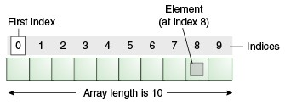
Array
Java array is an object which contains elements of a similar data type. Additionally, The elements of an array are stored in a contiguous memory location.
Advantages-
Code Optimization: It makes the code optimized, we can retrieve or sort the data efficiently.
Random access: We can get any data located at an index position.
Disadvantages-
Size Limit: We can store only the fixed size of elements in the array. It doesn't grow its size at runtime. To solve this problem, collection framework is used in Java which grows automatically.

Slide 3
Single Dimensional Array
//Java Program to illustrate the use of declaration, instantiation
//and initialization of Java array in a single line
class Testarray1{
public static void main(String args[]){
int a[]={33,3,4,5};//declaration, instantiation and initialization
//printing array
for(int i=0;i<a.length;i++)//length is the property of array
System.out.println(a[i]);
}
}

Slide 4
Multi Dimensional Array
A multidimensional array is an array of arrays.
Multidimensional arrays are useful when you want to store data as a tabular form, like a table with rows and columns.
To create a two-dimensional array, add each array within its own set of curly braces:
Example:
int[][] myNumbers = { {1, 2, 3, 4}, {5, 6, 7} };
myNumbers[1][2] = 9;
System.out.println(myNumbers[1][2]); // Outputs 9 instead of 7

Slide 5
Jagged Array
If we are creating odd number of columns in a 2D array, it is known as a jagged array. In other words, it is an array of arrays with different number of columns.
//Java Program to illustrate the jagged array
class TestJaggedArray{
public static void main(String[] args){
//declaring a 2D array with odd columns
int arr[][] = new int[3][];
arr[0] = new int[3];
arr[1] = new int[4];
arr[2] = new int[2];
//initializing a jagged array
int count = 0;
for (int i=0; i<arr.length; i++) {
for(int j=0; j<arr[i].length; j++) {
arr[i][j] = count++;
}
}
//printing the data of a jagged array
for (int i=0; i<arr.length; i++){
for (int j=0; j<arr[i].length; j++){
System.out.print(arr[i][j]+" ");
}
System.out.println();//new line
}
}
}
output:
0 1 2
3 4 5 6
7 8

Slide 6
Anonymous Array
As its name suggests, arrays having no name are called Anonymous arrays in java. This type of array is used only when we require an array instantly. We can also pass this array to any method without any reference variable.
Syntax:
new datatype[] {values separated by comma}
Example:
//One-dimensional integer type anonymous array
new int[] {2,4,6,8};
// Multi-dimensional integer type anonymous array
new int[][] { {1,3,5}, {2,4,6} };

Slide 7
Array Class
public class Arrays
extends Object
Arrays class is present in java.util.Arrays Package.
This class contains various methods for manipulating arrays (such as sorting and searching). This class also contains a static factory that allows arrays to be viewed as lists.
The methods in this class all throw a NullPointerException, if the specified array reference is null, except where noted.
Syntax: In order to use Arrays
Arrays.<function name>;
Benefits of Arrays Class in Java:
Arrays class makes it easier to perform common operations on an array.
No need to use complicated loops to work with an array.
No need to reinvent the wheel for operations such as binary search and sorting.

Slide 8
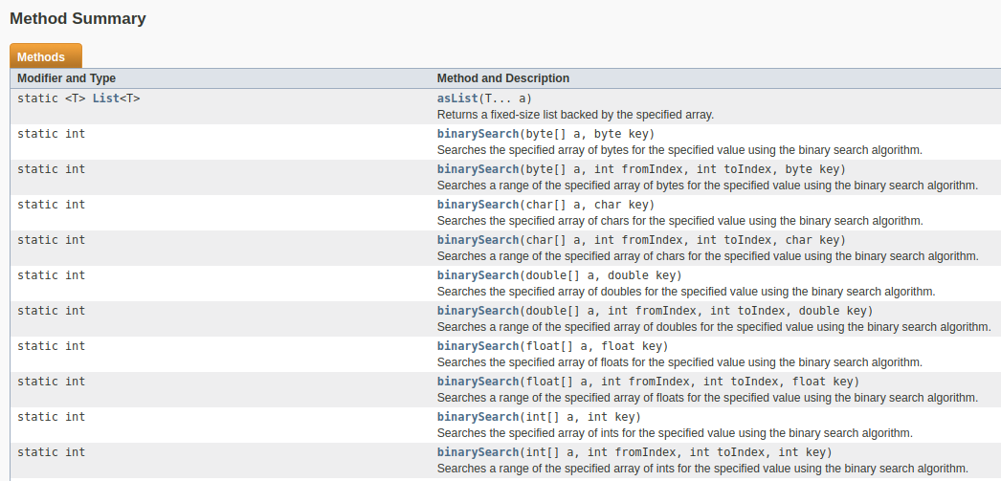

Slide 9
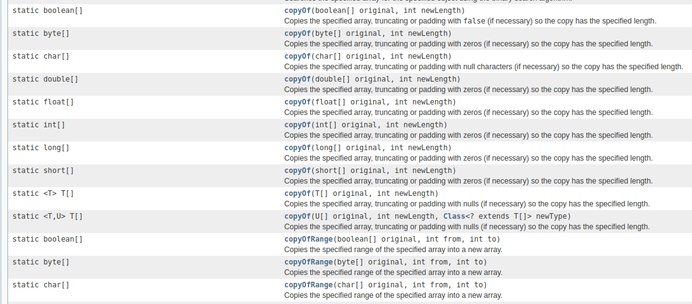

Slide 10
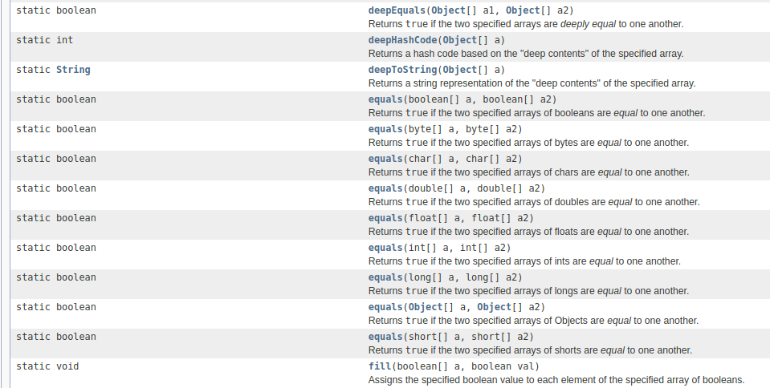

Slide 11
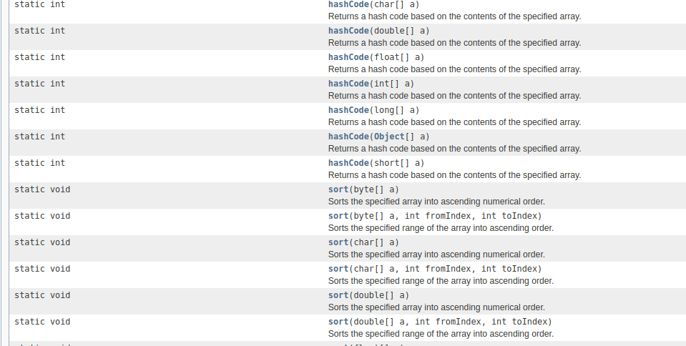

Slide 12
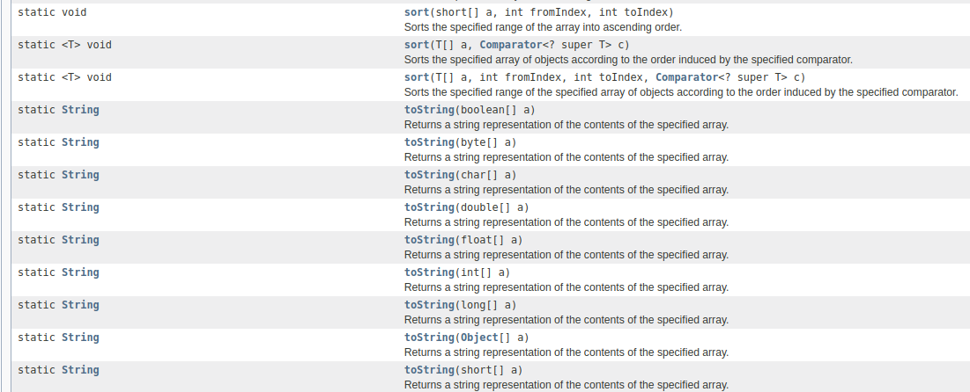

Slide 13
Thanks
Anirudha Gaikwad

