Slide 1
JAVA
What you learn ?
Java | Expressions
What is Polymorphism? | Method overloading
Method Overriding | Adv. & Dis. Adv. Of Polymorphism
super keyword | final keyword
instanceof operator | Encapsulation

Slide 2
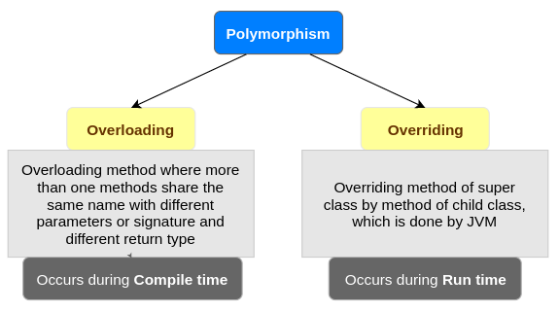
Polymorphism
The word polymorphism means having many forms. In simple words, we can define polymorphism as the ability of a message to be displayed in more than one form.

Slide 3
Method Overloading
If a class has multiple methods having same name but different in parameters, it is known as Method Overloading.
class Demo {
void multiply(int a, int b) {
System.out.printIn("Result is"+(a*b)) ;
}
void multiply(int a, int b,int c) { System.out.printIn("Result is"+(a*b*c));
}
public static void main(String[] args)
{ Demo obj = new Demo();
obj.multiply(8,5);
obj.multiply(4,6,2);
}
}
Different ways to overload the method
By changing number of arguments
By changing the data type
In Java, Method Overloading is not possible by changing the return type of the method only because of ambiguity.

Slide 4
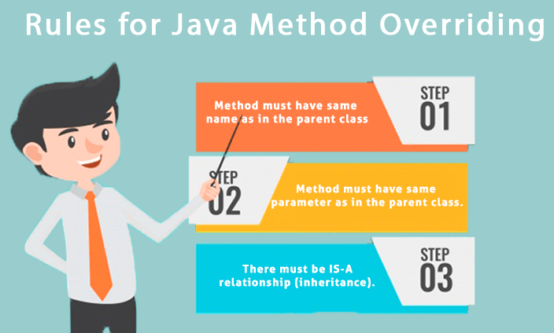
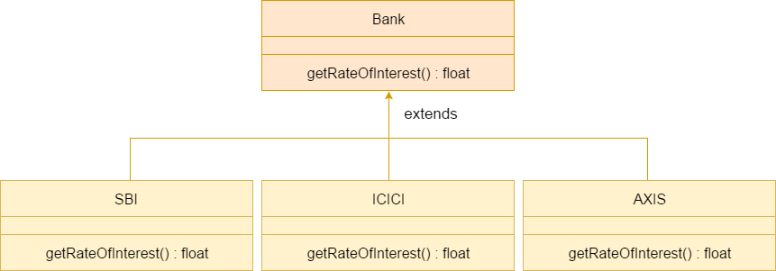
Method Overriding
If subclass (child class) has the same method as declared in the parent class, it is known as method overriding in Java.

Slide 5
Method Overriding
class Bank{
int getRateOfInterest(){return 0;}
}
//Creating child classes.
class SBI extends Bank{
int getRateOfInterest(){return 8;}
}
class ICICI extends Bank{
int getRateOfInterest(){return 7;}
}
//Test class to create objects and call the methods
class Test2{
public static void main(String args[]){
SBI s=new SBI();
ICICI i=new ICICI();
System.out.println("SBI Rate of Interest: "+s.getRateOfInterest());
System.out.println("ICICI Rate of Interest: "+i.getRateOfInterest());
}
}
Output:
SBI Rate of Interest: 8
ICICI Rate of Interest: 7

Slide 6
Advantages & Disadvantages of Polymorphism
Advantages of Polymorphism in Java:
Increases code reusability by allowing objects of different classes to be treated as objects of a common class.
Improves readability and maintainability of code by reducing the amount of code that needs to be written and maintained.
Supports dynamic binding, enabling the correct method to be called at runtime, based on the actual class of the object.
Enables objects to be treated as a single type, making it easier to write generic code that can handle objects of different types.
Disadvantages of Polymorphism in Java:
Can make it more difficult to understand the behavior of an object, especially if the code is complex.
May lead to performance issues, as polymorphic behavior may require additional computations at runtime.

Slide 7
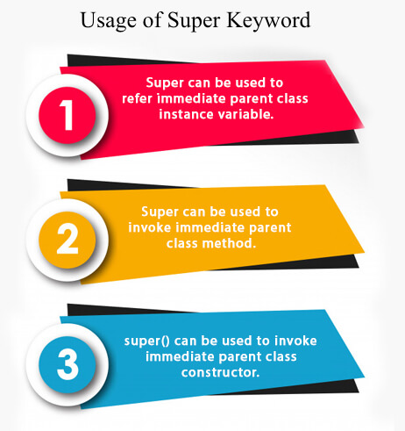
super keyword
The super keyword in Java is a reference variable which is used to refer immediate parent class object.

Slide 8
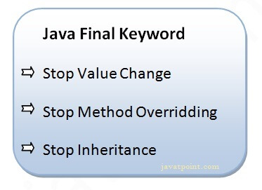
final keyword
The final keyword in java is used to restrict the user.
The java final keyword can be used in many context. Final can be:
variable
method
class

Slide 9
instanceof operator
The java instanceof operator is used to test whether the object is an instance of the specified type (class or subclass or interface).
The instanceof in java is also known as type comparison operator because it compares the instance with type. It returns either true or false. If we apply the instanceof operator with any variable that has null value, it returns false.
class Simple1{
public static void main(String args[]){
Simple1 s=new Simple1();
System.out.println(s instanceof Simple1);//true
}
}

Slide 10
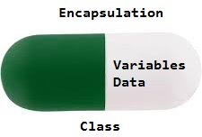
Encapsulation
Encapsulation in Java is a process of wrapping code and data together into a single unit, for example, a capsule which is mixed of several medicines.
We can create a fully encapsulated class in Java by making all the data members of the class private. Now we can use setter and getter methods to set and get the data in it.
The meaning of Encapsulation, is to make sure that "sensitive" data is hidden from users. To achieve this, you must:
declare class variables/attributes as private
provide public get and set methods to access and update the value of a private variable

Slide 11
Advantages of Encapsulation
By providing only a setter or getter method, you can make the class read-only or write-only. In other words, you can skip the getter or setter methods.
It provides you the control over the data. Suppose you want to set the value of id which should be greater than 100 only, you can write the logic inside the setter method. You can write the logic not to store the negative numbers in the setter methods.
It is a way to achieve data hiding in Java because other class will not be able to access the data through the private data members.
The encapsulate class is easy to test. So, it is better for unit testing.
The standard IDE's are providing the facility to generate the getters and setters. So, it is easy and fast to create an encapsulated class in Java.

Slide 12
Encapsulation Example
//A Java class which is a fully encapsulated class.
//It has a private data member and getter and setter methods.
package com.javatpoint;
public class Student{
private String name; //private data member
//getter method for name
public String getName(){
return name;
}
//setter method for name
public void setName(String name){
this.name=name
}
}

Slide 13
Thanks
Anirudha Gaikwad

