Slide 1
JAVA
What you learn ?
Java | Expressions
Package | Accessing package
Subpackage | Access modifiers
Non access modifiers

Slide 2
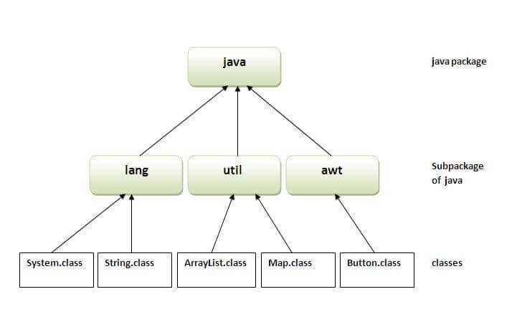
Package in JAVA
A java package is a group of similar types of classes, interfaces and sub-packages.
Package in java can be categorized in two form, built-in package and user-defined package.
There are many built-in packages such as java, lang, awt, javax, swing, net, io, util, sql etc.

Slide 3
Package in JAVA
Example:
//save as Simple.java
package mypack;
public class Simple{
public static void main(String args[]){
System.out.println("Welcome to package");
}
}
To Compile: javac -d . Simple.java
To Run: java mypack.Simple
Output: Welcome to package
Advantage of Java Package:
Java package is used to categorize the classes and interfaces so that they can be easily maintained.
Java package provides access protection.
Java package removes naming collision.

Slide 4
Accessing package
There are three ways to access the package from outside the package:
import package.*;
import package.classname;
fully qualified name.
//save by A.java
package pack;
public class A{
public void msg(){System.out.println("Hello");}
}
// 2nd way
import package.classname
package mypack;
import pack.A;
class B{
public static void main(String args[]){
A obj = new A();
obj.msg();
}
}
// 1st way import package.*
package mypack;
import pack.*;
class B{
public static void main(String args[]){
A obj = new A();
obj.msg();
}
}
//3rd way fully qualified name
package mypack;
class B{
public static void main(String args[]){
pack.A obj = new pack.A();//using fully qualified name
obj.msg();
}
}

Slide 5
Subpackage
Note: If you import a package, subpackages will not be imported.
If you import a package, all the classes and interface of that package will be imported excluding the classes and interfaces of the subpackages. Hence, you need to import the subpackage as well.
Package inside the package is called the subpackage. It should be created to categorize the package further.
Example:
package com.javatpoint.core;
class Simple{
public static void main(String args[]){
System.out.println("Hello subpackage");
}
}
To Compile: javac -d . Simple.java
To Run: java com.javatpoint.core.Simple
Output: Hello subpackage

Slide 6
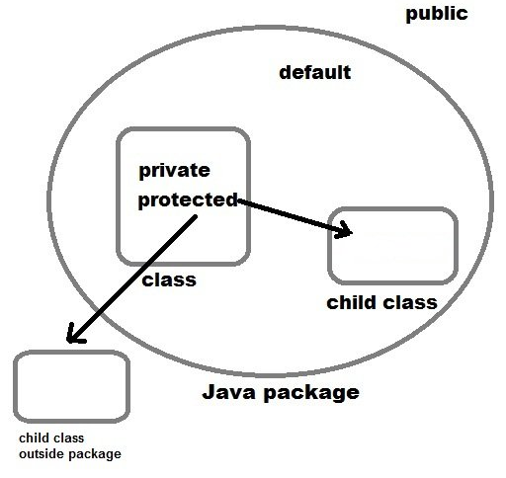
Access Modifiers
There are four types of Java access modifiers:
Private: The access level of a private modifier is only within the class. It cannot be accessed from outside the class.
Default: The access level of a default modifier is only within the package. It cannot be accessed from outside the package. If you do not specify any access level, it will be the default.
Protected: The access level of a protected modifier is within the package and outside the package through child class. If you do not make the child class, it cannot be accessed from outside the package.
Public: The access level of a public modifier is everywhere. It can be accessed from within the class, outside the class, within the package and outside the package.

Slide 7
Access Modifiers
The access modifiers in Java specifies the accessibility or scope of a field, method, constructor, or class. We can change the access level of fields, constructors, methods, and class by applying the access modifier on it.
Access Modifier | within class | within package | outside package by subclass only | outside package
Private | Y | N | N | N
Default | Y | Y | N | N
Protected | Y | Y | Y | N
Public | Y | Y | Y | Y

Slide 8
Non Access Modifiers
Along with access modifiers, Java provides non-access modifiers as well. These modifier are used to set special properties to the variable or method.
Non-access modifiers do not change the accessibility of variable or method, but they provide special properties to them.
Java provides following non-access modifiers.
Final
Static
Transient
Synchronized
Volatile

Slide 9
Non Access Modifiers
Final Modifier:
If variable is declared final then we cannot change its value. If method is declared final then it can not be overridden and if a class is declared final then we can not inherit it.
Static modifier:
We can use it to declare static variable, method, class etc. static can be use to declare class level variable. If a method is declared static then we don’t need to have object to access that.
Transient modifier:
When an instance variable is declared as transient, then its value doesn't persist when an object is serialized
Synchronized modifier:
When a method is synchronized it can be accessed by only one thread at a time. We will discuss it in detail in Thread.
Volatile modifier:
Volatile modifier tells to the compiler that the volatile variable can be changed unexpectedly by other parts of a program. Volatile variables are used in case of multi-threading program. It can be only used with a variable.

Slide 10
Thanks
Anirudha Gaikwad

