Slide 1
JAVA
What you learn ?
Java | Expressions
Recursion | Searching
Sorting | Analysis of Algorithm
Asymptotic Notations | Recursive Complexity

Slide 2
Recursion
Recursion is the technique of making a function call itself. This technique provides a way to break complicated problems down into simple problems which are easier to solve.
Example:
public class Main {
public static void main(String[] args) {
int result = sum(10);
System.out.println(result);
}
public static int sum(int k) {
if (k > 0) {
return k + sum(k - 1);
} else {
return 0;
}
}
}
Syntax:
returntype methodname(){
//code to be executed
methodname();//calling same method
}

Slide 3
Linear Search
Linear search is also called as sequential search algorithm. It is the simplest searching algorithm.
In Linear search, we simply traverse the list completely and match each element of the list with the item whose location is to be found. If the match is found, then the location of the item is returned; otherwise, the algorithm returns NULL.
It is widely used to search an element from the unordered list, i.e., the list in which items are not sorted.

Slide 4
Linear Search
Linear_Search(a, n, val) //a-array, n-size of array, val- key to search
Step 1: set pos = -1
Step 2: set i = 1
Step 3: repeat step 4 while i <= n
Step 4: if a[i] == val
set pos = i
print pos
go to step 6
[end of if]
set ii = i + 1
[end of loop]
Step 5: if pos = -1
print "value is not present in the array "
[end of if]
Step 6: exit

Slide 5
Linear Search
Case | Time Complexity
Best Case | O(1)
Average Case | O(n)
Worst Case | O(n)
Space Complexity | O(1)

Slide 6
Binary Search
Binary search is the search technique that works efficiently on sorted lists. Hence, to search an element into some list using the binary search technique, we must ensure that the list is sorted.
Binary search follows the divide and conquer approach in which the list is divided into two halves, and the item is compared with the middle element of the list. If the match is found then, the location of the middle element is returned. Otherwise, we search into either of the halves depending upon the result produced through the match.

Slide 7
Binary Search
Binary_Search(a, lower_bound, upper_bound, val)
Step 1: set beg = lower_bound, end = upper_bound, pos = - 1
Step 2: repeat steps 3 and 4 while beg <=end
Step 3: set mid = (beg + end)/2
Step 4: if a[mid] = val
set pos = mid print pos go to step 6
else if a[mid] > val set end = mid - 1
else set beg = mid + 1
[end of if]
[end of loop]
Step 5: if pos = -1
print "value is not present in the array"
[end of if]
Step 6: exit

Slide 8
Binary Search
Case | Time Complexity
Best Case | O(1)
Average Case | O(logn)
Worst Case | O(logn)
Space Complexity | O(1)

Slide 9
Sorting Algorithms
bubble sort: swap adjacent pairs that are out of order
selection sort: look for the smallest element, move to front
insertion sort: build an increasingly large sorted front portion
merge sort: recursively divide the array in half and sort it
heap sort: place the values into a sorted tree structure
quick sort: recursively partition array based on a middle value
other specialized sorting algorithms:
bucket sort: cluster elements into smaller groups, sort them
radix sort: sort integers by last digit, then 2nd to last, then ...

Slide 10
Bubble Sort
Bubble sort is a sorting algorithm that compares two adjacent elements and swaps them until they are in the intended order.
Just like the movement of air bubbles in the water that rise up to the surface, each element of the array move to the end in each iteration. Therefore, it is called a bubble sort.
Time Complexity
Best | O(n)
Worst | O(n²)
Average | O(n²)
Space Complexity | O(1)
Stability | Yes

Slide 11
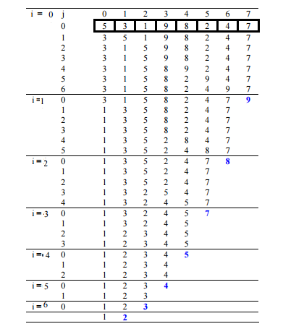
Bubble Sort
Example:

Slide 12
Bubble Sort
Algorithm:
begin BubbleSort(list)
for all elements of list
if list[i] > list[i+1]
swap(list[i], list[i+1])
end if
end for
return list
end BubbleSort

Slide 13
Selection Sort
Selection sort is a sorting algorithm that selects the smallest element from an unsorted list in each iteration and places that element at the beginning of the unsorted list.
Time Complexity
Best | O(n²)
Worst | O(n²)
Average | O(n²)
Space Complexity | O(1)
Stability | No

Slide 14
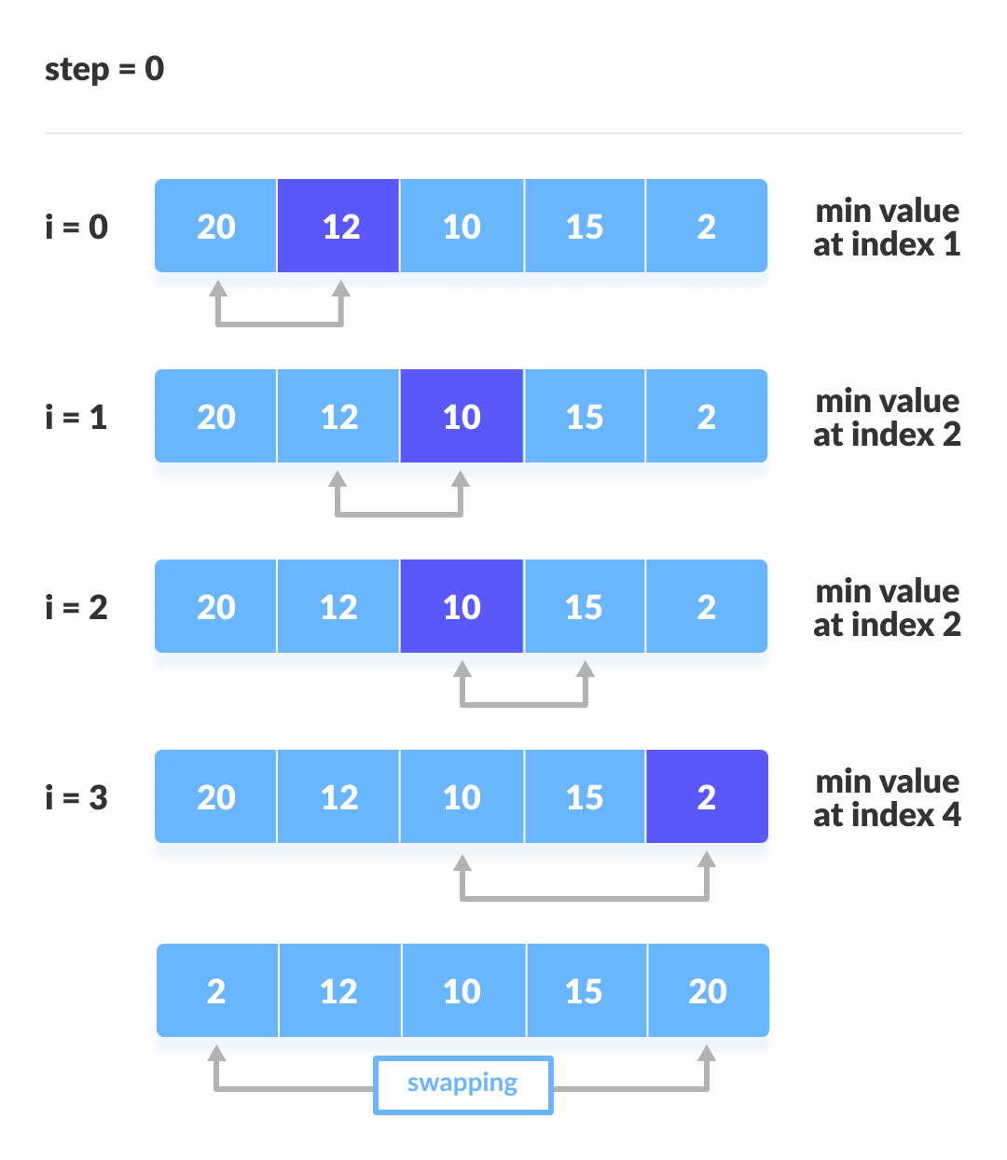
Selection Sort
Example:

Slide 15
Selection Sort
Algorithm:
selectionSort(array, size)
repeat (size - 1) times
set the first unsorted element as the minimum
for each of the unsorted elements
If element < currentMinimum
set element as new minimum
swap minimum with first unsorted position
end selectionSort

Slide 16
Insertion Sort
Insertion sort is a sorting algorithm that places an unsorted element at its suitable place in each iteration. Insertion sort works similarly as we sort cards in our hand in a card game
Time Complexity
Best | O(n)
Worst | O(n²)
Average | O(n²)
Space Complexity | O(1)
Stability | Yes

Slide 17
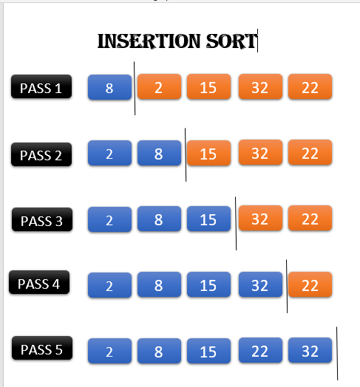
Insertion Sort
Example:

Slide 18
Insertion Sort
Algorithm:
insertionSort(array)
mark first element as sorted
for each unsorted element X
'extract' the element X
for j <- lastSortedIndex down to 0
if current element j > X
move sorted element to the right by 1
break loop and insert X here
end insertionSort

Slide 19
Merge Sort
Merge Sort is one of the most popular sorting algorithms that is based on the principle of Divide and Conquer Algorithm. Here, a problem is divided into multiple sub-problems. Each sub-problem is solved individually. Finally, sub-problems are combined to form the final solution.
Time Complexity
Best | O(n*log n)
Worst | O(n*log n)
Average | O(n*log n)
Space Complexity | O(n)
Stability | Yes

Slide 20
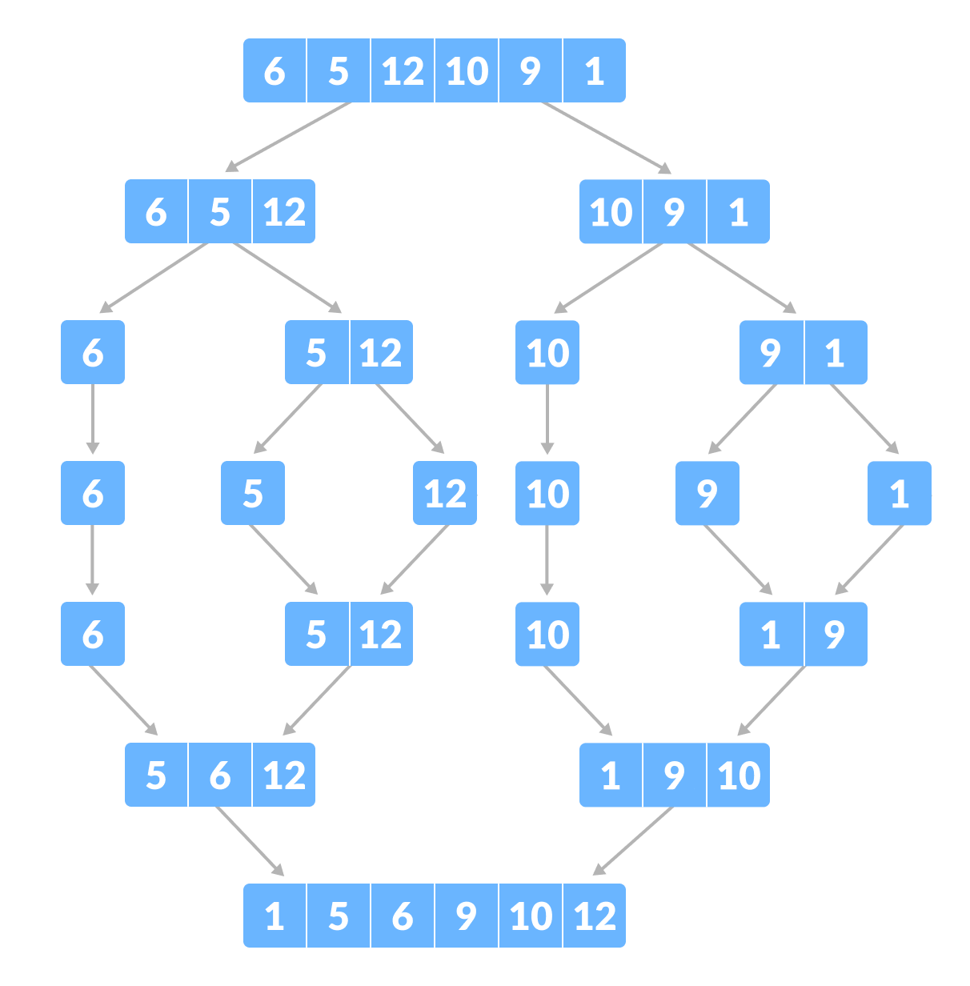
Merge Sort
Example:

Slide 21
Merge Sort
Algorithm:
MERGE_SORT(arr, beg, end)
if beg < end
set mid = (beg + end)/2
MERGE_SORT(arr, beg, mid)
MERGE_SORT(arr, mid + 1, end)
MERGE (arr, beg, mid, end)
end of if
END MERGE_SORT

Slide 22
Quick Sort
Quicksort is a sorting algorithm based on the divide and conquer approach where
An array is divided into subarrays by selecting a pivot element (element selected from the array).
While dividing the array, the pivot element should be positioned in such a way that elements less than pivot are kept on the left side and elements greater than pivot are on the right side of the pivot.
Time Complexity
Best | O(n*log n)
Worst | O(n²)
Average | O(n*log n)
Space Complexity | O(log n)
Stability | No

Slide 23
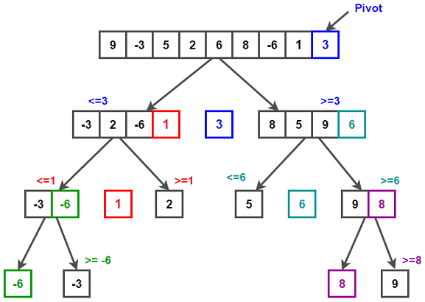
Quick Sort
Example:

Slide 24
Quick Sort
Algorithm:
quickSort(array, leftmostIndex, rightmostIndex)
if (leftmostIndex < rightmostIndex)
pivotIndex <- partition(array,leftmostIndex, rightmostIndex)
quickSort(array, leftmostIndex, pivotIndex - 1)
quickSort(array, pivotIndex, rightmostIndex)
partition(array, leftmostIndex, rightmostIndex)
set rightmostIndex as pivotIndex
storeIndex <- leftmostIndex - 1
for i <- leftmostIndex + 1 to rightmostIndex
if element[i] < pivotElement
swap element[i] and element[storeIndex]
storeIndex++
swap pivotElement and element[storeIndex+1]
return storeIndex + 1

Slide 25
Radix Sort
Radix sort is a sorting algorithm that sorts the elements by first grouping the individual digits of the same place value. Then, sort the elements according to their increasing/decreasing order.
Time Complexity
Best | O(n+k)
Worst | O(n+k)
Average | O(n+k)
Space Complexity | O(max)
Stability | Yes

Slide 26
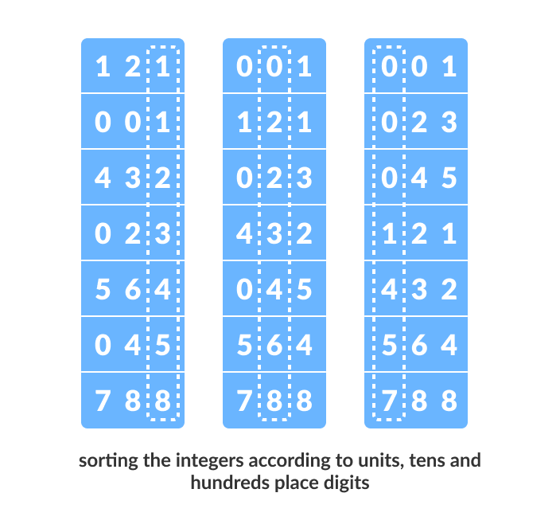
Radix Sort
Example:

Slide 27
Radix Sort
Algorithm:
radixSort(array)
d <- maximum number of digits in the largest element
create d buckets of size 0-9
for i <- 0 to d
sort the elements according to ith place digits using countingSort
countingSort(array, d)
max <- find largest element among dth place elements
initialize count array with all zeros
for j <- 0 to size
find the total count of each unique digit in dth place of elements and
store the count at jth index in count array
for i <- 1 to max
find the cumulative sum and store it in count array itself
for j <- size down to 1
restore the elements to array
decrease count of each element restored by 1

Slide 28
Heap Sort
Heap sort processes the elements by creating the min-heap or max-heap using the elements of the given array. Min-heap or max-heap represents the ordering of array in which the root element represents the minimum or maximum element of the array.
Heap sort basically recursively performs two main operations -
Build a heap H, using the elements of array.
Repeatedly delete the root element of the heap formed in 1st phase.
Time Complexity
Best | O(nlog n)
Worst | O(nlog n)
Average | O(nlog n)
Space Complexity | O(1)
Stability | No

Slide 29
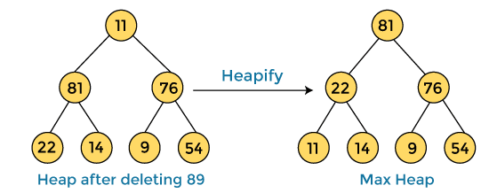


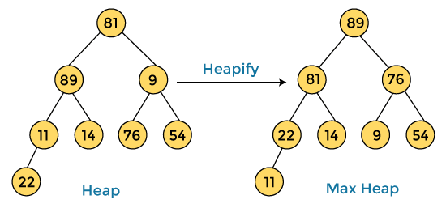

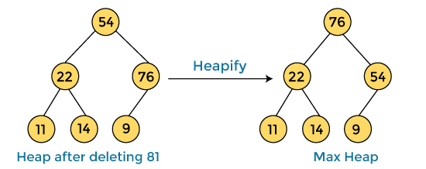
Heap Sort
Example:
After swapping the array element 89 with 11, and converting the heap into max-heap, the elements of array are -
First, we have to construct a heap from the given array and convert it into max heap.
In the next step, again, we have to delete the root element (81) from the max heap. To delete this node, we have to swap it with the last node, i.e. (54). After deleting the root element, we again have to heapify it to convert it into max heap.
After converting the given heap into max heap, the array elements are -
Next, we have to delete the root element (89) from the max heap. To delete this node, we have to swap it with the last node, i.e. (11). After deleting the root element, we again have to heapify it to convert it into max heap.

Slide 30


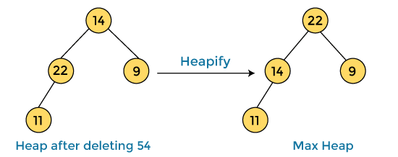
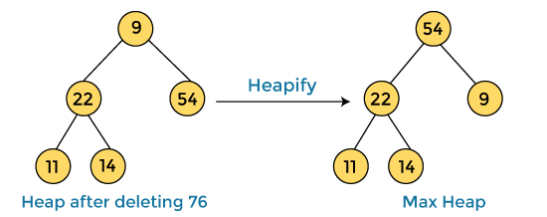

Heap Sort
Heap Sort
After swapping the array element 76 with 9 and converting the heap into max-heap, the elements of array are -
Example Continued…:
After swapping the array element 81 with 54 and converting the heap into max-heap, the elements of array are -
In the next step, again we have to delete the root element (54) from the max heap. To delete this node, we have to swap it with the last node, i.e. (14). After deleting the root element, we again have to heapify it to convert it into max heap.
In the next step, we have to delete the root element (76) from the max heap again. To delete this node, we have to swap it with the last node, i.e. (9). After deleting the root element, we again have to heapify it to convert it into max heap.
After swapping the array element 54 with 14 and converting the heap into max-heap, the elements of array are -

Slide 31
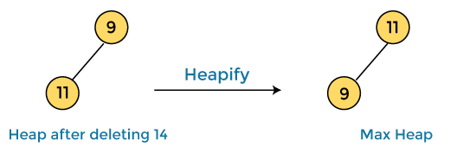

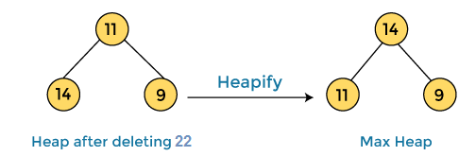
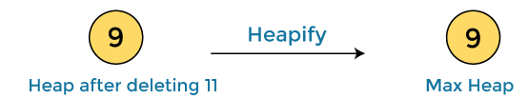



Heap Sort
Heap Sort
Example Continued…:
In the next step, again we have to delete the root element (22) from the max heap. To delete this node, we have to swap it with the last node, i.e. (11). After deleting the root element, we again have to heapify it to convert it into max heap.
After swapping the array element 14 with 9 and converting the heap into max-heap, the elements of array are -
In the next step, again we have to delete the root element (11) from the max heap. To delete this node, we have to swap it with the last node, i.e. (9). After deleting the root element, we again have to heapify it to convert it into max heap.
After swapping the array element 22 with 11 and converting the heap into max-heap, the elements of array are -
After swapping the array element 11 with 9, the elements of array are -
In the next step, again we have to delete the root element (14) from the max heap. To delete this node, we have to swap it with the last node, i.e. (9). After deleting the root element, we again have to heapify it to convert it into max heap.
Now, heap has only one element left. After deleting it, heap will be empty. Sorted array is-

Slide 32
Heap Sort
Algorithm:
HeapSort(arr)
BuildMaxHeap(arr)
for i = length(arr) to 2
swap arr[1] with arr[i]
heap_size[arr] = heap_size[arr] ? 1
MaxHeapify(arr,1)
End
BuildMaxHeap(arr)
BuildMaxHeap(arr)
heap_size(arr) = length(arr)
for i = length(arr)/2 to 1
MaxHeapify(arr,i)
End
MaxHeapify(arr,i)
MaxHeapify(arr,i)
L = left(i)
R = right(i)
if L ? heap_size[arr] and arr[L] > arr[i]
largest = L
else
largest = i
if R ? heap_size[arr] and arr[R] > arr[largest]
largest = R
if largest != i
swap arr[i] with arr[largest]
MaxHeapify(arr,largest)
End

Slide 33
Shell Sort
Shell sort is a generalized version of the insertion sort algorithm. It first sorts elements that are far apart from each other and successively reduces the interval between the elements to be sorted.
The interval between the elements is reduced based on the sequence used.
Time Complexity
Best | O(nlog n)
Worst | O(n²)
Average | O(nlog n)
Space Complexity | O(1)
Stability | No

Slide 34
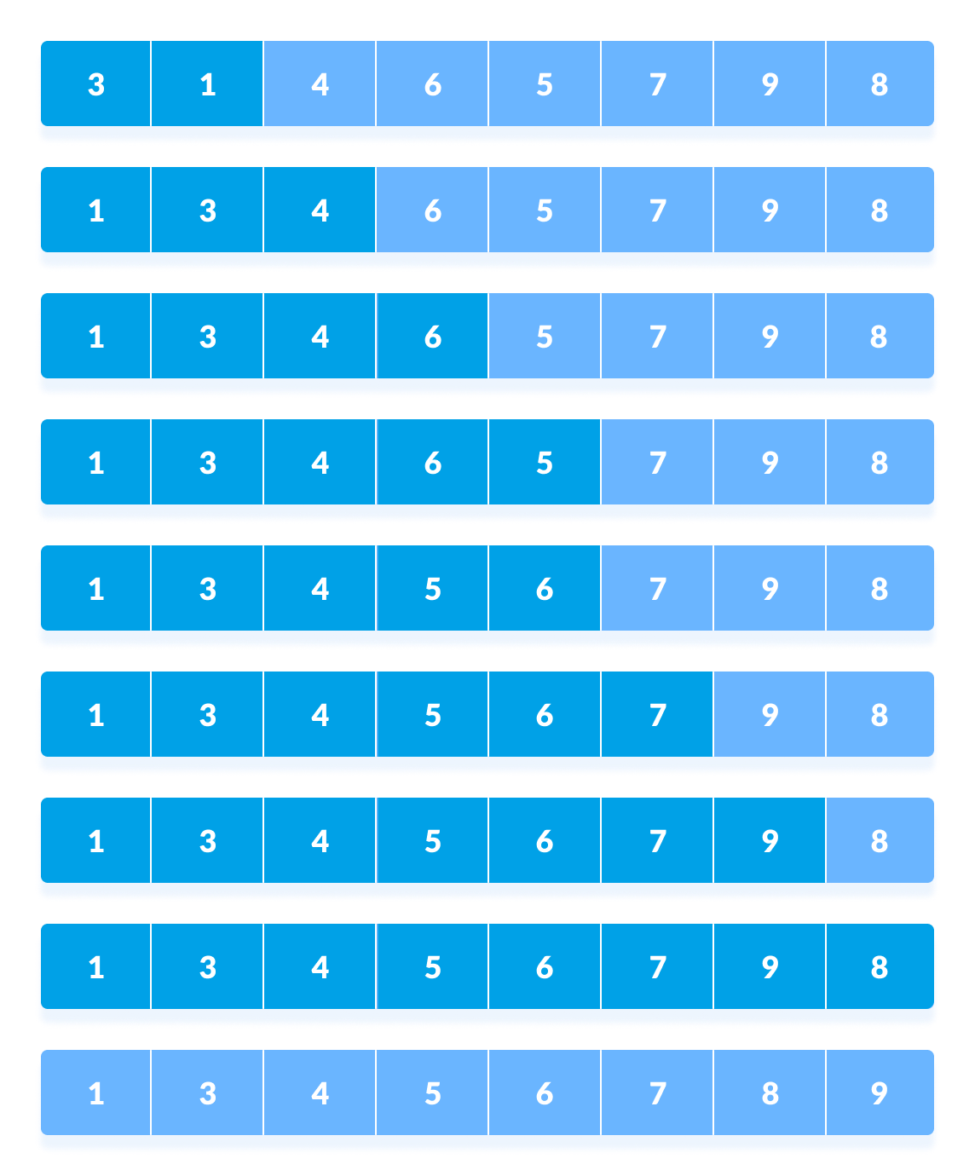
Shell Sort
Example:

Slide 35
Shell Sort
Algorithm:
shellSort(array, size)
for interval i <- size/2n down to 1
for each interval "i" in array
sort all the elements at interval "i"
end shellSort

Slide 36
Analysis of Algorithms
In the analysis of the algorithm, it generally focused on CPU (time) usage, Memory usage, Disk usage, and Network usage.
All are important, but the most concern is about the CPU time. Be careful to differentiate between:
Performance: How much time/memory/disk/etc. is used when a program is run. This depends on the machine, compiler, etc. as well as the code we write.
Complexity: How do the resource requirements of a program or algorithm scale, i.e. what happens as the size of the problem being solved by the code gets larger.
Usually, the time complexity is determined by the size of the algorithm's input to the number of steps taken to execute it. Also, the space complexity is mostly determined by the amount of storage needed by the algorithm to execute.

Slide 37
Analysis of Algorithms
Types of Algorithm Analysis:
Best case
Worst case
Average case
1) Best case: Define the input for which algorithm takes less time or minimum time. In the best case calculate the lower bound of an algorithm. Example: In the linear search when search data is present at the first location of large data then the best case occurs.
2) Worst Case: Define the input for which algorithm takes a long time or maximum time. In the worst calculate the upper bound of an algorithm. Example: In the linear search when search data is not present at all then the worst case occurs.
3) Average case: In the average case take all random inputs and calculate the computation time for all inputs.
And then we divide it by the total number of inputs.

Slide 38
Asymptotic Notations
Asymptotic notations in general tell us about how good an algorithm performs when compared to another algorithm.
Asymptotic notations are used to represent the complexities of algorithms for asymptotic analysis. These notations are mathematical tools to represent the complexities.
There are three types of Asymptotic notations. They are as stated below :
Big-Oh (O) notation.
Big Omega (Ω) notation.
Big Theta (Θ) notation.

Slide 39
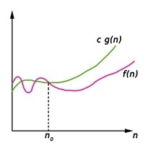
Asymptotic Notations
Big-Oh (O) notation.
Big-Oh (O) notation gives an upper bound for a function f(n) to within a constant factor.
We write f(n) = O(g(n)), If there are positive constantsn0 and c such that, to the right of n0 the f(n) always lies on or below c*g(n).
O(g(n)) = { f(n) : There exist positive constant c and n0 such that 0 ≤ f(n) ≤ c g(n), for all n ≥ n0}

Slide 40
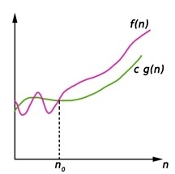
Asymptotic Notations
2. Big Omega (Ω) notation.
Big-Omega (Ω) notation gives a lower bound for a function f(n) to within a constant factor.
We write f(n) = Ω(g(n)), If there are positive constantsn0 and c such that, to the right of n0 the f(n) always lies on or above c*g(n).
Ω(g(n)) = { f(n) : There exist positive constant c and n0 such that 0 ≤ c g(n) ≤ f(n), for all n ≥ n0}

Slide 41
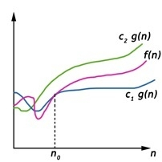
Asymptotic Notations
3. Big Theta (Θ) notation.
Big-Theta(Θ) notation gives bound for a function f(n) to within a constant factor.
We write f(n) = Θ(g(n)), If there are positive constantsn0 and c1 and c2 such that, to the right of n0 the f(n) always lies between c1*g(n) and c2*g(n) inclusive.
Θ(g(n)) = {f(n) : There exist positive constant c1, c2 and n0 such that 0 ≤ c1 g(n) ≤ f(n) ≤ c2 g(n), for all n ≥ n0}

Slide 42
Recursive Complexity
In computer science, when a function (or method or subroutine) calls itself, we call it recursion.
To find out the recursive complexities of the algorithms, we perform the below steps :
Step - 1 :Determine the number of subproblems and the parameters indicating the size of each subproblem's input (function call with smaller input size). For example, for finding the Nth Fibonacci number, the number of subproblems is 2, and the input size of subproblems are (N−1) and (N−2).
Step - 2 :Add the time complexities of the sub-problems with the total number of fundamental operations performed at that particular stage of recursion.
Step - 3 :Create a recurrence relation for the number of times the operation is done, with the proper base condition. For example, the recurrence relation for finding out the Nth Fibonacci number is
T(N)=T(N−1)+T(N−2)+c.
Step - 4 :Find a solution to the recurrence, or at the very least, determine how it will develop. There are many ways to analyze the recurrence relation, however, the two most popular methods for finding the solutions for the recurrence relations are Master Theorem and Recursion Tree Method.

Slide 43
Thanks
Anirudha Gaikwad

