Slide 1
JAVA
What you learn ?
Java
What are Computer Programming Languages | History of Computer Programming Languages
Scope of Java | Why do people use Java
Java Features | History of Java & Versions
Java Development Using Eclipse IDE | How JAVA works?
What is JRE,JDK,JVM | Memory Management in JAVA

Slide 2
What are Computer Programming Languages
Computer programming languages allow us to give instructions to a computer in a language the computer understands. Just as many human-based languages exist, there are an array of computer programming languages that programmers can use to communicate with a computer. The portion of the language that a computer can understand is called a “binary.” Translating programming language into binary is known as “compiling.” Each language, from C Language to Java, has its own distinct features, though many times there are commonalities between programming languages.
These languages allow computers to quickly and efficiently process large and complex swaths of information. For example, if a person is given a list of randomized numbers ranging from one to ten thousand and is asked to place them in ascending order, chances are that it will take a sizable amount of time and include some errors.
There are dozens of programming languages used in the industry today.

Slide 3
History of Computer Programming Languages
1883: Algorithm for the Analytical Engine
1949: Assembly Language | 1952: Autocode | 1957: Fortran | 1958: Algol | 1959: COBOL
1959: LISP | 1964: BASIC | 1970: Pascal | 1972: Smalltalk | 1972: C
1972: SQL | 1978: MATLAB | 1983: Objective-C | 1983: C++ | 1987: Perl
1990: Haskell | 1991: Python | 1991: Visual Basic | 1993: R | 1995: Java
1995: PHP | 1995: Ruby | 1995: JavaScript | 2000: C# | 2003: Scala
2003: Groovy | 2009: Go | 2010: Rust | 2014: Swift

Slide 4
Scope of Java
Desktop GUI Applications | Mobile Applications | Enterprise Applications
Scientific Applications | Web-based Applications | Embedded Systems
Big Data Technologies | Distributed Applications | Cloud-based Applications
Software Tools | Gaming Applications | Web servers and Application servers

Slide 5
Why do people use Java
Easy to Learn and Use
Java is easy to learn and use. It is developer-friendly and high level programming language.
Expressive Language
Java language is more expressive means that it is more understandable and readable.
Cross-platform Language
Java can run equally on different platforms such as Windows, Linux, Unix and Macintosh etc. So, we can say that Java is a portable language.
Free and Open Source
Java language is freely available at offical web address.The source-code is also available. therefore it is open source.
The Better Way to write Program

Slide 6
Why do people use Java
Object-Oriented Language
Java supports object oriented language
Extensible
It implies that other languages such as C/C++ can be used to compile the code and thus it can be used further in our Java code.
Large Standard Library
Java has a large and broad library and provides rich set of module and functions for rapid application development.
GUI Programming Support
Graphical user interfaces can be developed using Java.
Integrated
It can be easily integrated with languages like C, C++ etc.

Slide 7
History of Java & Versions
Java was developed by James Gosling, who is known as the father of Java, in 1995.
Java SE Version | Version Number | Release Date
JDK 1.0 | 1.0 | January 1996
JDK 1.1 | 1.1 | February 1997
J2SE 1.2 | 1.2 | December 1998
J2SE 1.3 | 1.3 | May 2000
J2SE 1.4 | 1.4 | February 2002
J2SE 5.0 | 1.5 | September 2004

Slide 8
History of Java & Versions
Java SE Version | Version Number | Release Date
Java SE 6 | 1.6 | December 2006
Java SE 7 | 1.7 | July 2011
Java SE 8 | 1.8 | March 2014
Java SE 9 | 9 | September, 21st 2017
Java SE 10 | 10 | March, 20th 2018
Java SE 11 | 11 | September, 25th 2018

Slide 9
History of Java & Versions
Java SE Version | Version Number | Release Date
Java SE 12 | 12 | March, 19th 2019
Java SE 13 | 13 | September, 17th 2019
Java SE 14 | 14 | March, 17th 2020
Java SE 15 | 15 | September, 15th 2020
Java SE 16 | 16 | March, 16th 2021
Java SE 17 | 17 | September, 14th 2021
Java SE 18 | 18 | March, 22nd 2022

Slide 10
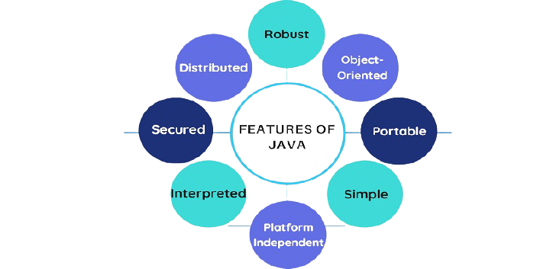
Java Features

Slide 11
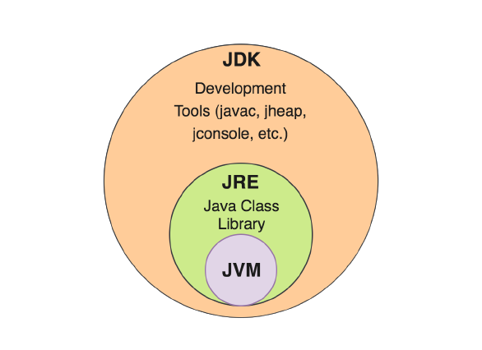
JRE,JDK,JVM

Slide 12
Java Development Using Eclipse IDE
Latest Eclipse IDE available with pre loaded JAVA ,so we don’t need to install java separately
To download visit following site
https://www.eclipse.org/downloads/packages/
from this site download
Eclipse IDE for Enterprise Java and Web Developers
as per your platform that is windows,mac or linux

Slide 13
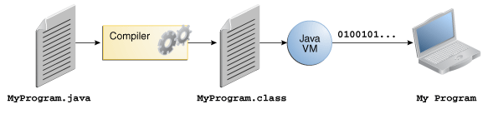
Compiling & Running the Program

Slide 14
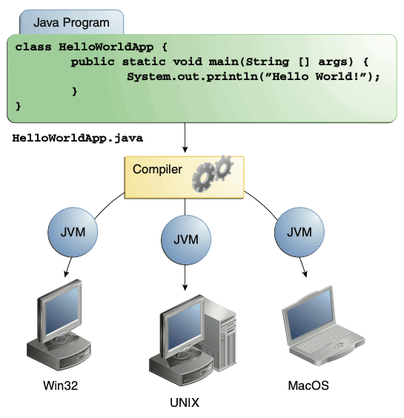
Compiling & Running the Program

Slide 15
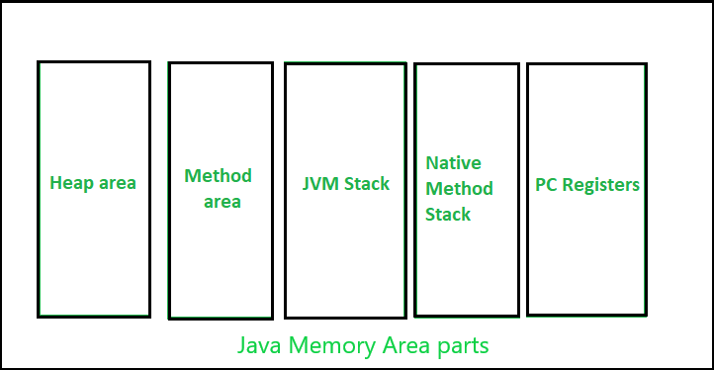
Memory Management in JAVA

Slide 16
Heap area in Memory Management in JAVA
Heap :
It is a shared runtime data area and stores the actual object in a memory. It is instantiated during the virtual machine startup.
This memory is allocated for all class instances and array. Heap can be of fixed or dynamic size depending upon the system’s configuration.
JVM provides the user control to initialize or vary the size of heap as per the requirement. When a new keyword is used, object is assigned a space in heap, but the reference of the same exists onto the stack.
There exists one and only one heap for a running JVM process.

Slide 17
Stack area in Memory Management in JAVA
Stack :
A stack is created at the same time when a thread is created and is used to store data and partial results which will be needed while returning value for method and performing dynamic linking.
Stacks can either be of fixed or dynamic size. The size of a stack can be chosen independently when it is created.
The memory for stack needs not to be contiguous.

Slide 18
Garbage collector in JAVA
Garbage Collection is process of reclaiming the runtime unused memory automatically. In other words, it is a way to destroy the unused objects.
Advantages of Garbage Collection :
It makes java memory efficient because garbage collector removes the unreferenced objects from heap memory.
It is automatically done by the garbage collector(a part of JVM) so we don't need to make extra efforts.
finalize() method
The finalize() method is invoked each time before the object is garbage collected. This method can be used to perform cleanup processing.
gc() method
The gc() method is used to invoke the garbage collector to perform cleanup processing. The gc() is found in System and Runtime classes.
Note: Neither finalization nor garbage collection is guaranteed.

Slide 19
Thanks
Anirudha Gaikwad

