Slide 1
JAVA
What you learn ?
Java | Expressions
Java I/O | Stream
InputStream | OutputStream
ByteStream | CharacterStream
NIO Package | NIO classes
IO VS NIO | NIO with SocketChannel
Serialization | Deserialization

Slide 2
JAVA I/O
Java I/O (Input and Output) is used to process the input and produce the output.
Java uses the concept of a stream to make I/O operation fast. The java.io package contains all the classes required for input and output operations.
We can perform file handling in Java by Java I/O API.
Stream:
A stream is a sequence of data. In Java, a stream is composed of bytes. It's called a stream because it is like a stream of water that continues to flow.
In Java, 3 streams are created for us automatically. All these streams are attached with the console.
1) System.out: standard output stream
2) System.in: standard input stream
3) System.err: standard error stream

Slide 3
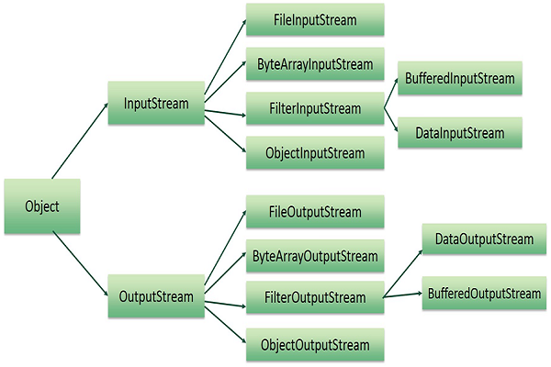
Hierarchy of stream classes

Slide 4
InputStream
Java application uses an input stream to read data from a source; it may be a file, an array, peripheral device or socket.
InputStream class is an abstract class, superclass of all classes representing an input stream of bytes.
Method | Description
1) public abstract int read()throws IOException | reads the next byte of data from the input stream. It returns -1 at the end of the file.
2) public int available()throws IOException | returns an estimate of the number of bytes that can be read from the current input stream.
3) public void close()throws IOException | is used to close the current input str

Slide 5
InputStream Classes
InputStream classes | Description
FileInputStream | Reads data from a file
ByteArrayInputStream | Data is read from a byte array
FilterInputStream | Has subclasses BufferedInputStream, DataInputStream and PushbackInputStream
BufferedInputStream | Used to read information from a stream. Internal buffer mechanism enhances performance.
DataInputStream | Reads in Java's built datatype from an input stream.
PushbackInputStream | Reads byte data from inputstream and returns it back to the stream
PipedInputStream | It reads data bytes from one thread that are sent to PipedOutputStream for writing on another thread.
ObjectInputStream | Deserializes the inbuilt data types and objects that are written using ObjectOutputStream.

Slide 6
OutputStream
OutputStream class is an abstract class. It is the superclass of all classes representing an output stream of bytes. An output stream accepts output bytes and sends them to some sink.
Method | Description
1) public void write(int)throws IOException | is used to write a byte to the current output stream.
2) public void write(byte[])throws IOException | is used to write an array of byte to the current output stream.
3) public void flush()throws IOException | flushes the current output stream.
4) public void close()throws IOException | is used to close the current output stream.

Slide 7
OutputStream Classes
InputStream classes | Description
FileOutputStream | Writes data to a file
ByteArrayOutputStream | Writes data to multiple files. By default, biffer size is 32 bits.
FilterOutputStream | Has subclasses named BufferedInputStream, DataOutputStream and PrintInputStream
BufferedOutputStream | Uses internal buffer to store data. More efficient and faster than writing data into the stream.
DataOutputStream | Enables to write Java's built datatype to output stream. It is machine-independent.
PrintStream | It has methods to write data into other stream without throwing IOException
PipedOutputStream | Used with PipedInputStream. They are connected using connect() method of PipedOutputStream. It writes data that are provided by PipedInputStream.
ObjectOutputStream | Used with ObjectInputStream.Writes the inbuilt data types and objects to an ObjectOutputStream.

Slide 8
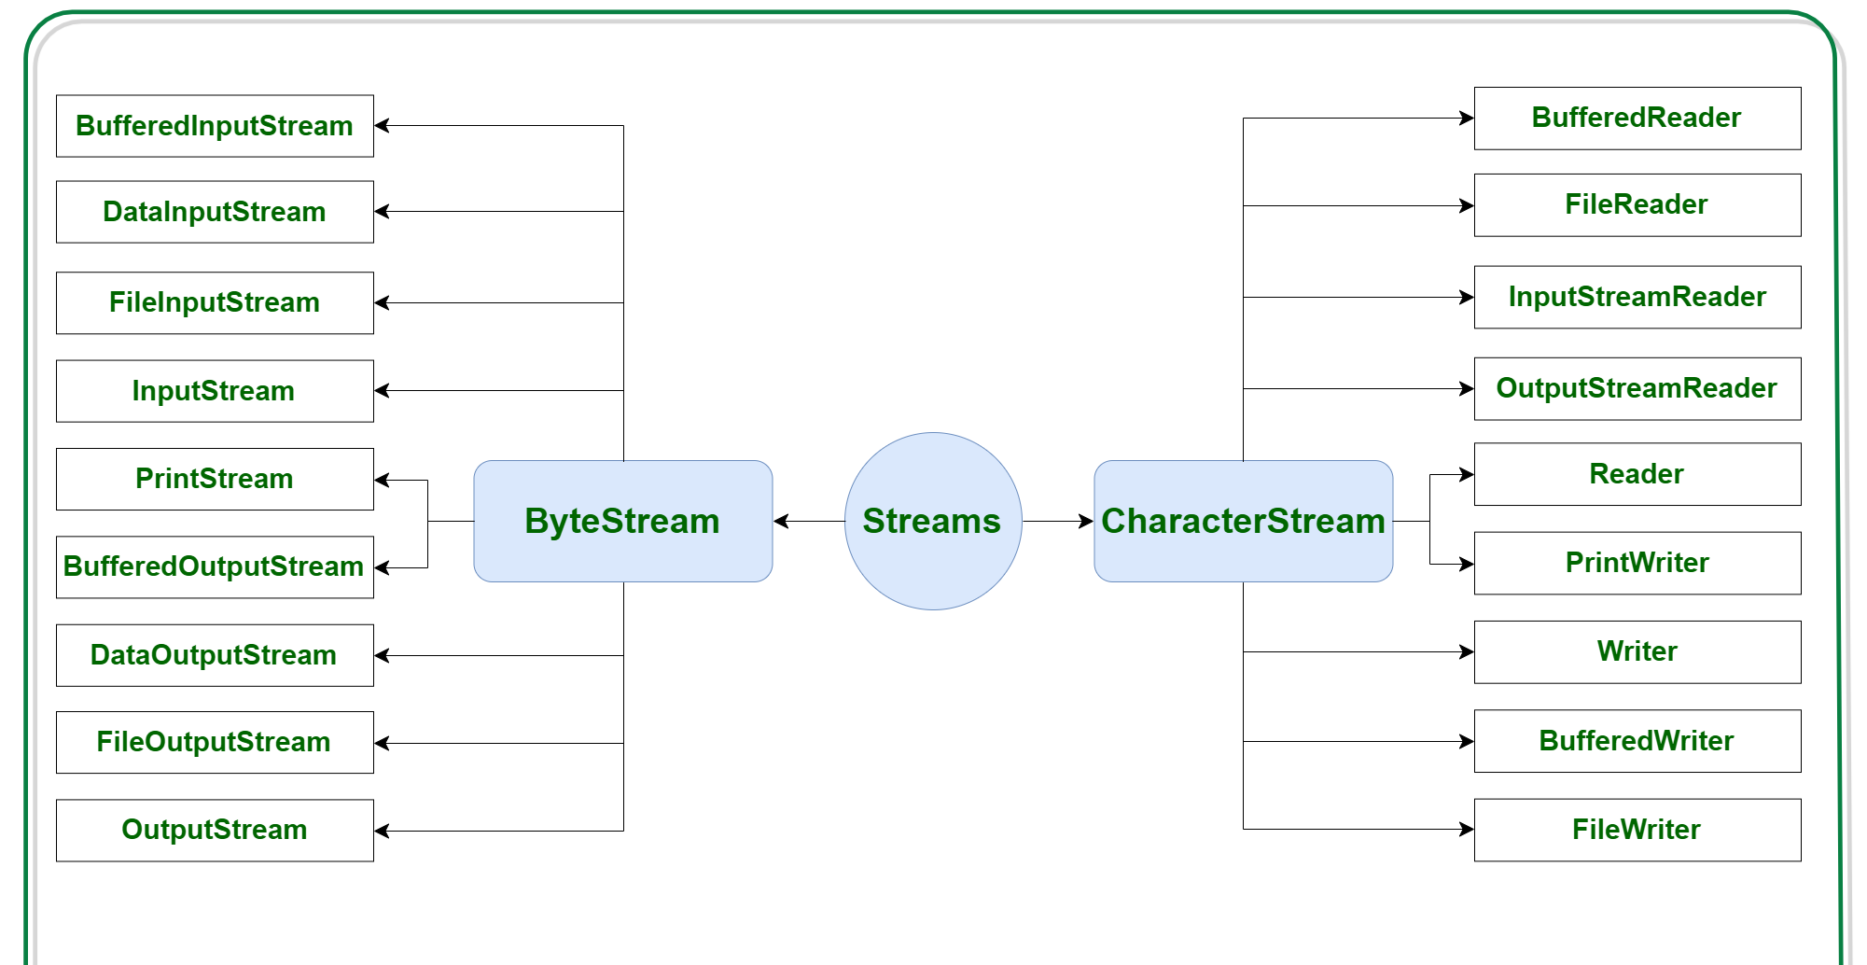
Types of stream
Depending on the types of file, Streams can be divided into two primary classes- ByteStream, CharacterStream

Slide 9
Types of stream
ByteStream:
This is used to process data byte by byte (8 bits). Though it has many classes, the FileInputStream and the FileOutputStream are the most popular ones. The FileInputStream is used to read from the source and FileOutputStream is used to write to the destination
Stream class | Description
BufferedInputStream | It is used for Buffered Input Stream.
DataInputStream | It contains method for reading java standard datatypes.
FileInputStream | This is used to reads from a file
InputStream | This is an abstract class that describes stream input.
PrintStream | This contains the most used print() and println() method
BufferedOutputStream | This is used for Buffered Output Stream.
DataOutputStream | This contains method for writing java standard data types.
FileOutputStream | This is used to write to a file.
OutputStream | This is an abstract class that describe stream output.

Slide 10
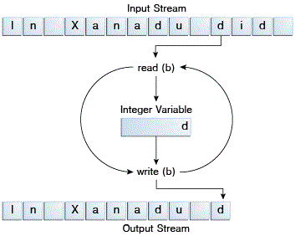
ByteStream
Programs use byte streams to perform input and output of 8-bit bytes.
All byte stream classes are descended from InputStream and OutputStream.
There are many byte stream classes. To demonstrate how byte streams work, our focus is on the file I/O byte streams, FileInputStream and FileOutputStream.
ByteStream input and output

Slide 11
FileOutputStream
FileOutputStream is an outputstream for writing data/streams of raw bytes to file or storing data to file.
For writing byte-oriented and character-oriented data, we can use FileOutputStream but for writing character-oriented data, FileWriter is more preferred.
Constructors of FileOutputStream
FileOutputStream fout = new FileOutputStream(File file);
FileOutputStream fout = new FileOutputStream(File file, boolean append);
FileOutputStream fout = new FileOutputStream(FileDescripter fdobj);
FileOutputStream fout = new FileOutputStream( String name);
FileOutputStream fout = new FileOutputStream( String name, boolean append);

Slide 12
FileOutputStream
Methods of FileOutputStream class:
Method | Description
void close() | It closes the file output stream.
protected void finalize() | It is used to clean up all the connection with the file output stream and finalize the data.
FileChannel getChannel() | Returns the unique FileChannel object associated with this file output stream.
FileDescriptor getFD() | It returns the file descriptor associated with the stream.
void write(int b) | It is used to write the specified byte to the file output stream.
void write(byte[] arr) | It is used to write data in bytes of arr[] to file output stream.
void write(byte[] ary, int off, int len) | It is used to write the number of bytes equal to length to the output stream from an array starting from the position start.

Slide 13
FileInputStream
A FileInputStream obtains input bytes from a file in a file system.
FileInputStream is meant for reading streams of raw bytes such as image data.
Constructors of FileInputStream:
FileInputStream(File file) Creates a FileInputStream by opening a connection to an actual file, the file named by the File object file in the file system.
FileInputStream(FileDescriptor fdObj) Creates a FileInputStream by using the file descriptor fdObj, which represents an existing connection to an actual file in the file system.
FileInputStream(String name) Creates a FileInputStream by opening a connection to an actual file, the file named by the path name name in the file system.

Slide 14
FileInputStream
Methods of FileInputStream class:
Methods | Action Performed
available() | Returns an estimate of the number of remaining bytes that can be read
close() | Closes this file input stream and releases any system resources associated with it
finalize() | Ensures that the close method of this file input stream is called when there are no more references to it.
getChannel() | Returns the unique FileChannel object associated with this file input stream.
getFD() | Returns the FileDescriptor object that represents the connection to the actual file in the file system being used by this FileInputStream.
read() | Reads a byte of data from this input stream
read(byte[] b) | Reads up to b.length bytes of data from this input stream into an array of bytes.
read(byte[] b, int off, int len) | Reads up to len bytes of data from this input stream into an array of bytes.
skip() | Skips over and discards n bytes of data from the input stream

Slide 15
Types of stream
CharacterStream:
Character stream automatically allows us to read/write data character by character. Though it has many classes, the FileReader and the FileWriter are the most popular ones. FileReader and FileWriter are character streams used to read from the source and write to the destination respectively.
Stream class | Description
BufferedReader | It is used to handle buffered input stream.
FileReader | This is an input stream that reads from file.
InputStreamReader | This input stream is used to translate byte to character.
OutputStreamReader | This output stream is used to translate character to byte.
Reader | This is an abstract class that define character stream input.
PrintWriter | This contains the most used print() and println() method
Writer | This is an abstract class that define character stream output.
BufferedWriter | This is used to handle buffered output stream.
FileWriter | This is used to output stream that writes to file.

Slide 16
CharacterStream
The Java platform stores character values using Unicode conventions. Character stream I/O automatically translates this internal format to and from the local character set.
All character stream classes are descended from Reader and Writer. As with byte streams, there are character stream classes that specialize in file I/O: FileReader and FileWriter.
character stream handles translation between characters and bytes. FileReader, for example, uses FileInputStream, while FileWriter uses FileOutputStream.

Slide 17
FileReader
Reads text from character files using a default buffer size. Decoding from bytes to characters uses either a specified charset or the platform's default charset.
Constructors of FileReader:
Constructor | Description
FileReader​(File file) | Creates a new FileReader, given the File to read, using the platform's default charset.
FileReader​(FileDescriptor fd) | Creates a new FileReader, given the FileDescriptor to read, using the platform's default charset.
FileReader​(File file, Charset charset) | Creates a new FileReader, given the File to read and the charset.
FileReader​(String fileName) | Creates a new FileReader, given the name of the file to read, using the platform's default charset.
FileReader​(String fileName, Charset charset) | Creates a new FileReader, given the name of the file to read and the charset.

Slide 18
FileReader
Methods of FileReader:
Method | Description
read() | The read() method reads and passes a single character or -1 if the stream is ended.
read(char[] charBuffer, int offset, int length) | It reads a stream of characters and stores them in the given Character Buffer. Offset is the position at which it starts reading and Length is the total number of characters to be read. It passes plenty of characters read or -1 if the stream is ended.
ready() | It tells whether the stream is ready to be read. A stream is said to be ready if its input buffer is not blank or empty.
getEncoding() | The getEncoding() is used to return the title of the character encoding which is being used by the stream.
close() | It closes the stream and releases the system resources associated with it.

Slide 19
FileWriter
Writes text to character files using a default buffer size.
The FileWriter is meant for writing streams of characters.
Constructor | Description
FileWriter​(File file) | Constructs a FileWriter given the File to write, using the platform's default charset
FileWriter​(FileDescriptor fd) | Constructs a FileWriter given a file descriptor, using the platform's default charset.
FileWriter​(File file, boolean append) | Constructs a FileWriter given the File to write and a boolean indicating whether to append the data written, using the platform's default charset.
FileWriter​(File file, Charset charset) | Constructs a FileWriter given the File to write and charset.
FileWriter​(File file, Charset charset, boolean append) | Constructs a FileWriter given the File to write, charset and a boolean indicating whether to append the data written.
FileWriter​(String fileName) | Constructs a FileWriter given a file name, using the platform's default charset
FileWriter​(String fileName, boolean append) | Constructs a FileWriter given a file name and a boolean indicating whether to append the data written, using the platform's default charset.
FileWriter​(String fileName, Charset charset) | Constructs a FileWriter given a file name and charset.
FileWriter​(String fileName, Charset charset, boolean append) | Constructs a FileWriter given a file name, charset and a boolean indicating whether to append the data written.

Slide 20
FileWriter
Methods of FileWriter class :
Method | Description
void write(String text) | It is used to write the string into FileWriter.
void write(char c) | It is used to write the char into FileWriter.
void write(char[] c) | It is used to write a char array into FileWriter.
void flush() | It is used to flushes the data of FileWriter.
void close() | It is used to close the FileWriter.

Slide 21
File class in Java
File class in Java is an abstract representation of file and directory path names. It contains variables and methods required for the creation, reading, updating, and deletion of files and directories.
File class present in java.io package.
File object is created by passing in a string that represents the name of a file.
File a = new File("<path_of file>");

Slide 22
Fields of File class in Java
Modifier | Type | Field | Description
static | String | pathSeparator | It is system-dependent path-separator character, represented as a string for convenience.
static | char | pathSeparatorChar | It is system-dependent path-separator character.
static | String | separator | It is system-dependent default name-separator character, represented as a string for convenience.
static | char | separatorChar | It is system-dependent default name-separator character.

Slide 23
Constructors of File class in Java
Constructor | Description
File(File parent, String child) | It creates a new File instance from a parent abstract pathname and a child pathname string.
File(String pathname) | It creates a new File instance by converting the given pathname string into an abstract pathname.
File(String parent, String child) | It creates a new File instance from a parent pathname string and a child pathname string.
File(URI uri) | It creates a new File instance by converting the given file: URI into an abstract pathname.

Slide 24
Methods of File class in Java
Methods | Description | Syntax
canRead() | Determines whether a file is readable or not. | boolean var = file.canRead()
canwrite() | Determines a file is writeable or not. | boolean var = file.canWrite()
createnewfile() | Generates a new file with no content. If the abstract file path does not exist, the method returns true, and a new file is created. If the filename already exists, it returns false. | boolean var = file.createNewFile();
exists() | Determines if the abstract filename denotes an existing file or directory. If the abstract file path exists, the method returns true; otherwise, it returns false. | boolean var = file.exists();
delete() | Deletes the file or directory denoted by the abstract pathname. The method returns true if the file or directory deleted successfully, otherwise returns false. | boolean var = file.delete();
getname() | The Name of the specified file object is returned by this function. A null string is returned if the abstract path does not have a name. | String var= file.getName();

Slide 25
Methods of File class in Java
Methods | Description | Syntax
getabsolutepath() | The absolute pathname of the specified file object is returned by this method. If the file object's pathname is absolute, it just returns the current file object's path. | String var= file.getabsolutepath();
length() | The length of the file specified by this abstract pathname was length is returned by this function. If the file does not exist or an exception occurs, the function returns a long value that indicates the number of bits, otherwise it returns 0L (long type). | long var = file.length();
list() | Returns lists the names of files and folders in a given directory | String[] paths= file.list();
mkdir() | Creates a new directory using the abstract pathname as its name. If a directory is created, the method returns true; otherwise, it returns false. | boolean var =file.mk

Slide 26
Java Directories
Create and modify directory Java has different methods for creating new directories and modifying the old ones.
Methods of Java directories-
METHOD | DESCRIPTION | EXCEPTION THROWN | Syntax
mkdir() | Creates a new directory using the abstract pathname as its name. Returns true if a directory is created, otherwise false. | SecurityException when creation of directory is denied. | boolean var = file.mkdir()
mkdirs() | Creates a new directory specified by the abstract pathname, along with all of the abstract pathname's non-existent parent directories. Returns true, if a directory is created, otherwise false. | SecurityException when creation of directory is denied. | boolean var = file.mkdirs()

Slide 27
Java Directories
Methods of Java directories-
METHOD | DESCRIPTION | EXCEPTION THROWN | Syntax
createnewfile() | Generates a new file with no content. Returns true,if the abstract file path does not exist and a new file is created. If the filename already exists, it returns false. | IO Exception when input output error occurs; Security Exception when write access is denied. | boolean var = file.createNewFile();
setreadonly() | Restricts access to the given file or directory to read activities only. | SecurityException, when write access, is denied. | boolean var = setreadonly()
renameTo() | Renames a File's abstract pathname to a specified pathname. Returns true if the file is renamed, otherwise false. | Security Exception when the method denies the write operation of the abstract pathnames.NullPointerException when the given filename is null. | boolean var =file.renameTo(File destination)
delete() | This method deletes file or directory given by abstract pathname. | NoSuchFileException when the file does not exist. DirectoryNotEmptyException when a directory could not otherwise be deleted as it is not empty.IOException when an I/O error occurs.SecurityException delete access is denied. | boolean var =file.delete()

Slide 28
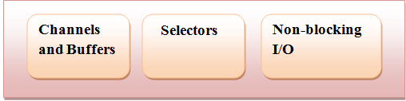
NIO Package
Java has provided a second I/O system called NIO (New I/O). Java NIO provides the different way of working with I/O than the standard I/O API's. It is an alternate I/O API for Java (from Java 1.4).
It supports a buffer-oriented, channel based approach for I/O operations. With the introduction of JDK 7, the NIO system is expanded, providing the enhanced support for file system features and file-handling. Due to the capabilities supported by the NIO file classes, NIO is widely used in file handling.
Java NIO fundamental components
Channels and Buffers: In standard I/O API the character streams and byte streams are used. In NIO we work with channels and buffers.
Selectors: It is an object that can be used for monitoring the multiple channels for events like data arrived, connection opened etc.
Non-blocking I/O: Java NIO provides the feature of Non-blocking I/O. Here the application returns immediately whatever the data available and application should have pooling mechanism to find out when more data is ready.

Slide 29
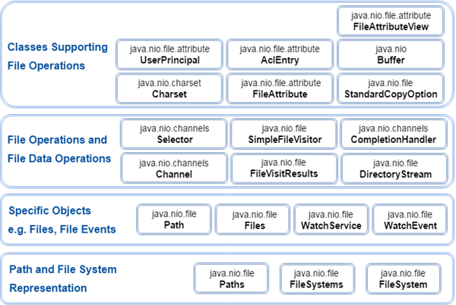
NIO Classes

Slide 30
IO VS NIO
IO | NIO
It is based on the Blocking I/O operation | It is based on the Non-blocking I/O operation
It is Stream-oriented | It is Buffer-oriented
Channels are not available | Channels are available for Non-blocking I/O operation
Selectors are not available | Selectors are available for Non-blocking I/O operation
Blocking I/O:
Blocking IO wait for the data to be write or read before returning.
Non blocking I/O:
Non blocking IO does not wait for the data to be read or write before returning.

Slide 31
NIO with SocketChannel
The Java NIO SocketChannel is used for connecting a channel with a TCP (Transmission Control Protocol) network socket. It is equivalent to Java Networking Sockets used in network programming.
Opening a SocketChannel
SocketChannel sc = SocketChannel.open();
sc.connect(new InetSocketAddress("http://abc.com", 70));
Closing a SocketChannel
SocketChannel.close();
Reading from a SocketChannel
ByteBuffer bb = ByteBuffer.allocate(84);
int bytesRead = SocketChannel.read(bb);
Writing to a SocketChannel
SocketChannel.write(bb);

Slide 32
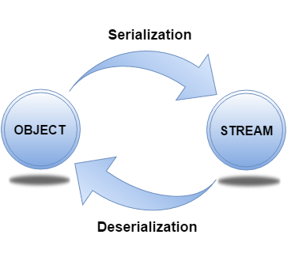
Serialization & Deserialization
Serialization in Java is a mechanism of writing the state of an object into a byte-stream. It is mainly used in Hibernate, RMI, JPA, EJB and JMS technologies.
The reverse operation of serialization is called deserialization where byte-stream is converted into an object.
For serializing the object, we call the writeObject() method of ObjectOutputStream class, and for deserialization we call the readObject() method of ObjectInputStream class.

Slide 33
Serialization & Deserialization
//Creating the object
Student s1 =new Student(211,"ravi");
//Creating stream and writing the object
FileOutputStream fout=new FileOutputStream("f.txt");
ObjectOutputStream out=new ObjectOutputStream(fout);
out.writeObject(s1);
out.flush();
//closing the stream
out.close();
System.out.println("success");
//Creating stream to read the object
ObjectInputStream in=new ObjectInputStream(new FileInputStream("f.txt"));
Student s=(Student)in.readObject();
//printing the data of the serialized object
System.out.println(s.id+" "+s.name);
//closing the stream
in.close();

Slide 34
Thanks
Anirudha Gaikwad

