Slide 1
JAVA
What you learn ?
Java | Expressions
What is Concurrency? | Main components of concurrent package
Process & Threads | Lifecycle of Thread
Defining & starting thread | Methods of thread class
isAlive() method | Join() method
Thread priorities | Synchronization
Deadlock | Advantages of Multithreading

Slide 2
What is Concurrency?
Concurrency is the ability to run several or multi programs or applications in parallel. Java Concurrency package covers concurrency, multithreading, and parallelism on the Java platform. The backbone of Java concurrency is threads (a lightweight process, which has its own files and stacks and can access the shared data from other threads in the same process).
The throughput and the interactivity of the program can be improved by performing time-consuming tasks asynchronously or in parallel. Java 5 added a new package to the java platform ⇾ java.util.concurrent package. This package has a set of classes and interfaces that helps in developing concurrent applications (multithreading) in java.

Slide 3
Main Components of Concurrent Package
Executor
ExecutorService
ScheduledExecutorService
Future
CountDownLatch
CyclicBarrier
Semaphore
ThreadFactory
BlockingQueue
DelayQueue
Lock
Phaser

Slide 4
Executor
Executor is an interface that represents an object that executes provided tasks.
We need to create an invoker to create the executor instance:
public class Invoker implements Executor {
@Override
public void execute(Runnable r) {
r.run();
}
}
Now, we can use this invoker to execute the task.
public void execute() {
Executor executor = new Invoker();
executor.execute( () -> {
// task to be performed
});
}

Slide 5
ExecutorService
ExecutorService is a complete solution for asynchronous processing. It manages an in-memory queue and schedules submitted tasks based on thread availability.
To use ExecutorService, we need to create one Runnable class.
public class Task implements Runnable {
@Override
public void run() {
// task details
}
}
Now we can create the ExecutorService instance and assign this task. At the time of creation, we need to specify the thread-pool size.
ExecutorService executor = Executors.newFixedThreadPool(10);
Once the executor is created, we can use it to submit the task.
public void execute() {
executor.submit(new Task());
}

Slide 6
ScheduledExecutorService
ScheduledExecutorService is a similar interface to ExecutorService, but it can perform tasks periodically.
Executor and ExecutorService‘s methods are scheduled on the spot without introducing any artificial delay. Zero or any negative value signifies that the request needs to be executed instantly.
We can use both Runnable and Callable interface to define the task.
executorService.scheduleAtFixedRate(() -> {
// ...
}, 1, 10, TimeUnit.SECONDS);
executorService.scheduleWithFixedDelay(() -> {
// ...
}, 1, 10, TimeUnit.SECONDS);

Slide 7
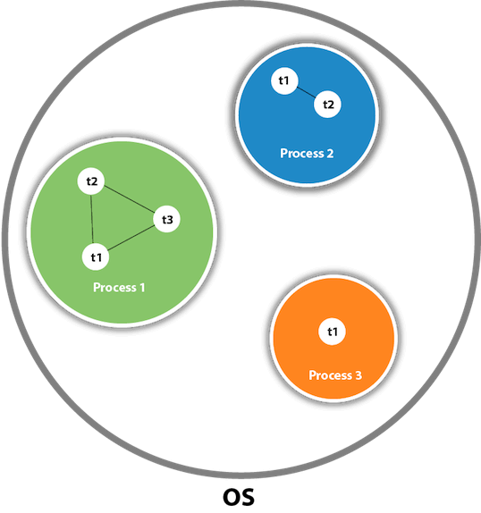
Process & Threads
In concurrent programming, there are two basic units of execution: processes and threads. In the Java programming language, concurrent programming is mostly concerned with threads. However, processes are also important.
Processes:
A process has a self-contained execution environment. A process generally has a complete, private set of basic run-time resources; in particular, each process has its own memory space.
Threads:
Threads are sometimes called lightweight processes. Multithreaded execution is an essential feature of the Java platform.

Slide 8
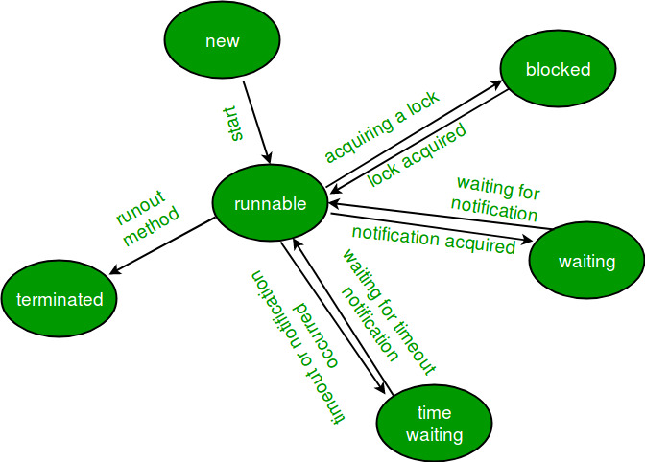
Lifecycle of Thread
New − A new thread begins its life cycle in the new state. It remains in this state until the program starts the thread.
Runnable − A thread in this state is considered to be executing its task.
Waiting − Sometimes, a thread transitions to the waiting state while the thread waits for another thread to perform a task.
Timed Waiting − A runnable thread can enter the timed waiting state for a specified interval of time.
Terminated (Dead) − A runnable thread enters the terminated state when it completes its task or otherwise terminates.

Slide 9
Defining & starting thread
There are two ways to create a thread:
By implementing Runnable interface:
class Multi3 implements Runnable{
public void run(){
System.out.println("thread is running...");
}
public static void main(String args[]){
Multi3 m1=new Multi3();
// Using the constructor Thread(Runnable r)
Thread t1 =new Thread(m1);
t1.start();
}
}
By extending Thread class
class Multi extends Thread{
public void run(){
System.out.println("thread is running...");
}
public static void main(String args[]){
Multi t1=new Multi();
t1.start();
}
}

Slide 10
Methods of Thread class
public void run(): is used to perform action for a thread.
public void start(): starts the execution of the thread.JVM calls the run() method on the thread.
public void sleep(long miliseconds): Causes the currently executing thread to sleep (temporarily cease execution) for the specified number of milliseconds.
public void join(): waits for a thread to die.
public void join(long miliseconds): waits for a thread to die for the specified miliseconds.
public int getPriority(): returns the priority of the thread.
public int setPriority(int priority): changes the priority of the thread.
public String getName(): returns the name of the thread.
public void setName(String name): changes the name of the thread.
public Thread currentThread(): returns the reference of currently executing thread.

Slide 11
Methods of Thread class
public int getId(): returns the id of the thread.
public Thread.State getState(): returns the state of the thread.
public boolean isAlive(): tests if the thread is alive.
public void yield(): causes the currently executing thread object to temporarily pause and allow other threads to execute.
public void suspend(): is used to suspend the thread(depricated).
public void resume(): is used to resume the suspended thread(depricated).
public void stop(): is used to stop the thread(depricated).
public boolean isDaemon(): tests if the thread is a daemon thread.
public void setDaemon(boolean b): marks the thread as daemon or user thread.
public void interrupt(): interrupts the thread.
public boolean isInterrupted(): tests if the thread has been interrupted.
public static boolean interrupted(): tests if the current thread has been interrupted.

Slide 12
isAlive() method of thread
The isAlive() method of thread class tests if the thread is alive.
A thread is considered alive when the start() method of thread class has been called and the thread is not yet dead.
This method returns true if the thread is still running and not finished.
Syntax:
public final boolean isAlive()
This method will return true if the thread is alive otherwise returns false.

Slide 13
join() method of thread
When the join() method is invoked, the current thread stops its execution and the thread goes into the wait state.
The current thread remains in the wait state until the thread on which the join() method is invoked has achieved its dead state.
If interruption of the thread occurs, then it throws the InterruptedException.
Syntax:
public final void join() throws InterruptedException

Slide 14
Daemon Thread
Daemon thread in Java is a low-priority thread that runs in the background to perform tasks such as garbage collection.
They can not prevent the JVM from exiting when all the user threads finish their execution.
JVM terminates itself when all user threads finish their execution.
If JVM finds a running daemon thread, it terminates the thread and, after that, shutdown it. JVM does not care whether the Daemon thread is running or not.
It is an utmost low priority thread.
Example of Daemon Thread in Java: Garbage collection in Java (gc), finalizer, etc.
Methods of Daemon Thread
1. void setDaemon(boolean status):
This method marks the current thread as a daemon thread or user thread.
2. boolean isDaemon():
This method is used to check that the current thread is a daemon. It returns true if the thread is Daemon. Else, it returns false.

Slide 15
Thread priorities
Each thread has a priority. Priorities are represented by a number between 1 & 10.
The setter and getter method of the thread priority:
public final int getPriority(): The java.lang.Thread.getPriority() method returns the priority of the given thread.
public final void setPriority(int newPriority):updates or assign the priority of the thread to newPriority.
3 constants defined in Thread class:
public static int MIN_PRIORITY
public static int NORM_PRIORITY
public static int MAX_PRIORITY
Default priority of a thread is 5 (NORM_PRIORITY).
The value of MIN_PRIORITY is 1 and the value of MAX_PRIORITY is 10.

Slide 16
Synchronization
Synchronization in Java is the capability to control the access of multiple threads to any shared resource.
Java Synchronization is better option where we want to allow only one thread to access the shared resource.
Why use Synchronization?
To prevent thread interference.
To prevent consistency problem.
Types of Synchronization
There are two types of synchronization
Process Synchronization
Thread Synchronization

Slide 17
Thread Synchronization
There are two types of thread synchronization:
mutual exclusive-
Synchronized method.
Synchronized block.
Static synchronization.
2) Cooperation (Inter-thread communication in java)

Slide 18
Synchronized method
//example of java synchronized method
class Table{
synchronized void printTable(int n){ //synchronized method
for(int i=1;i<=5;i++){
System.out.println(n*i);
try{
Thread.sleep(400);
}catch(Exception e){System.out.println(e);}
}
}
}
If you declare any method as synchronized, it is known as synchronized method.
Synchronized method is used to lock an object for any shared resource.
When a thread invokes a synchronized method, it automatically acquires the lock for that object and releases it when the thread completes its task.

Slide 19
Synchronized block
Synchronized block can be used to perform synchronization on any specific resource of the method.
Suppose we have 50 lines of code in our method, but we want to synchronize only 5 lines, in such cases, we can use synchronized block.
Java synchronized block is more efficient than Java synchronized method.
synchronized(this){//synchronized block
for(int i=1;i<=5;i++){
System.out.println(n*i);
try{
Thread.sleep(400);
}catch(Exception e){System.out.println(e);}
}
}

Slide 20
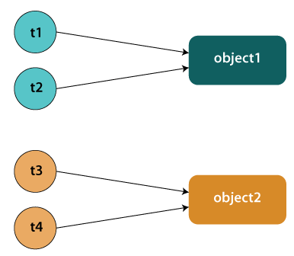
Static synchronization
If you make any static method as synchronized, the lock will be on the class not on object.
Suppose there are two objects of a shared class (e.g. Table) named object1 and object2. In case of synchronized method and synchronized block there cannot be interference between t1 and t2 or t3 and t4 because t1 and t2 both refers to a common object that have a single lock. But there can be interference between t1 and t3 or t2 and t4 because t1 acquires another lock and t3 acquires another lock. We don't want interference between t1 and t3 or t2 and t4.
Static synchronization solves this problem.

Slide 21

Deadlock in JAVA
Deadlock in Java is a part of multithreading. Deadlock can occur in a situation when a thread is waiting for an object lock, that is acquired by another thread and second thread is waiting for an object lock that is acquired by first thread. Since, both threads are waiting for each other to release the lock, the condition is called deadlock.

Slide 22
Advantages of Multithreading
It doesn't block the user because threads are independent and you can perform multiple operations at the same time.
You can perform many operations together, so it saves time.
Threads are independent, so it doesn't affect other threads if an exception occurs in a single thread.

Slide 23
Thanks
Anirudha Gaikwad

