Slide 1
JAVA
What you learn ?
Java | Expressions
Junit | Annotations for junit testing
Maven | Maven repository
Pom.xml | Default project structure of maven
JSON VS XML

Slide 2
Junit
JUnit tutorial provides basic and advanced concepts of unit testing in java with examples. Our junit tutorial is designed for beginners and professionals.
It is an open-source testing framework for java programmers. The java programmer can create test cases and test his/her own code.
It is one of the unit testing framework. Current version is junit 4.
To perform unit testing, we need to create test cases. The unit test case is a code which ensures that the program logic works as expected.
The org.junit package contains many interfaces and classes for junit testing such as Assert, Test, Before, After etc.

Slide 3
Annotations for Junit testing
The Junit 4.x framework is annotation based-
@Test annotation specifies that method is the test method.
@Test(timeout=1000) annotation specifies that method will be failed if it takes longer than 1000 milliseconds (1 second).
@BeforeClass annotation specifies that method will be invoked only once, before starting all the tests.
@Before annotation specifies that method will be invoked before each test.
@After annotation specifies that method will be invoked after each test.
@AfterClass annotation specifies that method will be invoked only once, after finishing all the tests.

Slide 4
Maven
Maven is a powerful project management tool that is based on POM (project object model). It is used for projects build, dependency and documentation.
What it does?
It makes a project easy to build
It provides uniform build process (maven project can be shared by all the maven projects)
It provides project information (log document, cross referenced sources, mailing list, dependency list, unit test reports etc.)
It is easy to migrate for new features of Maven
Apache Maven helps to manage
Builds
Documentation
Reporting
SCMs
Releases
Distribution

Slide 5
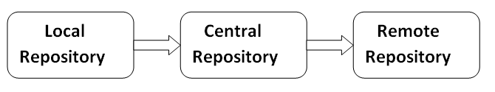
Maven Repository
A maven repository is a directory of packaged JAR file with pom.xml file.
Maven searches for dependencies in the repositories. There are 3 types of maven repository:
Maven pom.xml file:
POM is an acronym for Project Object Model. The pom.xml file contains information of project and configuration information for the maven to build the project such as dependencies, build directory, source directory, test source directory, plugin, goals etc.
Maven reads the pom.xml file, then executes the goal.
Before maven 2, it was named as project.xml file. But, since maven 2 (also in maven 3), it is renamed as pom.xml.

Slide 6
pom.xml File
Elements of maven pom.xml file
Element | Description
project | It is the root element of pom.xml file.
modelVersion | It is the sub element of project. It specifies the modelVersion. It should be set to 4.0.0.
groupId | It is the sub element of project. It specifies the id for the project group.
artifactId | It is the sub element of project. It specifies the id for the artifact (project). An artifact is something that is either produced or used by a project. Examples of artifacts produced by Maven for a project include: JARs, source and binary distributions, and WARs.
version | It is the sub element of project. It specifies the version of the artifact under given group.
pom.xml
<project xmlns="http://maven.apache.org/POM/4.0.0"
xmlns:xsi="http://www.w3.org/2001/XMLSchema-instance"
xsi:schemaLocation="http://maven.apache.org/POM/4.0.0
http://maven.apache.org/xsd/maven-4.0.0.xsd">
<modelVersion>4.0.0</modelVersion>
<groupId>com.javatpoint.application1</groupId>
<artifactId>my-app</artifactId>
<version>1</version>
</project>

Slide 7
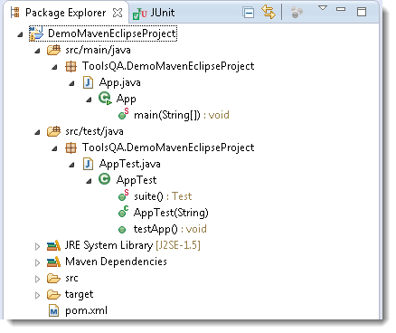
Default project structure of Maven

Slide 8
JSON VS XML
JSON | XML
JSON stands for javascript object notation. | XML stands for an extensible markup language.
The extension of json file is .json. | The extension of xml file is .xml.
The internet media type is application/json. | The internet media type is application/xml or text/xml.
The type of format in JSON is data interchange. | The type of format in XML is a markup language.
It is extended from javascript. | It is extended from SGML.
It is open source means that we do not have to pay anything to use JSON. | It is also open source.
The object created in JSON has some type. | XML data does not have any type.
The data types supported by JSON are strings, numbers, Booleans, null, array. | XML data is in a string format.
It does not have any capacity to display the data. | XML is a markup language, so it has the capacity to display the content.
JSON has no tags. | XML data is represented in tags, i.e., start tag and end tag.
JSON is quicker to read and write. | XML file takes time to read and write because the learning curve is higher.
JSON can use arrays to represent the data. | XML does not contain the concept of arrays.
It can be parsed by a standard javascript function. It has to be parsed before use. | XML data which is used to interchange the data, must be parsed with respective to their programming language to use that.
It can be easily parsed and little bit code is required to parse the data. | It is difficult to parse.
File size is smaller as compared to XML. | File size is larger.
JSON is data-oriented. | XML is document-oriented.
It is less secure than XML. | It is more secure than JSON.

Slide 9
Thanks
Anirudha Gaikwad

