Slide 1
JAVA
What you learn ?
Java | Expressions
SOLID Principles in JAVA | Lifecycle of JSP
JSP Directory Structure | JSP Scripting Elements
JSP Request | JSP Response
JSP Session | JSP Directives

Slide 2
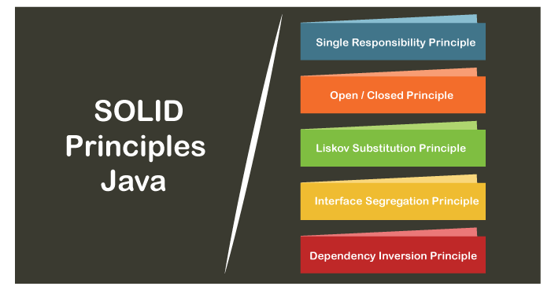
SOLID Principles in JAVA
In Java, SOLID principles are an object-oriented approach that are applied to software structure design.
These five principles have changed the world of object-oriented programming, and also changed the way of writing software. It also ensures that the software is modular, easy to understand, debug, and refactor.

Slide 3
SOLID Principles in JAVA
1) Single Responsibility Principle:
The single responsibility principle states that every Java class must perform a single functionality. Implementation of multiple functionalities in a single class mashup the code and if any modification is required may affect the whole class. It precise the code and the code can be easily maintained.

Slide 4
SOLID Principles in JAVA
2) Open-Closed Principle:
The application or module entities the methods, functions, variables, etc. The open-closed principle states that according to new requirements the module should be open for extension but closed for modification. The extension allows us to implement new functionality to the module.

Slide 5
SOLID Principles in JAVA
3) Liskov Substitution Principle:
The Liskov Substitution Principle (LSP) was introduced by Barbara Liskov. It applies to inheritance in such a way that the derived classes must be completely substitutable for their base classes. In other words, if class A is a subtype of class B, then we should be able to replace B with A without interrupting the behavior of the program.
It extends the open-close principle and also focuses on the behavior of a superclass and its subtypes. We should design the classes to preserve the property unless we have a strong reason to do otherwise

Slide 6
SOLID Principles in JAVA
4) Interface Segregation Principle:
The principle states that the larger interfaces split into smaller ones. Because the implementation classes use only the methods that are required. We should not force the client to use the methods that they do not want to use.
The goal of the interface segregation principle is similar to the single responsibility principle

Slide 7
SOLID Principles in JAVA
5) Dependency Inversion Principle:
The principle states that we must use abstraction (abstract classes and interfaces) instead of concrete implementations. High-level modules should not depend on the low-level module but both should depend on the abstraction. Because the abstraction does not depend on detail but the detail depends on abstraction. It decouples the software.

Slide 8
Why SOLID Principles?
Why should we use SOLID principles?
It reduces the dependencies so that a block of code can be changed without affecting the other code blocks.
The principles intended to make design easier, understandable.
By using the principles, the system is maintainable, testable, scalable, and reusable.
It avoids the bad design of the software.

Slide 9
Thanks
Anirudha Gaikwad

